Slide 1
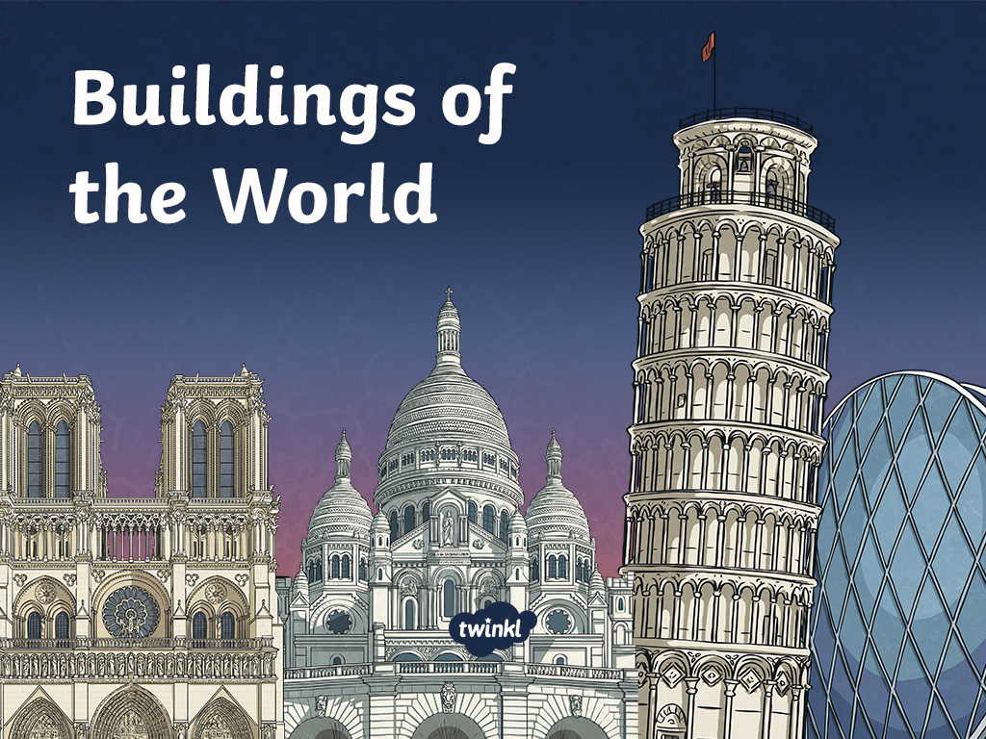

Slide 2
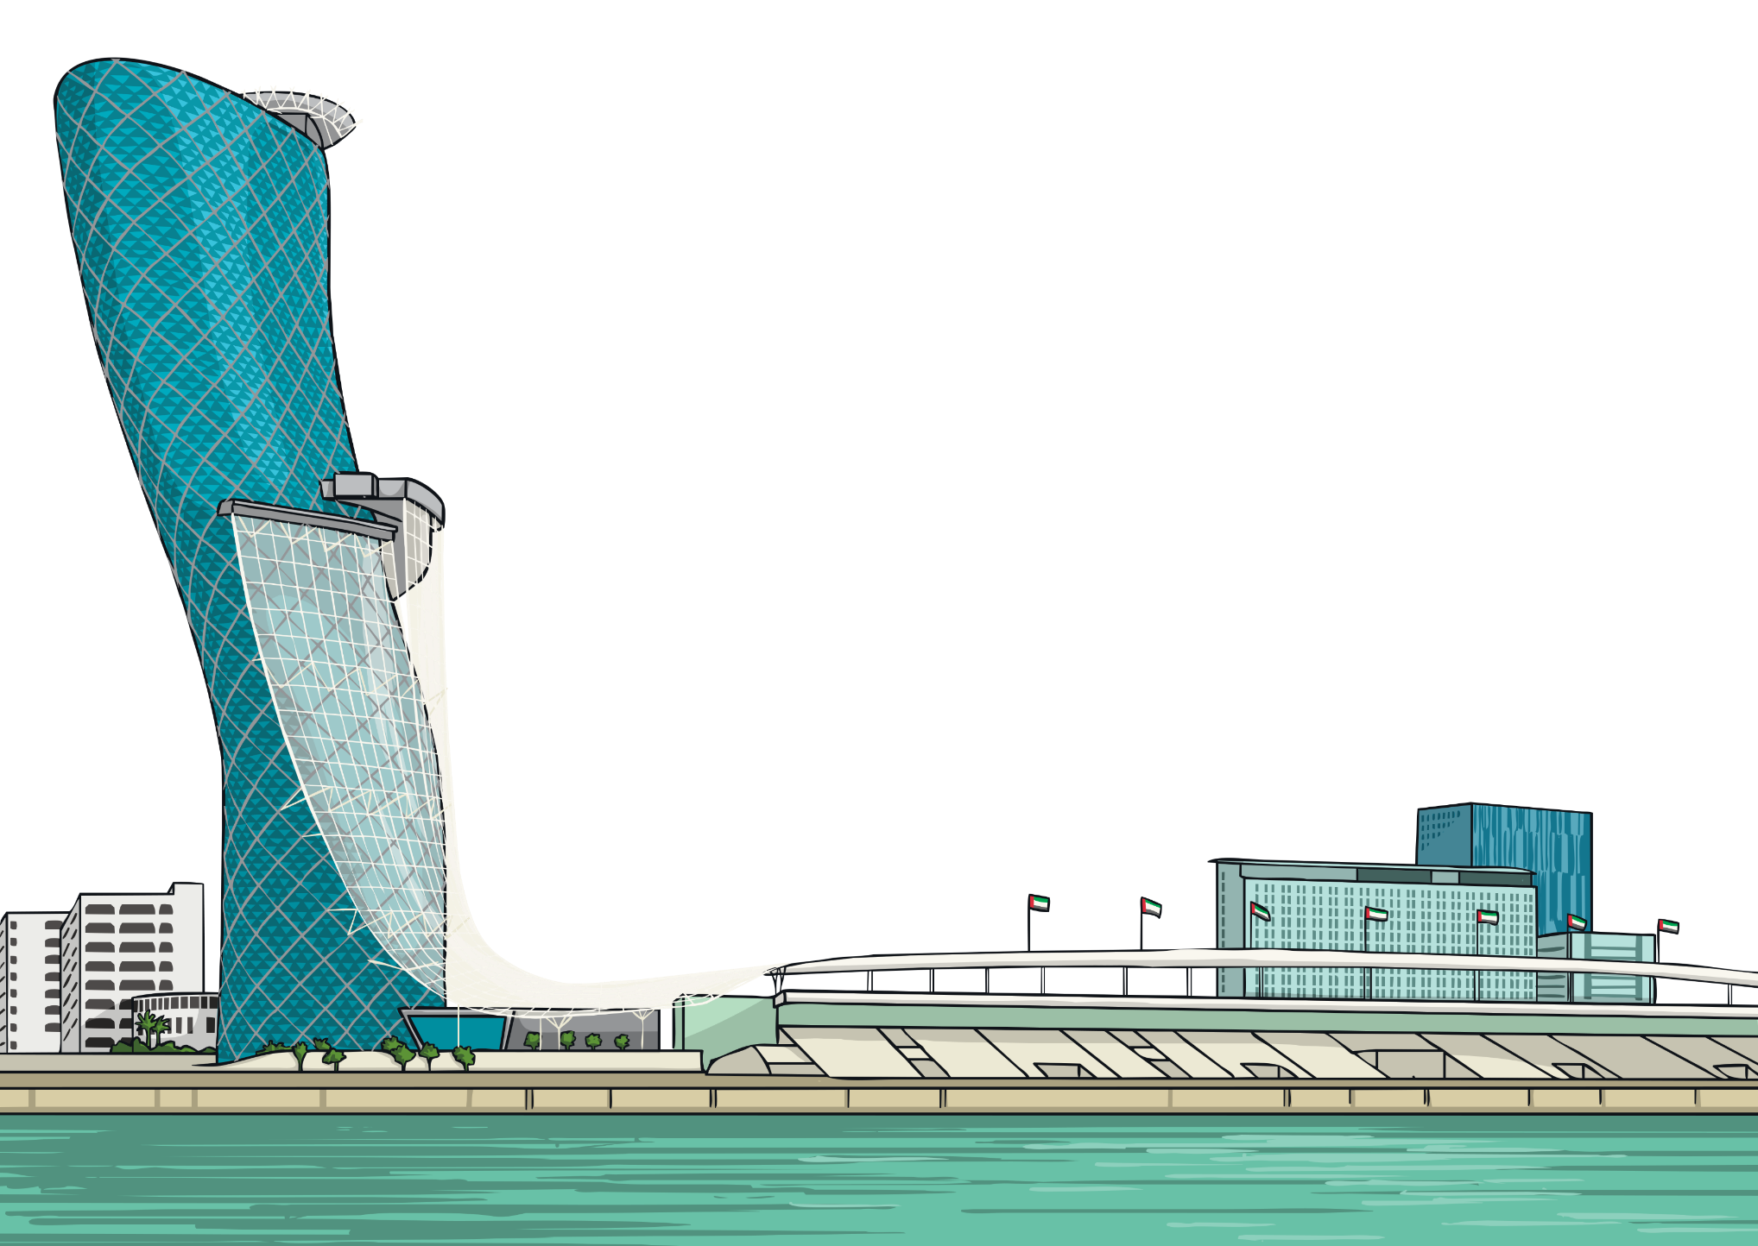
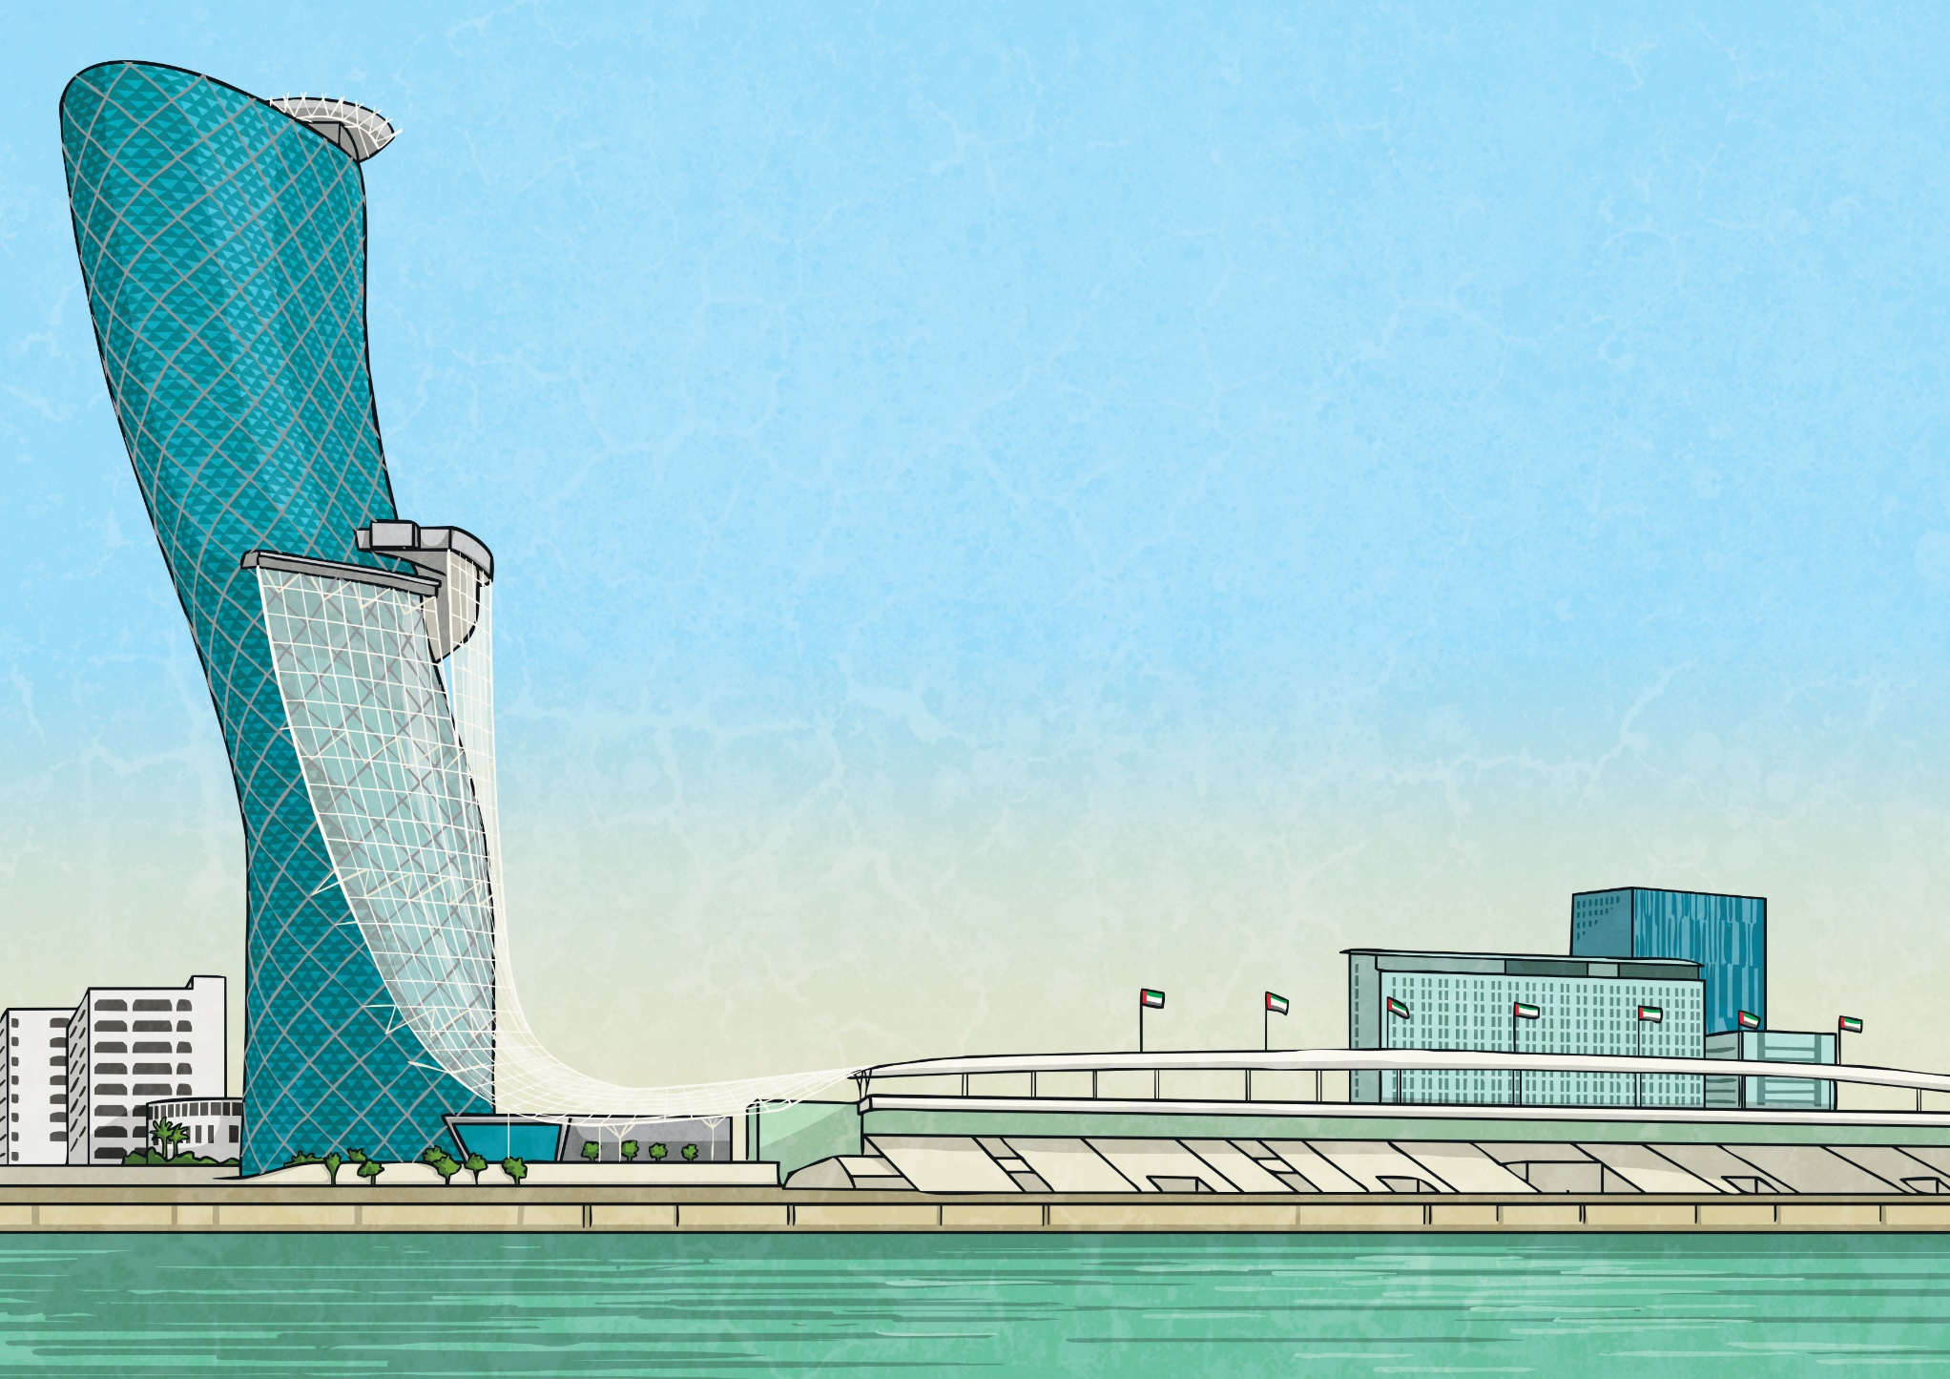
Buildings of the World
There are many wonderful and fascinating buildings around the world. Each one stands out for different reasons. This PowerPoint will introduce some of the most famous buildings and give you some important facts about them.

Slide 3
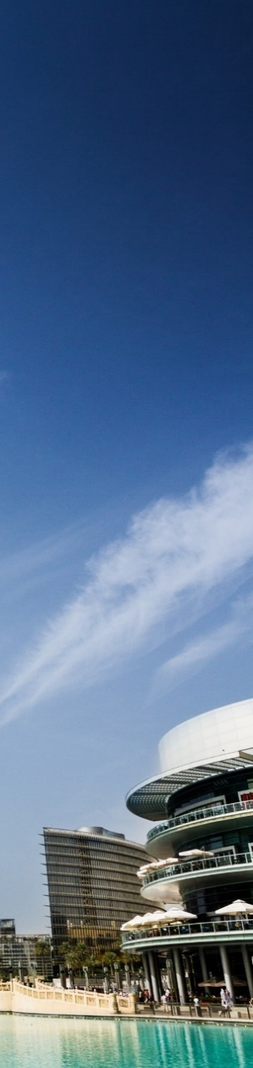
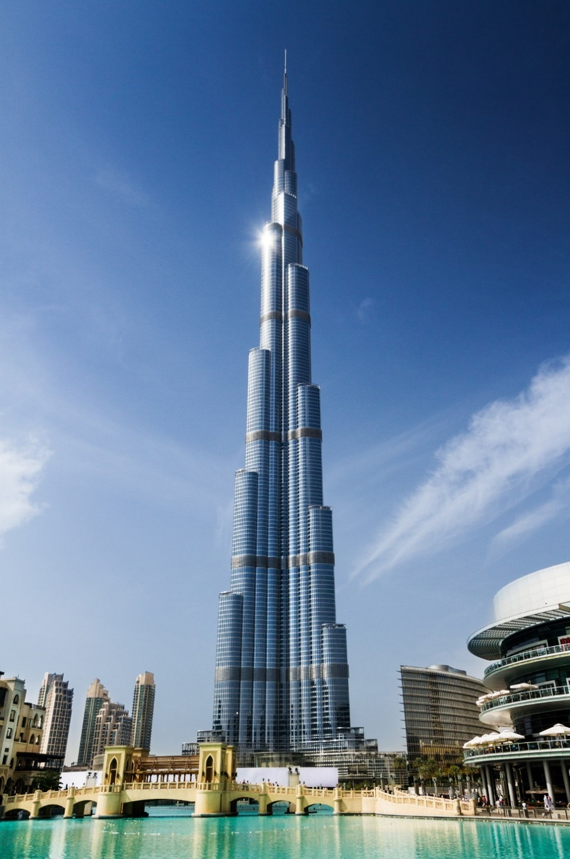
Burj Khalifa
Completion Date: October 2009
Location: Dubai
Height: 828 metres
Burj is the Arabic word for tower.
The Burj Khalifa is the tallest building in the world. It is twice the height of the Empire State Building and almost three times as tall as the Eiffel Tower!
The world’s highest swimming pool in a building is on level 76.
Over 12 000 workers from all over the world built the tower.

Slide 4
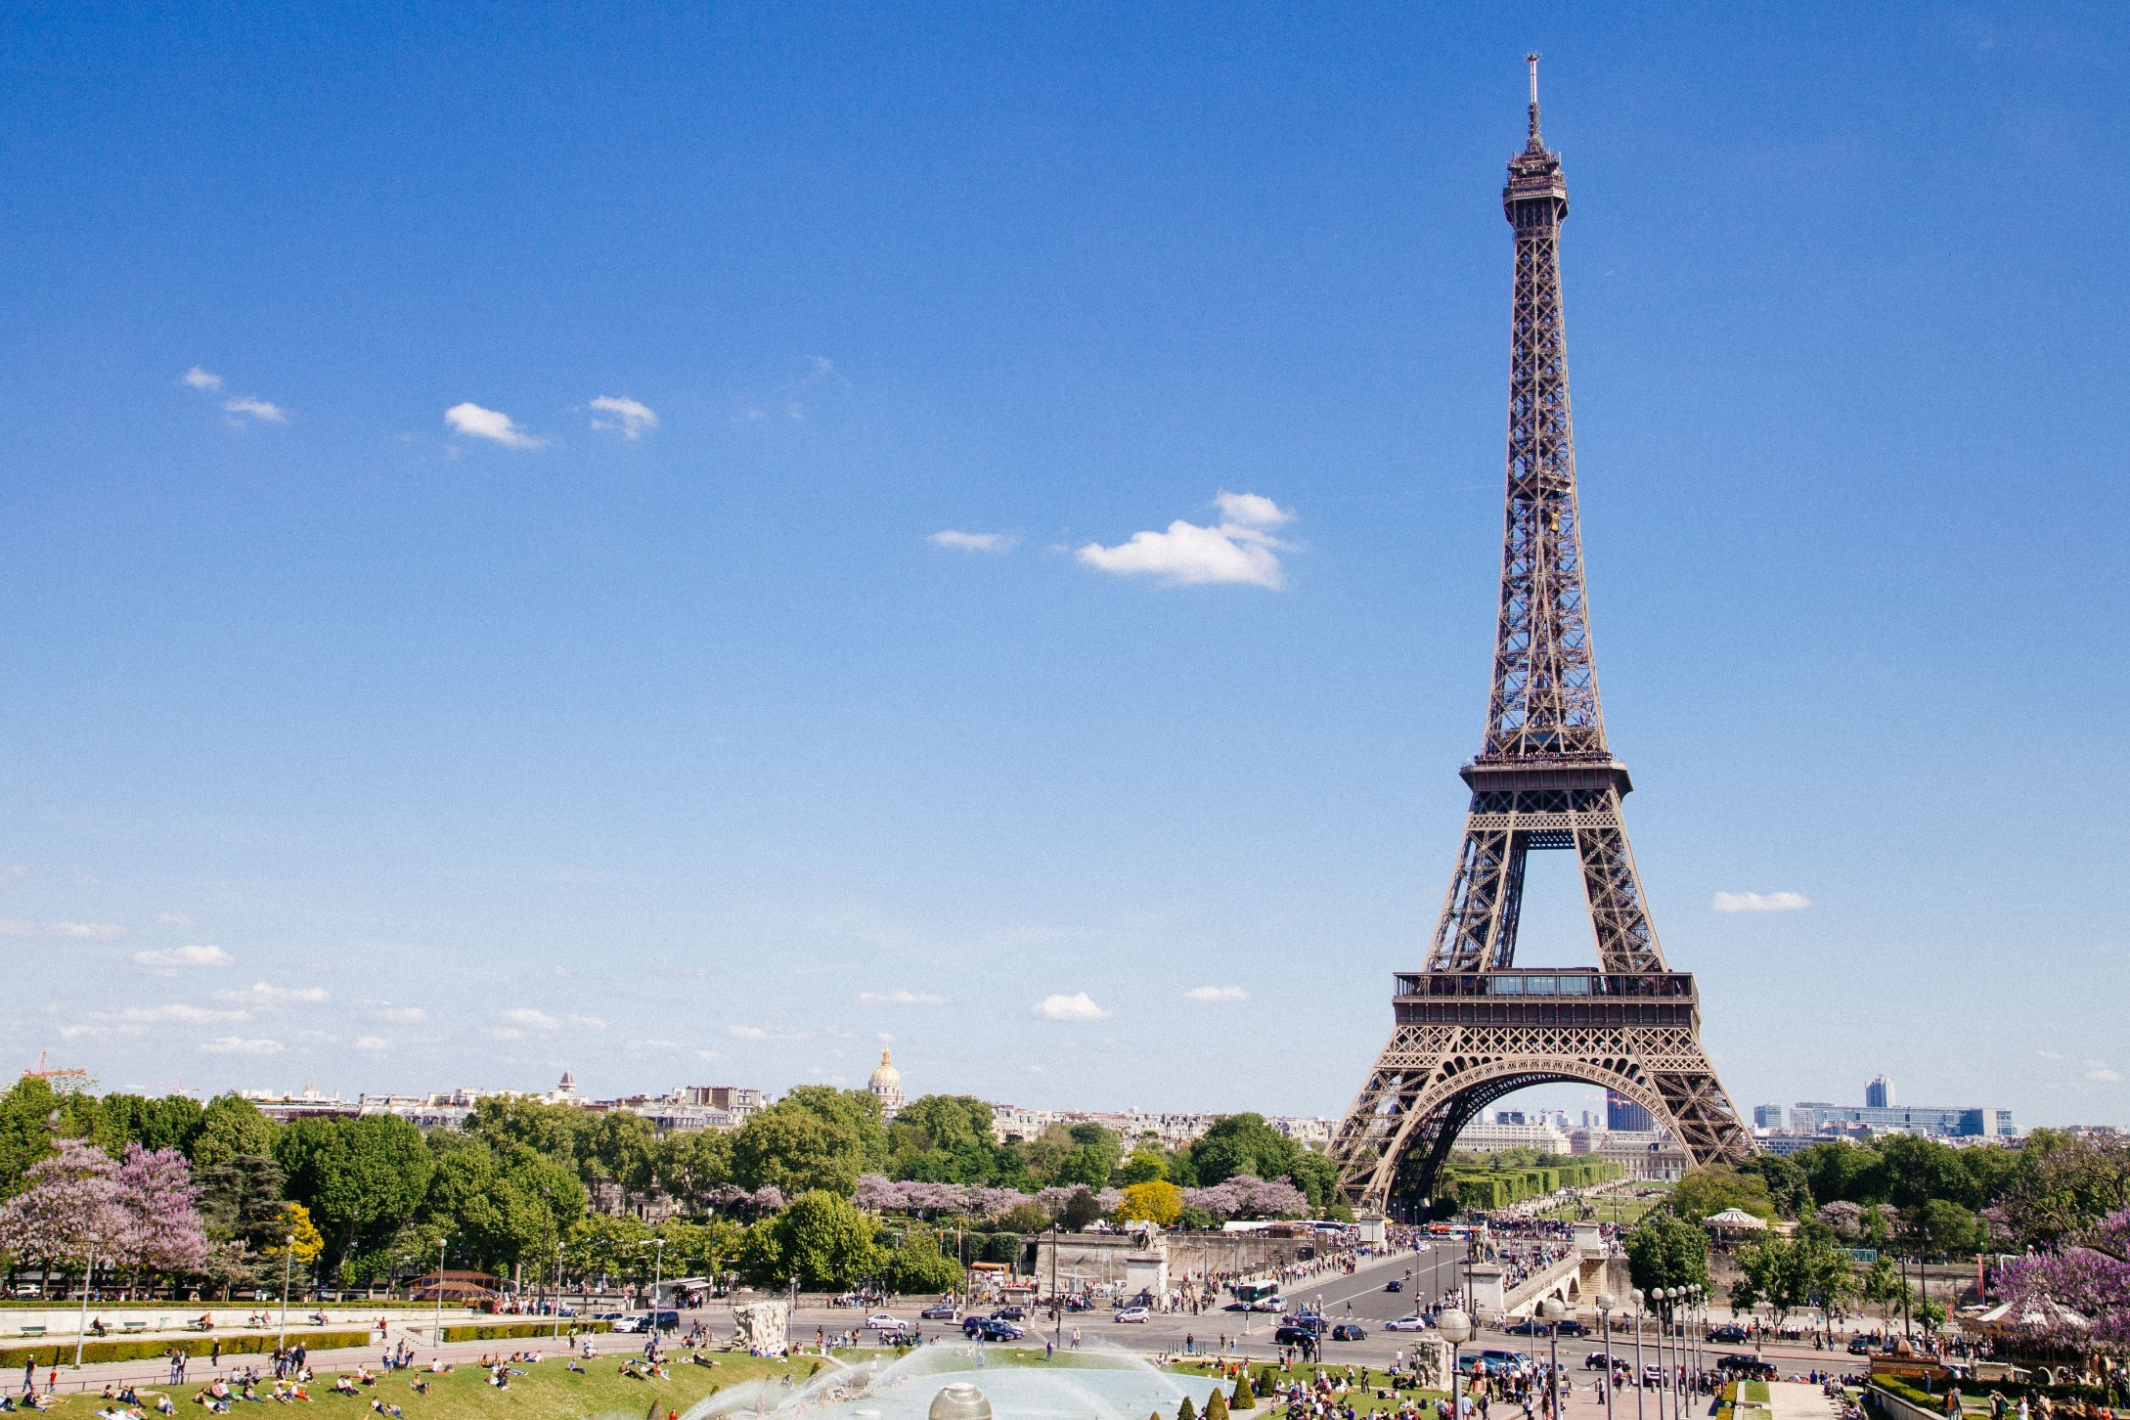
Eiffel Tower
Completion Date: 31st March 1889
Location: Paris, France
Height: 320 metres
The Eiffel Tower was named after Gustave Eiffel who designed it.
Millions of people climb the 1665 steps of the Eiffel Tower every year.
The Eiffel Tower’s nickname is ‘La dame de fer’ which means ‘the iron lady.’
It took two years, two months and five days to build.

Slide 5
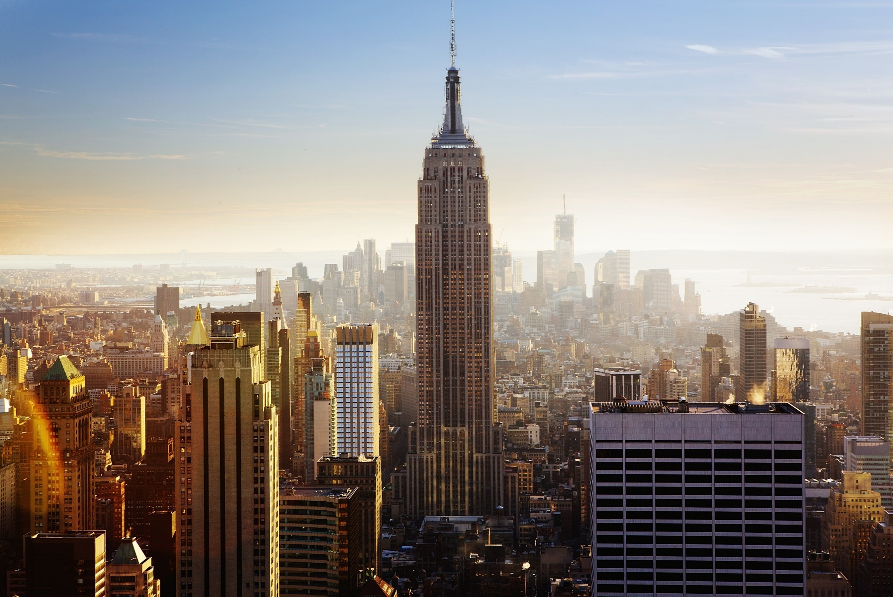
Empire State Building
Completion Date: 1st May 1931
Location: New York City, USA
Height: 381 metres (443 metres including the spire)
The Empire State Building was designed by William Lamb.
It took 410 days to build.
The building has 6514 windows.
It has a lightning rod near the top which is struck by lightning around 23 times every year.

Slide 6
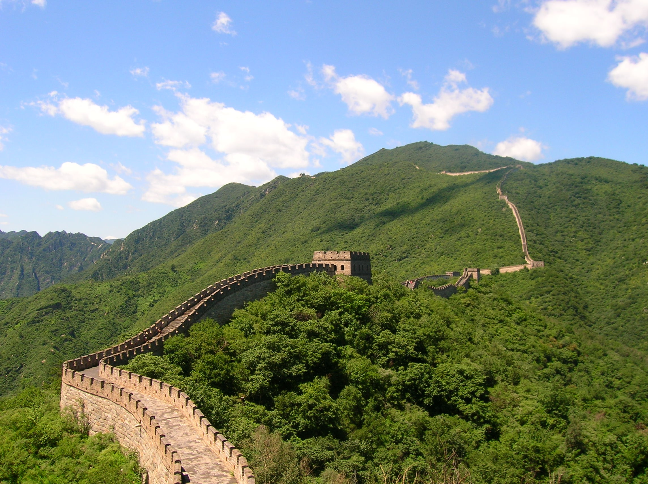
Great Wall of China
Completion Date: Over 2000 years ago
Location: China
The Great Wall of China is 3915 miles long.
It is the longest structure ever built by humans.
Although many people believe that the Great Wall can be seen from space, this isn’t true!
Earlier sections of the wall were made from stone, wood and earth.
Height: 14 metres at its highest point

Slide 7
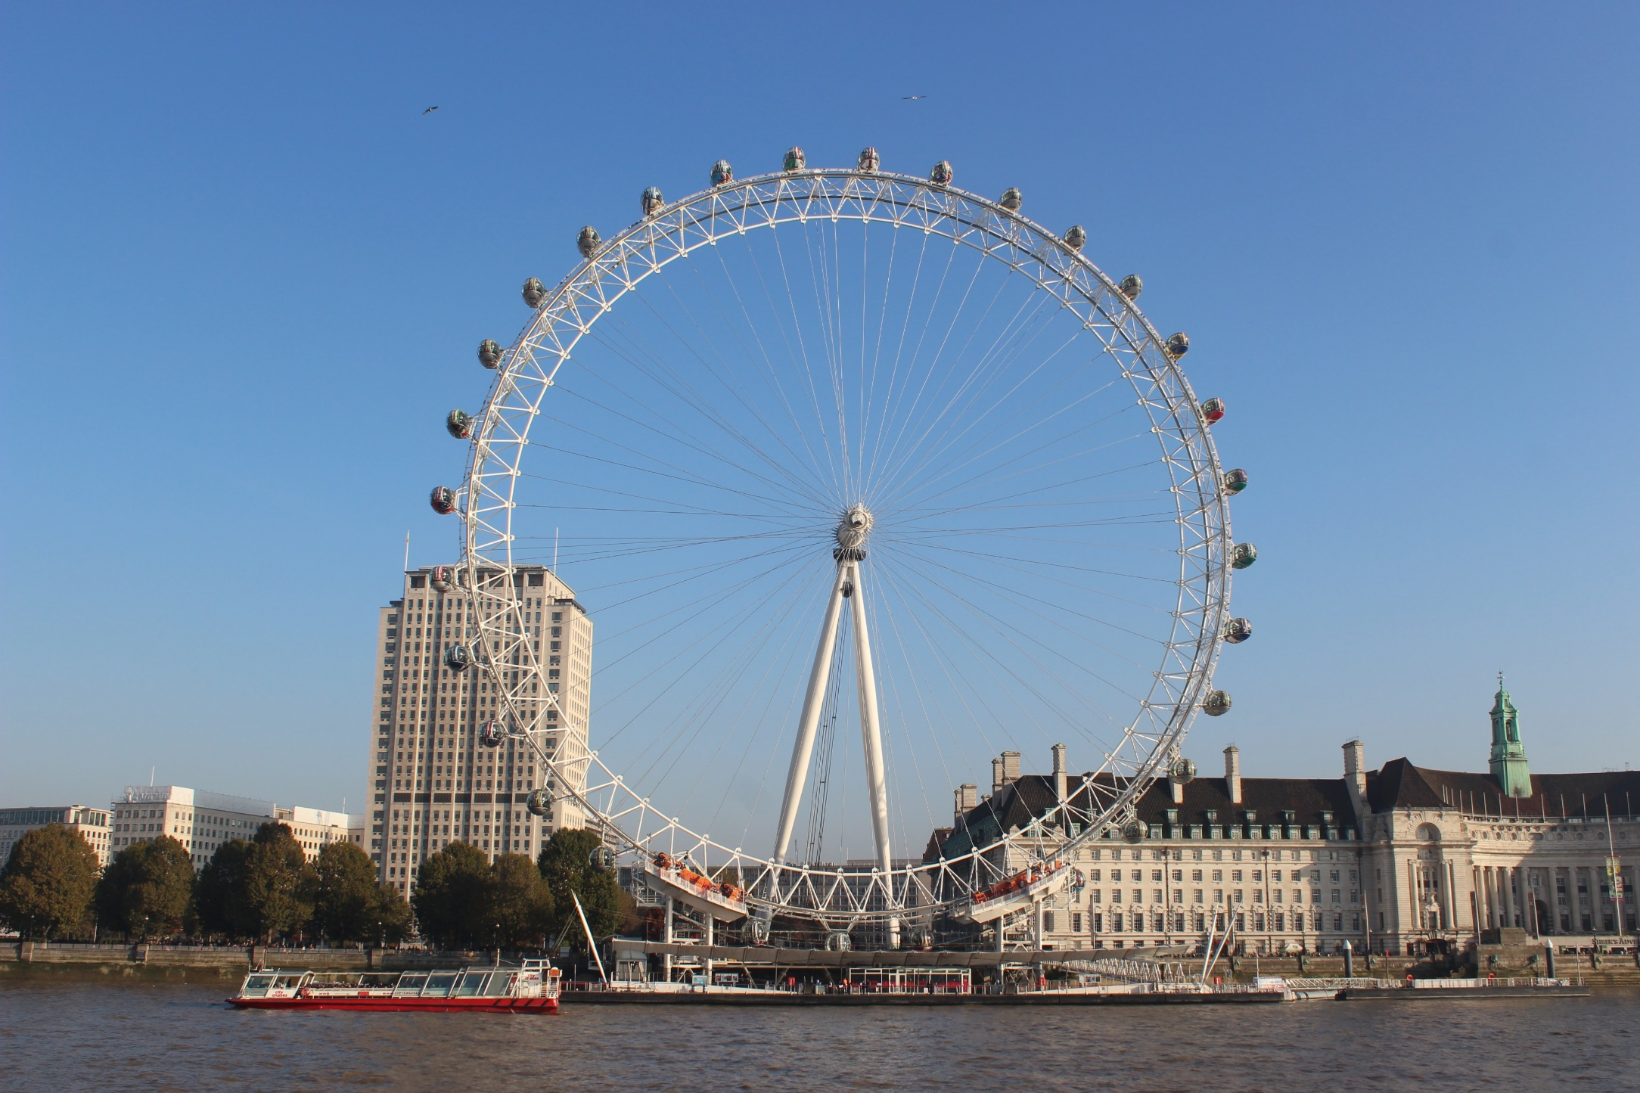
London Eye
Completion Date: 1999
It is also known as the Millennium Wheel.
It is one of London’s most popular tourist attractions, more than 3.5 million people visit every year.
There are 32 capsules shaped like ovals, one for each of London’s boroughs.
Each capsule can carry 25 people.
Location: London, UK
Height: 135 metres

Slide 8
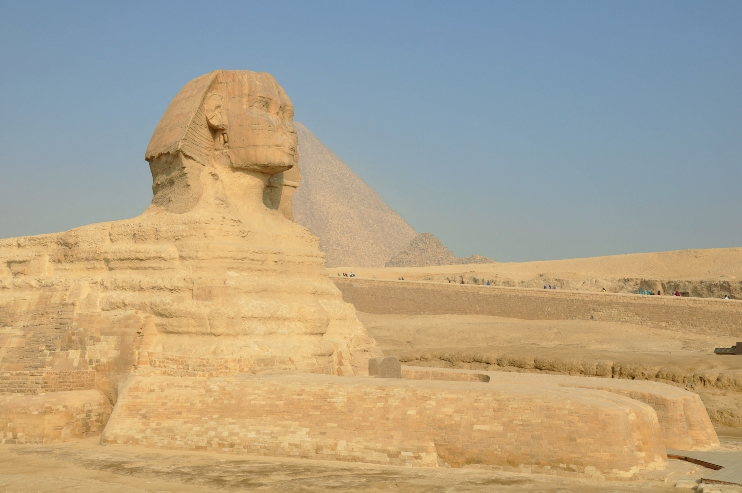
Sphinx
Completion Date: 4500 years ago
The Egyptians built sphinx statues to guard tombs and temples.
The Sphinx has the head of a Pharaoh and the body of a lion.
It was carved out of limestone and some people think it was once painted red, blue and yellow.
It is 73.5 metres long and 19.3 metres wide.
Location: Giza, Egypt
Height: 20 metres

Slide 9
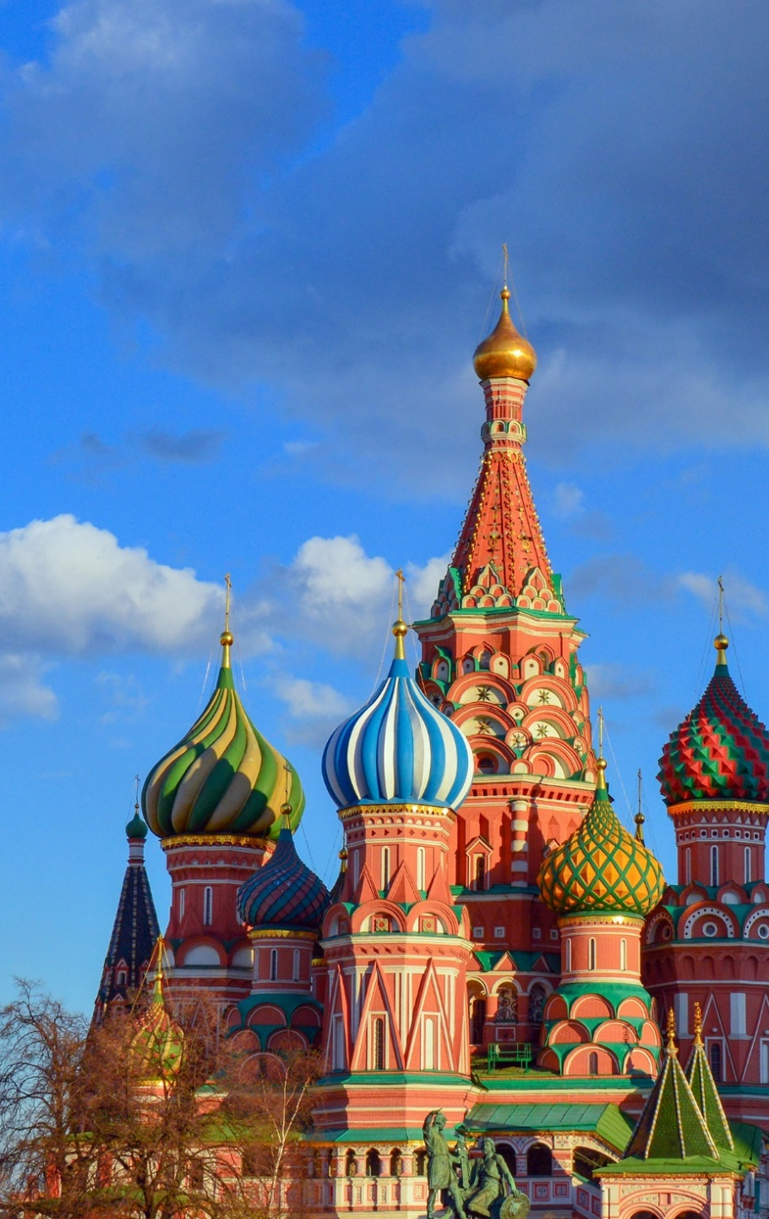

St Basil’s Cathedral
Completion Date: 1561
Location: Moscow, Russia
Height: 65 metres
The cathedral has 9 towers which are bright and colourful.
It took almost 10 years to build, and the inside is also full of patterns and colour.
It was built for Saint Basil the Blessed.
Only one service a year is held in the Cathedral.

Slide 10
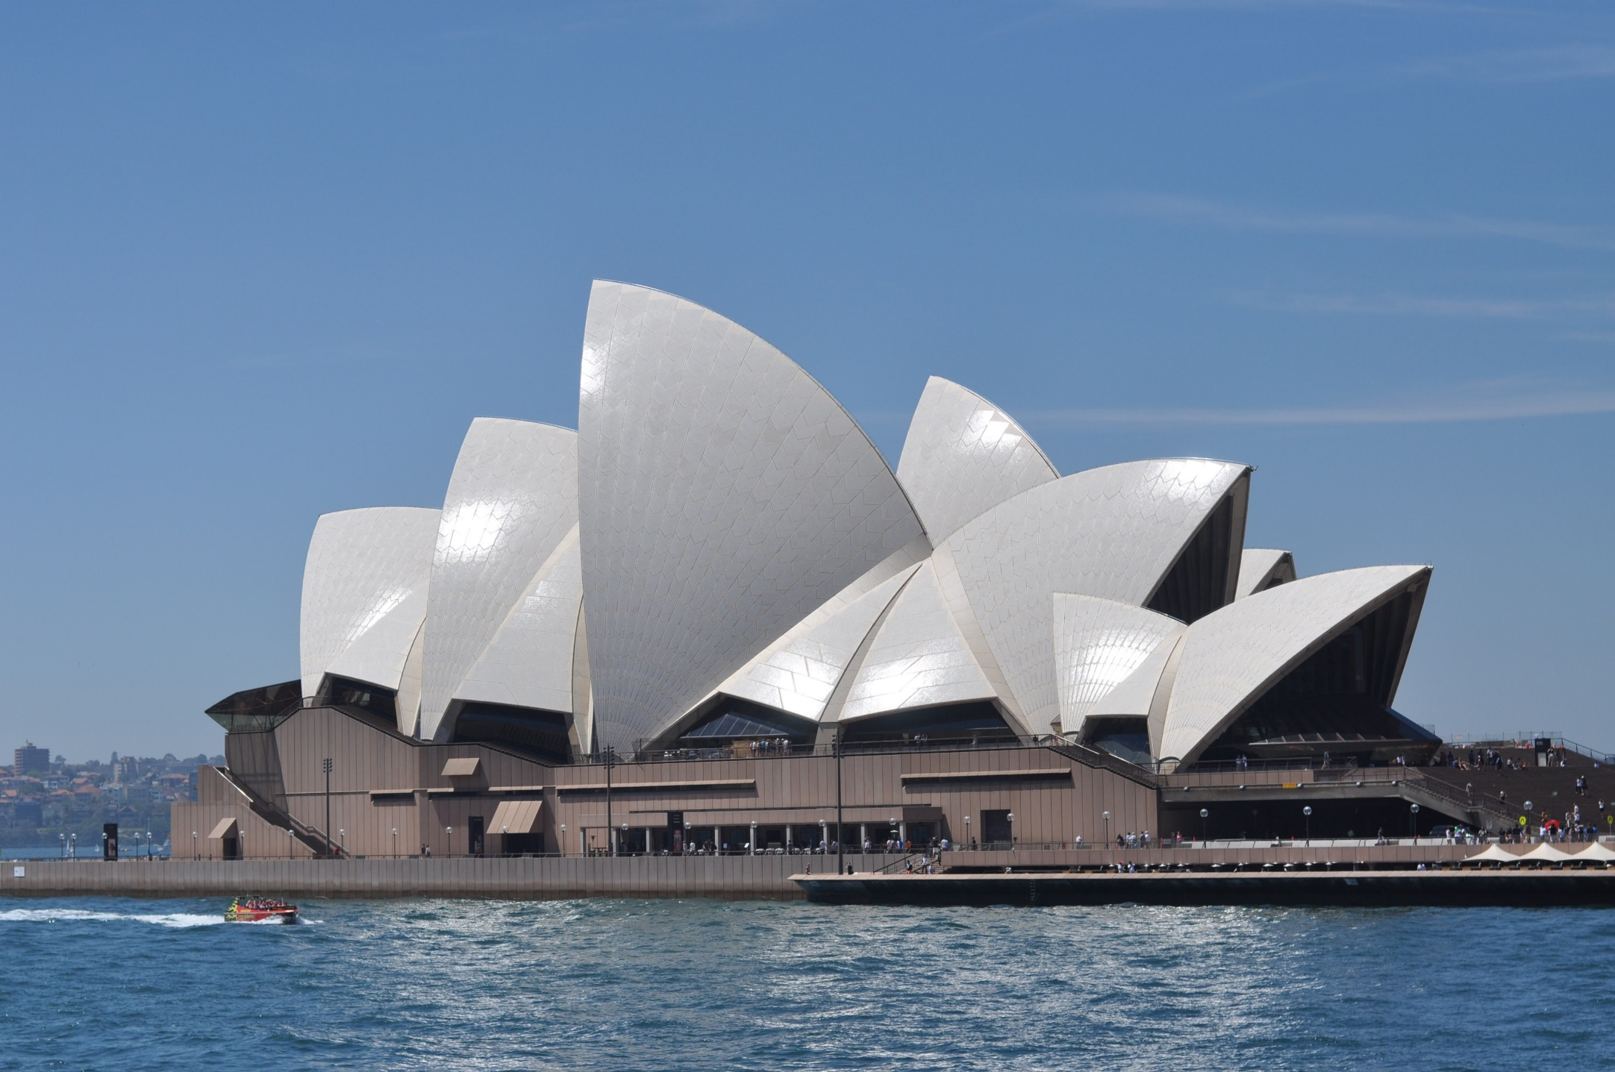
Sydney Opera House
Jorn Utzon, the architect, was inspired by things in nature such as shells, bird wings and walnuts.
It is 187 metres long and 115 metres wide.
There are 1000 rooms inside including 5 theatres.
The Grand Organ inside the Opera house is the largest mechanical musical instrument in the world.
Completion Date: 20th October 1973
Location: Sydney, Australia
Height: 67 metres above water

Slide 11
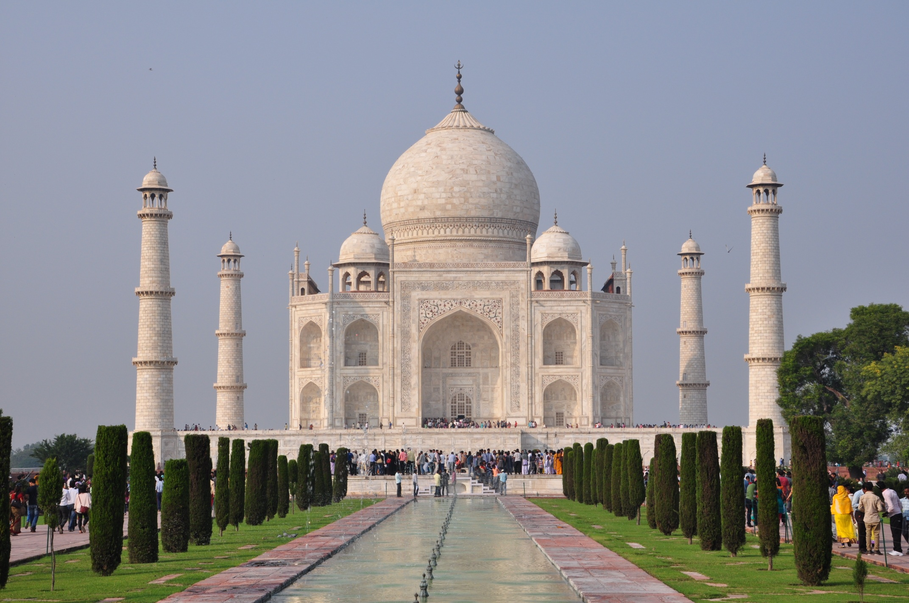
Taj Mahal
Completion Date: 1653
The Taj Mahal is made of white marble and took over 20 years to build.
It is a mausoleum which is a building that contains tombs for important people.
The name Taj Mahal means ‘crown of palaces.’
It is visited by up to 70,000 tourists every day.
Location: Agra, India
Height: 171 metres

Slide 12
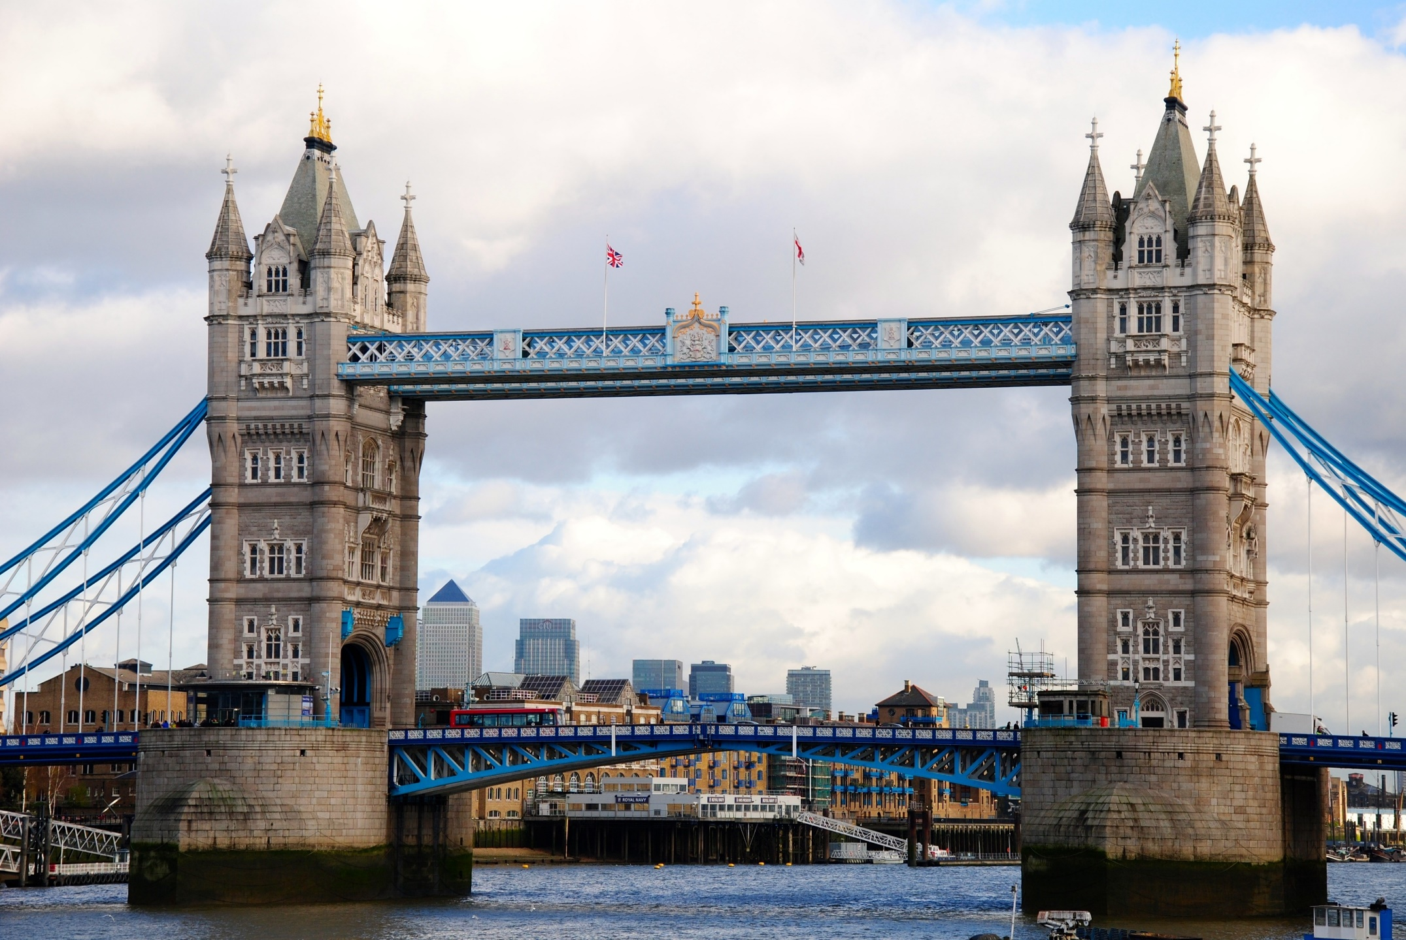
Tower Bridge
Completion Date: 30th June 1894
It took about 432 workers eight years to build.
It is 244 metres long and is 18 metres wide.
The roadway opens up to allow tall ships to pass through. This happens around 1000 times a year.
It is often confused with London Bridge which is further down the River Thames.
Location: London
Height: 65 metres

Slide 13
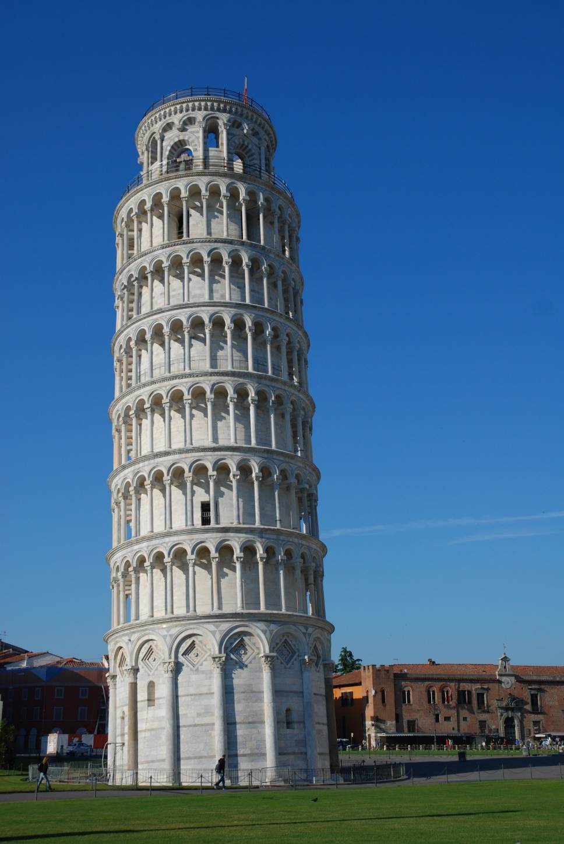
Tower of Pisa
The Tower of Pisa is famous for leaning to one side.
It took 200 years to build because several wars occurred and interrupted its construction.
The bell tower is home to 7 bells and was built on unstable, marshy soil.
There are either 296 steps or 294 steps to climb to the top, depending on which staircase is used.
Completion Date: 1372
Location: Pisa, Italy
Height: 55.86 metres

Slide 14
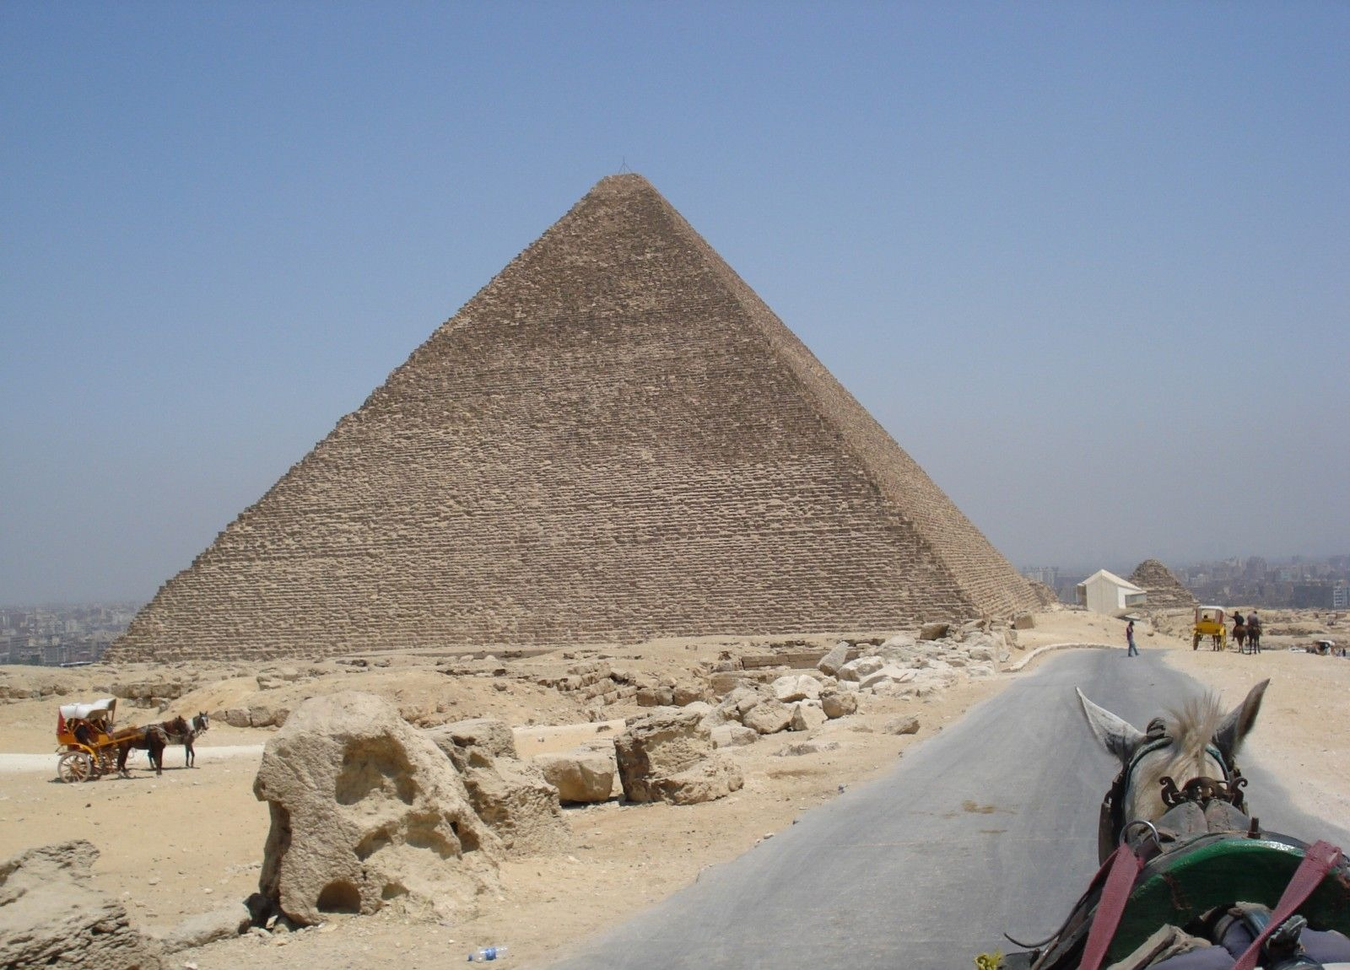
Great Pyramid of Giza
The Great Pyramid is one of the Seven Wonders of the World.
It is the largest of all the Egyptian pyramids which were built as tombs for pharaohs.
The Great Pyramid was built using 2.3 million stone blocks.
It took 20,000 workers around 20 years to build.
Completion Date: 2560 BC
Location: Cairo, Egypt
Height: 139 metres

Slide 15
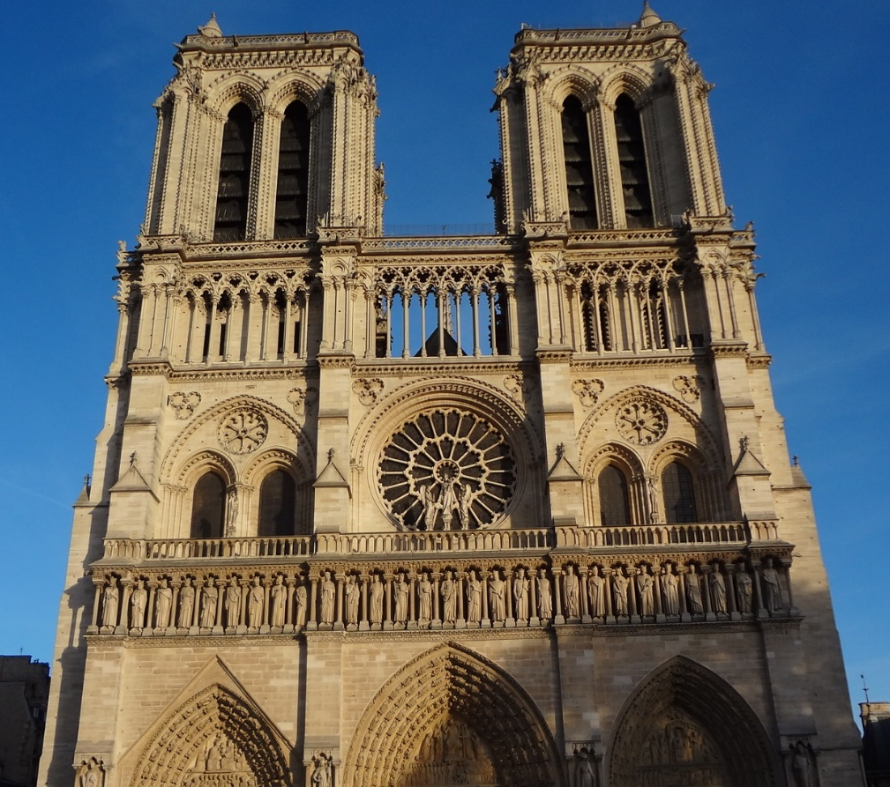

Notre Dame
Completion Date: 1345
Location: Paris, France
Height: 1369 metres
The Notre Dame is one of the largest religious buildings in the world.
It is 127 metres long and 48 metres wide.
There are many beautiful stained glass windows.
It is one of France’s most important landmarks and is visited by more than 13 million people each year.

Slide 16
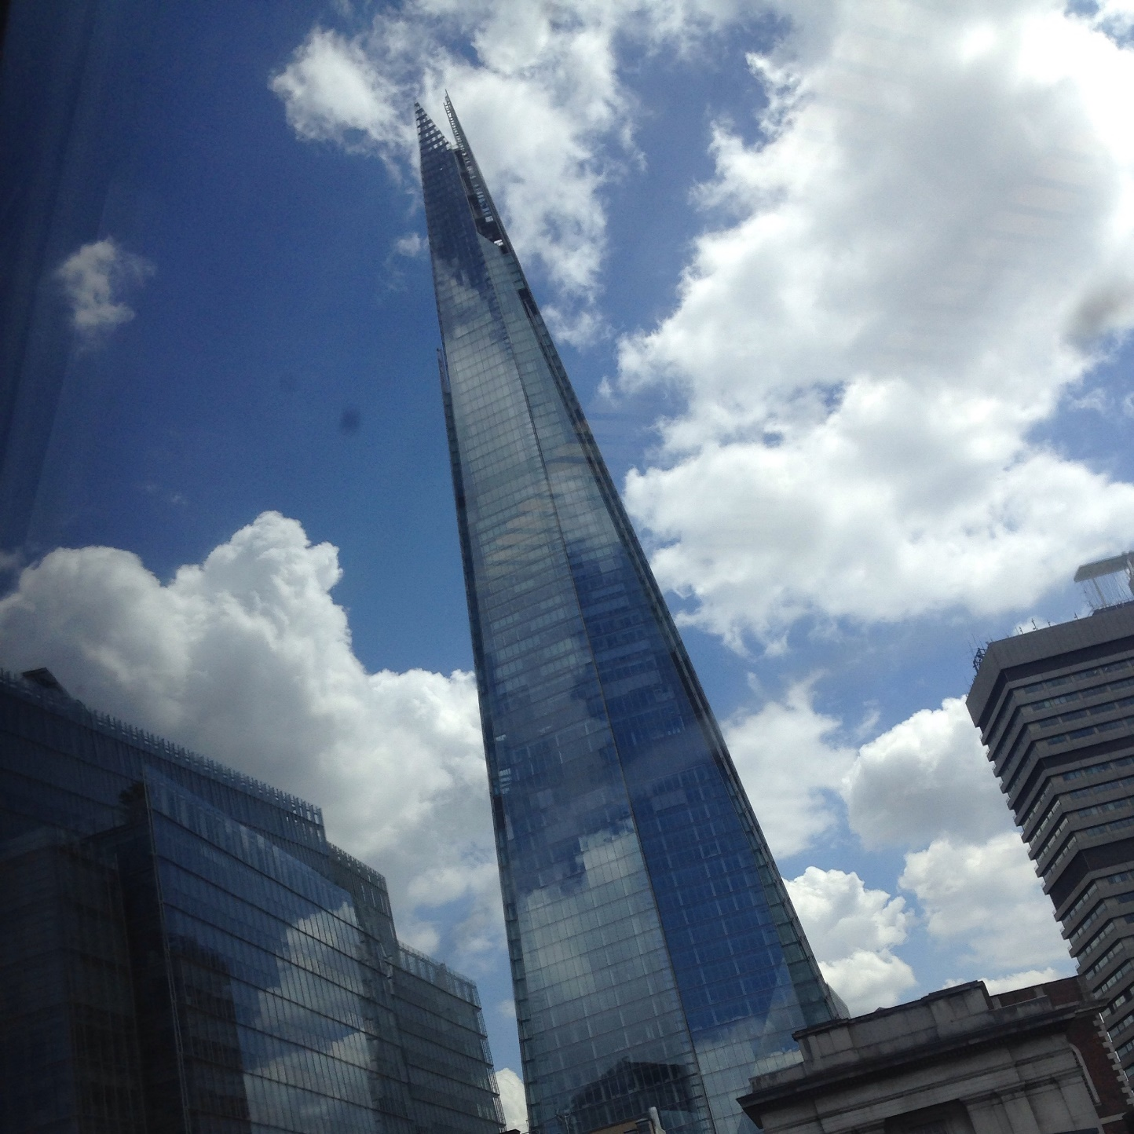
The Shard
The Shard is the tallest building in the UK.
It can be seen from 40 miles away and was designed by Renzo Piano.
There are 82 floors and 44 lifts which travel at 6 metres per second.
It was designed to look like the sail of a ship.
Completion Date: March 2012
Location: Southwark, London
Height: 306 metres

Slide 17


