Slide 2
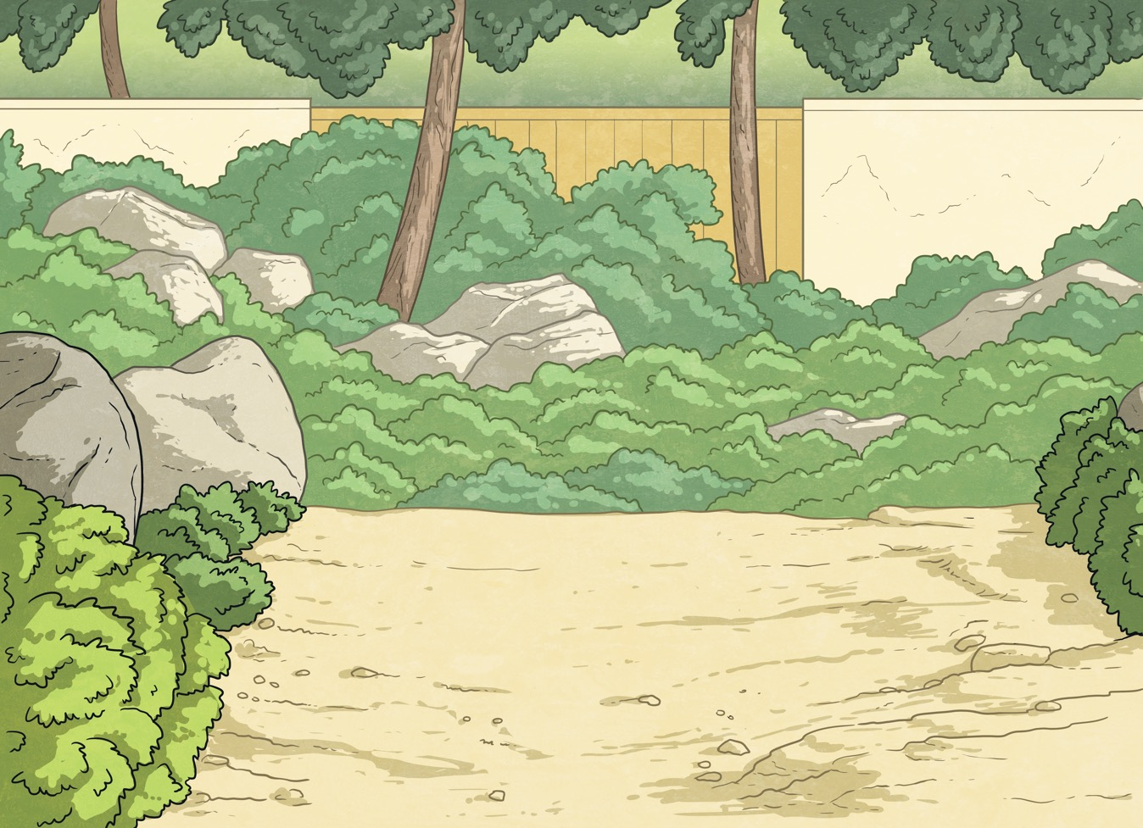
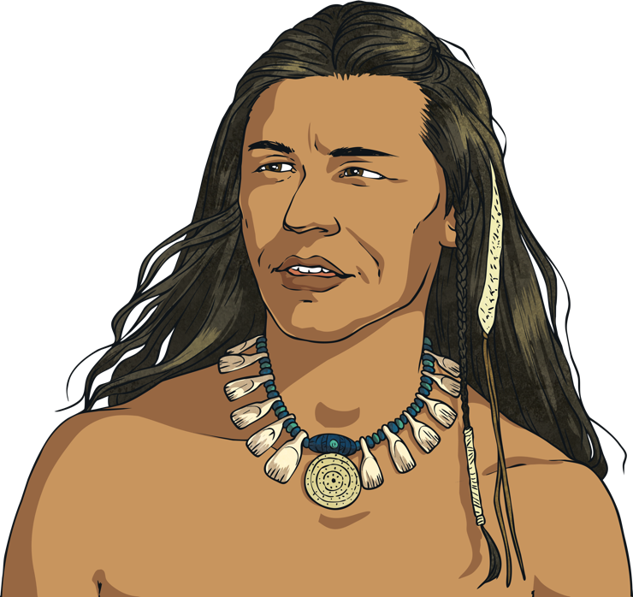
Indigenous
An indigenous person is a part of a population that was first to inhabit a land or country.

Slide 3
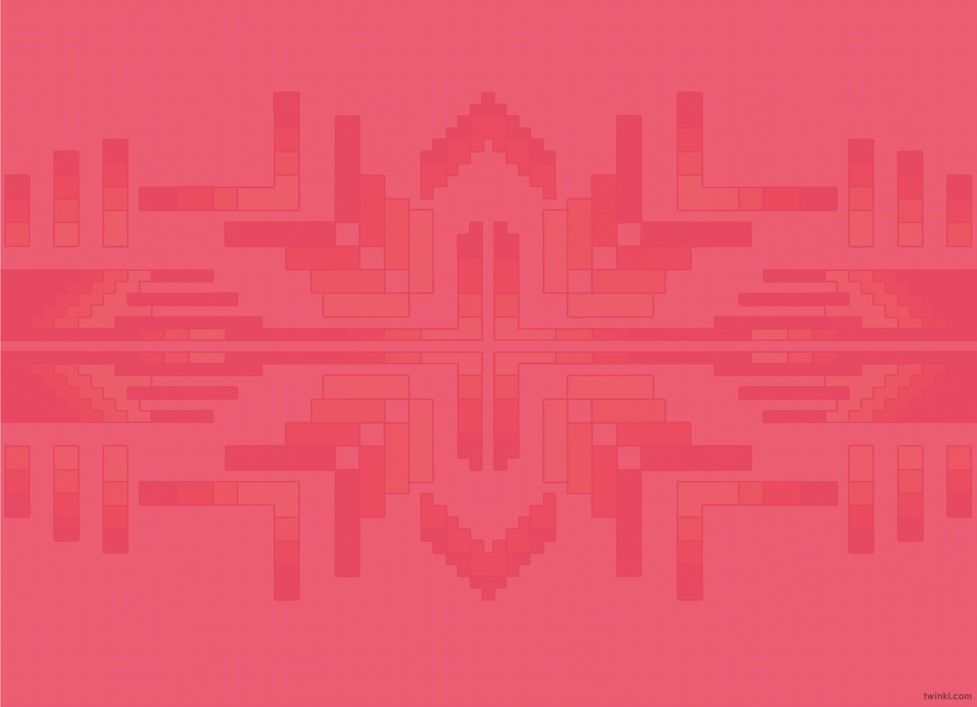
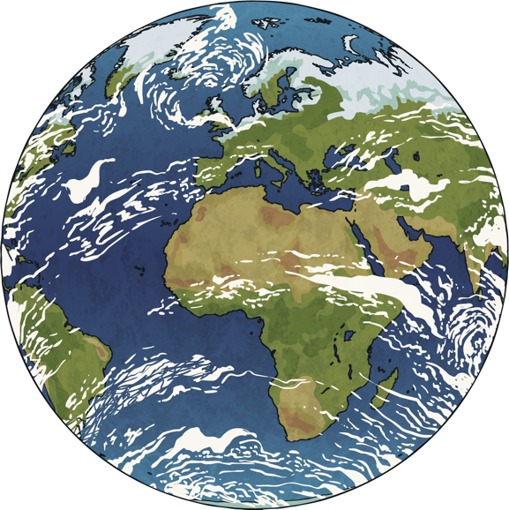
Native
Americans
Archaeologists believe the first people to
settle in North America came from
Siberia and Asia. These people eventually became known as Native Americans.

Slide 4
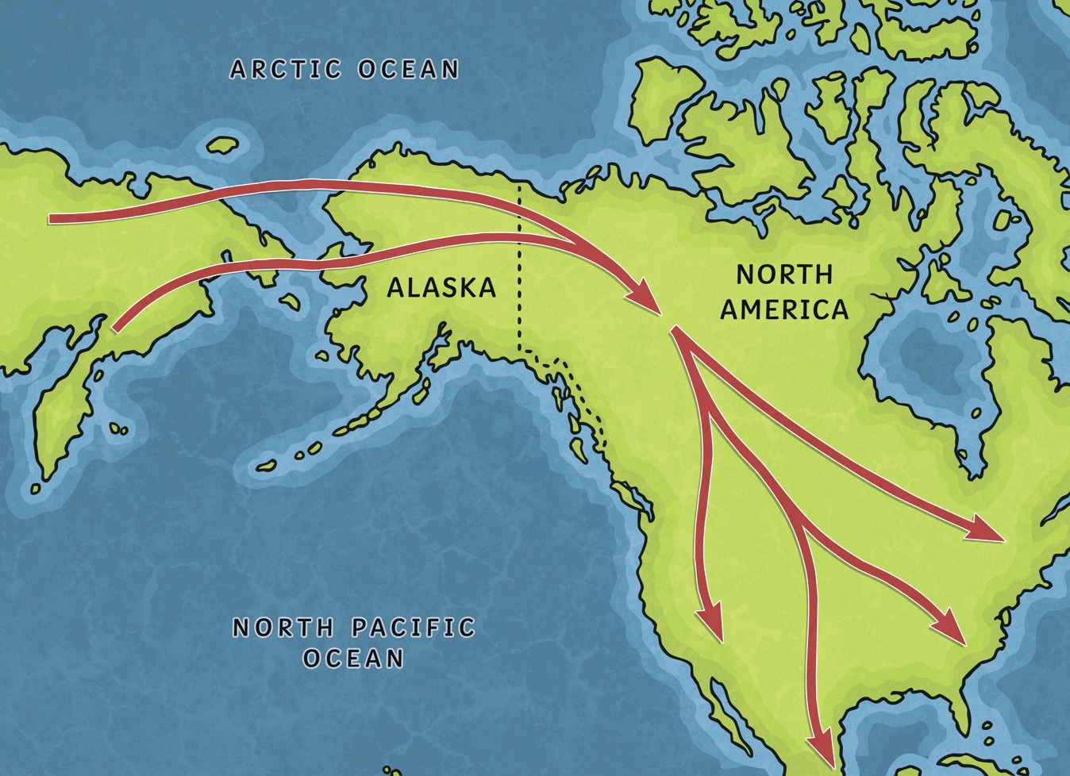
Journey
The indigenous people travelled all over North America, Central and South America. In North America, they lived and travelled from Alaska to what is now the Mexican border and everywhere in between. They lived in groups called tribes and each tribe had its own culture and language.

Slide 5
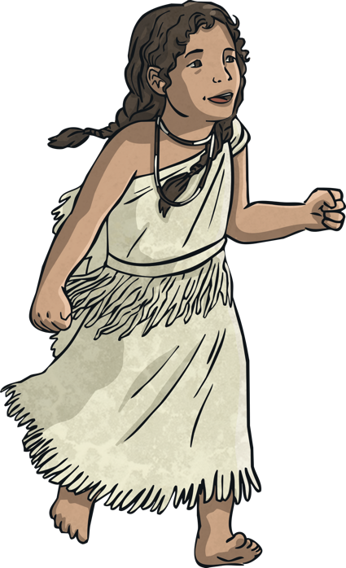
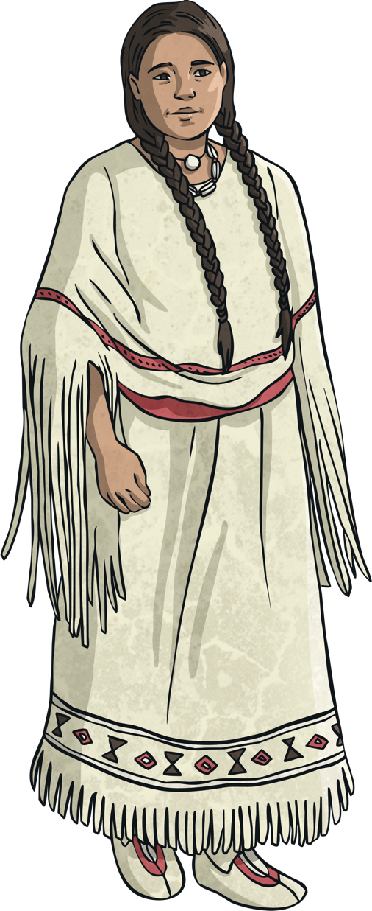
Tribes
Some tribes lived mostly in the central part of North America like the Comanche and the Arapaho. The Cherokee and the Seminole lived in the southeast part of North America.

Slide 6
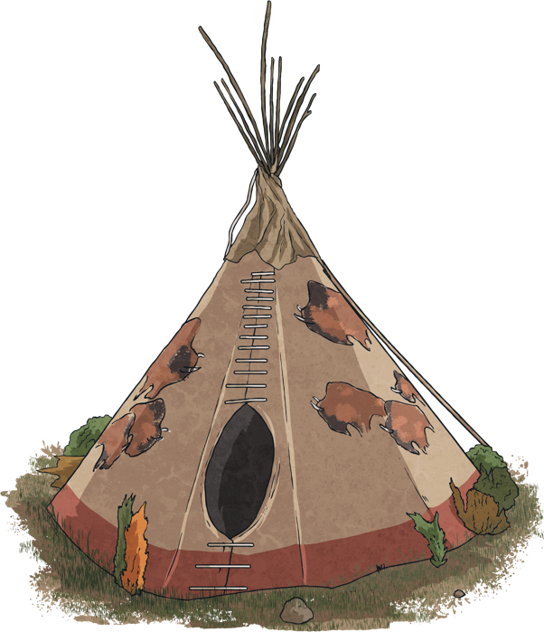
Native
Americans
Native American tribes each
lived in their own kind of special homes. Some Nomadic tribes lived in tipis, while other tribes lived in more permanent dwellings such as a Native American Longhouse or pueblo villages.

Slide 7
Children
Young children and babies spent all of their time close to their mothers. The mother would go about her daily work and chores carrying the baby on her back in a cradleboard.

Slide 8
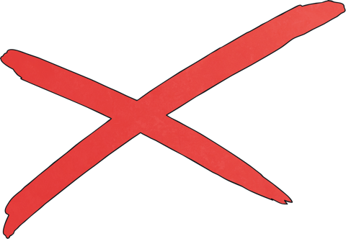
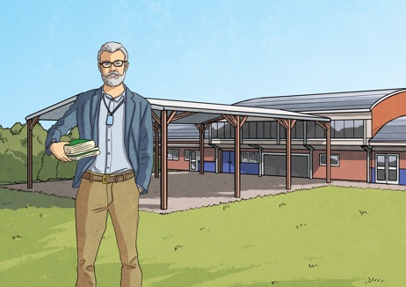
Education
The early tribes did not have any sort of official education or schools like we have now, but the children were expected to learn. The boys followed the men around and were taught how to hunt and do what were seen as men's chores.
Children learned of the history and moral rules of the tribe from stories told by the elders. These stories were not only entertaining, but also held meaning and taught the children how they were expected to behave.
Young girls followed the women around and learned to do traditional women's work like making baskets, working the fields, and cooking.

Slide 9
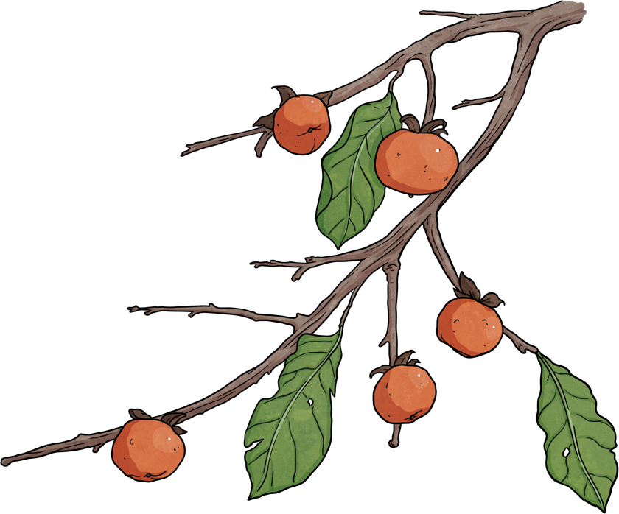
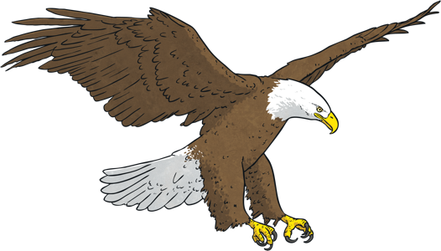
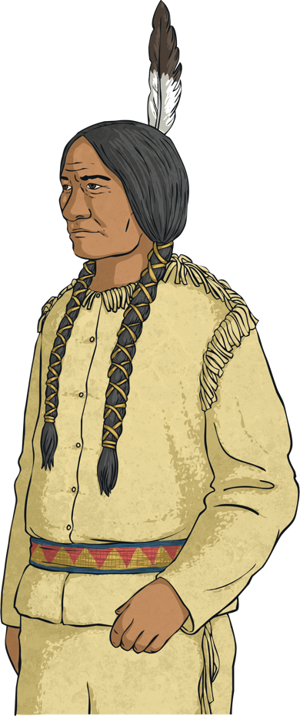
Religion
Some Native Americans believed that all living things were watched over by guardian spirits. This included animals, trees, people, and even some inanimate objects like the wind, storms and water.

Slide 10
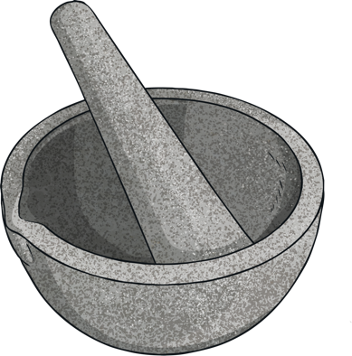
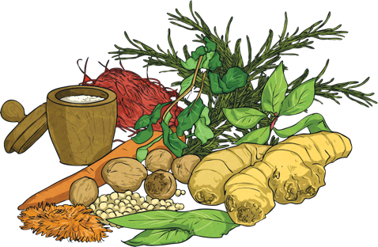
Medicine
The spiritual leaders of the Native American tribes were the medicine men and women of the village or tribe and were sometimes called shaman. They were considered wise and to have a special relationship with nature and the many gods that Native Americans believed in.
These shaman often used herbs to help heal sick people. They also called on gods and spirits to help the tribe for things like growing crops or when they were going in to battle.

Slide 11

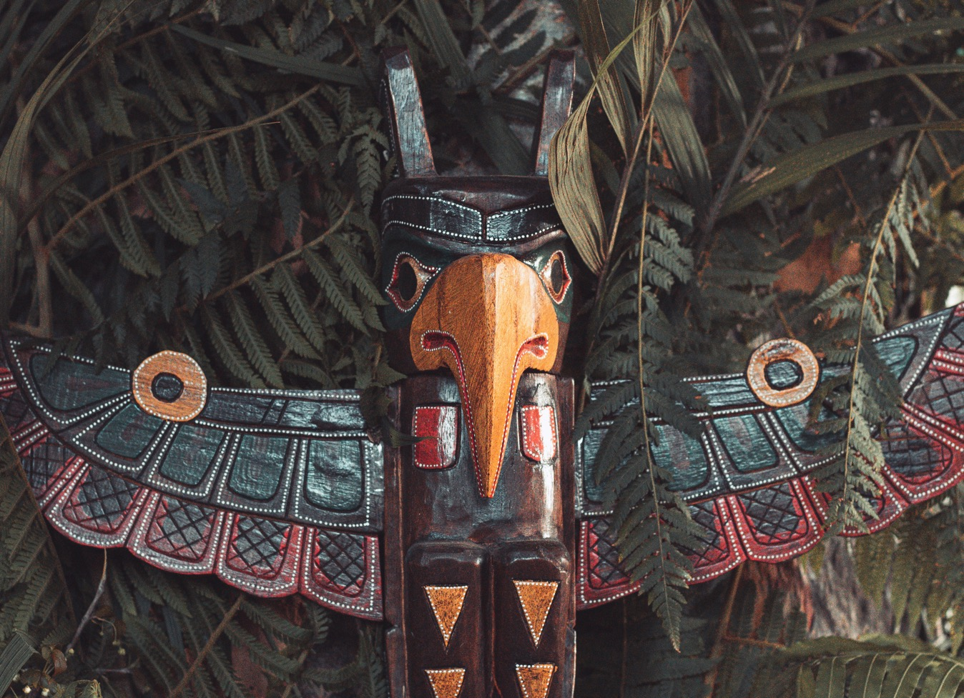
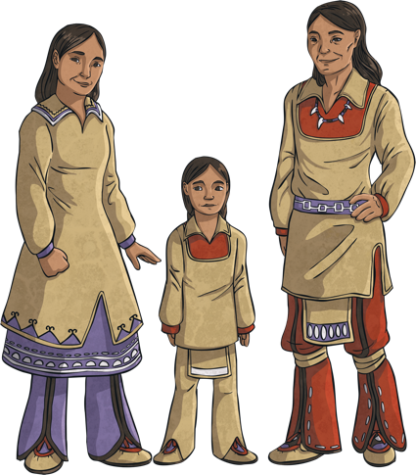
Totem
The totem pole was a form of art for many Native American tribes. Totem poles were generally carved from cedar wood.
The meaning of their carvings varied from tribe to tribe. Sometimes they they told stories of local legends or events. They were often carved for spiritual or religious reasons.

Slide 12

Homes
Today, some of the descendants
of the original Native Americans
live on reservations. These are areas of land set aside specifically for Native Americans. These areas have been created to protect their heritage and culture and to protect their land.
However, only around 30% of people
who identify as Native American live on reservations. The rest of the Native
American population live outside the
reservations, just like anyone else.

