Slide 1
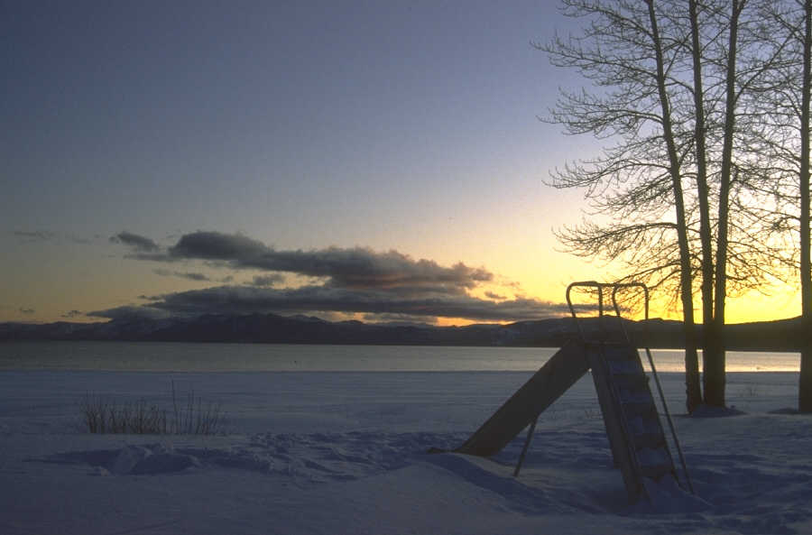
Tanka
poems in 31 syllables

Slide 2
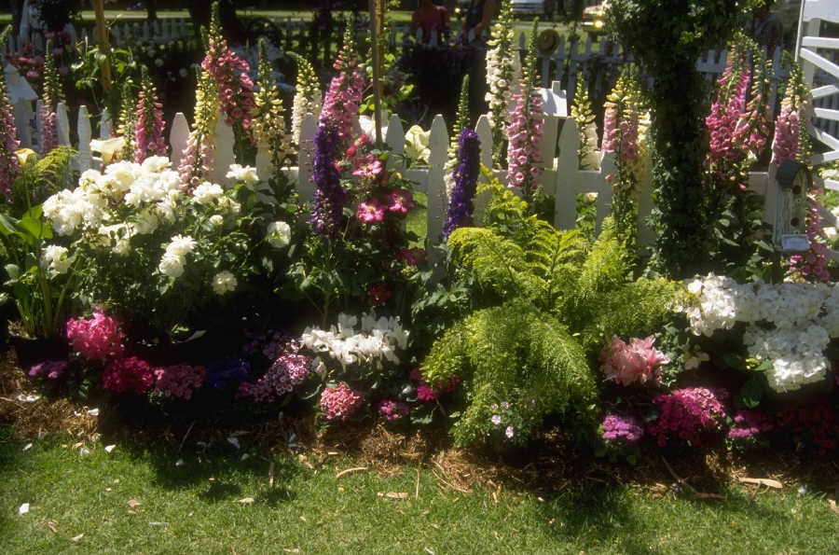
Saying Goodbye
Carefully I walk
Trying so hard to be brave
They all see my fear
Dark glasses cover their eyes
As mine flow over with tears
Tanka poems are short, lyrical poetry structured in 31 syllables arranged in groups of 5, 7, 5, 7 and 7, syllables, in a two-part form with the first part in 5, 7, 5, and the second part in 7 and 7.
Even in the "Man'yoshu,"(the Collection of Ten Thousand Leaves) which is the Japan's oldest anthology of poetry, compiled in the eighth century, many of the poems were already composed in this form.

Slide 3
Saying Goodbye
Carefully I walk
Trying so hard to be brave
They all see my fear
Dark glasses cover their eyes
As mine flow over with tears
5
7
5
7
7
31

Slide 4
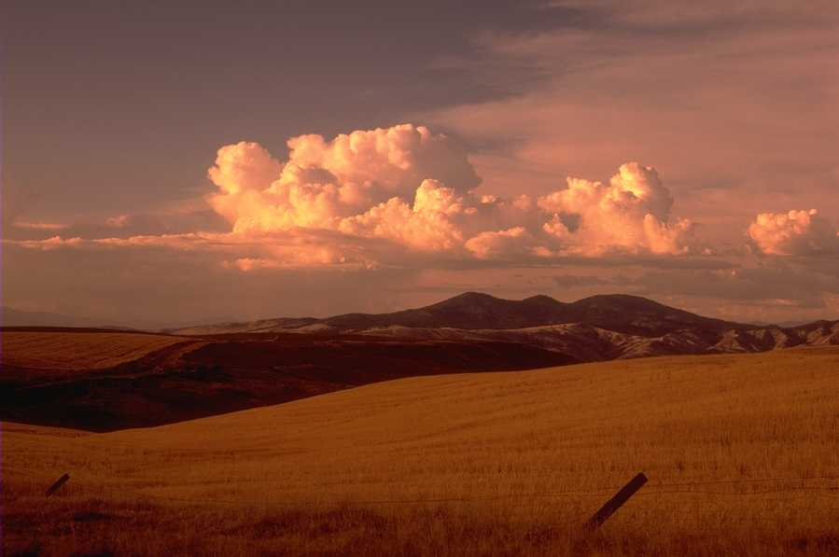
Tanka can use similes, metaphor and personification
Similes
Uses ‘as’ or ‘like’, compares two things - she was as graceful as a swan, he was like a towering tree
Metaphor
States that one thing IS another, when it isn’t – he was a remorseless eating machine.
Personification
Pretends something has human characteristics – the tree sighed longingly.

Slide 5

Tanka poems are written about nature, seasons, love, sadness and other strong emotions
Its main feature is that, in expressing the feelings in a simple form, it must contain--and this is an indispensable feature--a suggestiveness felt beyond the words.
Perhaps a requirement for an outstanding tanka poem is that it causes associations with a suggestiveness not expressed in words, and a deep elegance.

