Slide 1
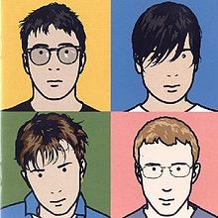
JULIAN
OPIE

Slide 2
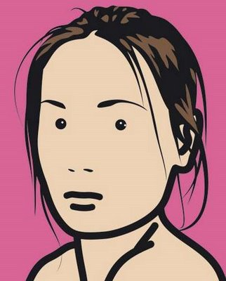
Julian Opie
Born in 1958 in London
One of the most popular artists alive now.
Made famous when he was asked to do the Blur ‘Best of’ Album cover
Works with ‘Portraiture’

Slide 3
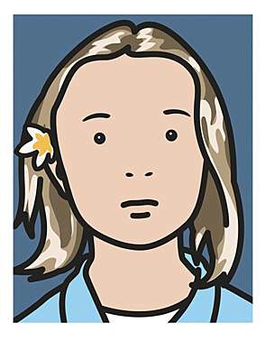
Julian Opie
Famous for ‘Computer Art’
His work is ‘stylized’
He takes a photo or a bit of film and makes it ‘simplified’

Slide 4
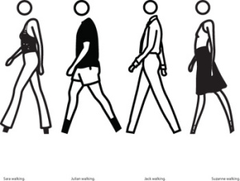
Julian Opie
His work is characterized by using black outlines.
Some of his pictures are so simple that the characters feet are just stumps and their heads are not joined on to their bodies

Slide 5
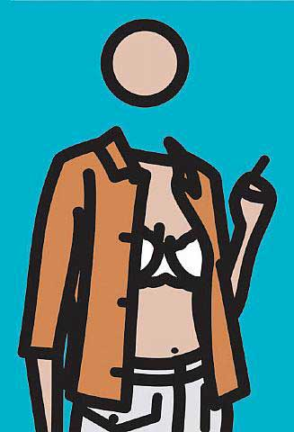
Julian Opie
Lots of his work is about bodies and the way they move.
He has done animations of women dancing.
People like to look at his work because it surprises them, what you think is a painting will suddenly move.

Slide 6
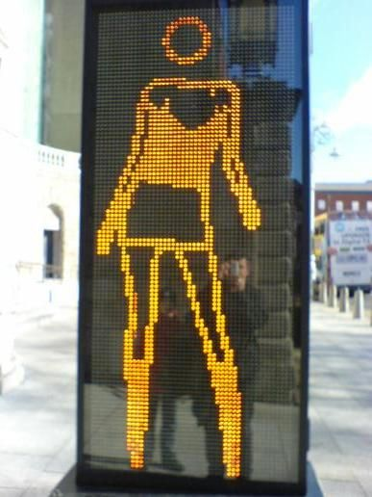
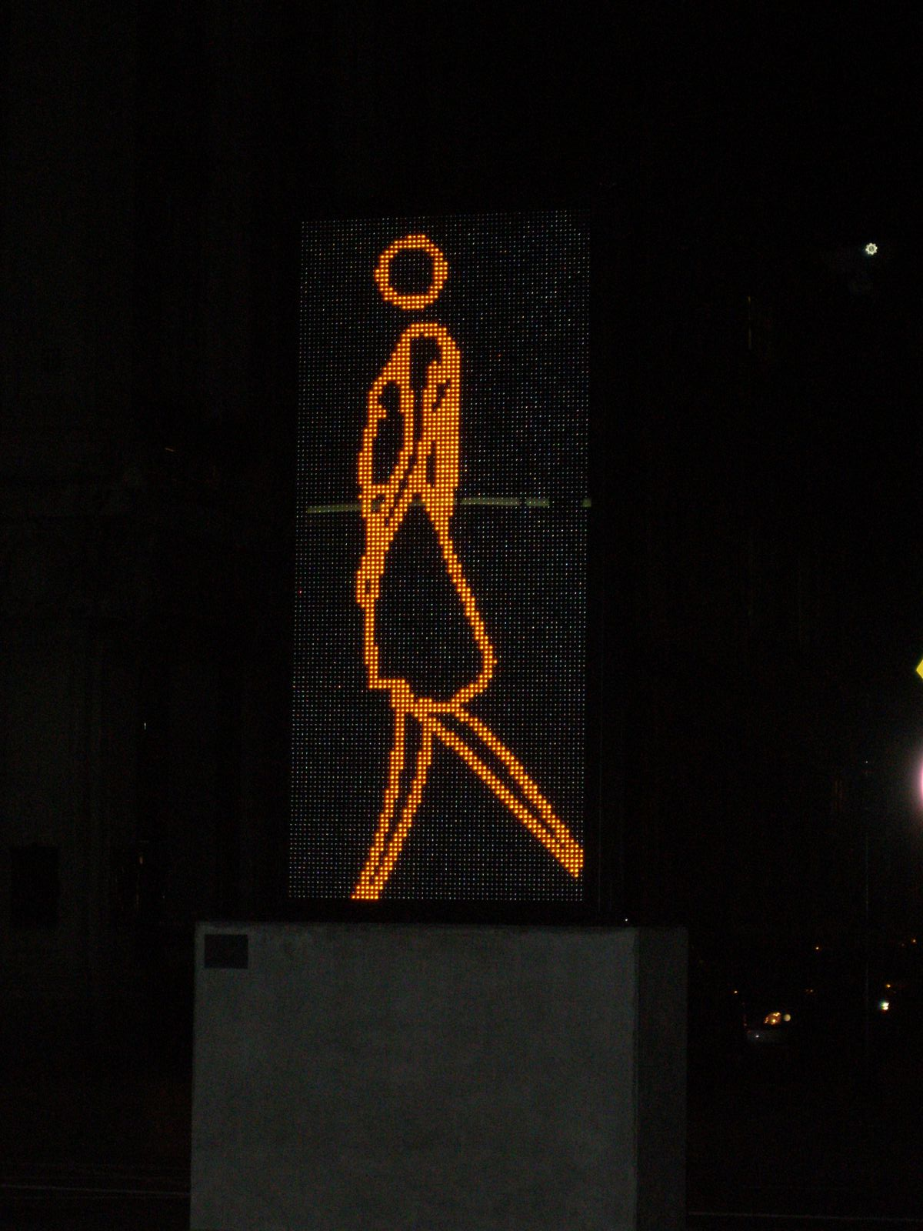
Julian Opie
He has done ‘Street Art’ of people walking and dancing on screens that look a bit like the green man.

Slide 7
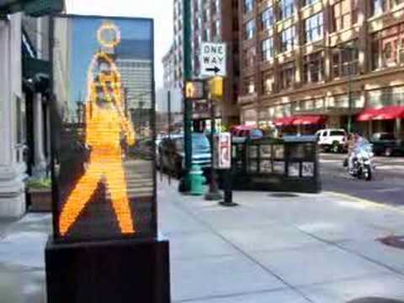

Slide 8


