Slide 2
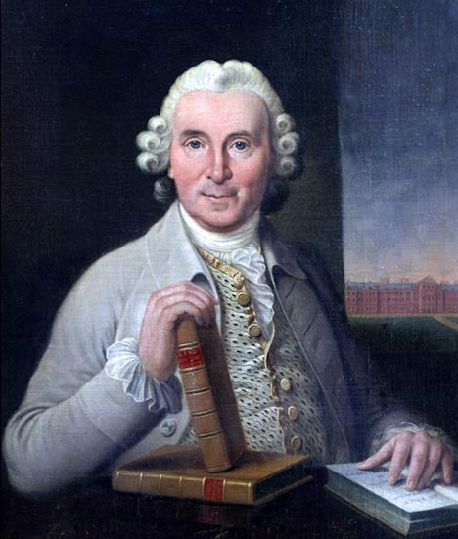
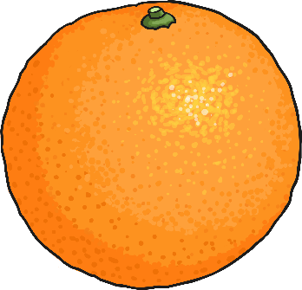
Who Was James Lind?
Born in 1716, he began his working life by completing an apprenticeship at the Edinburgh College of Surgeons.
After working as a ship’s surgeon, he set up a surgery in 1748.
Because of his work on ships, Lind began to investigate scurvy. This was a disease which affected sailors whilst at sea.

Slide 3
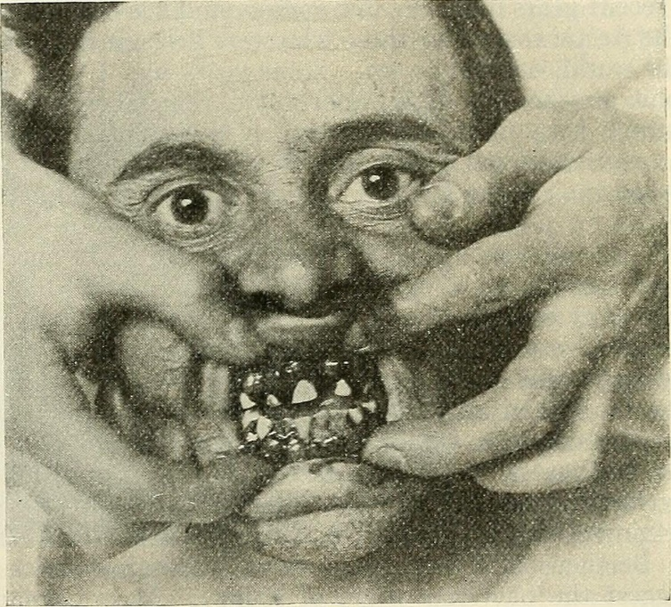
What Is Scurvy?
Scurvy is a disease caused by not having enough vitamin C in your diet.
Symptoms include:
tiredness
muscle weakness
joint and muscle aches
a rash on the legs
bleeding gums
Photo courtesy of internetarchivebookimages@flickr.com - granted under creative commons licence - attribution

Slide 4
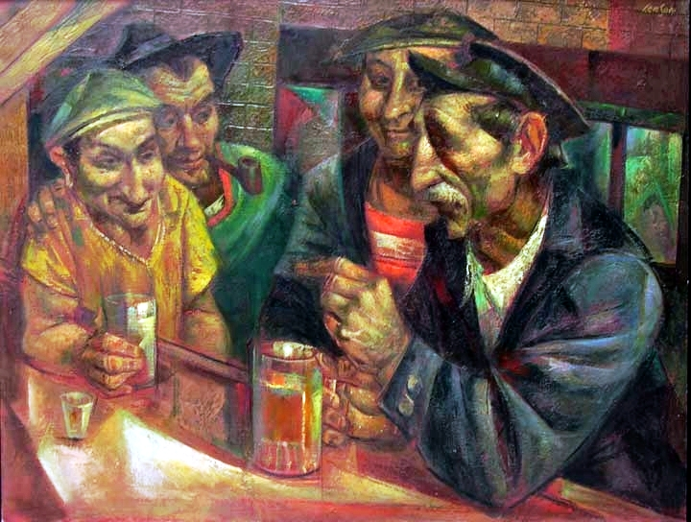
Who Suffered From Scurvy?
In the past, scurvy was common among sailors and those who couldn’t eat fresh fruits and vegetables for long periods of time.
Photo courtesy of RasMarley@flickr.com - granted under creative commons licence - attribution

Slide 5
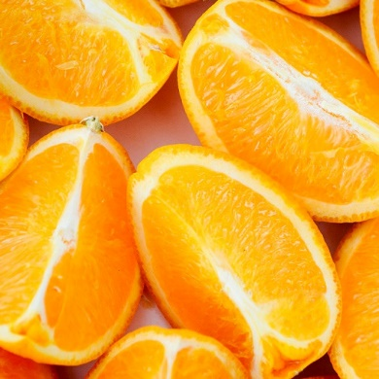
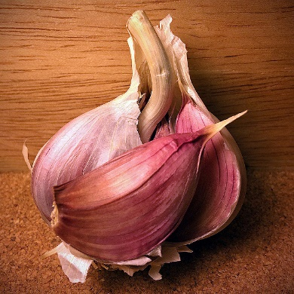
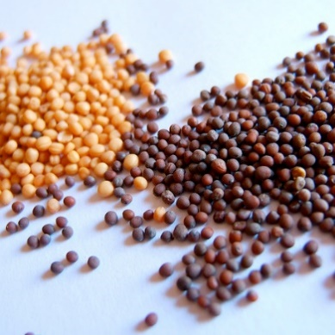
First Clinical Trial
Lind carried out the first clinical trial.
Although earlier doctors thought fresh fruit could prevent scurvy, Lind tested the effects of different diets methodically on a group of patients as part of a clinical trial.
Photos courtesy of Tiff, AJC1 and Jessica Spengler @flickr.com - granted under creative commons licence - attribution

Slide 6

Lind’s Observation
In those days many British sailors, who spent a long time at sea, suffered from scurvy.
James Lind noticed that Dutch sailors, who had been at sea for the same length of time, were less likely to suffer from scurvy.
Photo courtesy of Canadian Pacific @flickr.com - granted under creative commons licence - attribution
Can you think why this was?

Slide 7

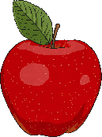

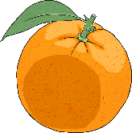

Lind’s Observation
Photo courtesy of Canadian Pacific @flickr.com - granted under creative commons licence - attribution
Lind noticed that Dutch ships carried large barrels of fresh fruit for the sailors.
He wondered if this prevented scurvy.

Slide 8
How Did Lind Test His Idea?
Although earlier doctors thought fresh fruit could prevent scurvy, Lind tested the effects of different diets methodically on a group of patients as part of a clinical trial.
In 1754, he fed a group of twelve scurvy sufferers different foods. Patients, who ate citrus fruits, such as lemons and oranges, recovered much faster.
He made his test fair by:
choosing men who were equally ill;
having them all lie in the same place;
feeding them the same meals every day.

Slide 9


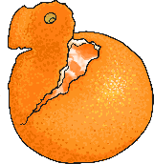
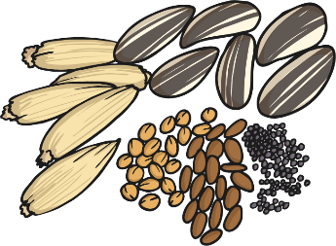
Clinical Trial
Each group tried a different remedy.
A quart of cider
An elixir
Two spoons of vinegar three times a day
Half a pint of seawater
A mixture including mustard seeds, garlic and gum myrrh
Two oranges and a lemon every day
Which group do you think showed the best results?

Slide 10
The Result
The two sailors who ate the oranges and lemons showed by far the best results. One of the sailors was able to return to work within 6 days; the other recovered enough to
help nurse the other
sick men.
A quart of cider
An elixir
Two spoons of vinegar three times a day
Half a pint of seawater
A mixture including mustard seeds, garlic and gum myrrh
Two oranges and a lemon every day

Slide 11
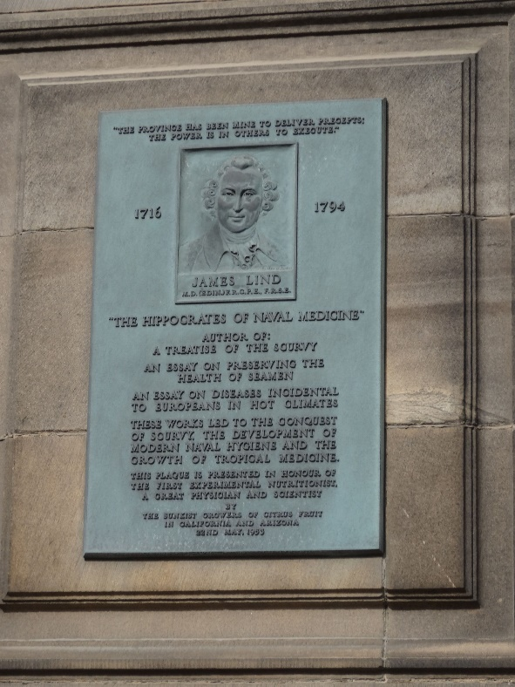
Lind’s Achievements
However, it was not until forty years after the clinical trial that the Royal Navy began to give lemon juice to sailors.
Lind continued to work tirelessly to improve the life of seamen.
After this, Lind began to investigate how to turn salt water into fresh, drinking water.
Clinical trials following Lind's example also led to the development of vaccination as a way of preventing specific diseases, starting with smallpox in the late 1700s.

Slide 12
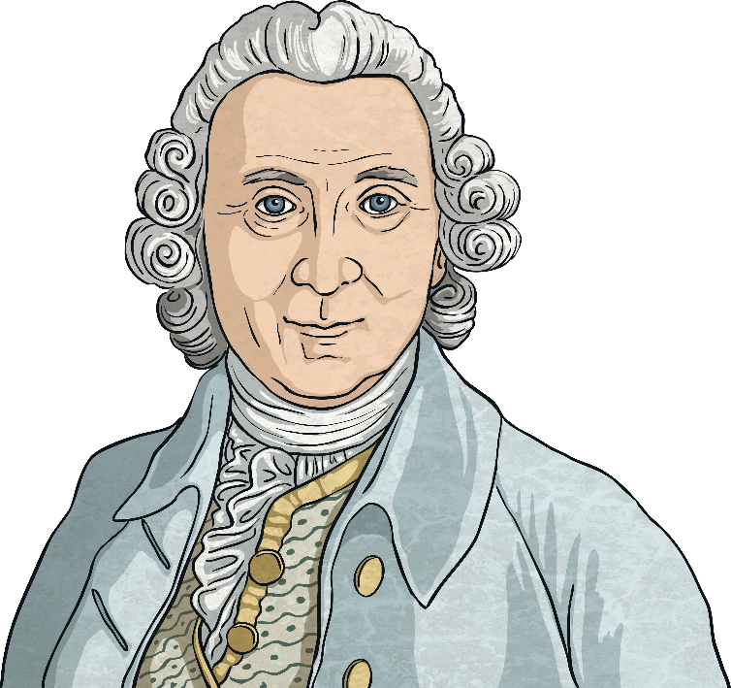
Next
Can you use what you have learned to answer the quiz questions about James Lind?

