Slide 2
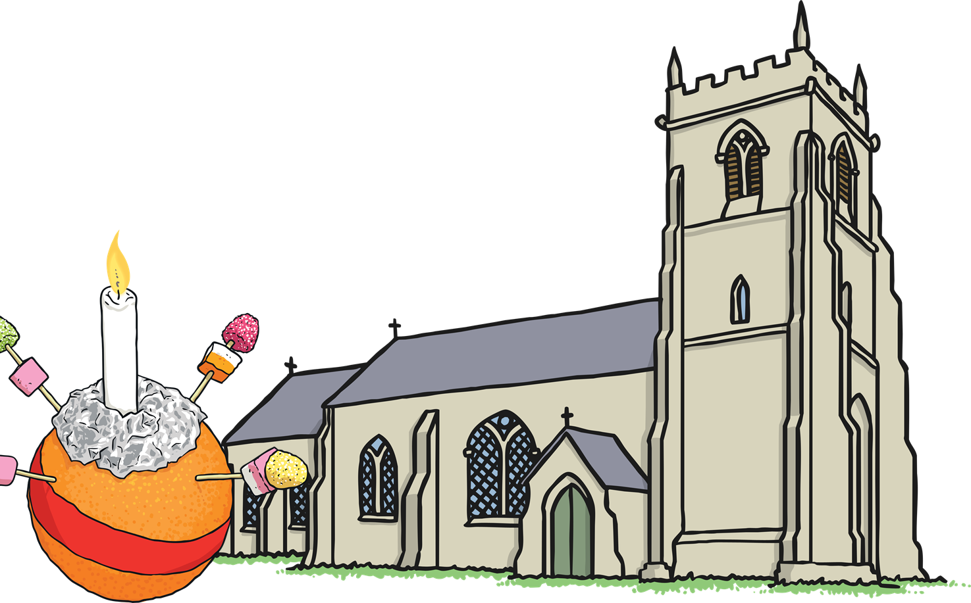
What is a Christingle?
Christingles are used in some Christian churches during the time of Advent.
Each part of a Christingle represents something special for this time of year.

Slide 3
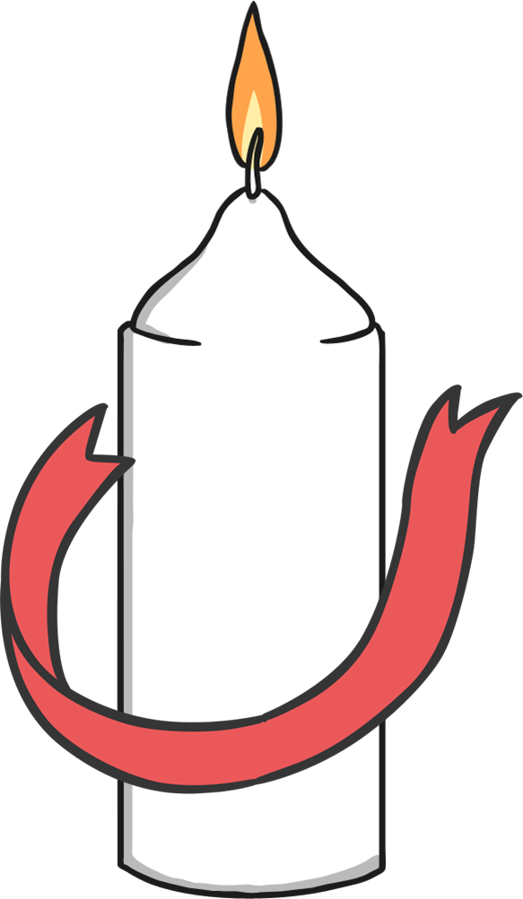
A Long Time Ago
Over three hundred years ago, a bishop in Germany wanted to explain to children the happiness that people feel through knowing Jesus.
At his Advent service, the bishop gave all the children a candle with a red ribbon around it as a symbol of this.

Slide 4
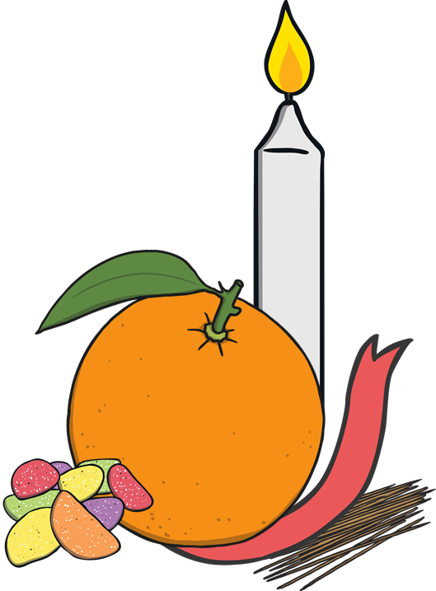
A Christingle
In 1968, the Children’s Society charity used the idea of the Christingle and made their own version.
You need:
4 cocktail sticks
an orange
a red ribbon
some sweets or dried fruit
a candle
You may need some help from an adult to make your Christingle.

Slide 5
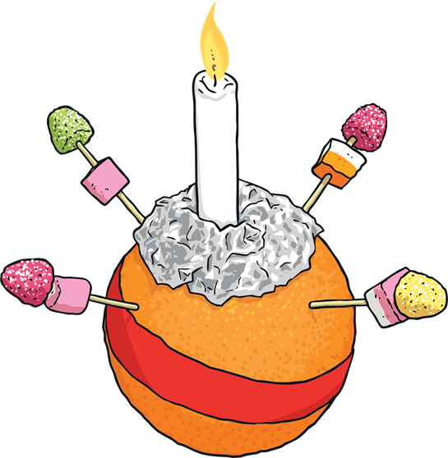
Making a Christingle
The red ribbon goes around the middle of the orange.
The sticks are pushed in around the edge of the orange.
The sweets are put onto the top of each of the cocktail sticks.
The candle is pushed into the top of the orange.

Slide 6
What Does It All Mean?
What do you think is the meaning of each part of the Christingle?
The candle represents Jesus being the light of the world, bringing hope.
Reveal
Reveal
The sweets/dried fruit represent God’s creations in the four seasons.
The red ribbon represents God’s love for the world and the blood of Jesus.
Reveal
The orange represents the world.
Reveal

Slide 7

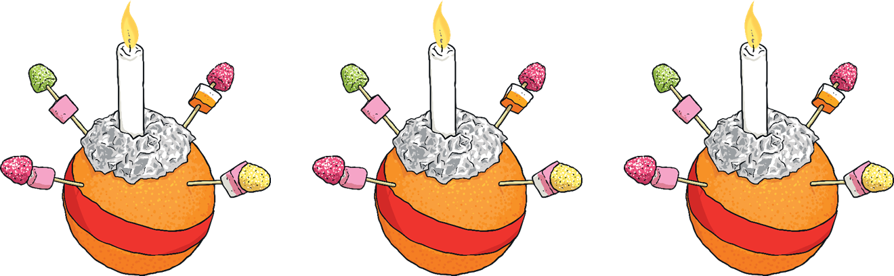
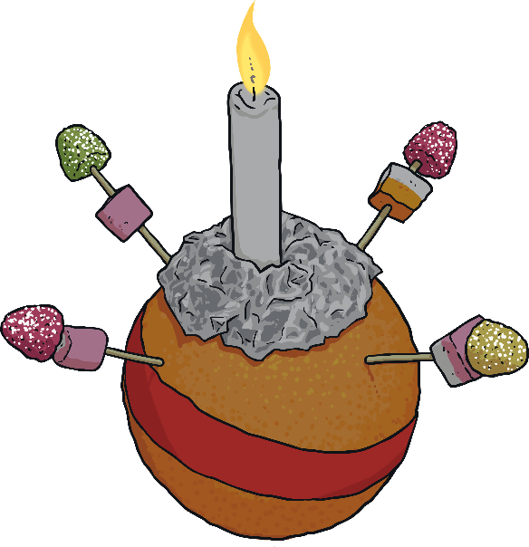
Christingle Services
Click to turn off the lights!
Christingles are often used during Advent in Christingle services.
Prayers for people in need are said and songs are sung.
During the service, the candles on the Christingles are lit and all the lights are turned off.
Christians think about the hope that the light of Jesus brings to the world.

Slide 8

Think about how you can bring light to other people who might be feeling sad or lonely.

