Slide 2

The Letter N Looks Like This…
N
Click on the pencil to see the letter formation.
Can you draw it with your finger?

Slide 3
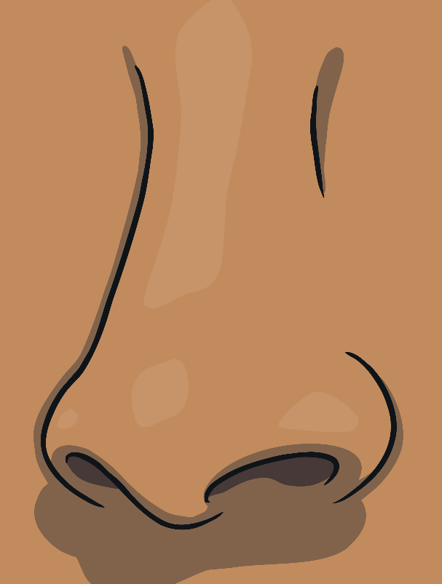
The Letter N Sounds Like This…
N, N, N
Teaching note: Say the sound /n/ and have children repeat it back multiple times

Slide 4
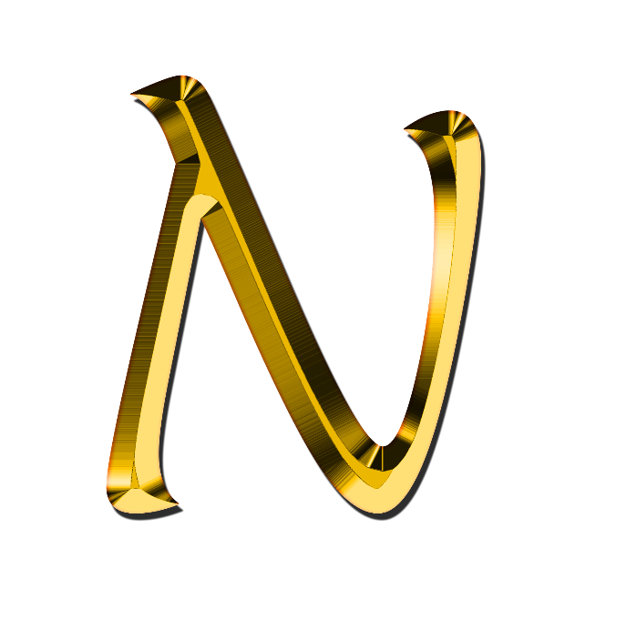

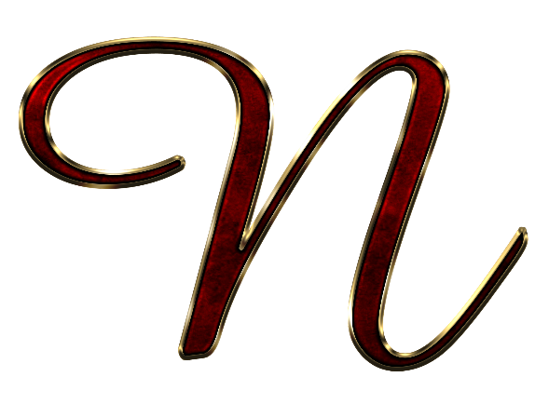

It Can Also Look Like This…

Slide 5
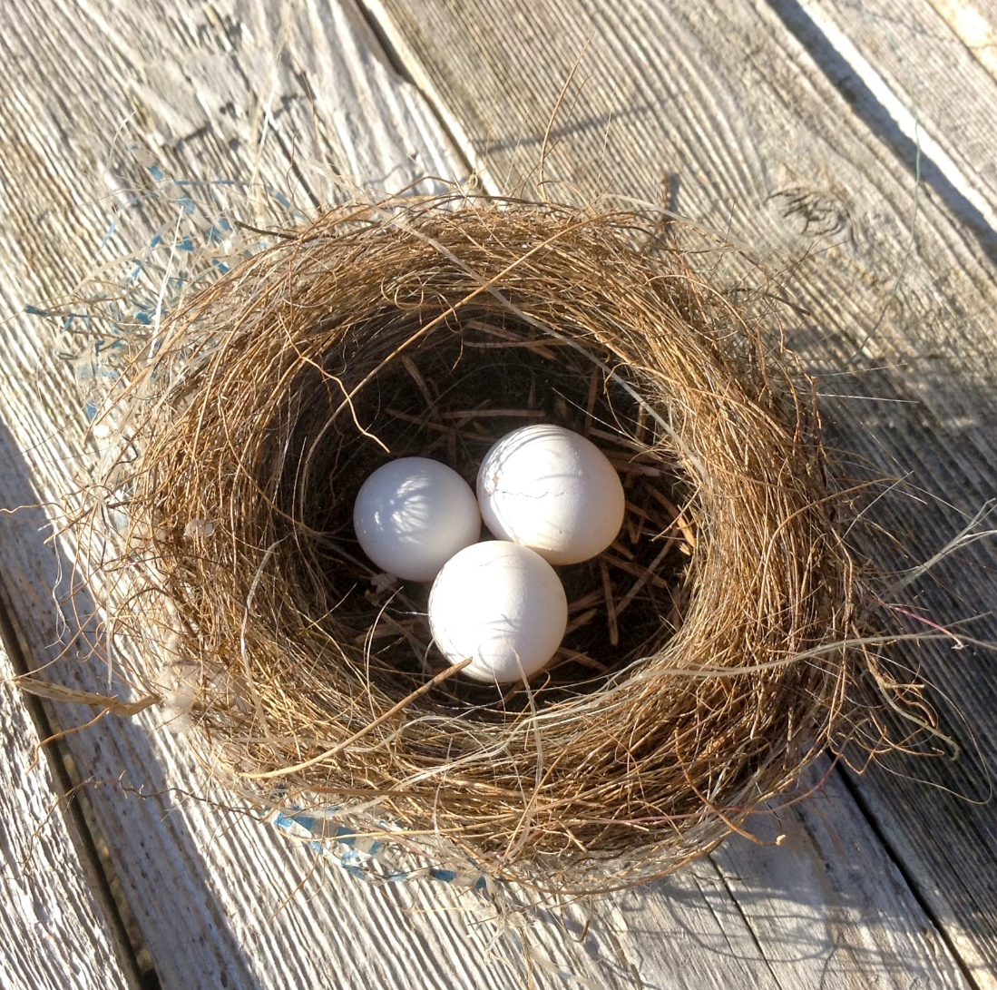
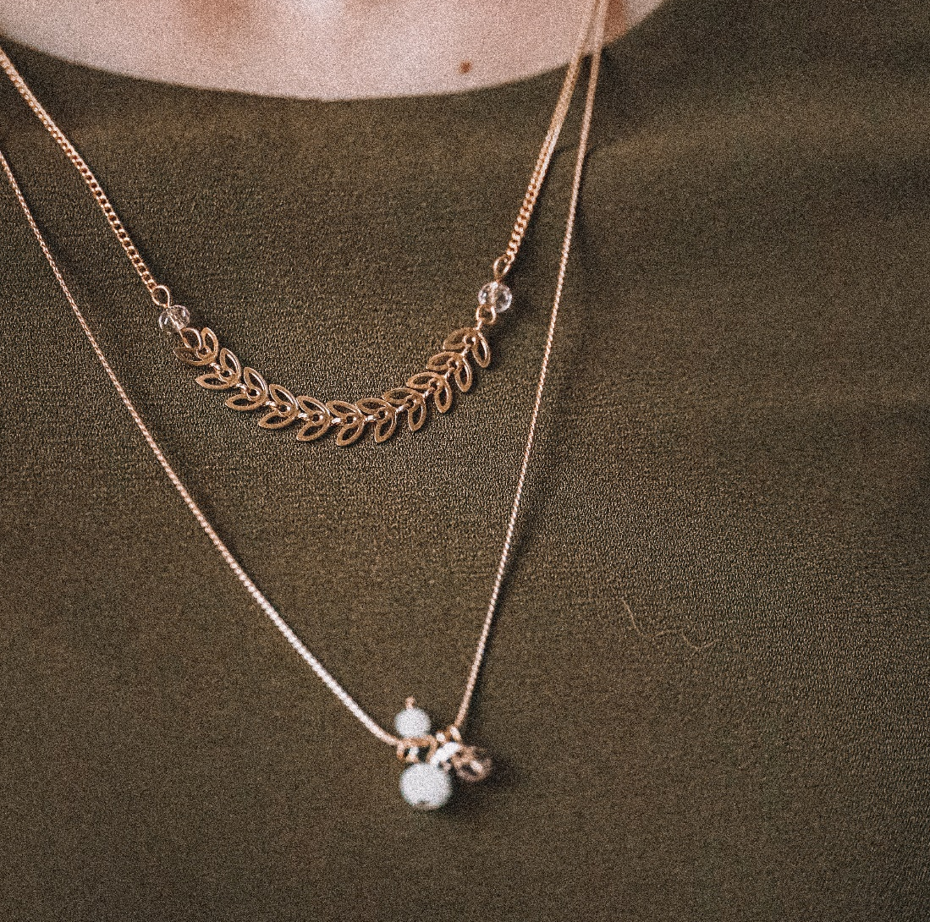
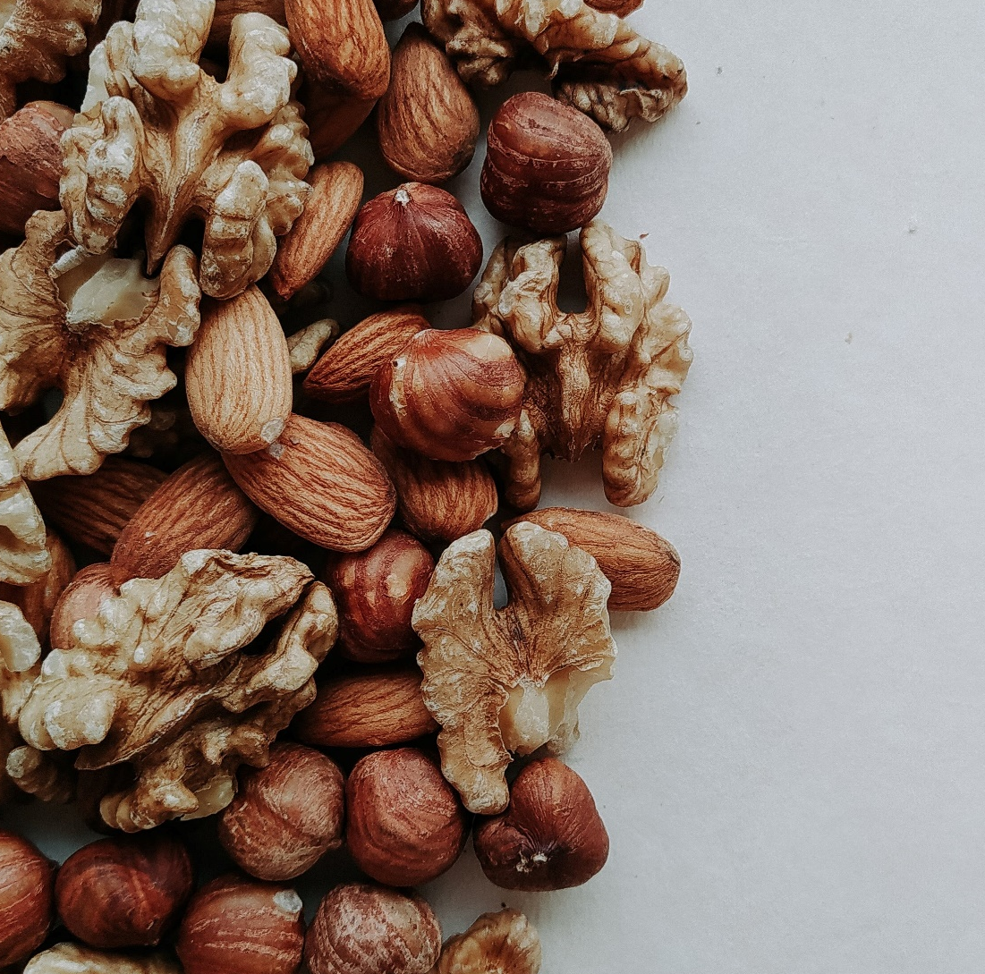
Some Things That Start With N Are…

Slide 6

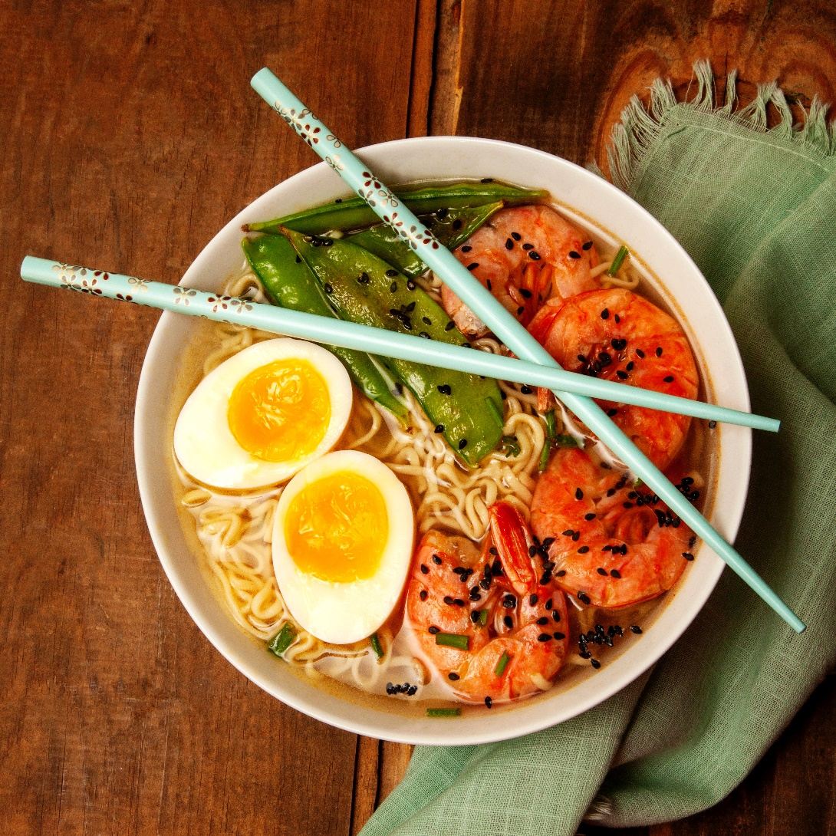

Some Things That Start With N Are…

Slide 7

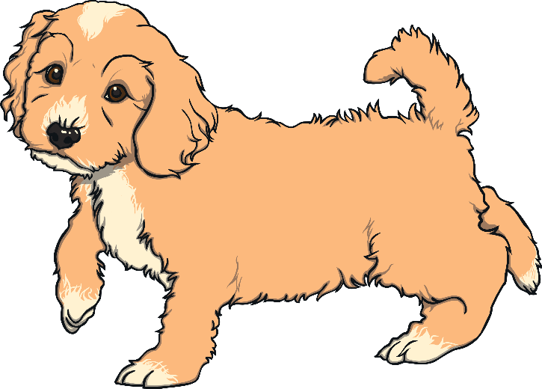
Which of These Start With N?
TRY AGAIN!
YES!
9
Teaching note: Pause briefly after the initial sound of each word to assist students to identify the sounds

Slide 8
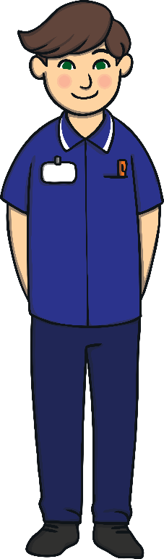
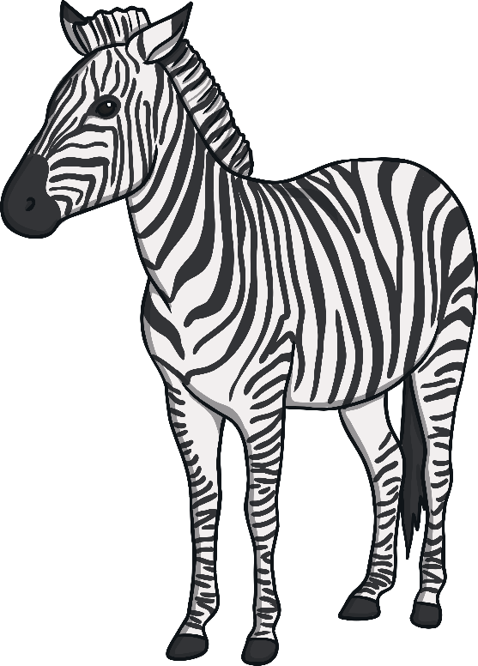
Which of These Start With N?
TRY AGAIN!
YES!
Teaching note: Pause briefly after the initial sound of each word to assist students to identify the sounds

Slide 9


Which of These Start With N?
TRY AGAIN!
YES!
Teaching note: Pause briefly after the initial sound of each word to assist students to identify the sounds

