Slide 1


Mathematics
Number and Algebra
Year One
Mathematics | Year 1 | Number and Algebra | Patterns and Algebra | Pattern and Sequence | Lesson 3 of 3: 3D Object Sequences

Slide 3
Aim
I can make and describe patterns with 3D objects and identify where an object will appear in the sequence.
Success Criteria
I can complete a 3D object pattern.
I can identify where an object will appear in a sequence.
I can create my own 3D object pattern.
I can draw, name and discuss the properties of 3D objects.

Slide 4

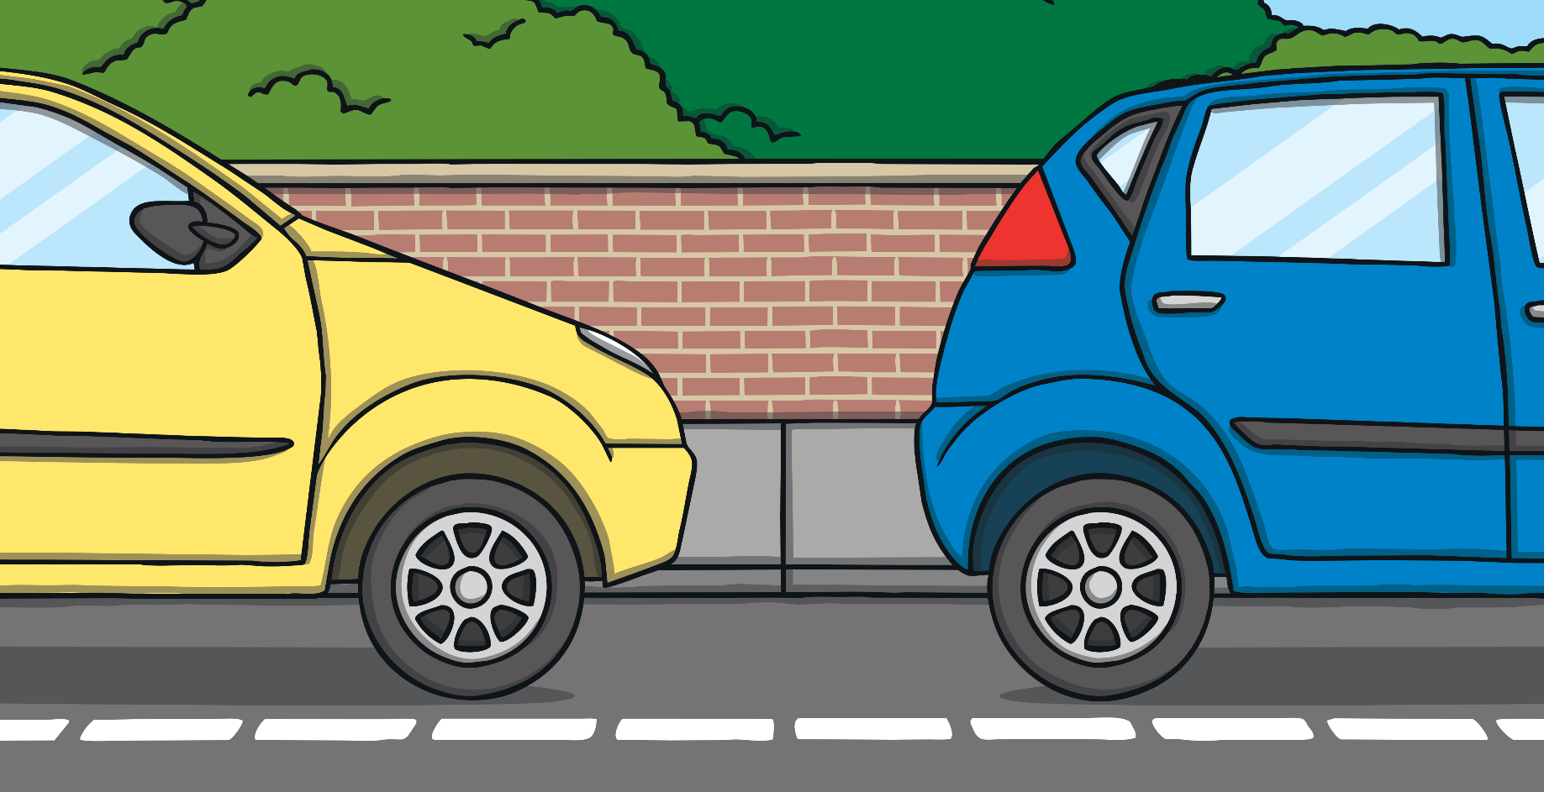
Left and Right 3D Objects
Which direction are the objects driving to?
Click here to start

Slide 5
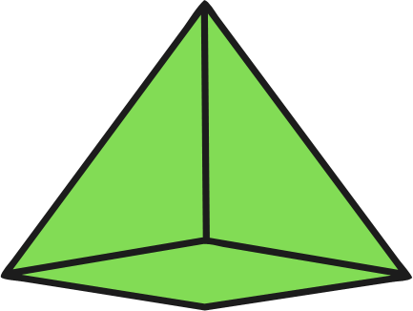



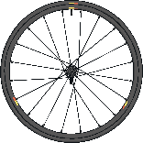
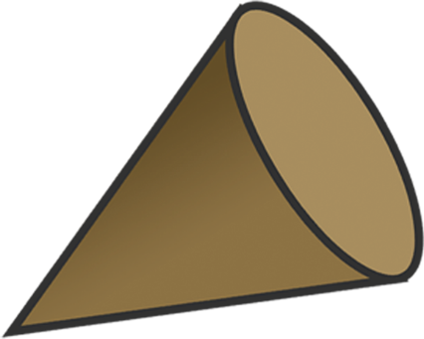
Which direction are the objects driving to?
Click for next object.

Slide 6

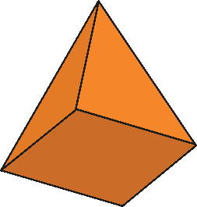



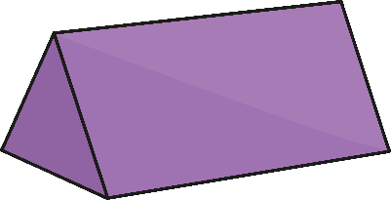
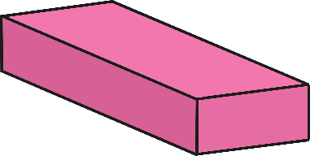
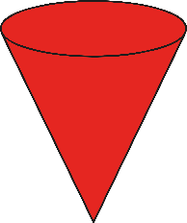
Guess My Object
I am going to choose a 3D object. Your task is to guess my object by asking questions that have a ‘yes’ or ‘no’ answer.
square-based
pyramid
cube
sphere
cylinder
cone
triangular pyramid
cuboid
Does the object have flat faces?
Can the object roll?

Slide 7


3D Object Sequences
Predict the next three objects in the sequence. What colour will each object be?
?
?
?
What would be the 10th object in the sequence?
?

Slide 8

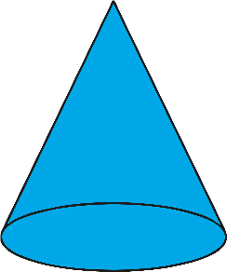
3D Object Sequences
Predict the next three objects in the sequence. What colour will each object be?
?
?
?
What would be the 12th object in the sequence?
?

Slide 9



3D Object Sequences
Predict the next three objects in the sequence. What colour will each object be?
?
?
?
What would be the 14th object in the sequence?
?

Slide 10

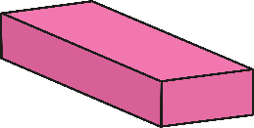
3D Object Sequences
Predict the next three objects in the sequence. What colour will each object be?
?
?
?
What would be the 15th object in the sequence?
?

Slide 11

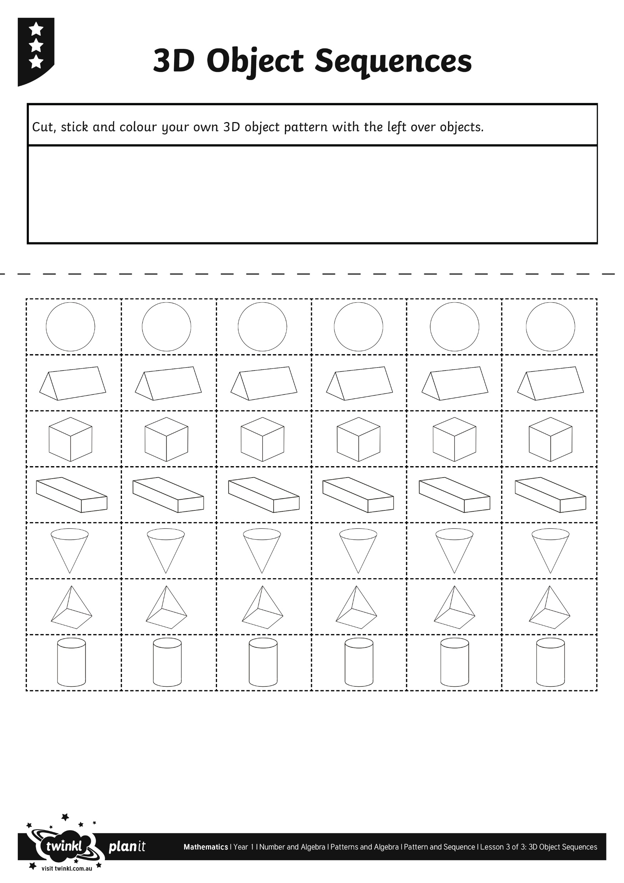
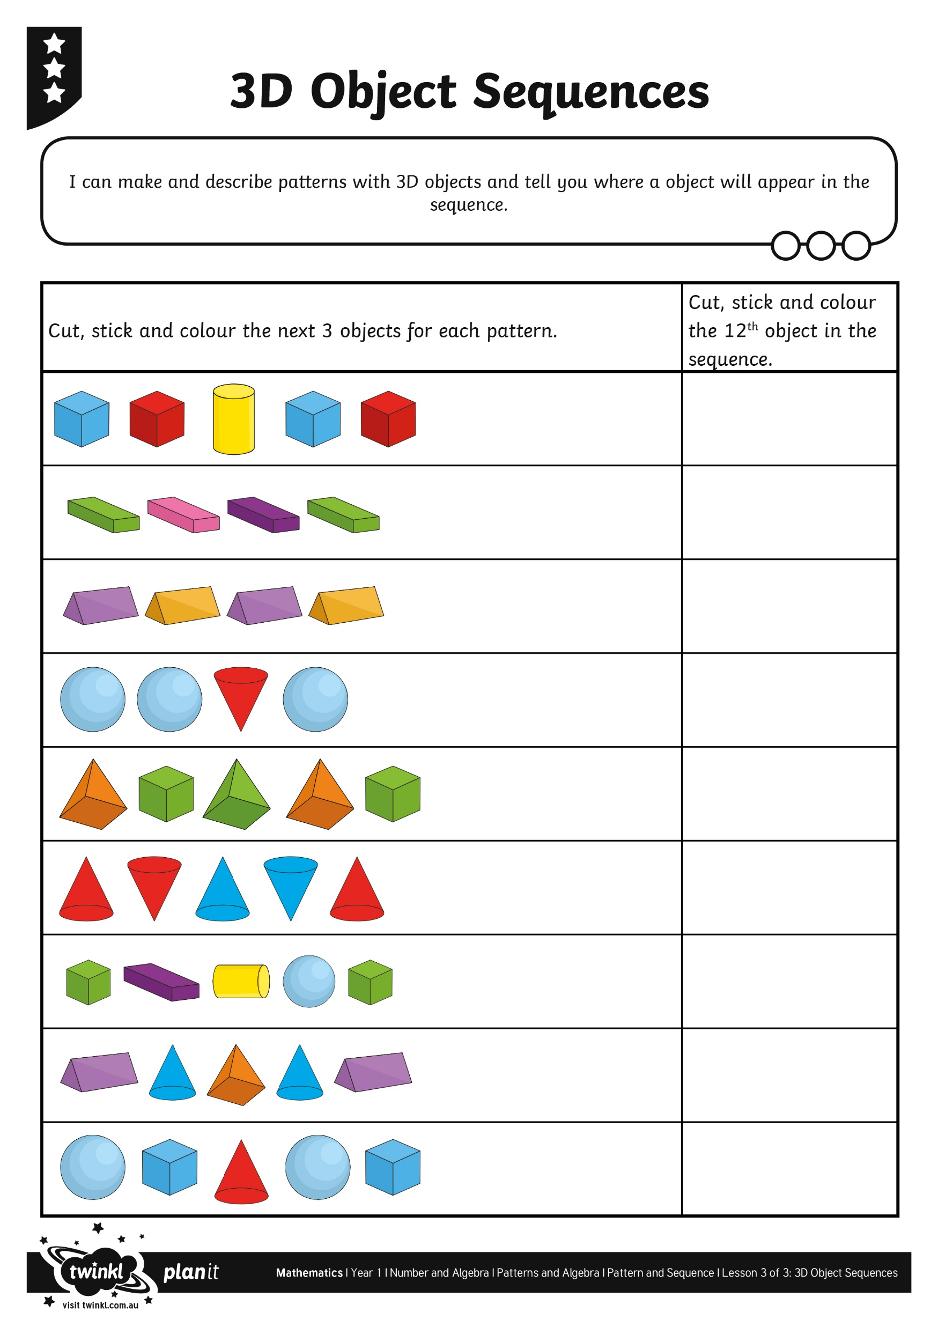
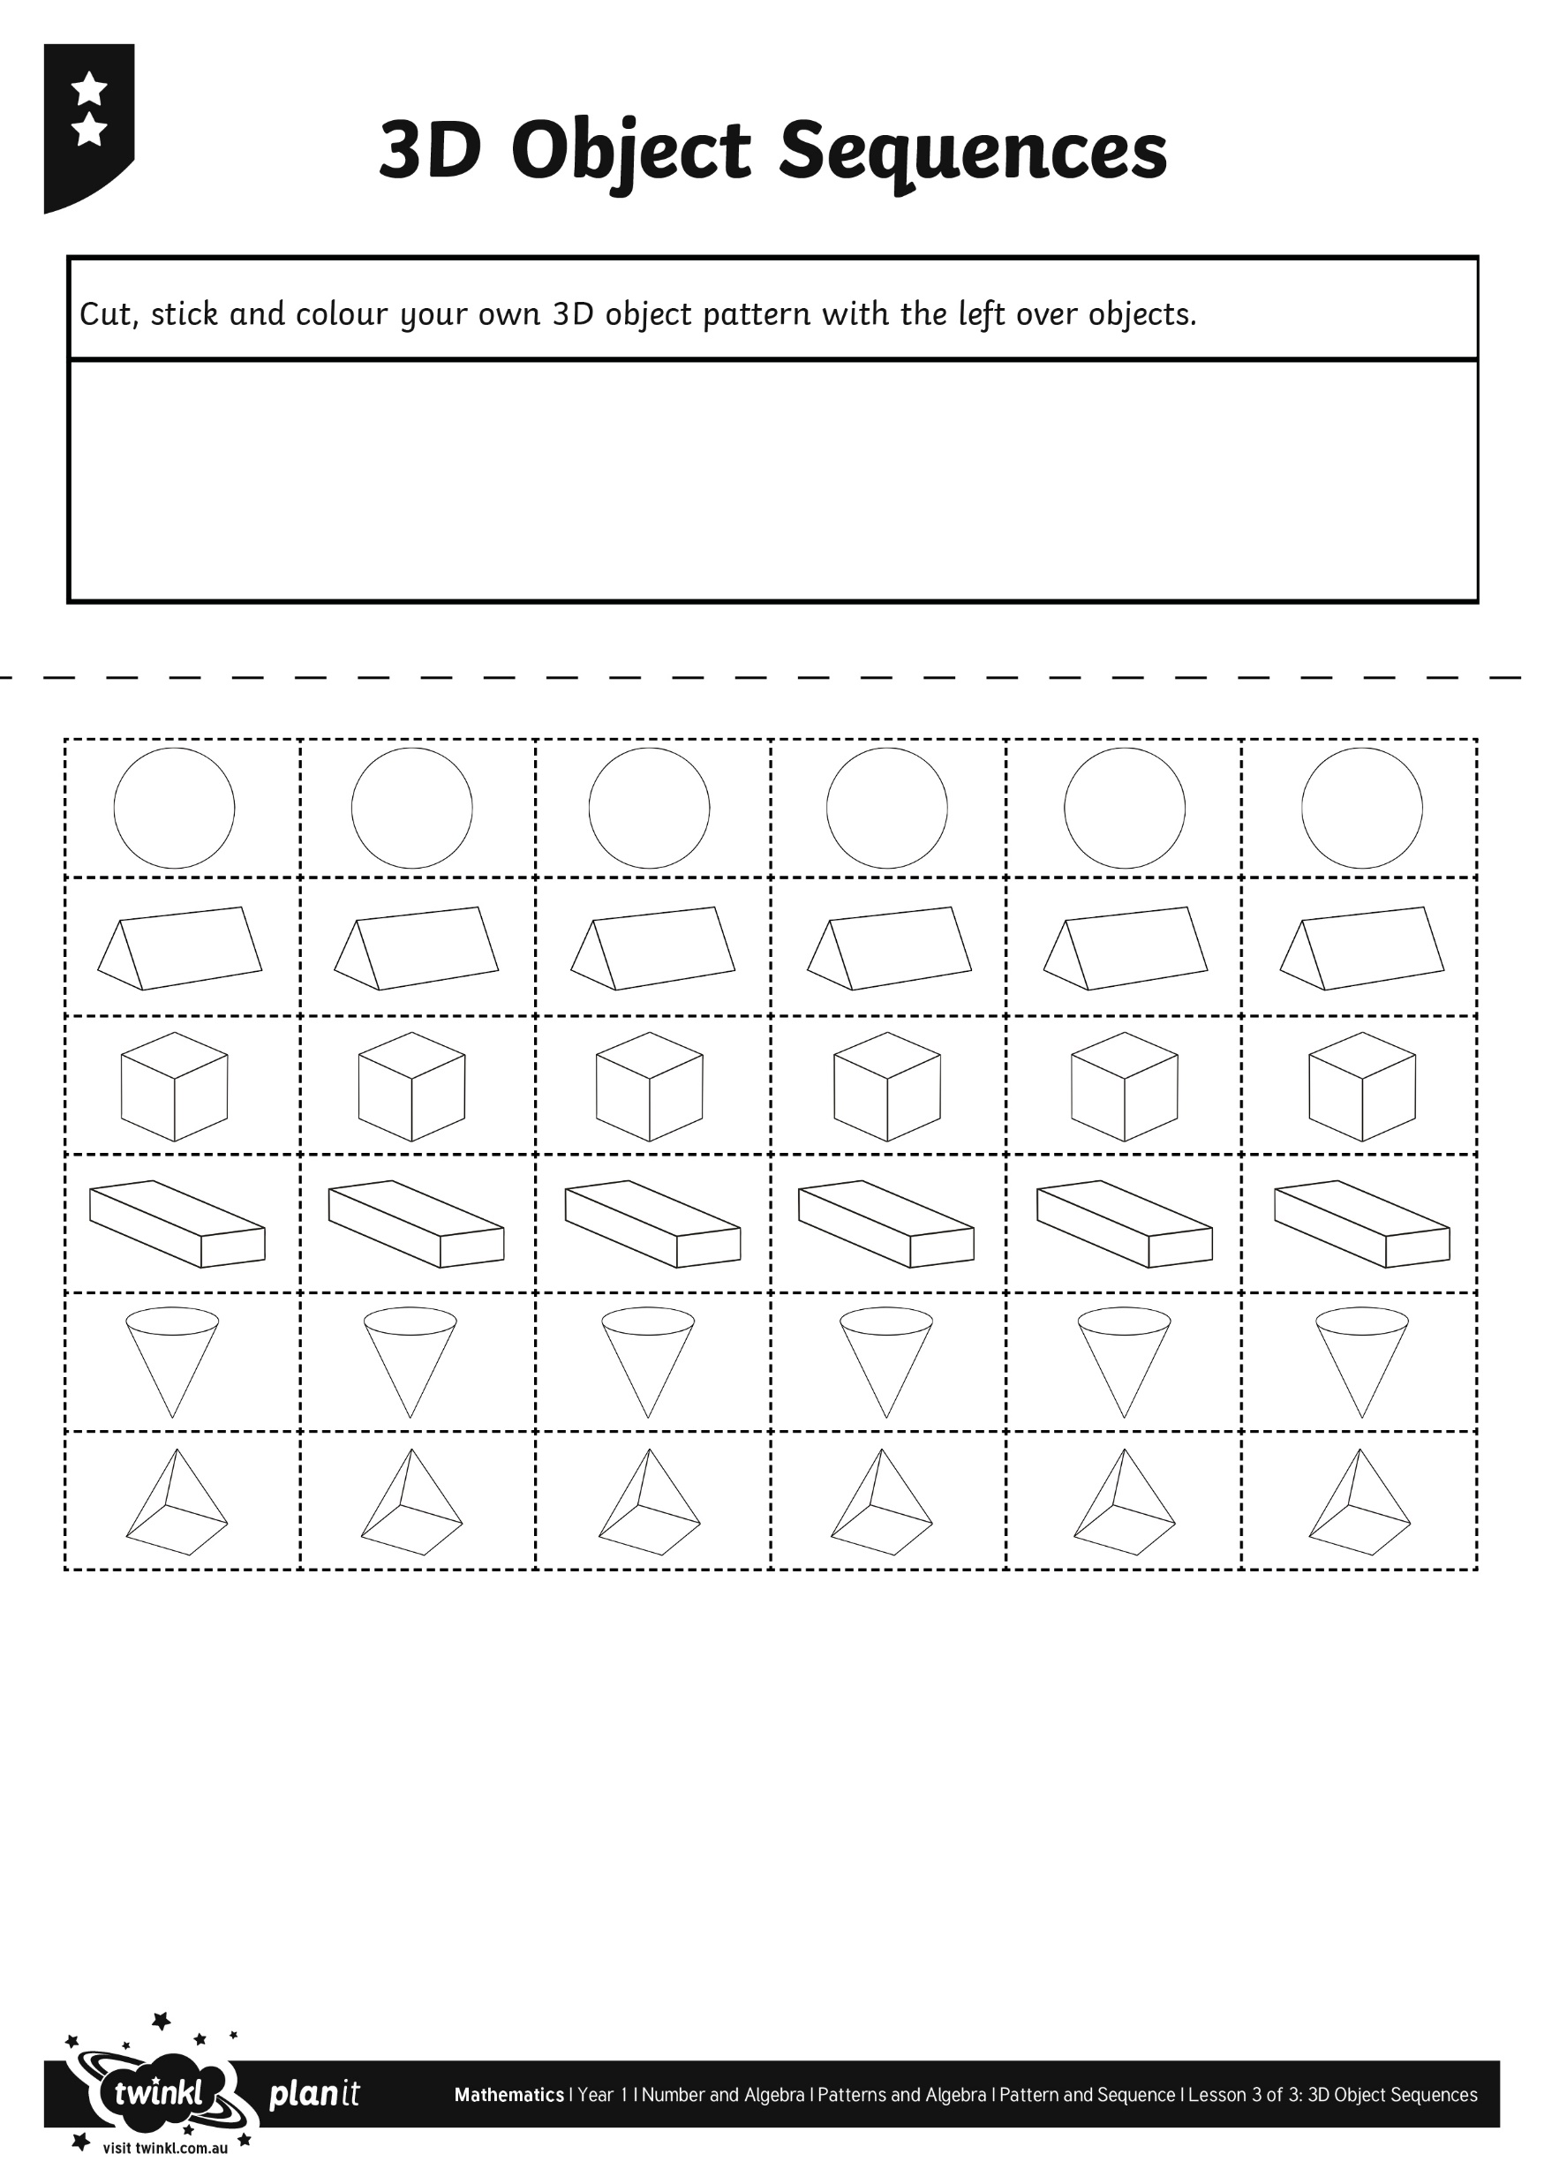


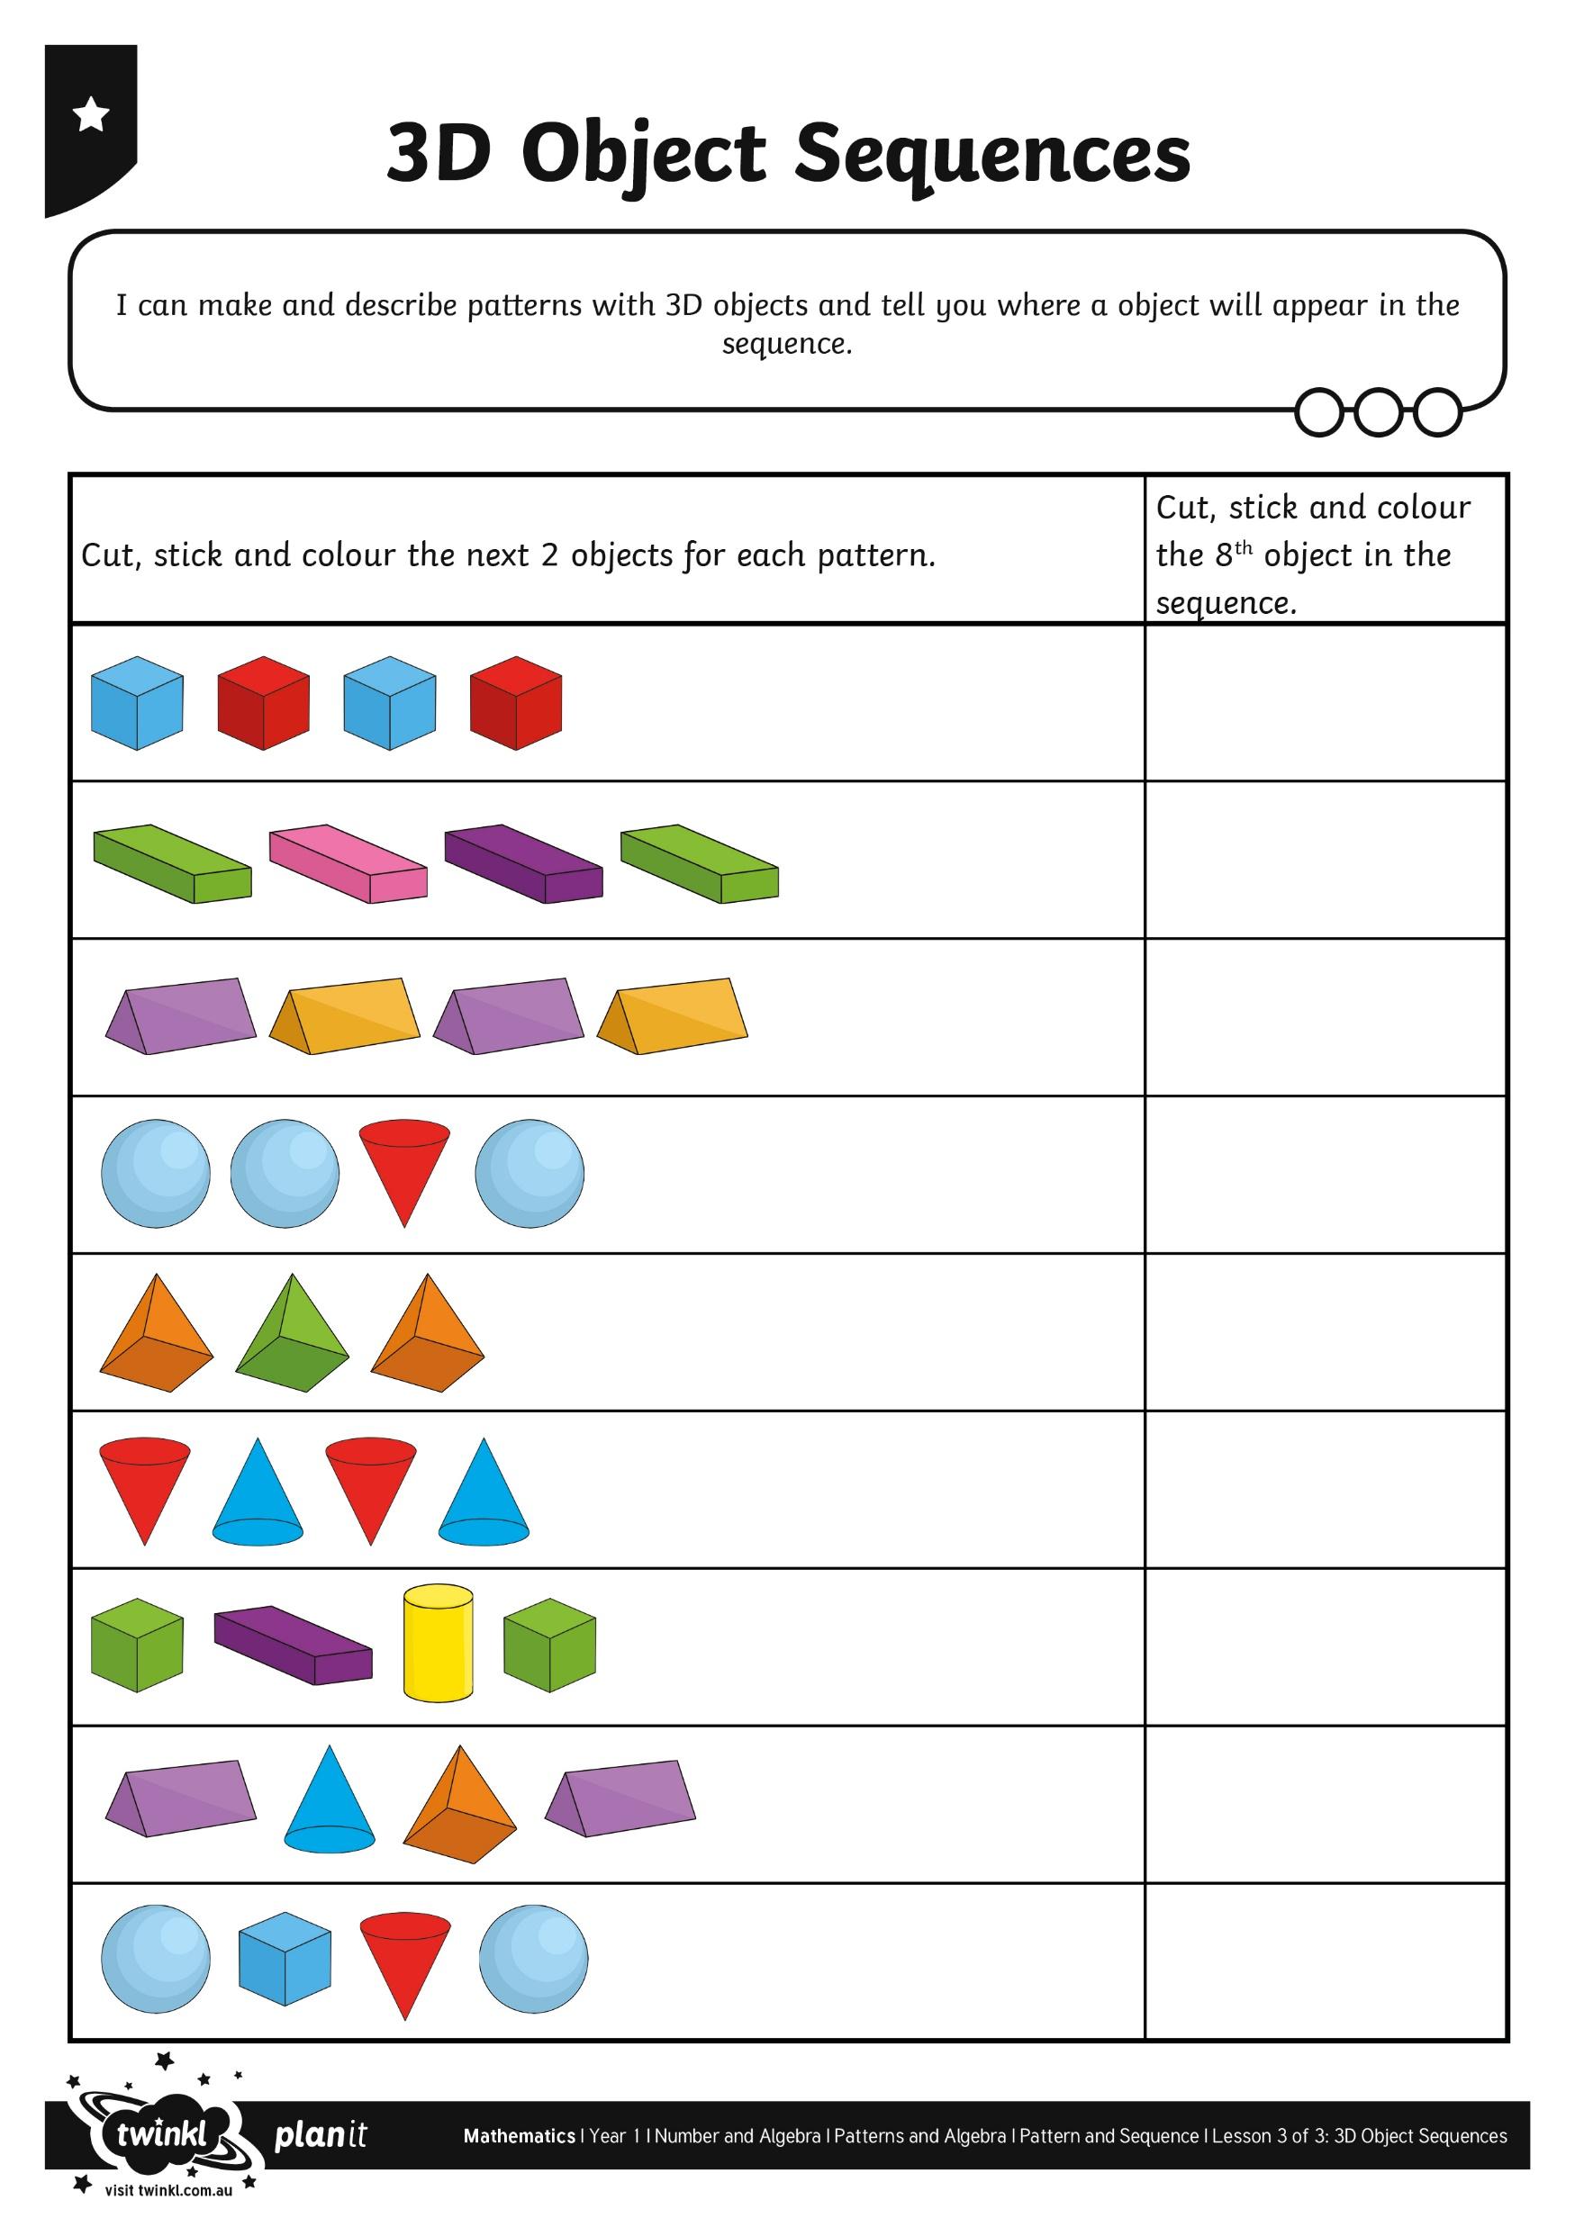
3D Object Sequences Activity

Slide 12
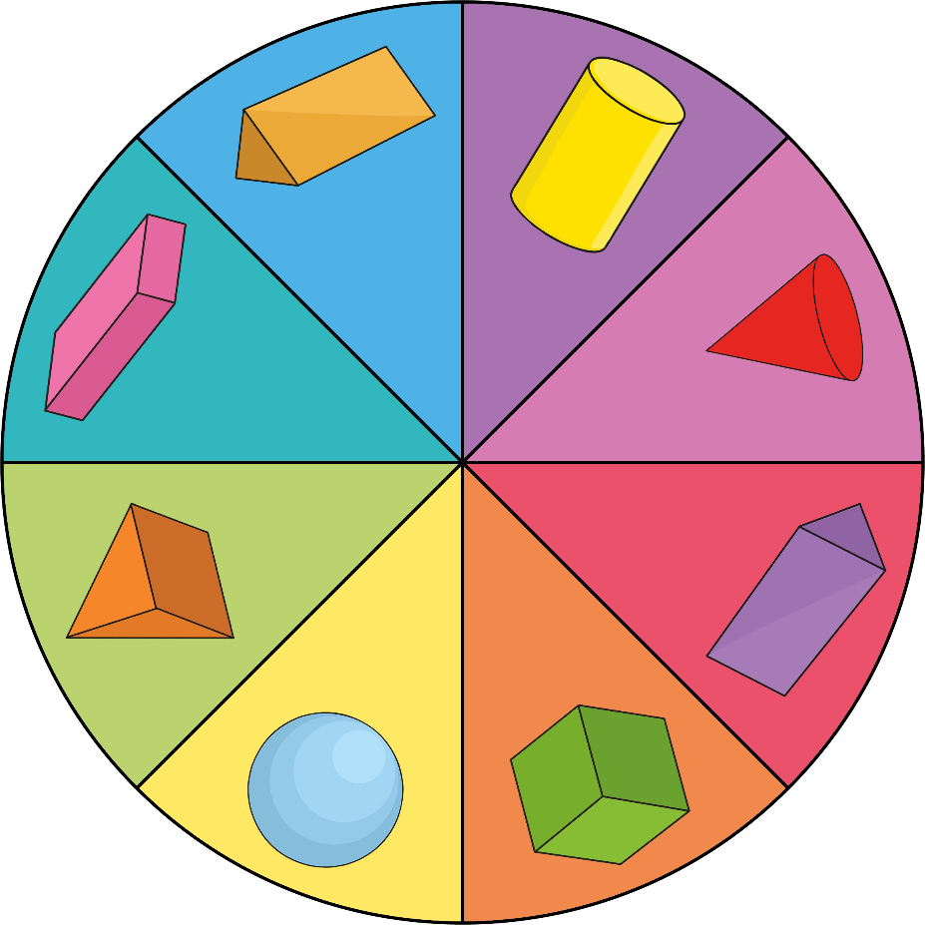
Spinning a Sequence
Follow the pattern and describe what object comes next.
SPIN

Slide 13

Aim
I can make and describe patterns with 3D objects and identify where an object will appear in the sequence.
Success Criteria
I can complete a 3D object pattern.
I can identify where an object will appear in a sequence.
I can create my own 3D object pattern.
I can draw, name and discuss the properties of 3D objects.

