Slide 2
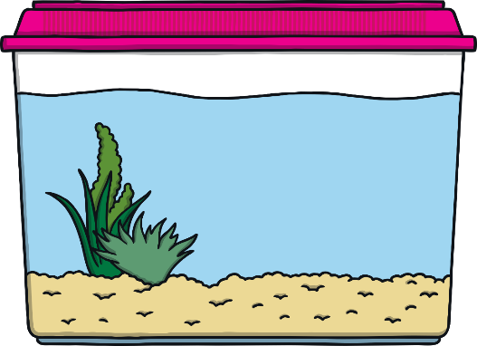


Introduction
This PowerPoint aims to support children with their addition skills by seeing that two groups can be added together.
The fish tanks introduce children to the very early idea of part-part-whole by separating the two colours of fish and then adding them together in the larger tank.
On each slide, there is the option of showing the children the addition number sentence, using the addition and equals symbols. Simply click the answer button to reveal this.

Slide 3




7
4
4+3=7
3
Answer

Slide 4



8
5
5+3=8
3
Answer

Slide 5




6
3
3+3=6
3
Answer

Slide 6


9
6
6+3=9
3
Answer

