Slide 1
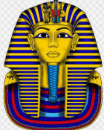
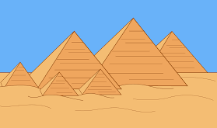
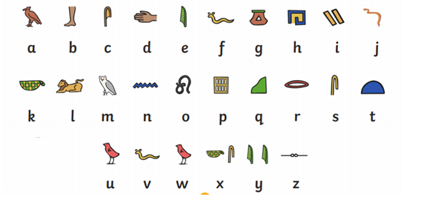
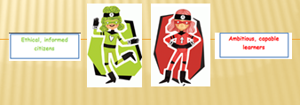
Yr eifftwyr
The Egyptians

Slide 2
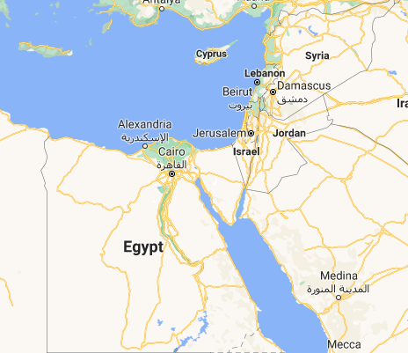
Task 1: Yr Aifft
Find Egypt on the map and label it in Welsh. Edit the arrow by moving it to the correct position.

Slide 3
Task 2:
Look at the different Egypt themed vocabulary on each slide and it’s corresponding Welsh word.
Find an image on a search engine that goes with each word. Try to find an image that goes with your Egyptian theme.
Copy and Paste or screenshot that image under the word. The first one has been done for you.

Slide 4

Crown - coron

Slide 5
Pyramid - pyramid

Slide 6
mummy - mymi

Slide 7
Tunic - tiwnig

Slide 8
snake - neidr

Slide 9
gold - aur

Slide 10
silver -silver

Slide 11
palace - palas

Slide 12
tomb - beddrod

Slide 13
cat- cath

Slide 14
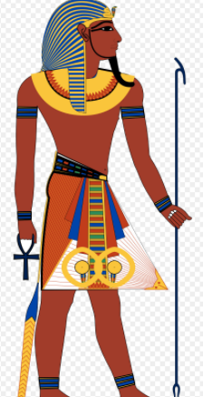
Task 3:
Look at the Year 3/4 Welsh language patterns.
Describe 3 the images within the PowerPoint.
Cath
Twinig
Coron
I have created some for you as an example but you need to think of your own.
Mae tiwnig y pharo yn aur
(the Pharaoh’s tunic is gold)

