Slide 1


Benjamin Britten
A New Year Carol
Listen & Appraise
Mission 2:

Slide 2
What instruments do you hear?

Slide 3
What do you think is the story told in this song?

Slide 4
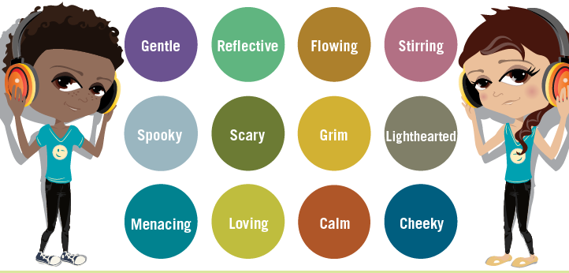
What is the mood of the song?

Slide 5
How do you think the music makes the story more interesting?

Slide 6
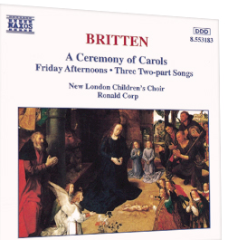
Design a front cover to the album – here is the original artwork
You can design your album cover on a piece of paper; take a picture of your design and then send it to me.

