Slide 1
Morriston Primary School
Attendance

Slide 2

Role Of Attendance Officer
Attendance officer will complete a daily register check.
Attendance officer will call first day absentees.
Attendance officer will make a home visit when appropriate. Address any issues that may arise that can prevent a child from attending school.
Refer to outside agencies if required.
Work closely with Education Welfare Officer (EWO).
Monitor children with attendance below 90%.

Slide 3
Register check and what it entails
Class registers will be checked by our attendance officer by 9am.
Teachers will mark absentees with an ‘N’ mark. Attendance officer will then change this mark with the appropriate code, depending on reason given by parents.
All codes will deduct a percentage off your child’s overall attendance percentage.

Slide 4
Home Visits
A home visit will be made if it is felt appropriate and we have had no correspondence from parents/guardians.
The attendance officer will attend a home visit and offer any support that may be needed to help the child return to school.
Parents will be given an up to date registration certificate of their child to make them aware of their child’s overall percentage.
The attendance officer will inform parents of what the next steps are if attendance is not improved.

Slide 5

Education Welfare Officer
Morriston Primary School has an Education Welfare Officer (EWO) assigned.
The attendance Officer will meet with them on a weekly basis to discuss overall school attendance. Discussions will be had regarding any pupils with attendance of 90% and under.
If no progress has been made, the family will be referred to the EWO, who will then contact the family to put a plan in place to move forward with attendance.

Slide 6
Holiday Requests
Holiday request forms are to be completed by parent/guardian, giving the school six weeks notice.
Holiday requests can only be authorised for exceptional circumstances. All other holiday requests will be deemed unauthorised and you may be at risk of a penalty notice.
If you have any questions regarding holiday requests, please please contact the school office.

Slide 7
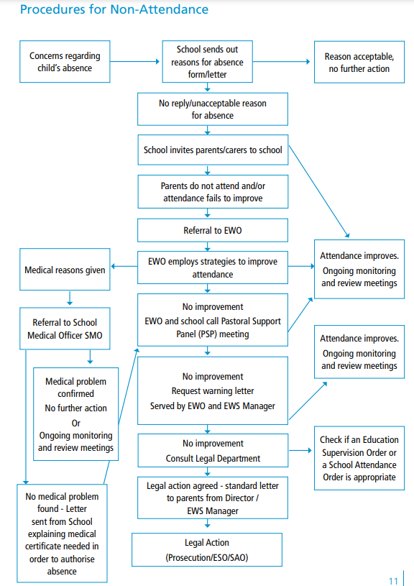

Procedures for Non-attendance

Slide 8
Fixed Penalty Notice
If a pupil who is registered at a school does not attend that school regularly, and attempts by the EWO and the school do not success in ensuring regular attendance for that pupil, then the Council will, ordinarily consider issuing the parent with a fixed penalty notice.
Section 444 of the Education Act 1996 states that if a child of compulsory school age who is a registered pupil at a school fails to attend regularly at the school, his parent is guilty of an offence. The use of legal action against parents will be considered as part of a planned intervention to improve attendance. This can include the issuing of fixed penalty notices under section 444A of that Act. If fixed penalty notices are used, then local authorities should take great care to ensure that notices are properly issued and only issued for offences where the local authority is willing and able to prosecute in the event the parent does not pay the fixed penalty.
Unless there are known mitigating circumstances, the Council will consider taking legal action by issuing a summons against the parents to appear before the Magistrates Court under Section 444 of the 1996 Education Act. In deciding whether or not to take legal action, the EWO must be satisfied that:
1. There is sufficient evidence to provide a realistic prospect of conviction; it must consider what the defence case may be and how this is likely to affect the prosecution case.
2. It is in the public interest to prosecute; in cases of any seriousness, a prosecution will usually take place unless there are public interest factors pointing against prosecution, which clearly outweigh those in favour.
3. Any action it takes complies with the Human Rights Act.
If after legal action has been taken the pupil still fails to attend school regularly, the EWO will, if deemed appropriate, take further legal action.

