Slide 1
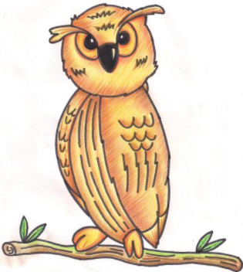

Morriston Primary school
Our Journey to Curriculum for Wales 2022

Slide 2
Our School Vision
Our vision is encapsulated in Article 29 –
‘Your Right to be the best you can be.’
In Morriston Primary School we aim to provide a broad, balanced and rich curriculum. We offer an inclusive environment where pupils are encouraged to be happy, digitally competent, creative, confident and resilient learners. We challenge our pupils to reach their full potential, equipping them with the skills necessary to continue on their journey of life-long learning

Slide 3
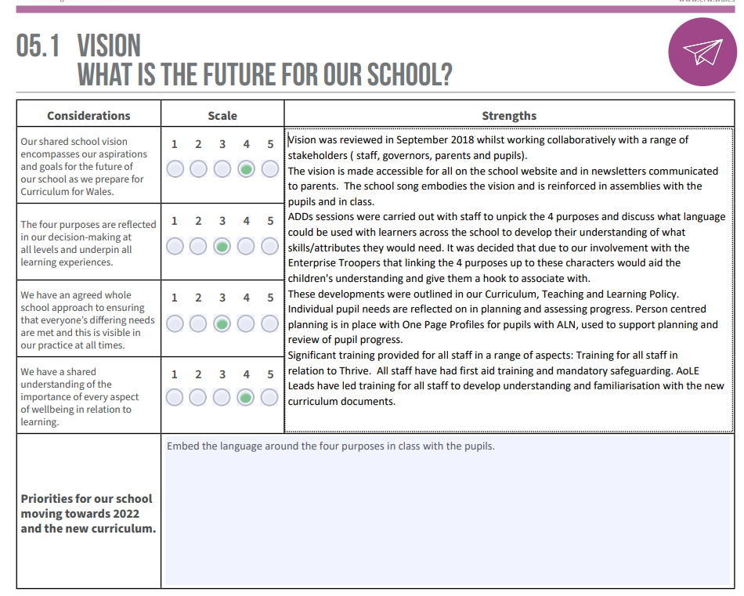

Slide 4
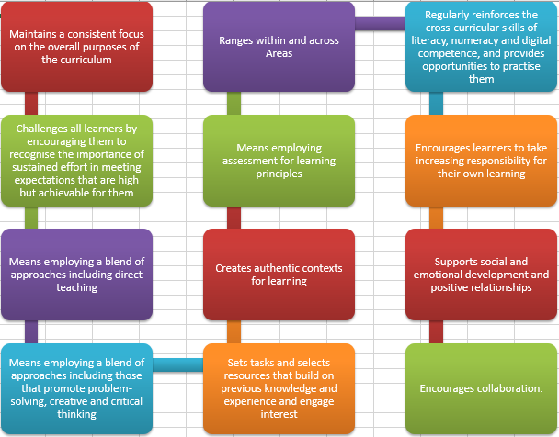
Pedagogical principles

Slide 5
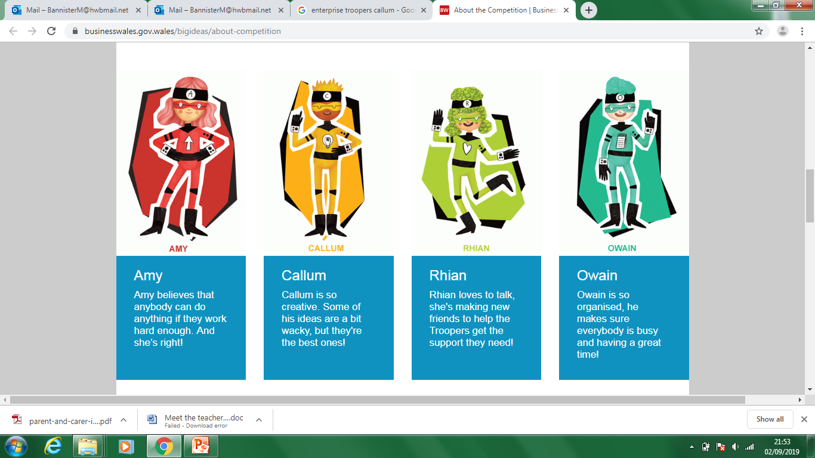
Four Purposes
Ambitious, capable learners
Enterprising, creative contributors
Ethical, informed citizens
Healthy, confident individuals

Slide 6
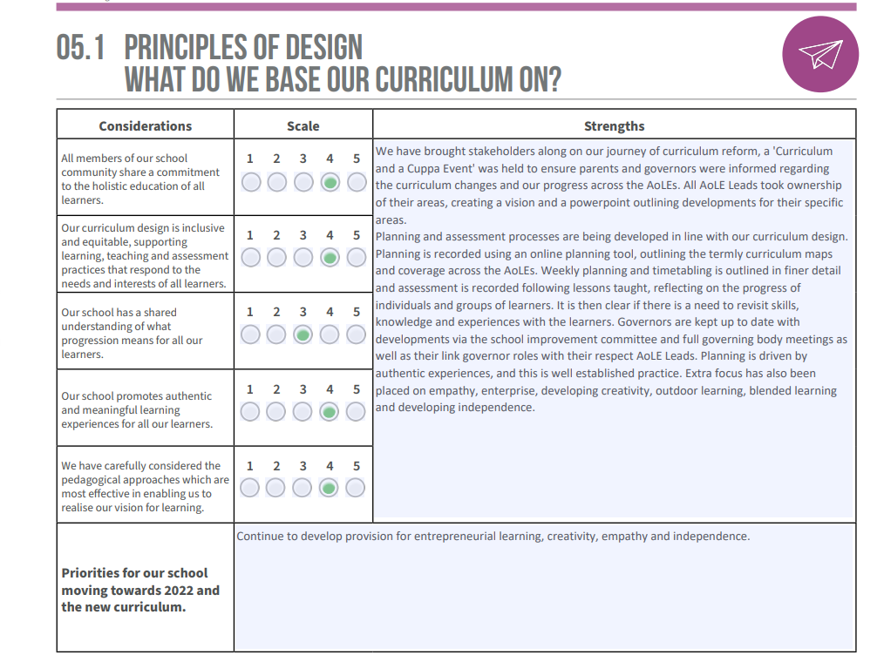

Slide 7

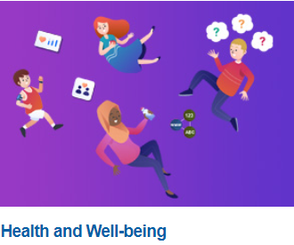
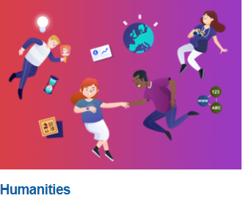
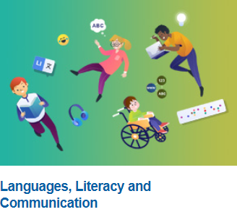
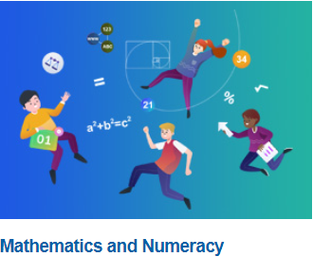
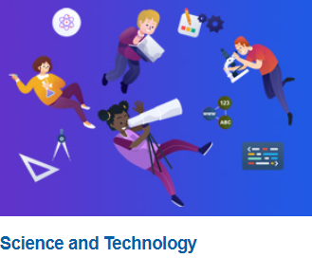
Cross-curricular Skills frameworks https://hwb.gov.wales/curriculum-for-wales/cross-curricular-skills-frameworks/

Slide 8

Expressive Arts
Pupils of Morriston Primary School will be inspired to develop their creative, artistic and performance skills to the fullest through engaging with the Expressive Arts area of the curriculum.
It is important for our children to learn and have experiences in this Area which encourages the development of knowledge, skills and values that can help learners grasp the opportunities and meet the challenges that arise in their lives now and in the future.
Our curriculum must embed the mandatory cross curricular-skills and the integral skills which underpin the four purposes of the curriculum. Learners will develop critical analysis skills and language skills that help them communicate in a variety of different languages, with an emphasis on the Welsh language. They will also learn to communicate with symbols and a range of mathematical language.
Learners will become healthy, confident individuals, ready to lead fulfilling lives as valued members of society as Expressive Arts is accessible to all learners through an inclusive approach valuing each learner as an individual. Through their experience with the expressive arts our learners will develop physically, socially and emotionally and will nurture their well-being, self-esteem and resilience.
Our children will become ambitious, capable learners ready to learn throughout their lives through perseverance and close attention to detail through engagement of the Expressive Arts.
Engagement with the expressive arts will encourage our children to manage their time and resources to achieve meaningful work and become enterprising, creative contributors, ready to play a full part in life and work.
It is important that our children become ethical, informed citizens of Wales and the world and through the Expressive Arts learners will achieve a better understanding of their own and other's cultural identity.
Finally Expressive Arts will allow our children to learn in a fun, engaging and creative way, building their confidence and self-esteem to become the best learners that they can be.
Area of Learning Experience
Home

Slide 9

Health and well-being
Pupils of Morriston Primary School are provided with a holistic structure and vision for understanding health and well-being. It is important to support the development of learners through the inclusion of the four core purposes to navigate life's opportunities and challenges. Pupils are taught the fundamental components of this Area which are physical health and development, mental health, and emotional and social well-being. Pupils will in turn learn to understand and appreciate how the different components of health and well-being are interconnected and embedded to show how vital good health and well-being is to enable successful learning.
Learners will become healthy, confident individuals, ready to lead fulfilling lives as valued members of society. By developing learners’ motivation, resilience, empathy and decision-making abilities, they can be supported to become ambitious, capable learners, ready to learn throughout their lives. Teaching and learning in this area will also support pupils to become ethical, informed citizens of Wales and the world by developing their ability to show respect, to value equity, to listen to others and to evaluate the social influences affecting them. Through enabling learners to manage risks, express ideas and emotions, develop and maintain healthy relationships, and take on different roles and responsibilities, the learning and experience in this Area supports learners to become enterprising, creative contributors ready to play a full part in life and work. Our school aims to help children grow and develop emotionally through this provision and promoting a broad and enriched curriculum inclusive of these four core purposes.
As a school we pride ourselves on being highly inclusive and nurture positive relationships with pupils to allow them to feel safe to share their feelings as well as to take risks. Our bespoke mental health toolkit provides a targeted provision (as well as universal provision), to the promotion of wellbeing and mental health for individuals or groups of pupils. Our vision for every child is that we equip them for lifelong learning by becoming resilient, confident, adaptable, and collaborative.
Area of Learning Experience
Home

Slide 10

Humanities
Pupils at Moriston Primary School will seek to awaken a sense of wonder, fire their imagination and be inspired to grow in knowledge, understanding and wisdom through the humanities area of learning. They will be encouraged to engage with the most important issues facing humanity.
Humanities encompasses geography; history; religion, values and ethics; business studies and social studies. These disciplines share many common themes, concepts and transferable skills, while having their own discrete body of knowledge and skills.
Humanities is central to learners becoming ethical, informed citizens of Wales and the world.
It is important that learners reflect upon the impact of their actions and those of others, and how such actions are influenced by interpretations of human rights, values, ethics, philosophies, religious and non-religious views. Such critical engagement with local, national and global challenges and opportunities past and present will help learners become enterprising, creative contributors, ready to play a full part in life and work.
As they explore their locality and Wales, as well as the wider world, learners can establish a solid base of knowledge and understanding of geographical, historical, religious, non-religious, business and social studies concepts. These experiences, in and outside the classroom, will help them become ambitious, capable learners, ready to learn throughout their lives.
It is important that learners have opportunities to discuss and explore their personal perspectives on religious and non-religious worldviews, ethical challenges and social inclusion issues. Likewise, opportunities to explore the natural world, locally, within and beyond Wales, will help foster in them a sense of place and of well-being. This will support the development of healthy, confident individuals, ready to lead fulfilling lives as valued members of society.
Area of Learning Experience
Home

Slide 11

Languages, literacy and communication
Pupils of Morriston Primary School are inspired to be lifelong learners who meet the four purposes of learning in meaningful contexts. In rich learning environments, learners will celebrate languages and cultures, embracing a bilingual Wales in an international context. Bringing together Welsh, English and international languages and literature for all.
Learners will listen, speak, read and write to the best of their abilities at all times, developing ambitious, capable and confident language learners who communicate effectively using a number of different international languages. Becoming creative, resilient, adaptable and empathetic young people; who learn about their own identity and others; who have pride in themselves and their cultures.
Area of Learning Experience
Home

Slide 12

Mathematics and Numeracy
Numeracy – the application of mathematics to solve problems in real-world contexts – plays a critical part in our everyday lives, and in the economic health of the nation. It is imperative, therefore, that mathematics and numeracy experiences are as engaging, exciting and accessible as possible for learners, and that these experiences are geared towards ensuring that learners develop mathematical resilience.
Pupils at Morriston Primary School will learn to develop their wonder of number and its role in the world and their lives. To develop a sense of size and estimation in context of everyday life and problems. They will use the what matters statements to help enable them to reach this level of numeracy understanding and the importance of being numerate.
Pupils at Morriston Primary School will learn to be numerate through their own exciting curriculum enabling them to develop towards the four purposes. We will endeavour to resource and plan opportunities for the learners to improve their numeracy skills and use them to improve all other AoLEs.
Area of Learning Experience
Home

Slide 13

Science and Technology
In Morriston Primary school, we aim to promote interest, enjoyment, creativity and lifelong learning in Science and Technology through real life and motivating first hand experiences. We are passionate about Science and its ability to enrich our learners’ minds to instill a never-ending curiosity about Wales and the wider World and to develop the skills necessary to investigate and explore scientific questions. We strive to appropriately and effectively challenge learners to recognise problems, ask and explore questions as well as finding practical solutions to everyday problems. Scientific understanding is central to how we see our world and we aim to allow our learners the freedom to experience and understand the life, movement and technology around them as lifelong learners in Wales.
In Morriston, planning for learners’ is now in line with the Curriculum for Wales in conjunction with the termly overarching themes. Teachers plan to cover the appropriate progression steps in the six What Matters Statements, together they contribute to realising the four purposes of the curriculum. This is delivered as part of a two year rolling programme cycle. Science provides the opportunity to develop cross-curricular links as it encourages language and communication, mathematical thinking and recording and opportunities for using I.C.T. The curriculum ensures that all learners celebrate and understand the distinctive quality of living and learning in Wales in the twenty-first century and are able identify their own sense of Welshness.
Through robust and consistent evaluation of scientific and technological evidence, learners can become ethical, informed citizens of Wales and the world, who will be able to make informed decisions about future actions. Healthy, confident individuals, ready to lead fulfilling lives as valued members of society are informed by knowledge of their bodies and the ecosystems around them, and of how technological innovations can support improvements in health and lifestyle.
Ambitious, capable learners, ready to learn throughout their lives should engage with scientific and technological change. Learners who are enterprising, creative contributors, ready to play a full part in life and work embrace such challenges, as they are encouraged to take risks, to innovate and evaluate, and learn to develop solutions.
Area of Learning Experience
Home

Slide 14
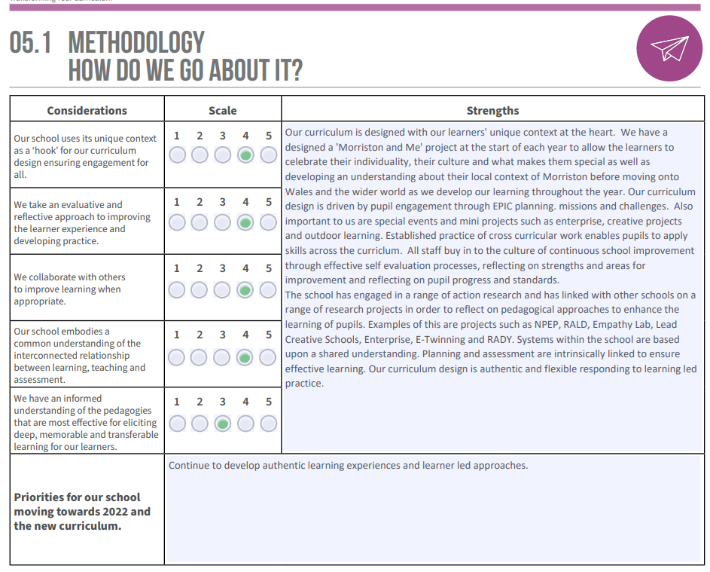

Slide 15
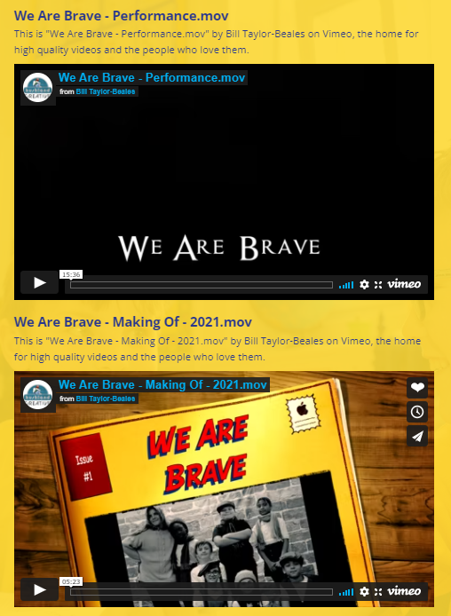
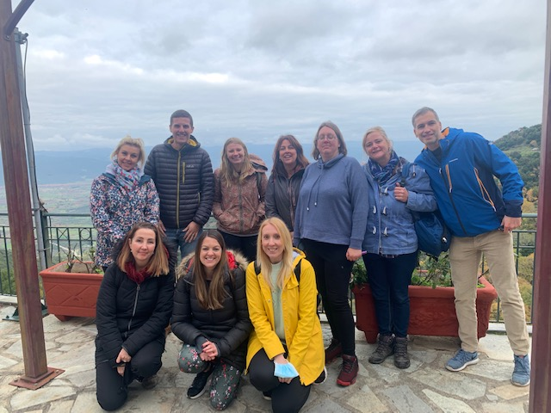
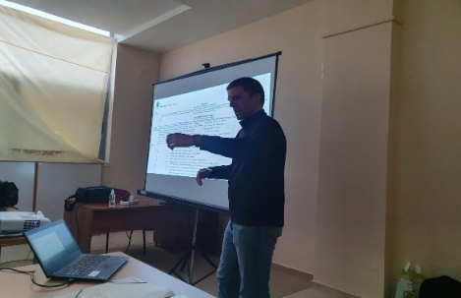
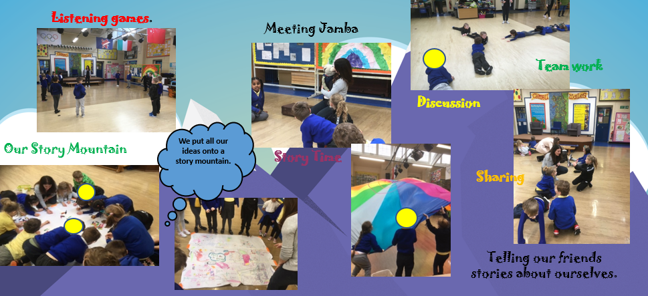
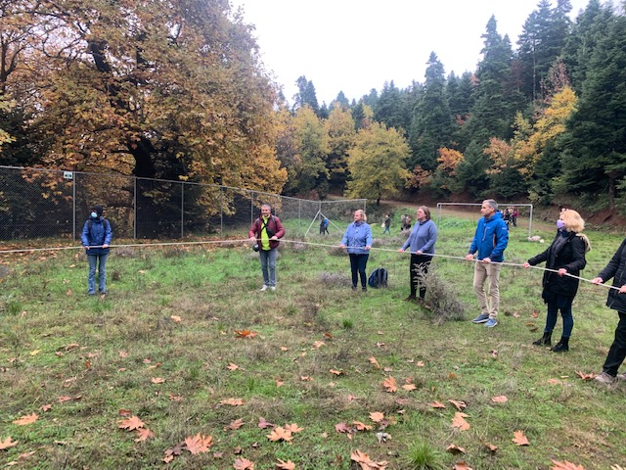
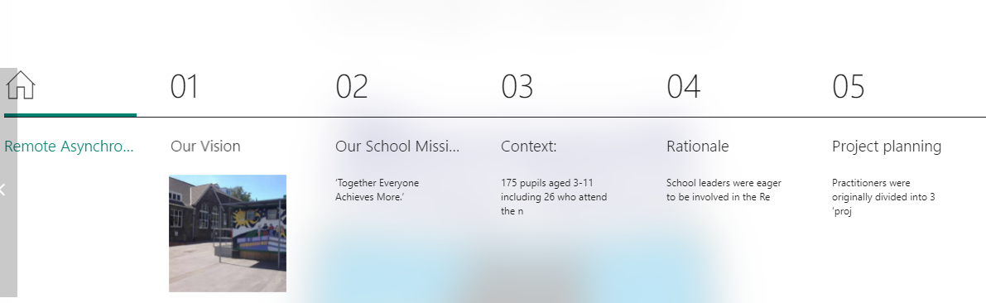
Examples of Projects
Links to evidence on the school website:
Professional Learning – RALD and NPEP https://www.morristonprimaryschool.co.uk/professional-learning/
Link to Erasmus+ Outdoor Learning Project https://www.morristonprimaryschool.co.uk/outdoor-learning/
Link to Lead Creative Schools Project: https://www.morristonprimaryschool.co.uk/lead-creative-schools-scheme/
Blended Learning:
https://www.morristonprimaryschool.co.uk/blended-learning-1/
Examples of planning and topics:
https://www.morristonprimaryschool.co.uk/class-pages/

Slide 16
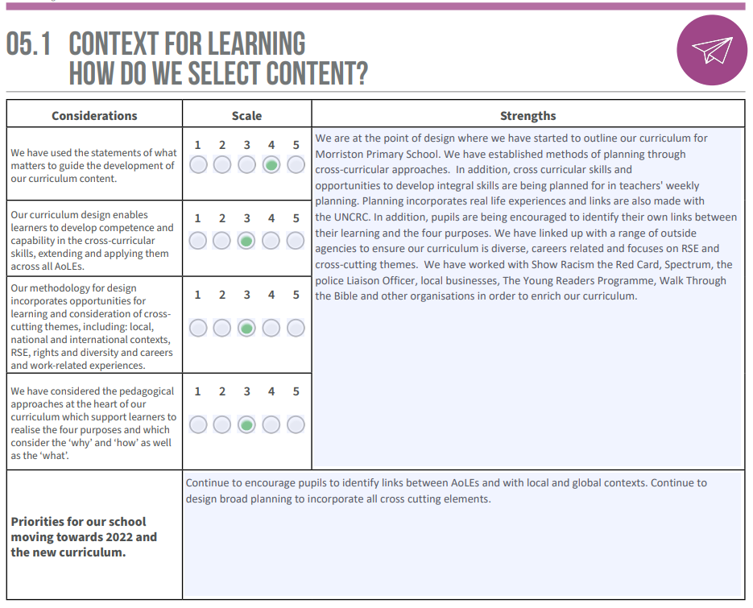

Slide 17
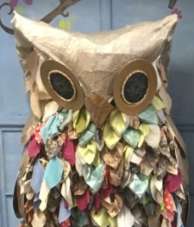
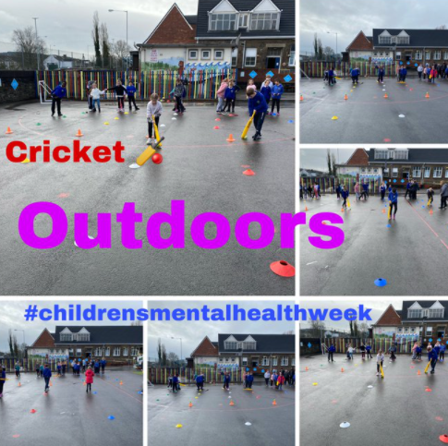
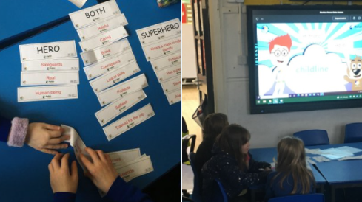
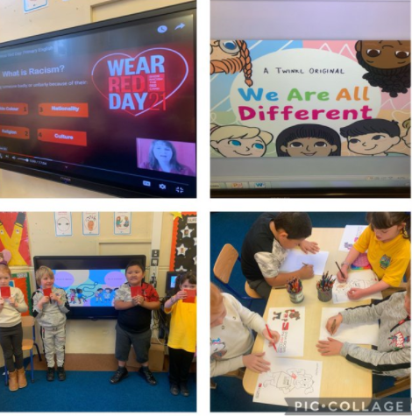
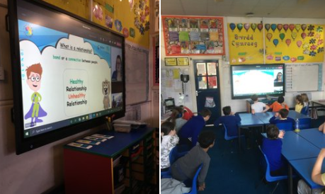
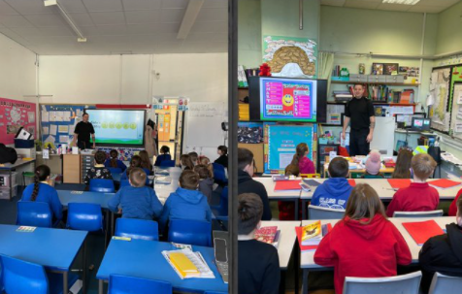
The wider curriculum:
Working with outside agencies

