Slide 1

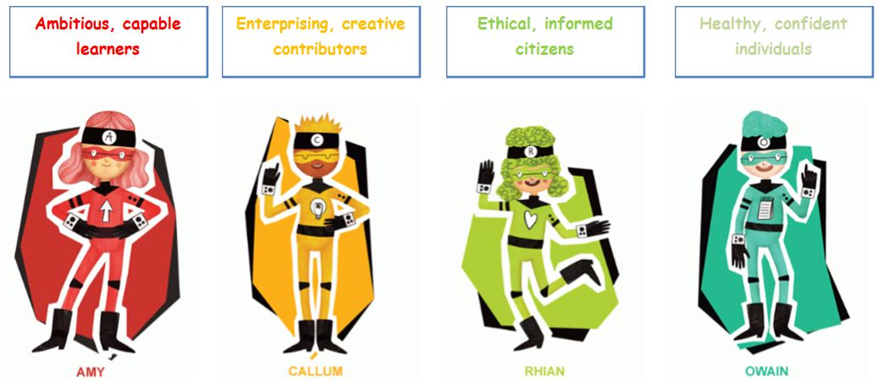

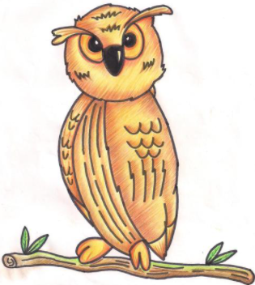

Our Curriculum
Pedagogy
Experiences
Each term starts with a new theme or topic, full of engaging, fun and inspiring activities to engage the pupils in their learning. Pupils contribute their own ideas that they would like to learn more about.
The 4 purposes are at the heart of our curriculum. The pupils refer to the Enterprise Troopers characters to support them to reflect on this.
All classes are encouraged to be digitally responsible communicators, prepared for life in the digital world.
We provide a range of enterprise activities, career and work-related experiences for authentic real-life contexts.
We learn about Cynefin and our locality through the Morriston and Me topic, focussing on what makes us special. We then make links nationally and internationally.
Missions in the upper phase and challenges in the lower phase are independent learning opportunities for pupils to reinforce their skills and knowledge both indoors and outdoors.
Our learning stems from
the 12 pedagogical Principles.
Staff conduct their own action research to improve our practice and results.
Pupils have lots of opportunity to learn in the outdoors in our school grounds
There are many visits during the school year to engage pupils and enhance learning, both locally, further afield in Wales and internationally.
We use focus groups for teacher led direct teaching across the school.
The Big Question or idea is what we aim to achieve by the end of the topic.
Staff refer to our Teacher Charter as a cornerstone of our practice.
We share good practice with other schools and organisations in the cluster/LA /Nationally and Internationally.
Dewi Dragon encourages the use of Welsh Language and cultural identity.
We invite professionals into school to share their real-life experiences and knowledge.
Pupils can attend a range of extra-curricular clubs either during or after school.
Knowledge & Skills
What Matters Statements outline the essential understanding in the six different Areas of Learning which are underpinned by the Principles of Progression.
Our School Vision
Our curriculum covers 6 Areas of Learning Experiences:
Language, literacy & communication
Expressive Arts
Health & Well-being.
Humanities
Science & Technology.
Mathematics & Numeracy.
Morriston Primary School encourages children to experiment in fun and engaging hands-on activities to help develop understanding.
Our vision is encapsulated in Article 29 –
‘Your Right to be the best you can be.’
In Morriston Primary School we aim to provide a broad, balanced and rich curriculum.
Knowledge, skills and experiences are broken down into progression steps which outline the descriptions of learning.
We offer an inclusive environment where pupils are encouraged to be healthy, happy, digitally competent, creative, confident and resilient learners. We challenge our pupils to reach their full potential, equipping them with the skills necessary to continue on their journey of life-long learning.
Assessment & Progression
We teach a range of integral skills and cross cutting themes.
Pupils reflect on their learning and identify their own next steps during ‘green for growth’/Dirt time.
Work is assessed and feed forward comments support pupils to redraft, respond to targets and improve their work, extending their learning.
Literacy & Numeracy and DCF are taught and applied as cross curricular skills.
Health and Well-being is at the heart of everything we do. The Thrive approach is used across the school to reinforce this.
Pupil Voice
Challenge and provision is appropriate to the needs of the learner whether ALN or MAT.
Effective questioning and steps to success help pupils to move their learning forward.
Pupils develop ideas and lead their learning through Epic Planning and self-evaluations.
We are a Rights respecting school. The School Council and other pupil voice group members are elected and voted for by pupils.
Review, evaluate and improve
Roger is our Rights
Respecting School mascot. All pupils create a class charter and follow our school rules – 'Kind hands, kind feet and kind words.'
At Morriston Primary School we regularly review our curriculum and monitor the impact it has on learning and teaching and pupil standards.
We work with our cluster to develop curriculum and assessment arrangements that meet requirements.
Learners have the opportunity to self and peer assess their work and support each other to suggest ways to develop.
Pupil groups develop action plans which help to improve the school and enhance learning experiences for all.
A range of AFL strategies are used to inform planning and assessment practice.
We regularly monitor, evaluate and review our processes supporting each other to continuously strive towards our vision.
We seek feedback from all stakeholders, in order to develop our school improvement plan, ensuring targets meet the needs of our school and learners.
Learners work collaboratively to support each other in class.

