Slide 1
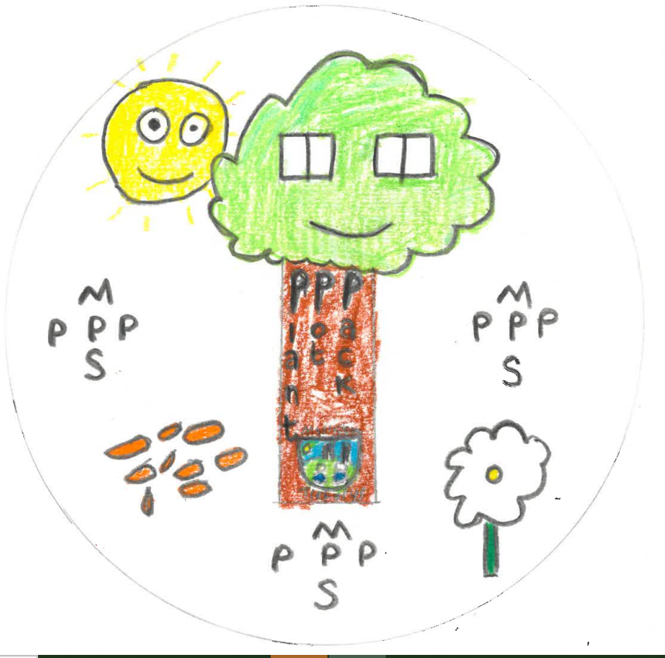


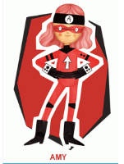



Morriston Primary School Plant Pot Pack
Year 4/5’s Enterprise Project – Summer Term 2021

Slide 2

Links to the curriculum & the Four Purposes
Throughout this PowerPoint we will highlight links to the four purposes. Our learning throughout the project was heavily dependant on these skills. Our four purposes characters also link to the Big Ideas Wales entrepreneurial characters and skills sets.
Amy
Callum
Rhian
Owain
Ambitious, capable learners
Enterprising, creative contributors
Ethical, informed citizens
Healthy, confident individuals

Slide 3
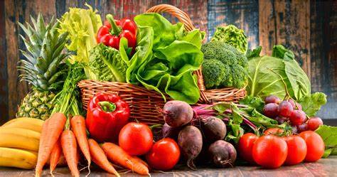
The starting point
Our teacher, Mr Bannister, shared the introductory video with us which outlined the challenge .
We understood that we needed to plan, design and create a fruit or vegetable-based product that we could sell, which promotes the importance of eating fruits and vegetables.

Slide 4
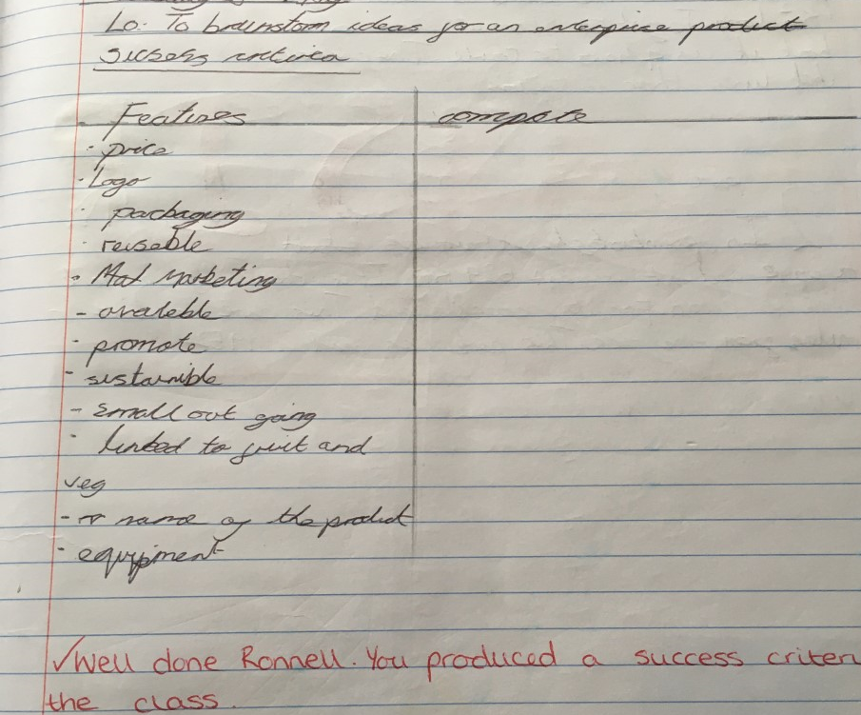
Getting to work
Once we understood the challenge the hard work started! We started off by creating a success criteria for the product. We used the introductory video to ensure we included the relevant details of the project.
Our product needed the following elements:
Eye catching Logo
Environmentally sensitive packaging
Linked to fruit and vegetables
Reasonably priced

Slide 5
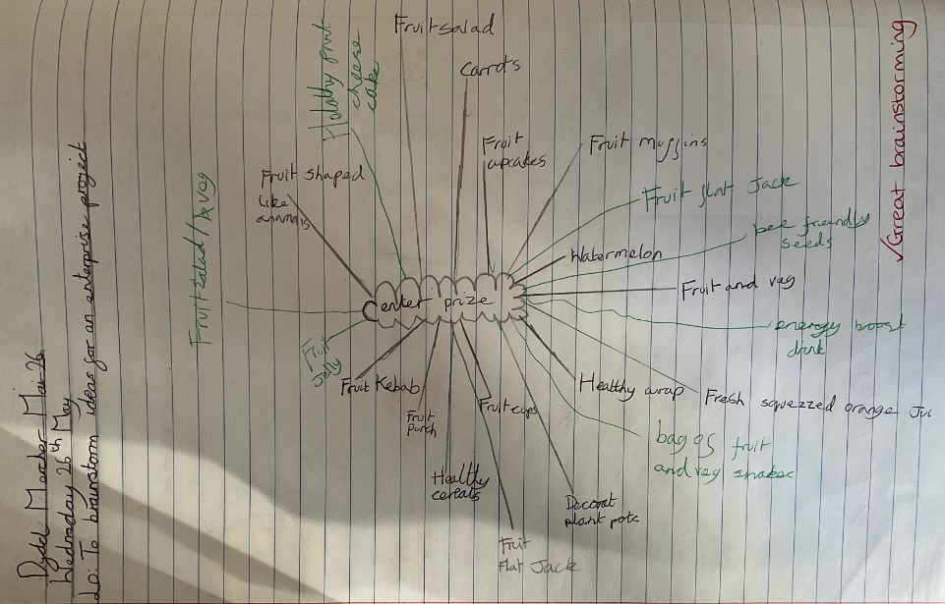
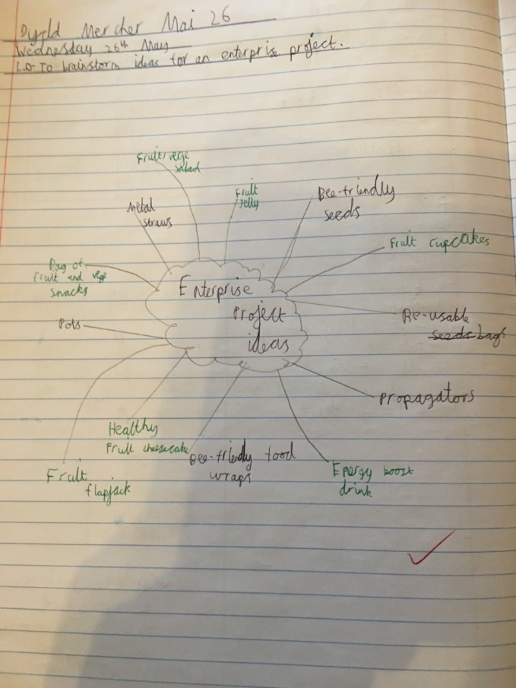
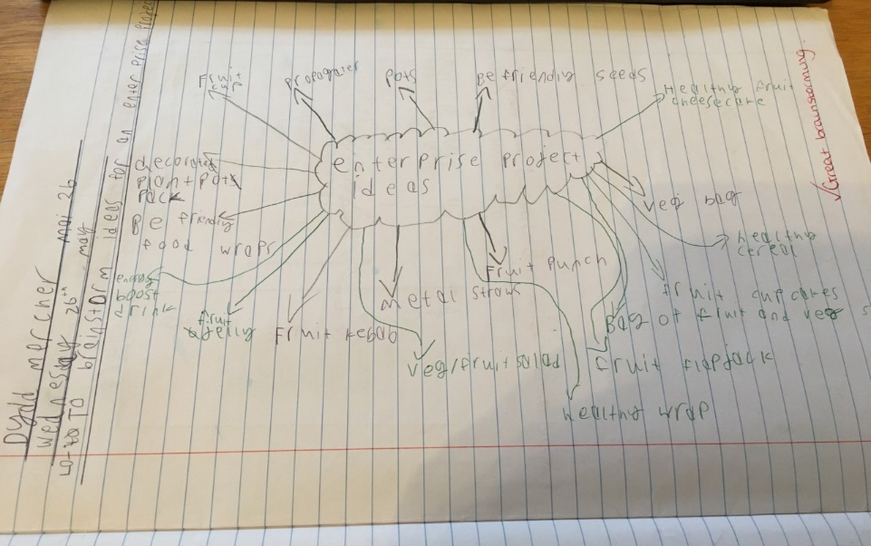
Ideas stage
We used our success criteria when generating ideas. We brainstormed as many different ideas as possible which linked to the earlier success criteria.

Slide 6
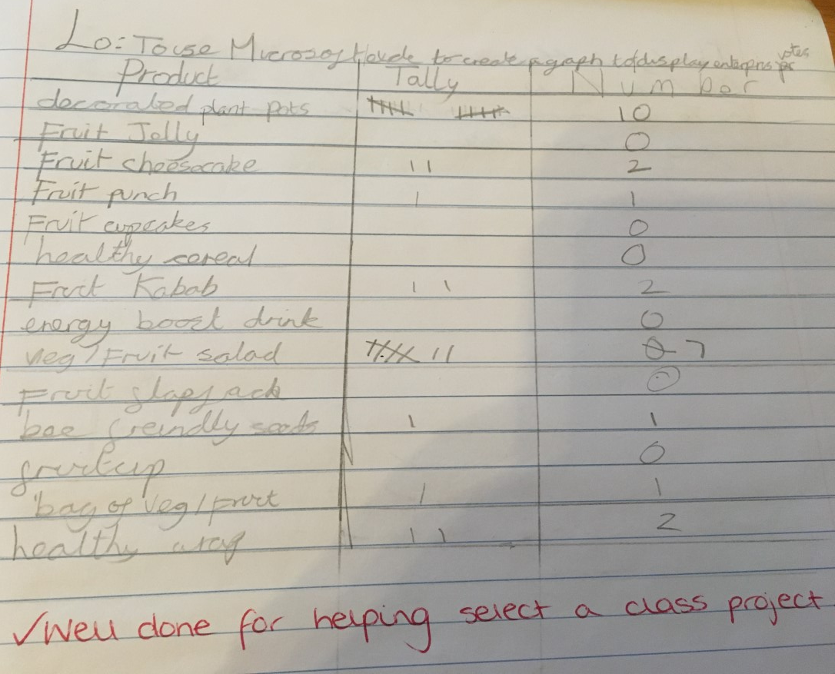
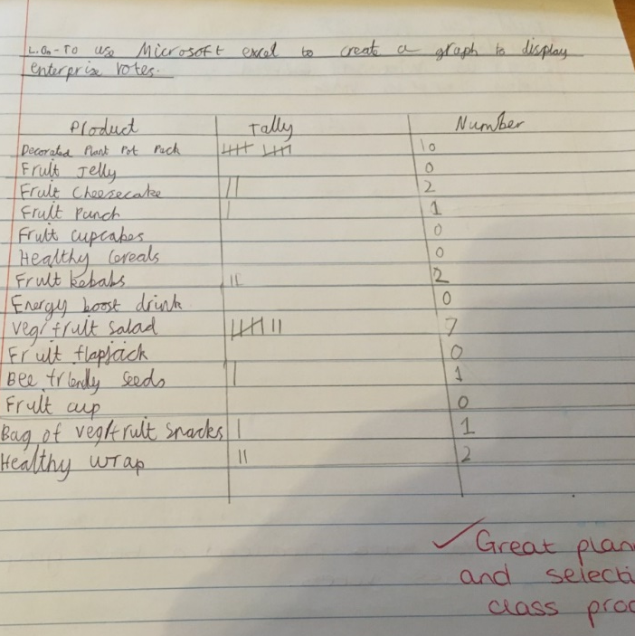
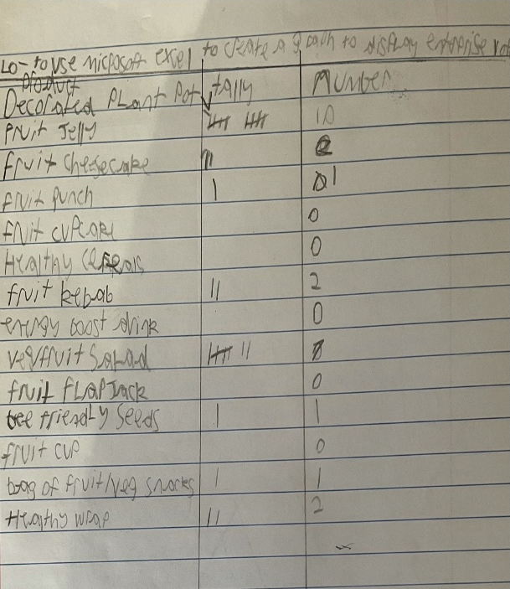
Choosing our product
Following the brainstorming task, we needed to narrow the list of possible products down. We all chose one product.
We voted for our favourite from the list. We used our numeracy skills to create tally charts to display our findings.

Slide 7
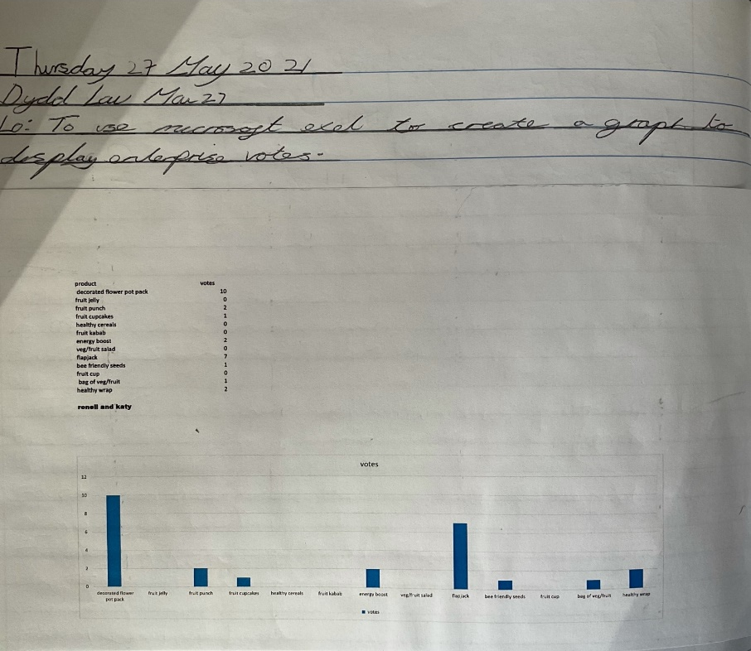
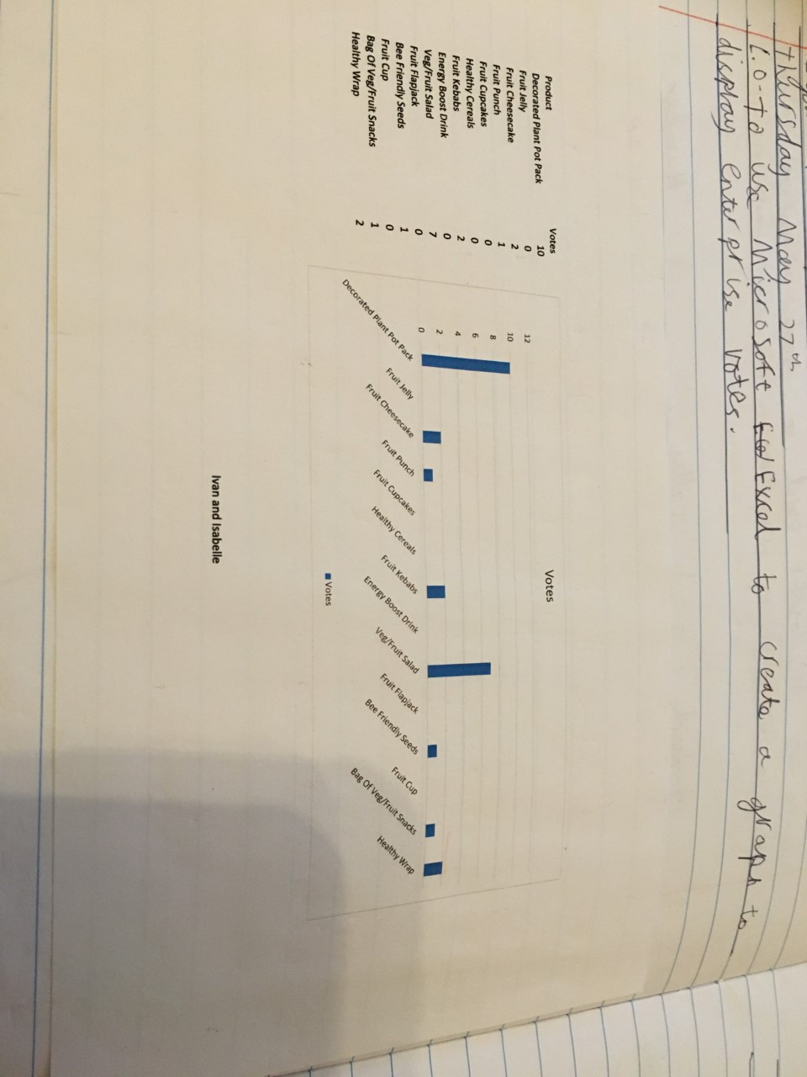
Choosing our product – continued
We used our ICT skills to convert our tally charts into bar graphs using Microsoft Excel.
The winning product was ‘decorated plant pots’

Slide 8
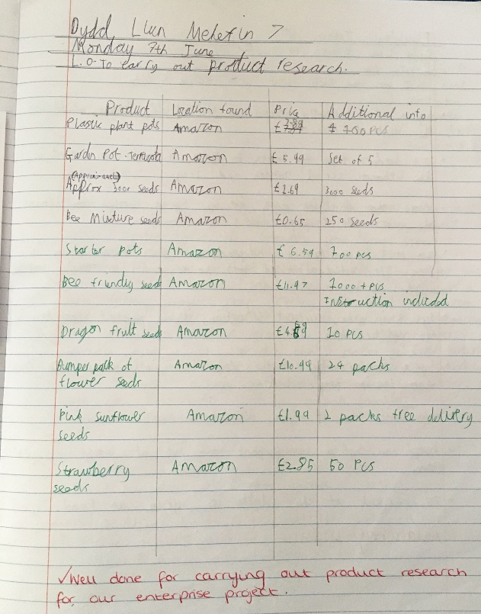
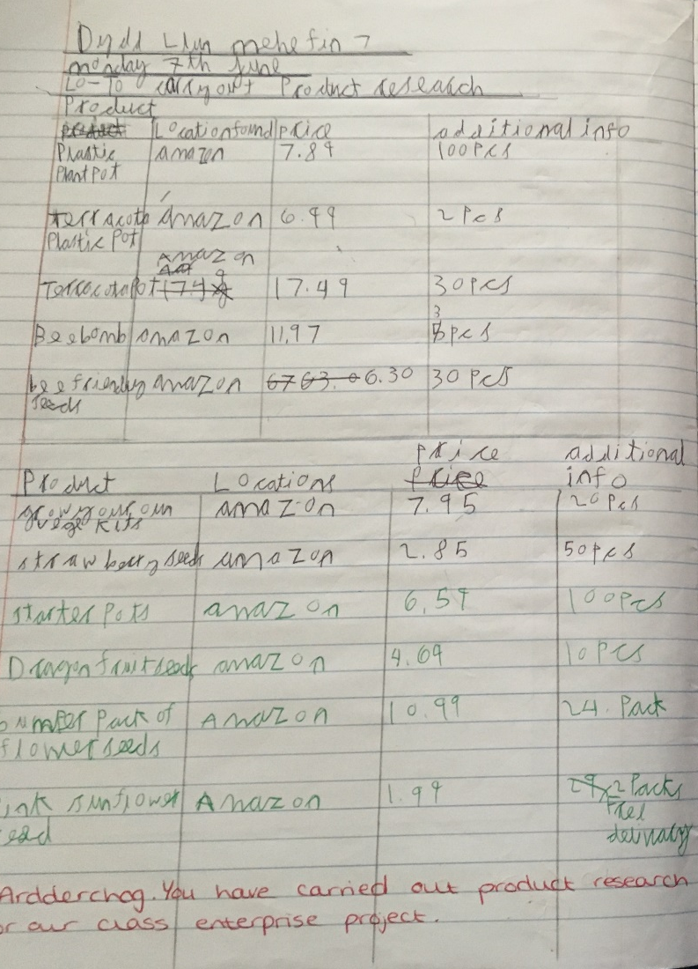
Market research
We used our DCF skills to conduct market research of products which are currently available on the market.
We noted the following information price, location and any additional information.

Slide 9
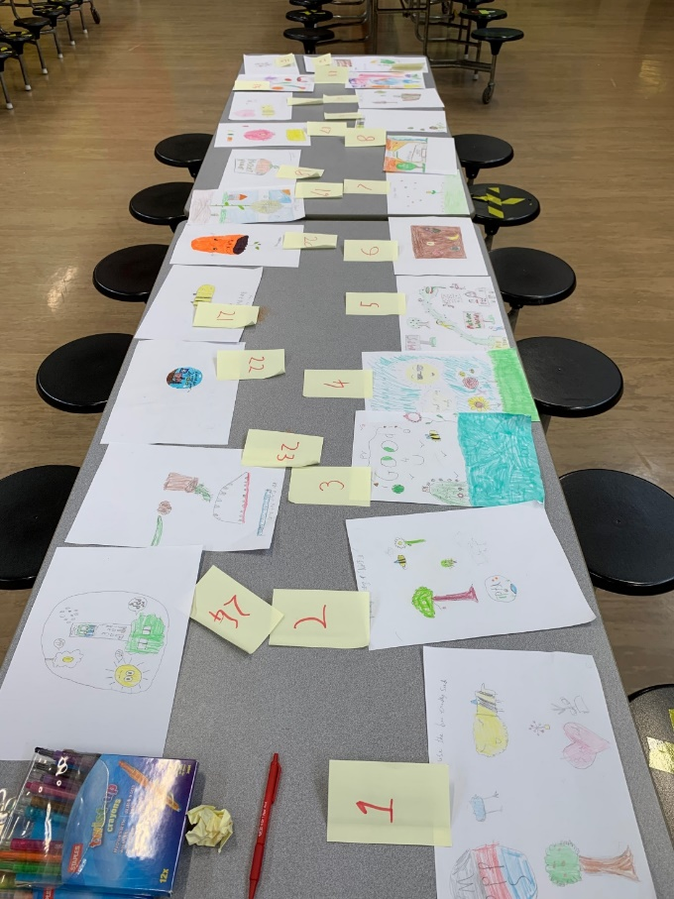
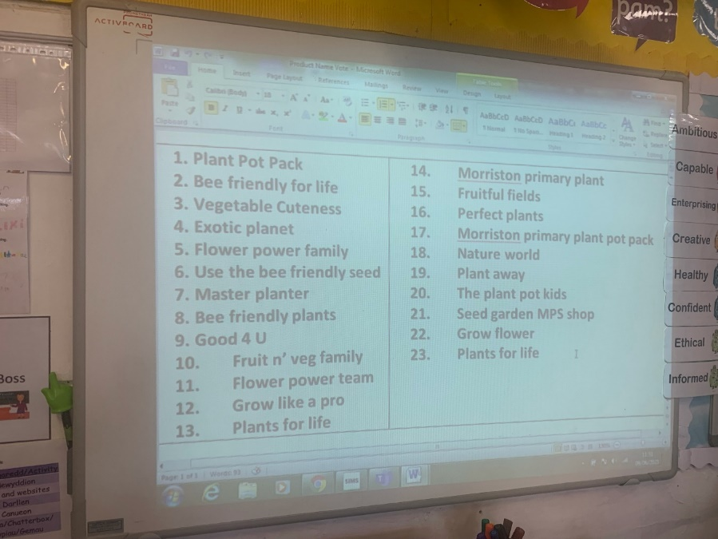
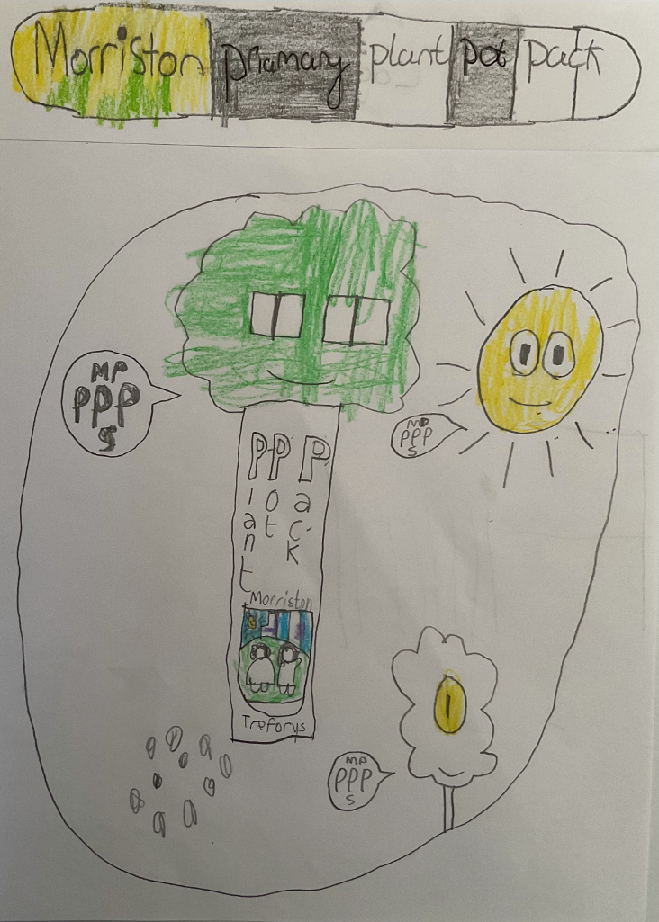
Brand logo and name
We designed logos and brand names for our product. We then took a class vote and chose our winning logo and brand name .
WINNER

Slide 10
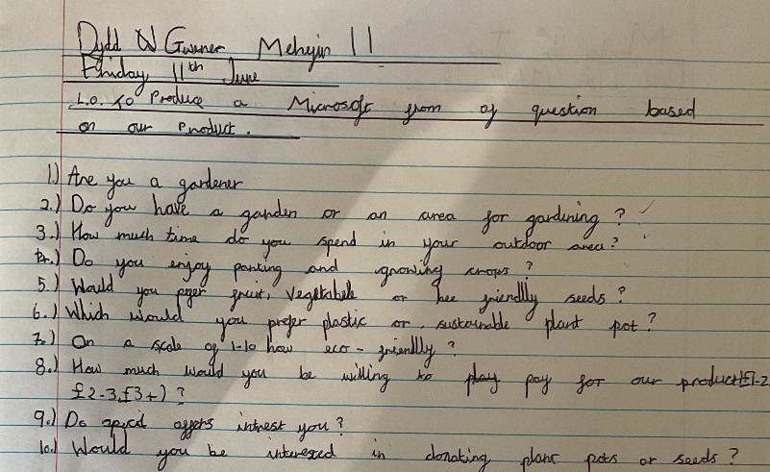
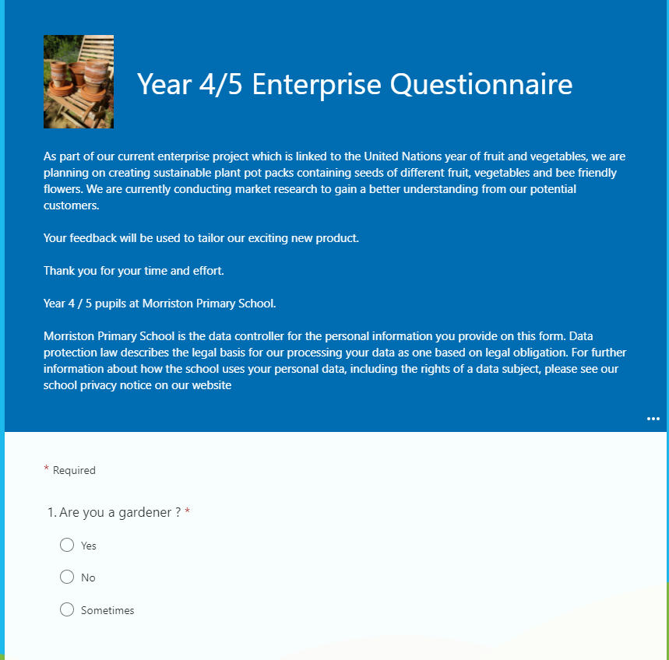
Market research – Questionnaire
During literacy sessions we learnt about open and closed questions.
Using this knowledge, we designed a questionnaire to collect market research data based on our product.
We used Microsoft Forms to create our questionnaires.

Slide 11
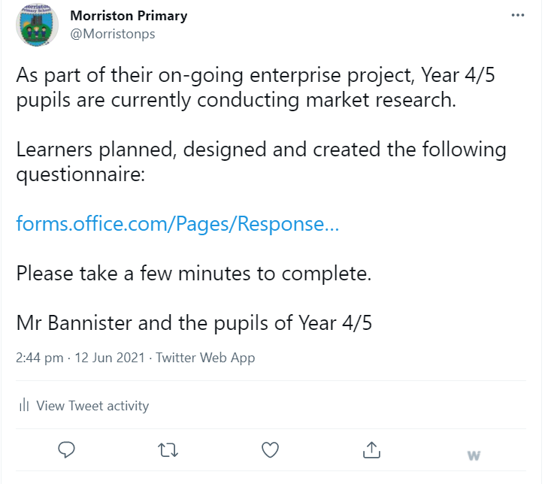
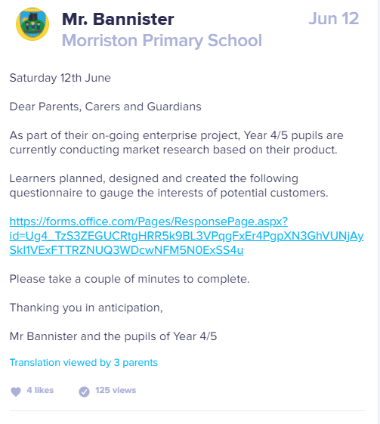
Market research – Questionnaire
Mr Bannister shared the questionnaire on the school’s twitter feed and Class Dojo feed.
Our questionnaire collected 47 responses.

Slide 12
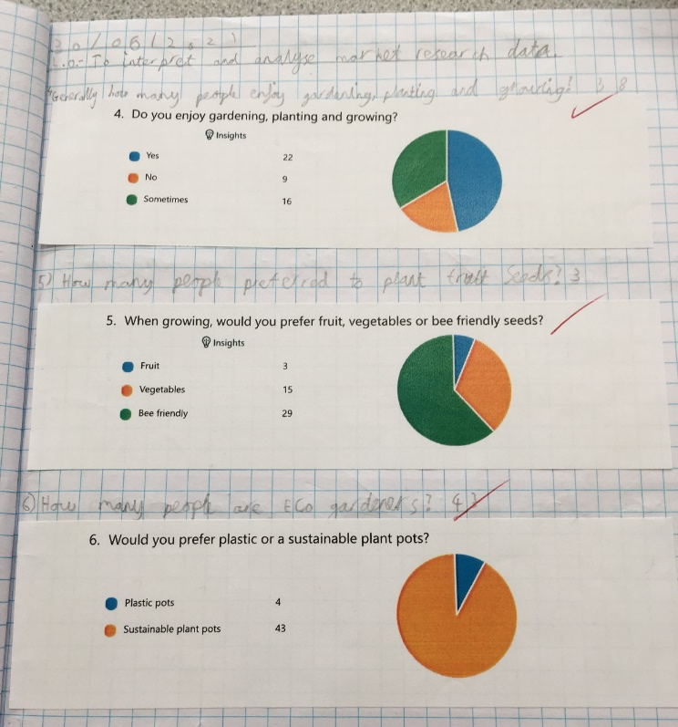
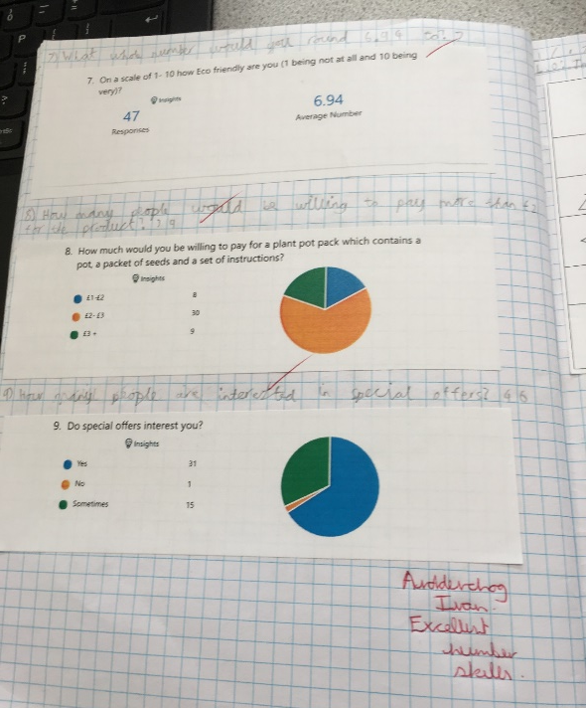
Using market research data
We used our numeracy skills to interpret and analyse the market research data. The information from the questionnaire allowed us to have a better understanding of customer preferences.
We also found out suitable prices that possible customers would be willing to pay for our product.

Slide 13
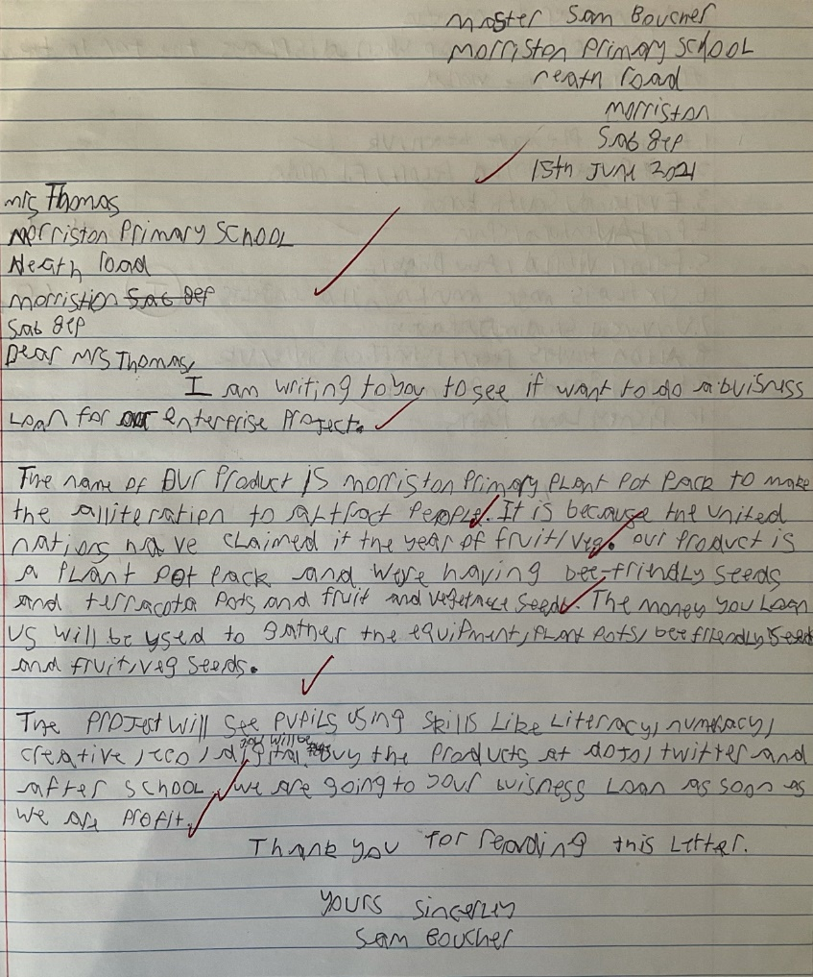
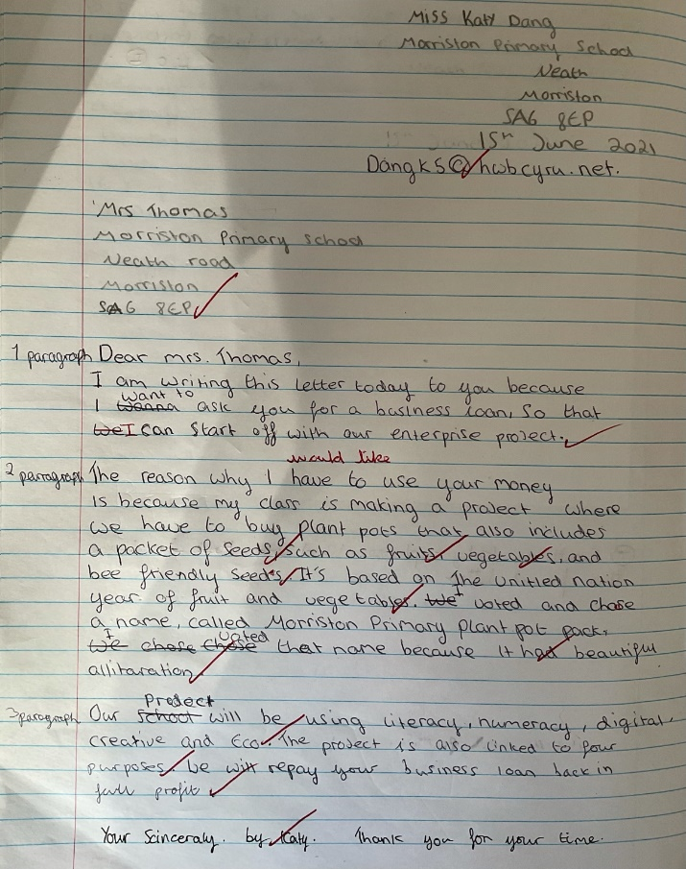
Drafting letters for a business loan
We learnt how to construct formal letters asking for monies to start our enterprise.
However, we received a large amount of donations from the school community, which meant we didn’t need to send our formal letters to Mrs Thomas.

Slide 14
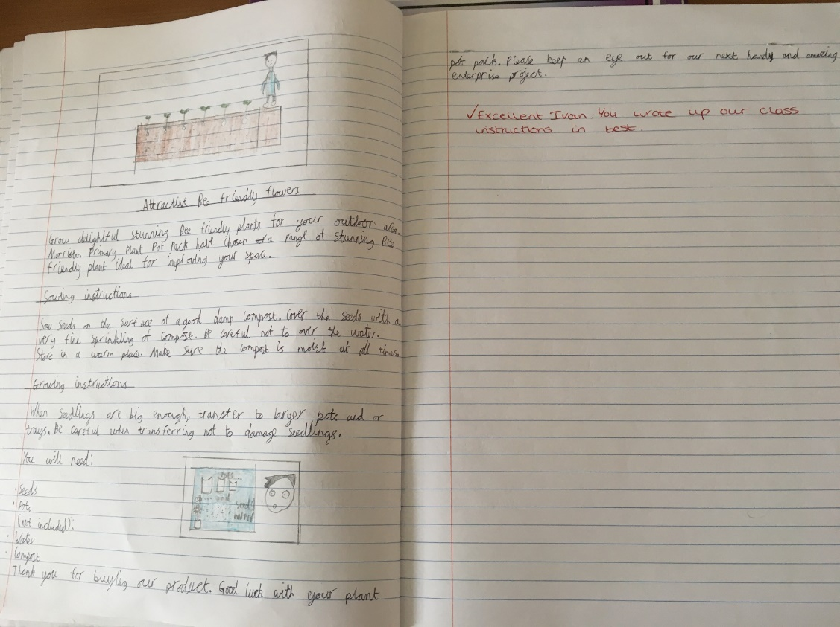
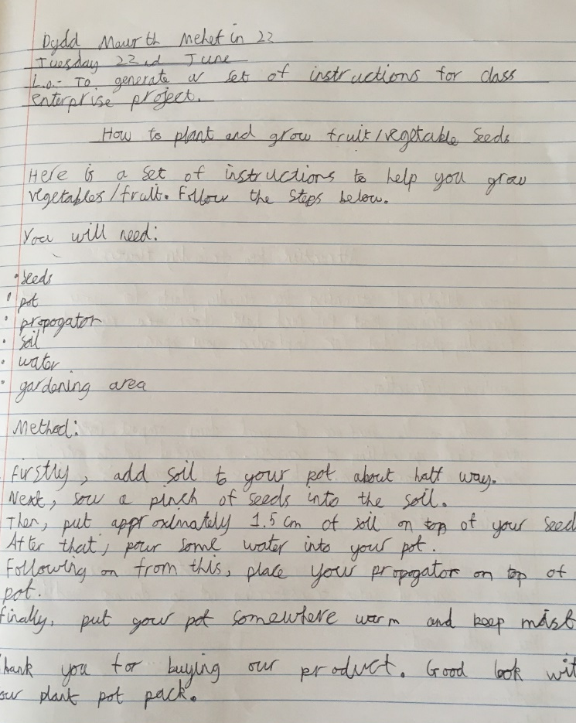
Instructional texts
We studied a range of instructional texts and seed packets.
We used these to help us create our own instructional texts for our product.

Slide 15
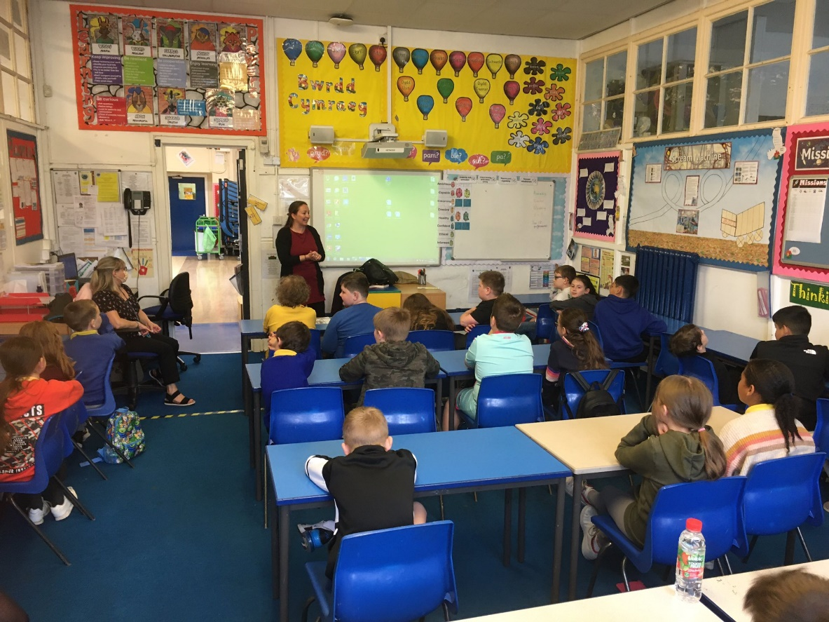
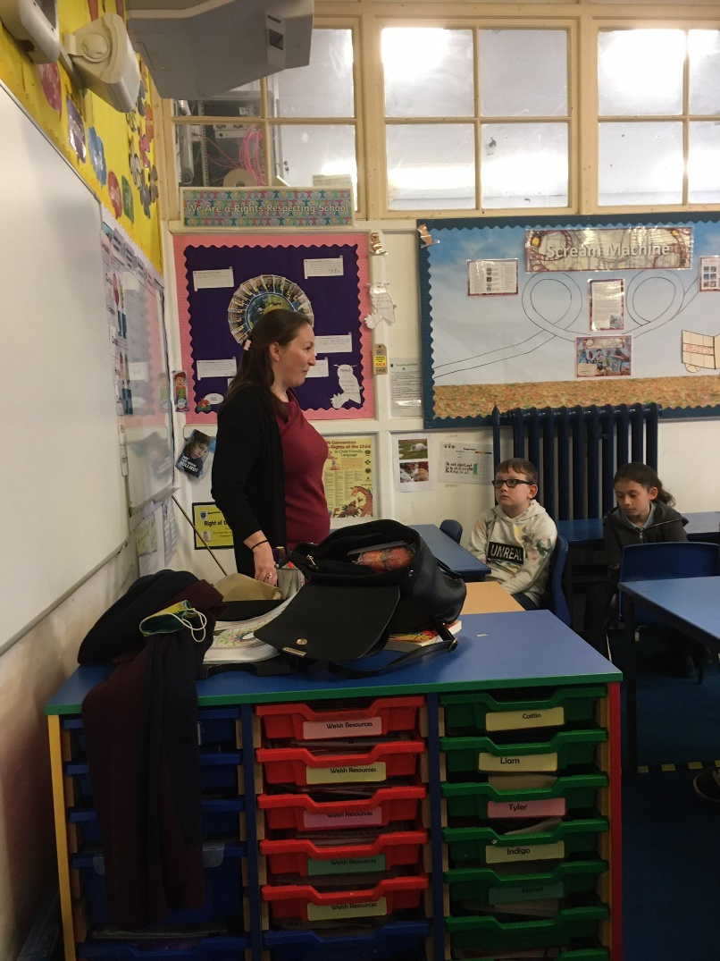
Entrepreneurship role model visit
We were fortunate to receive a visit from entrepreneurship role model Sarah Gittins from The Dance Den. Sarah shared her inspirational journey to becoming a successful business women and helped us with our product

Slide 16
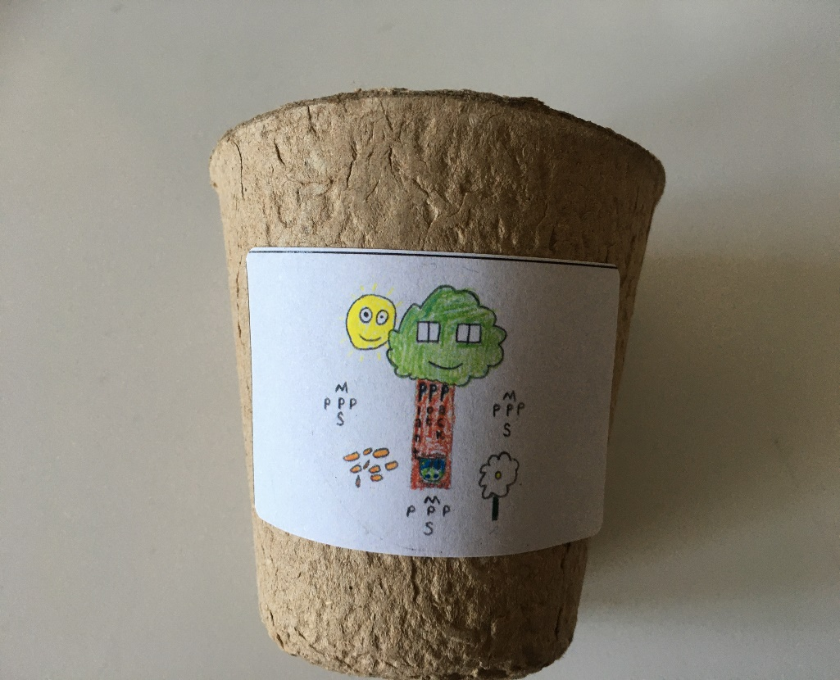
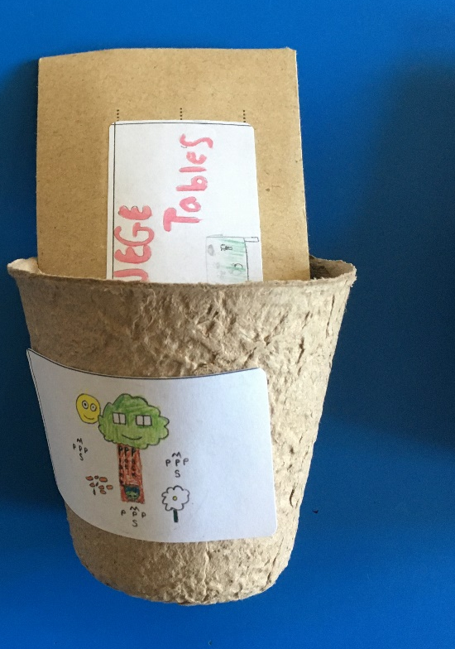
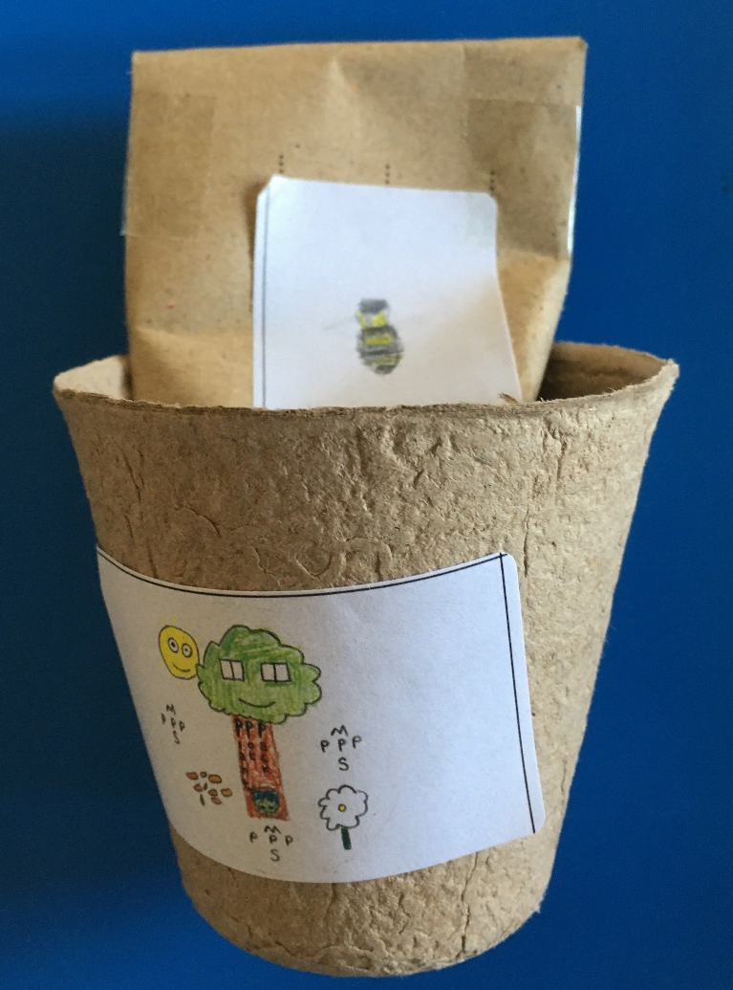
The product

Slide 17
The product
We are currently still selling our product to the school community.
Before the end of term, we will calculate our profit margin from the project and as a class we will suggest ideas how use the money.
We hope this PowerPoint outlines the benefits this project had to our learning. We gained and developed many different real life skills throughout the project.
More importantly we had FUN!

