Slide 1

Approaches to delivering a broad and balanced enterprise curriculum
Morriston Primary School

Slide 2
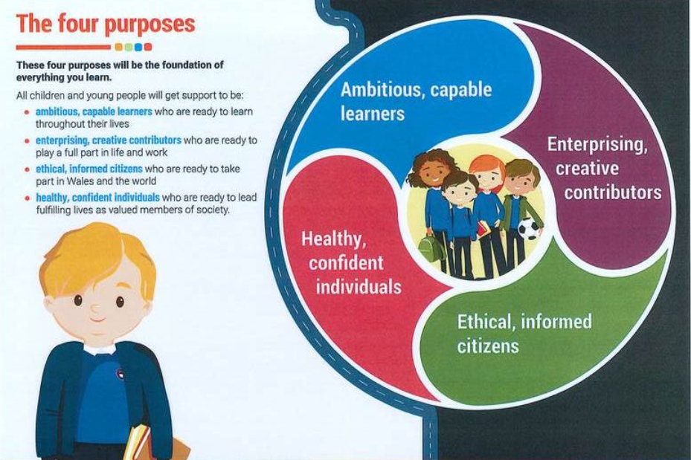
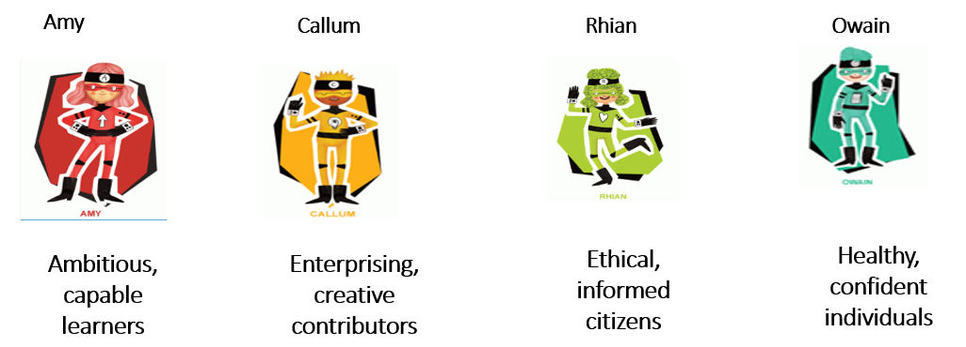

Four Purposes
All learning is heavily dependant and based upon the Four Purposes.
Our Four Purposes characters also link to the Big Ideas Wales entrepreneurial characters and skills sets

Slide 3
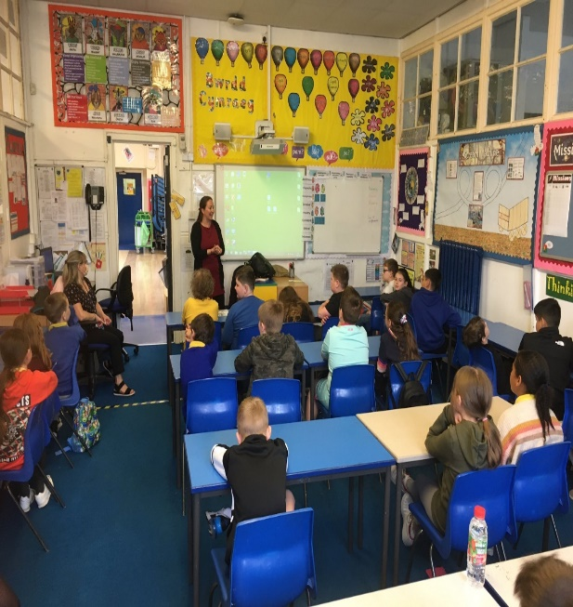
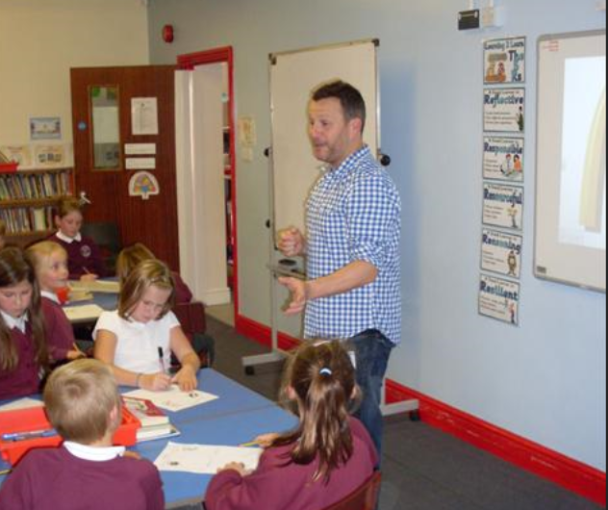
Entrepreneurship role model visit
The starting point…
Receive a visit from entrepreneurship role model.
Sharing their inspirational journey to becoming a successful business person.

Slide 4
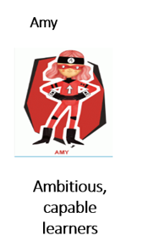
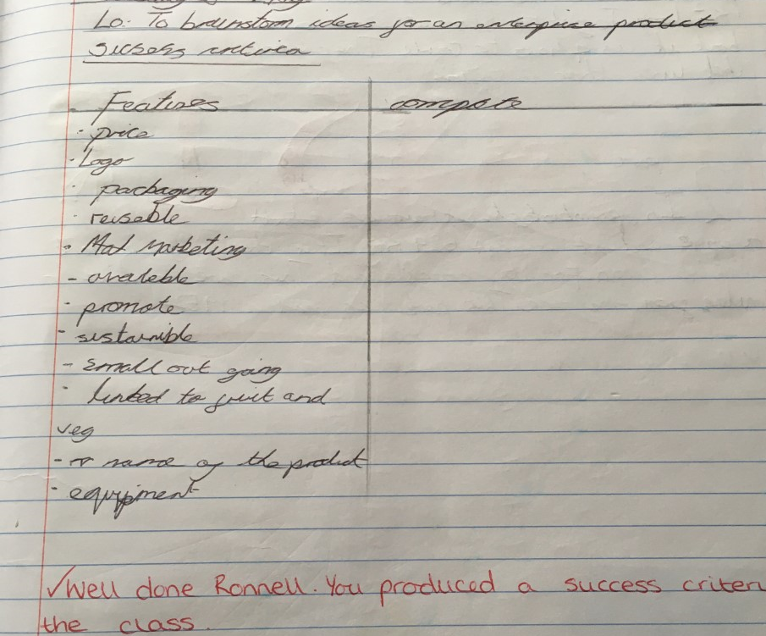
Authentic learning opportunities
The challenge is shared with the learners. Discussions take place with regards the aim of the project.
Aim: To plan, design and create a real life product which could be marketed and sold to customers.
Learners start by creating success criteria for the product:
Brand name linked to school/ product
Eye catching Logo
Environmentally sensitive packaging
Reasonably priced
A product which could be mass produced.

Slide 5
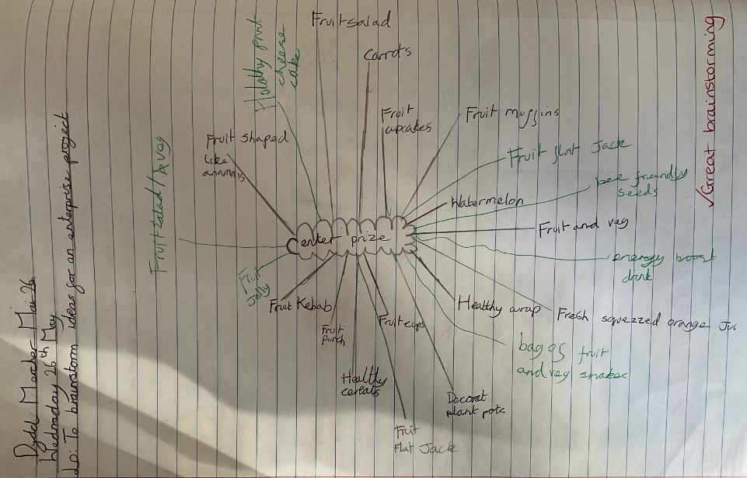

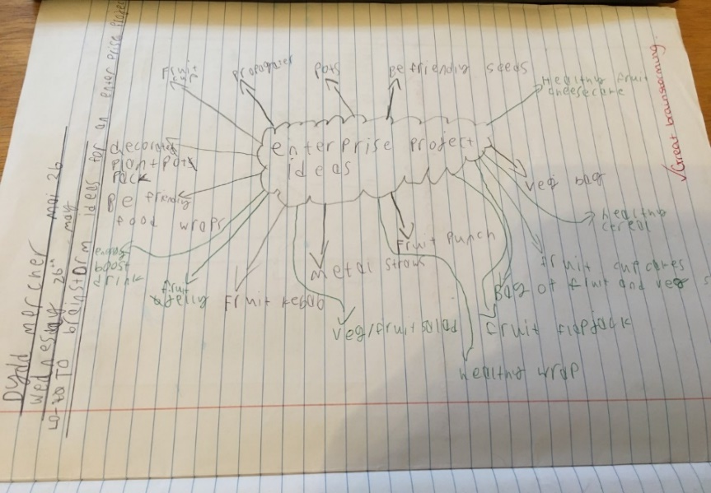
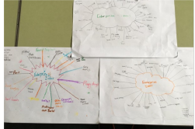
Ideas stage
Learners use previously generated success criteria to generate ideas.
Populating as many different ideas as possible.

Slide 6
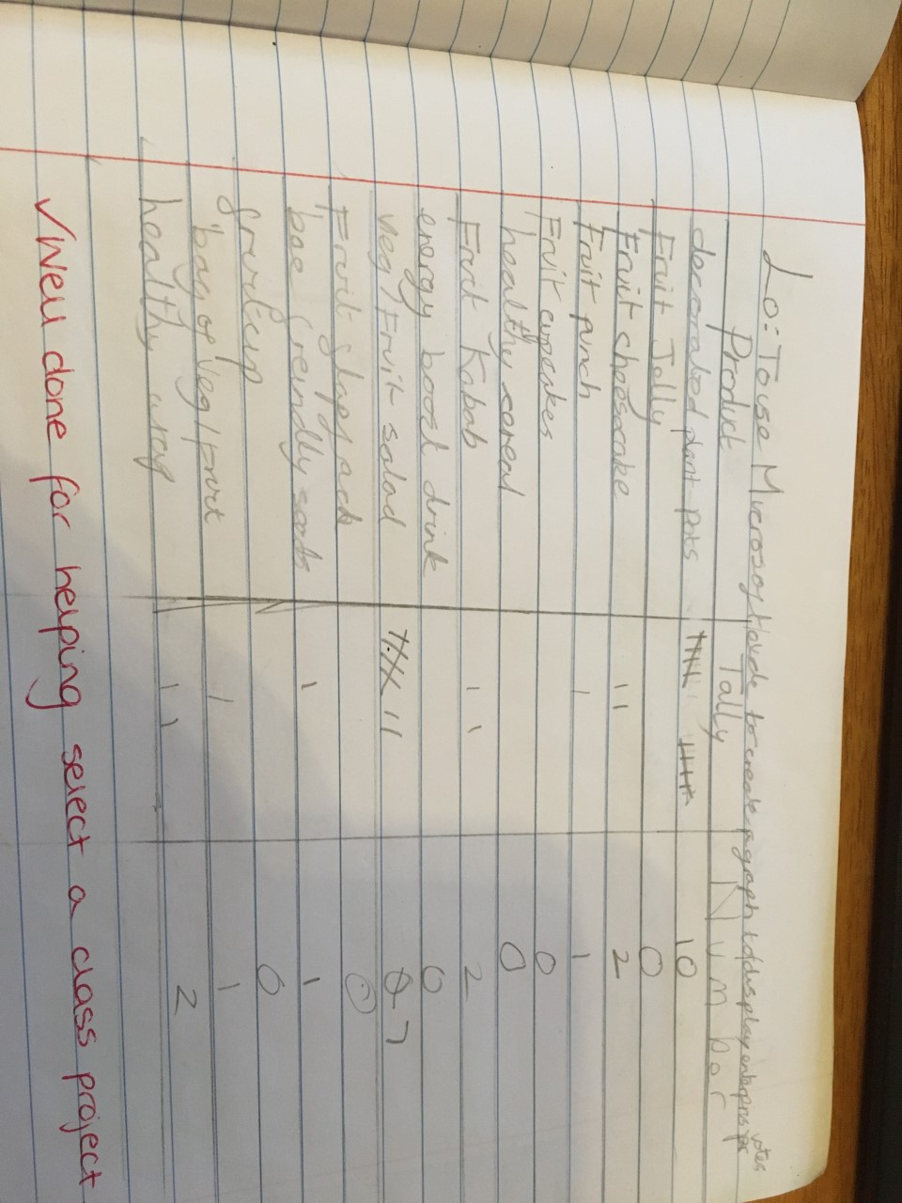
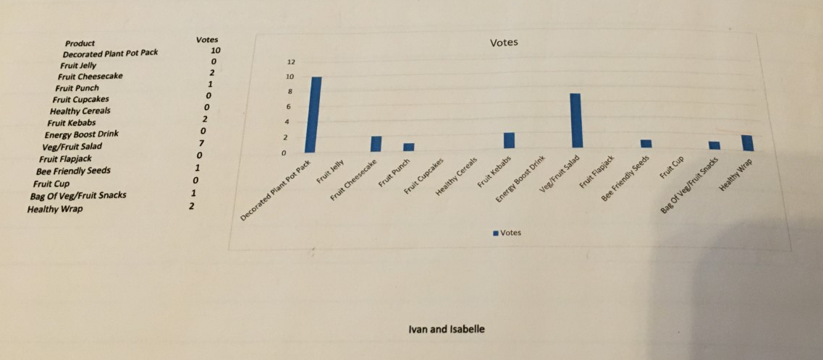

Choosing the product
Following the ideas generating stage, a list of possible products needs to be narrowed down.
Class vote for their favourite from the list. Using numeracy skills to create tally charts to display findings.
ICT skills used to convert tally charts into bar graphs using Microsoft Excel via Hwb

Slide 7
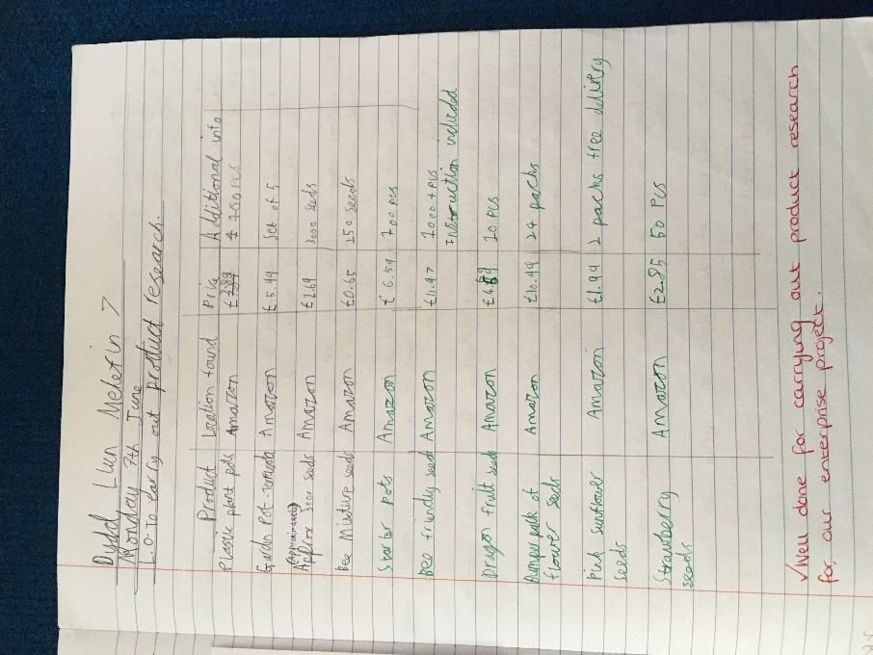
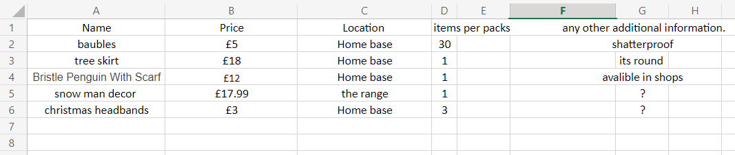
Market research
Learners use their cross curricular skills to conduct market research based on products which are currently available on the market.
Using DCF skills the learners note information, price, location and any additional information.

Slide 8

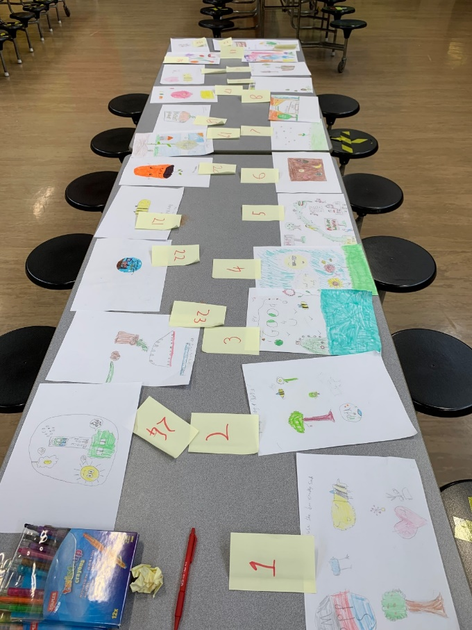
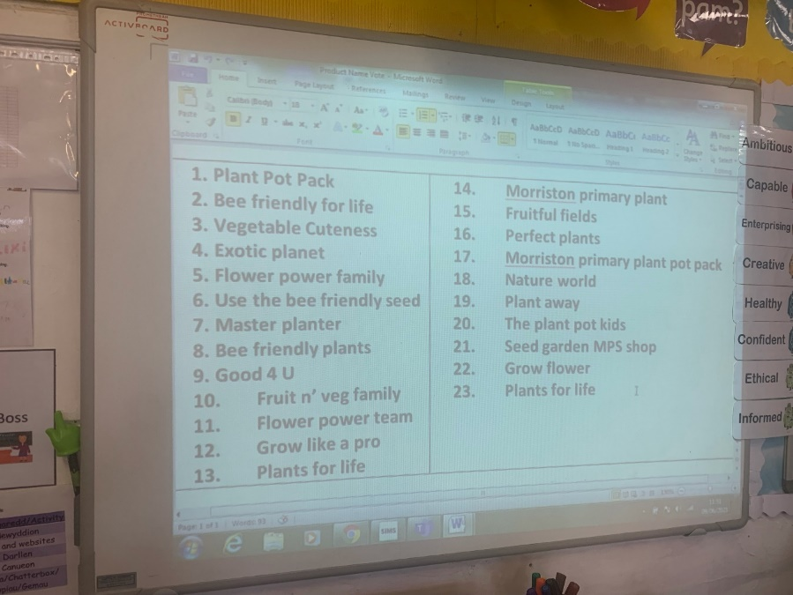
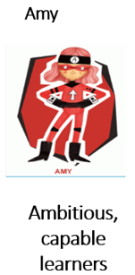



Branding
Pupils design logos and brand names for the product. A class vote to chose the winning logo and brand name

Slide 9
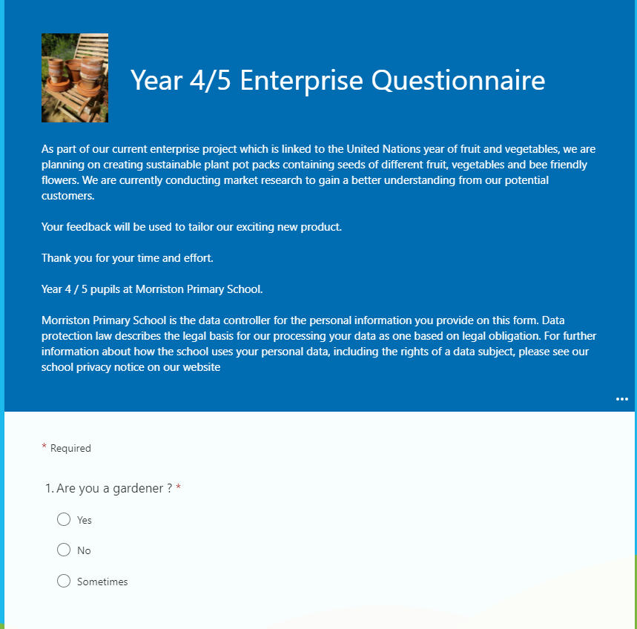
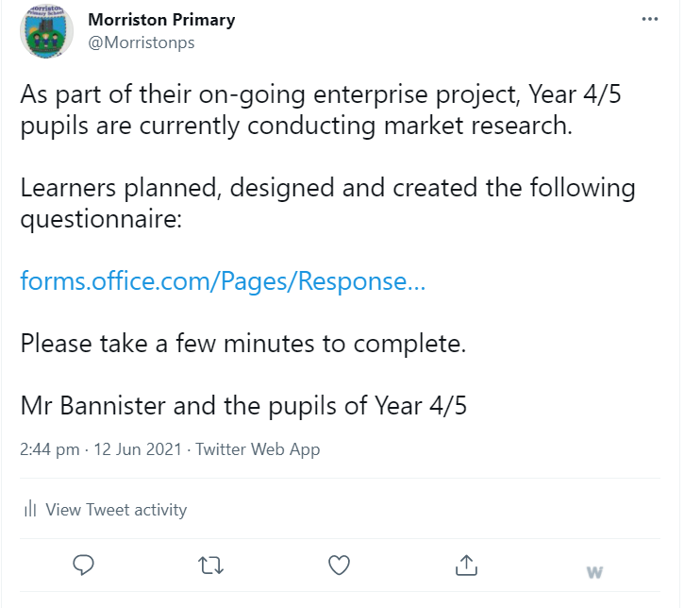
Market research – Questionnaire
Studying open and closed questions via literacy sessions.
Using this knowledge, design and create a questionnaire to collect market research data based on the product.
Pupils use Microsoft Forms to create questionnaires.

Slide 10
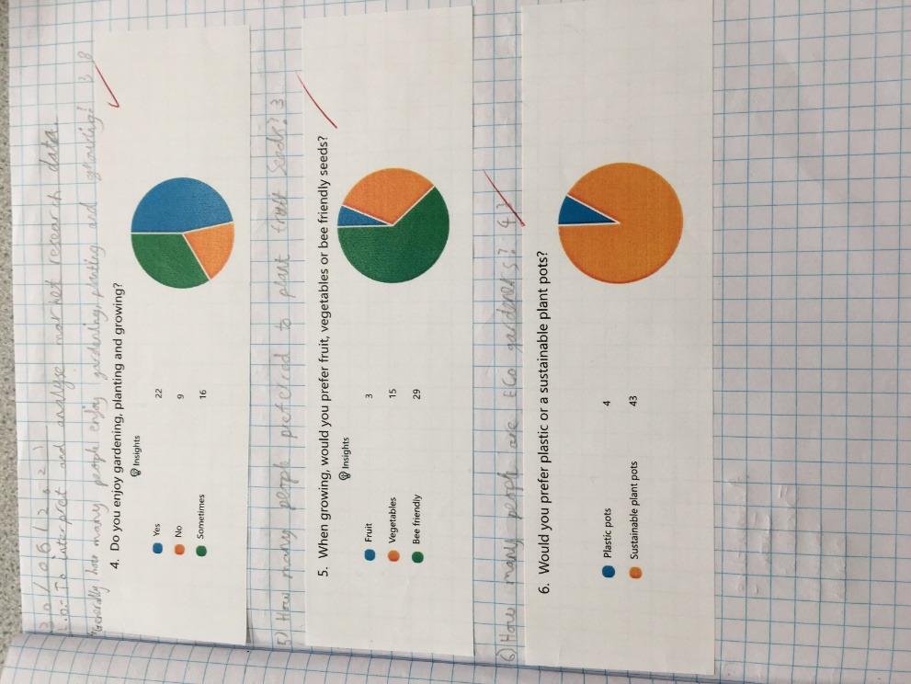
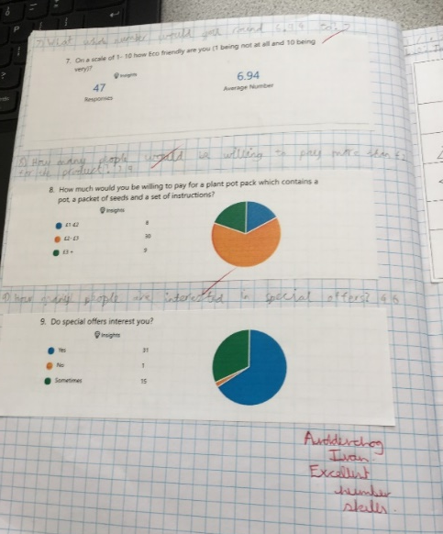
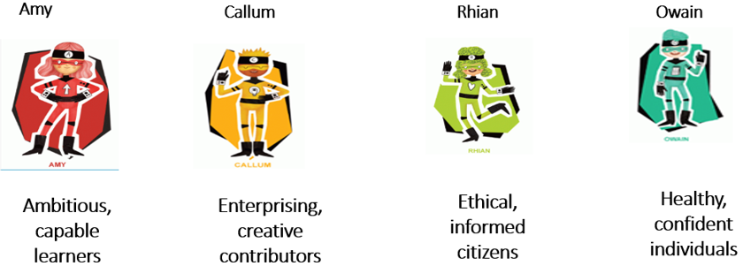
Using market research data
Use numeracy skills to interpret and analyse the market research data. Allowing the learners to have a better understanding of customer preferences.
Also find out suitable prices that possible customers would be willing to pay for our product.

Slide 11
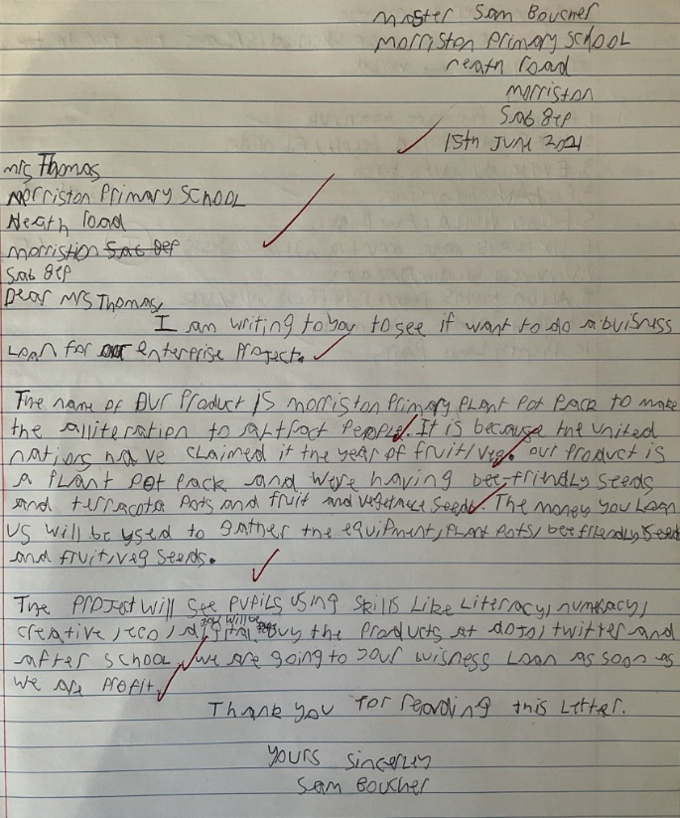
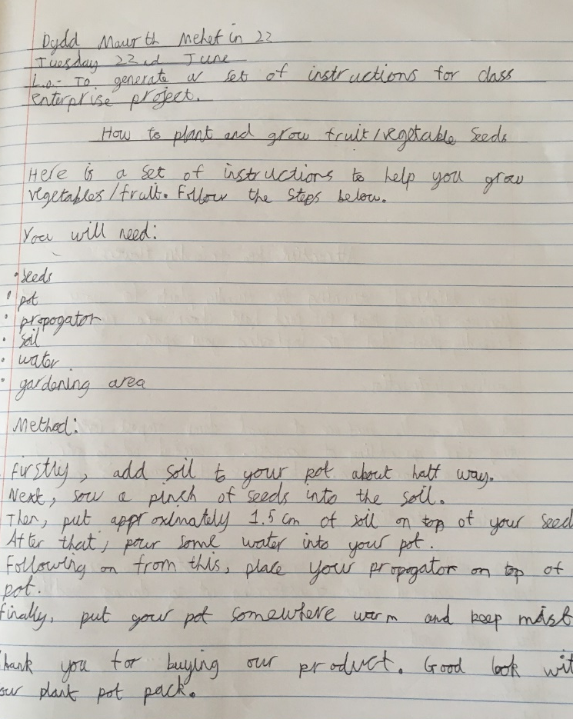
Developing literacy skills
Construction of formal letters asking for monies to start our enterprise.
Instructional texts for our product

Slide 12
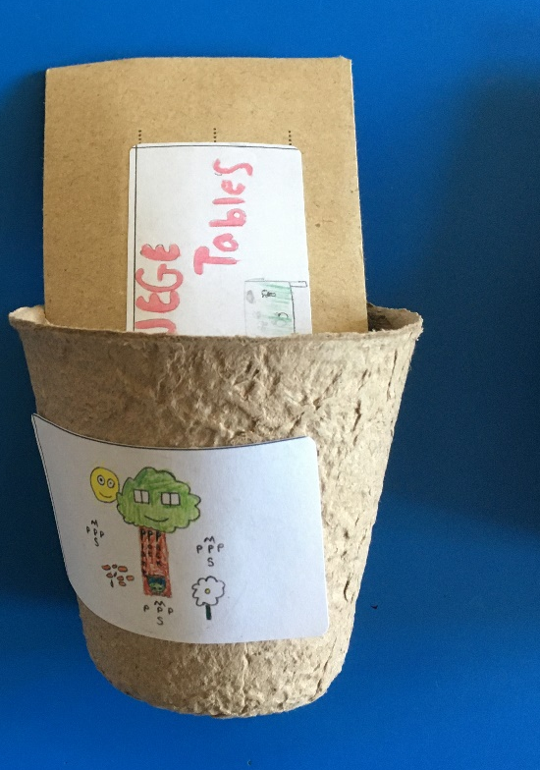
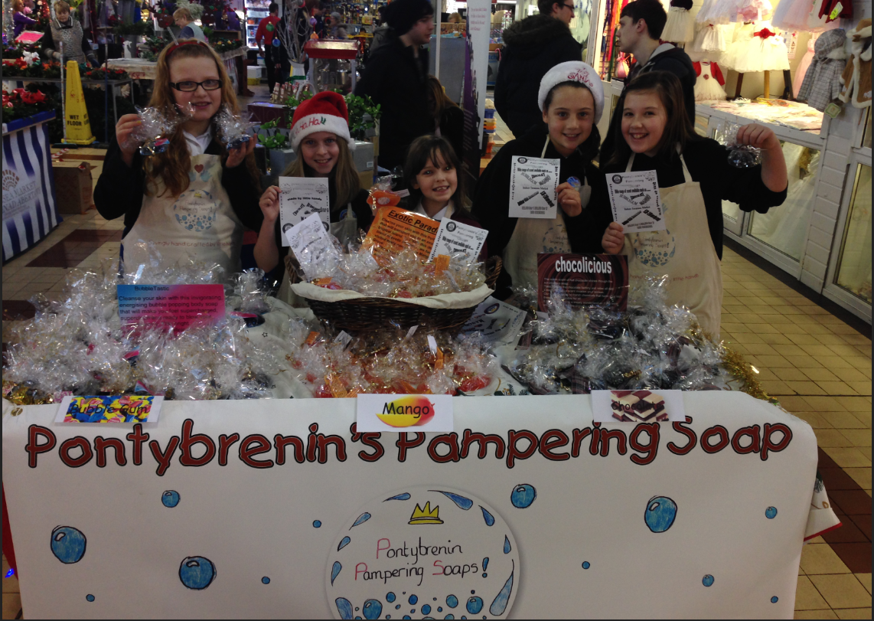
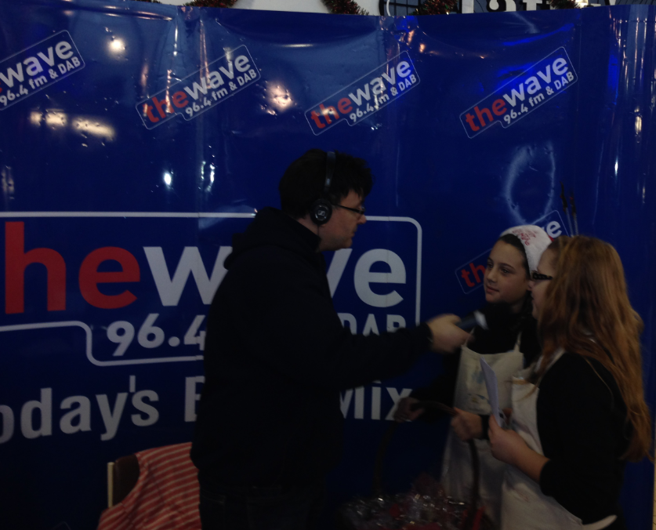

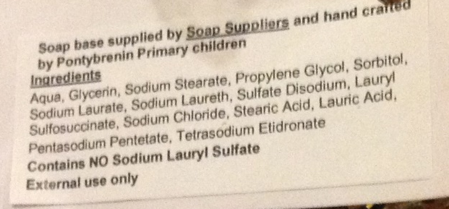
The product

Slide 13

Questions

