Slide 1
ESDGC/Geography and the AOLe.

Slide 2
Achieved so far
Embedding the ESDGC into the curriculum.
Platinum+ Status renewal.
Engage with the woodlands trust.
Monitoring of coverage through book scrutiny and listening to learners.
Develop online learning platform
Engage parents and community
Create a HWB ESDGC Network

Slide 3
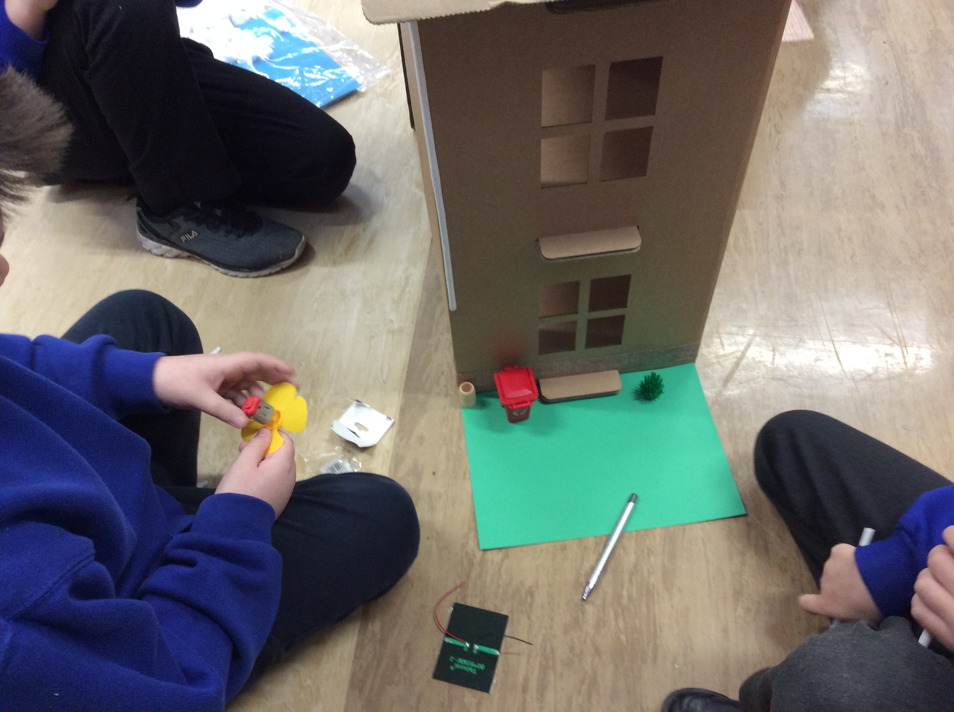
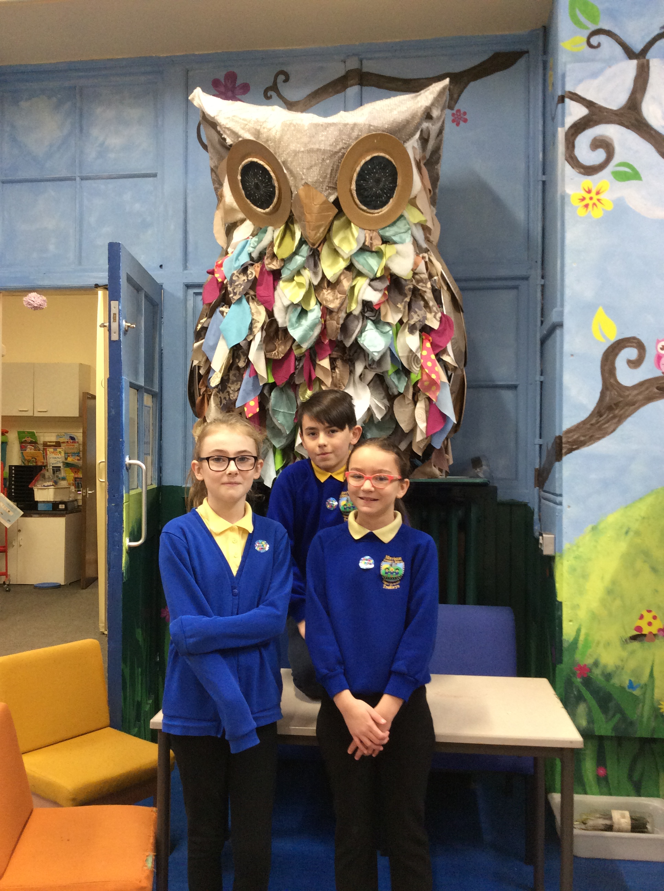
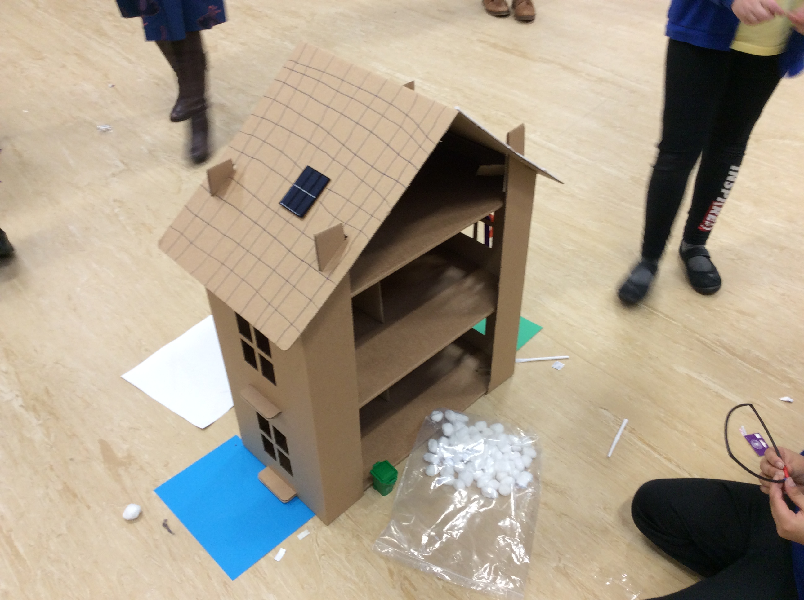
Engaging external agencies about Eco homes and sustainability
Creating a sustainable house as a team.
(Ethical informed citizens of the world.)
Platinum+ renewal status achieved.

Slide 4
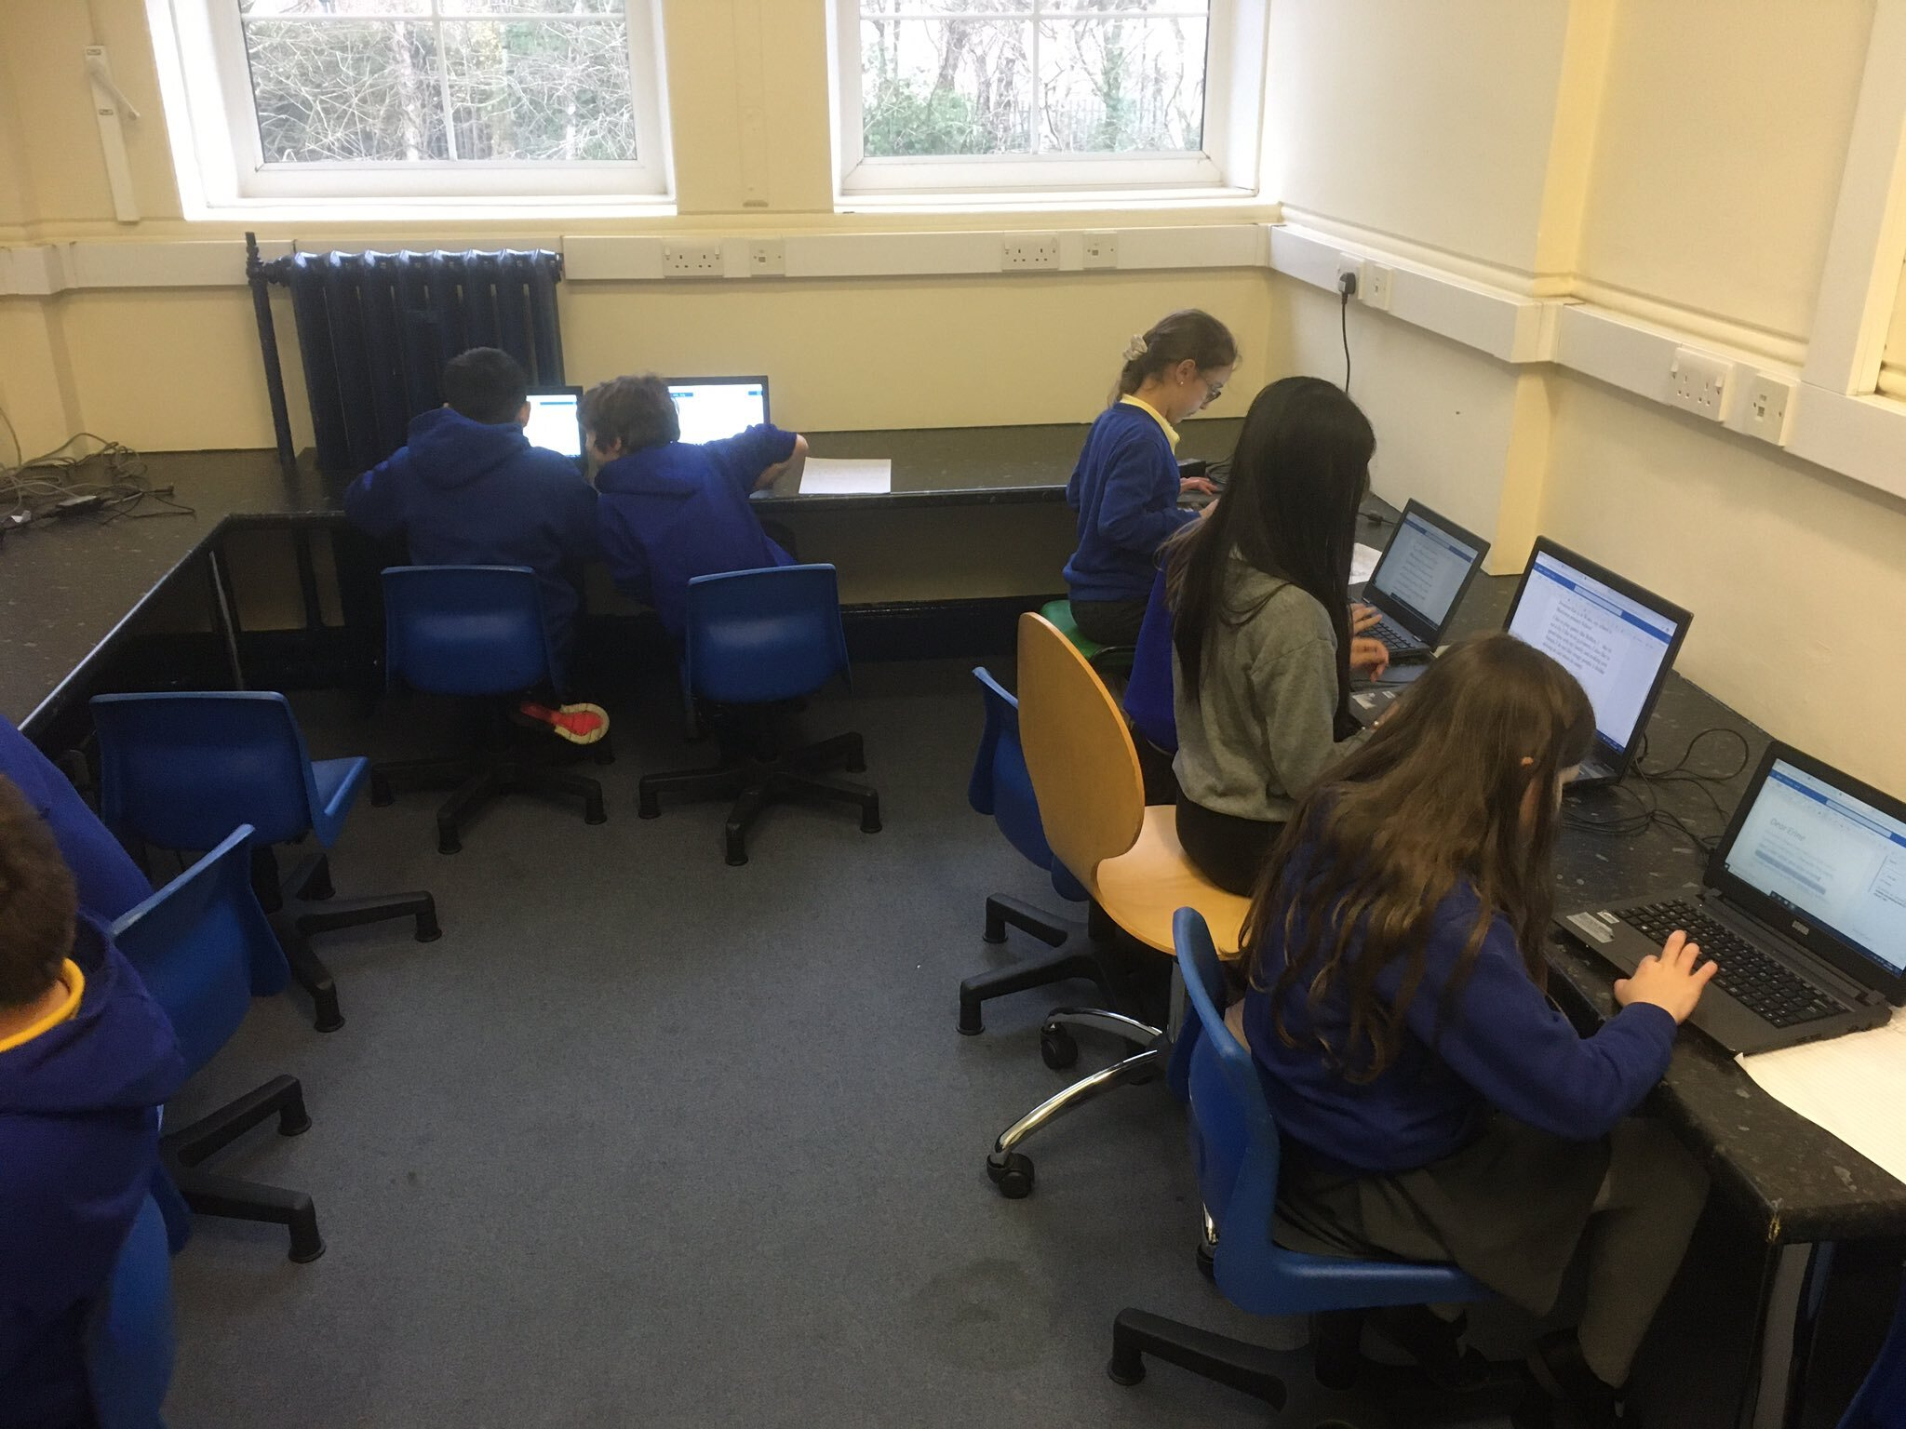
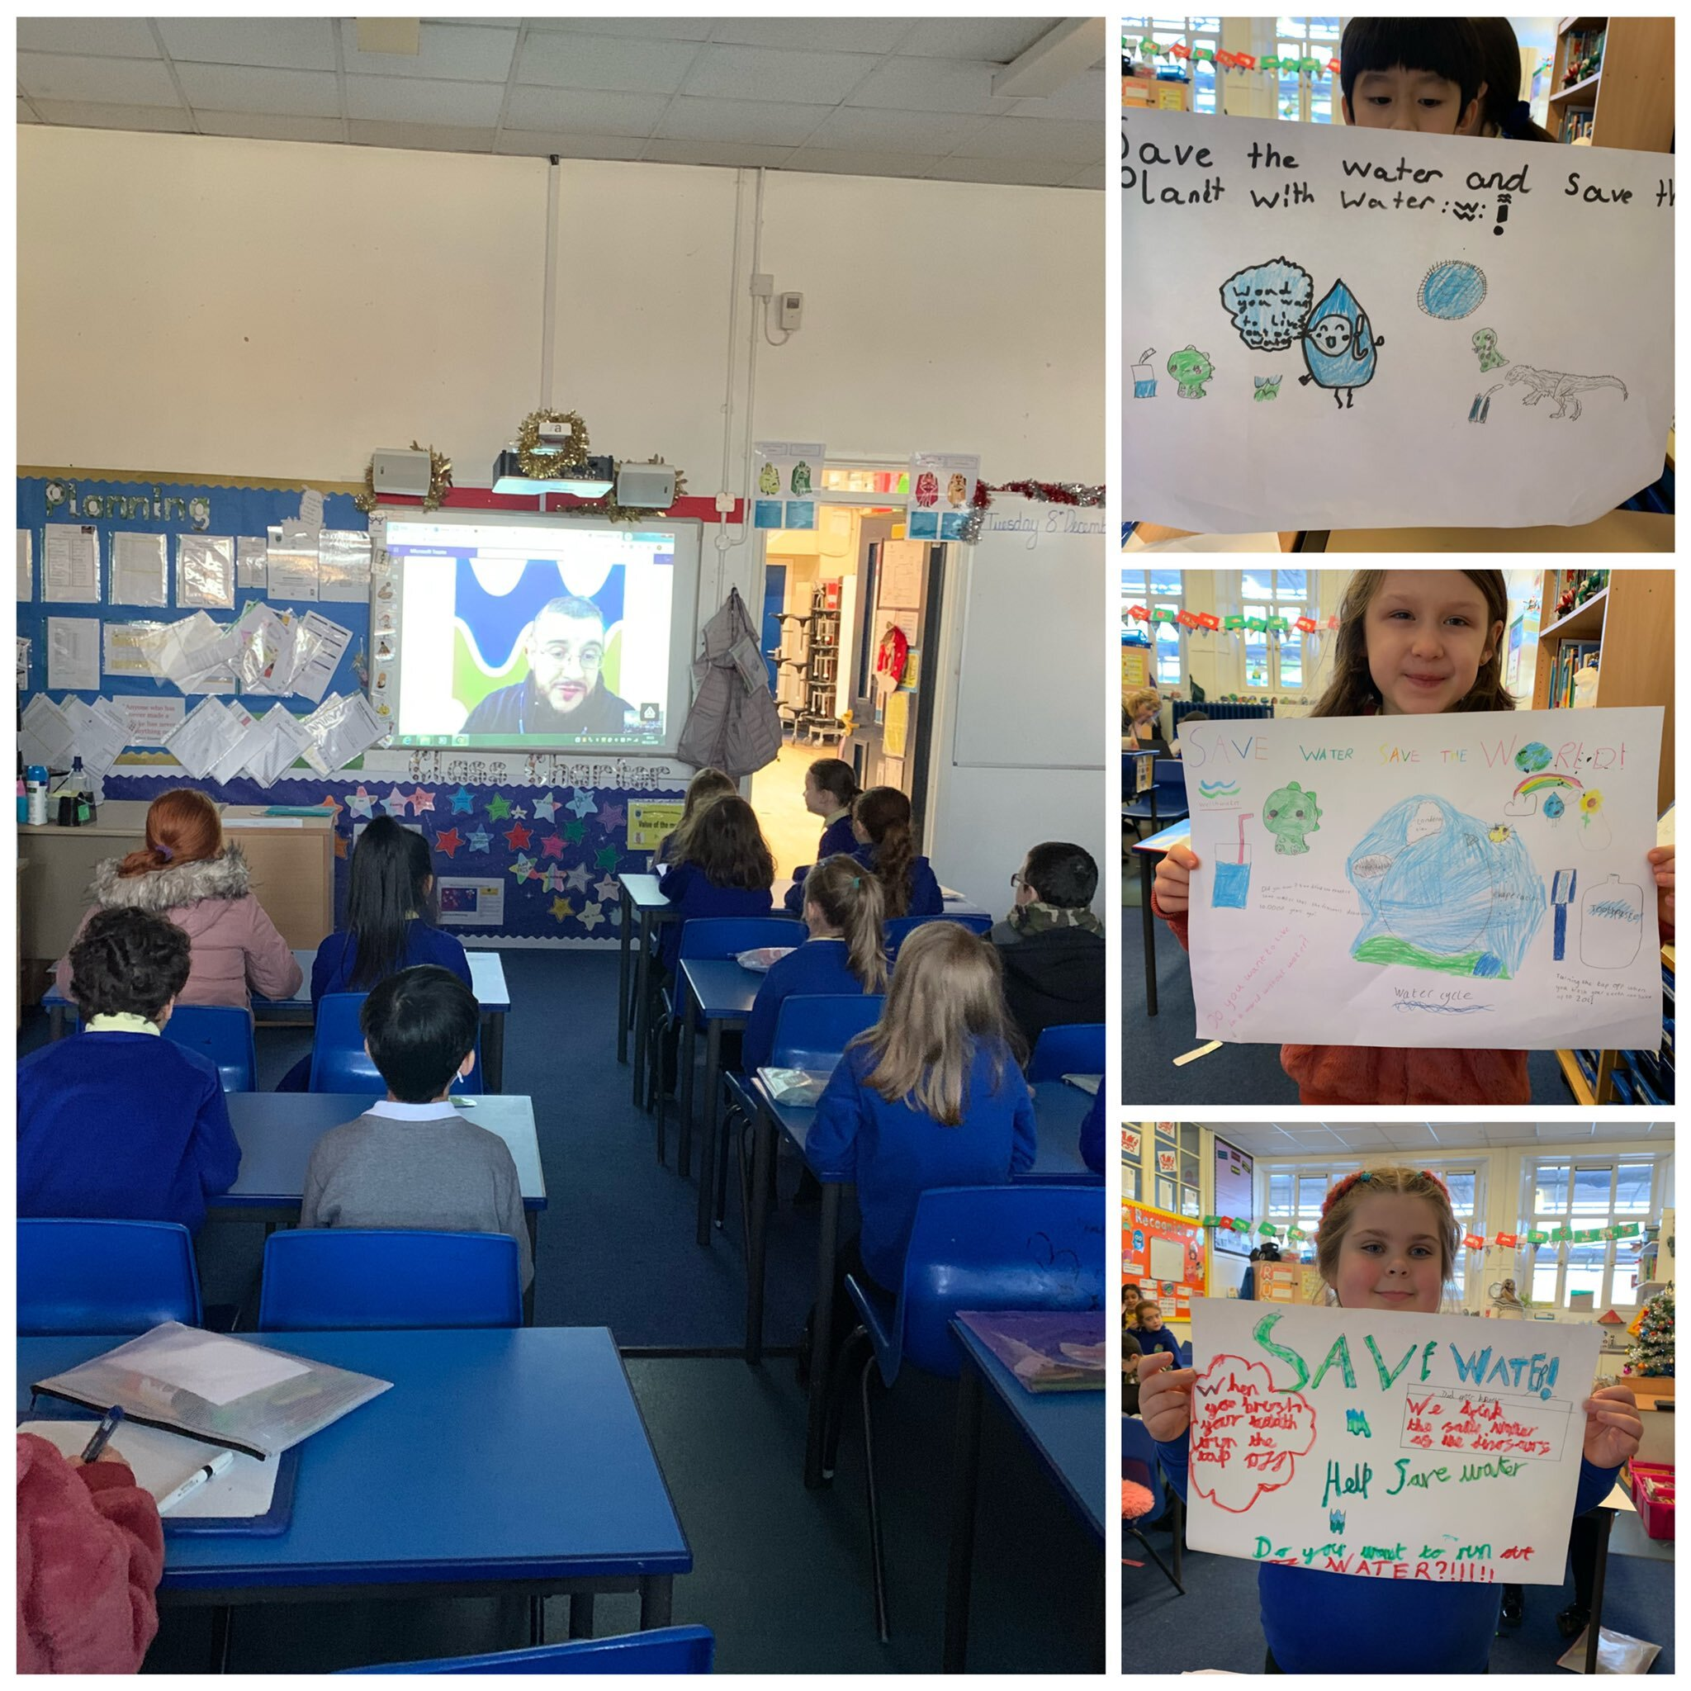
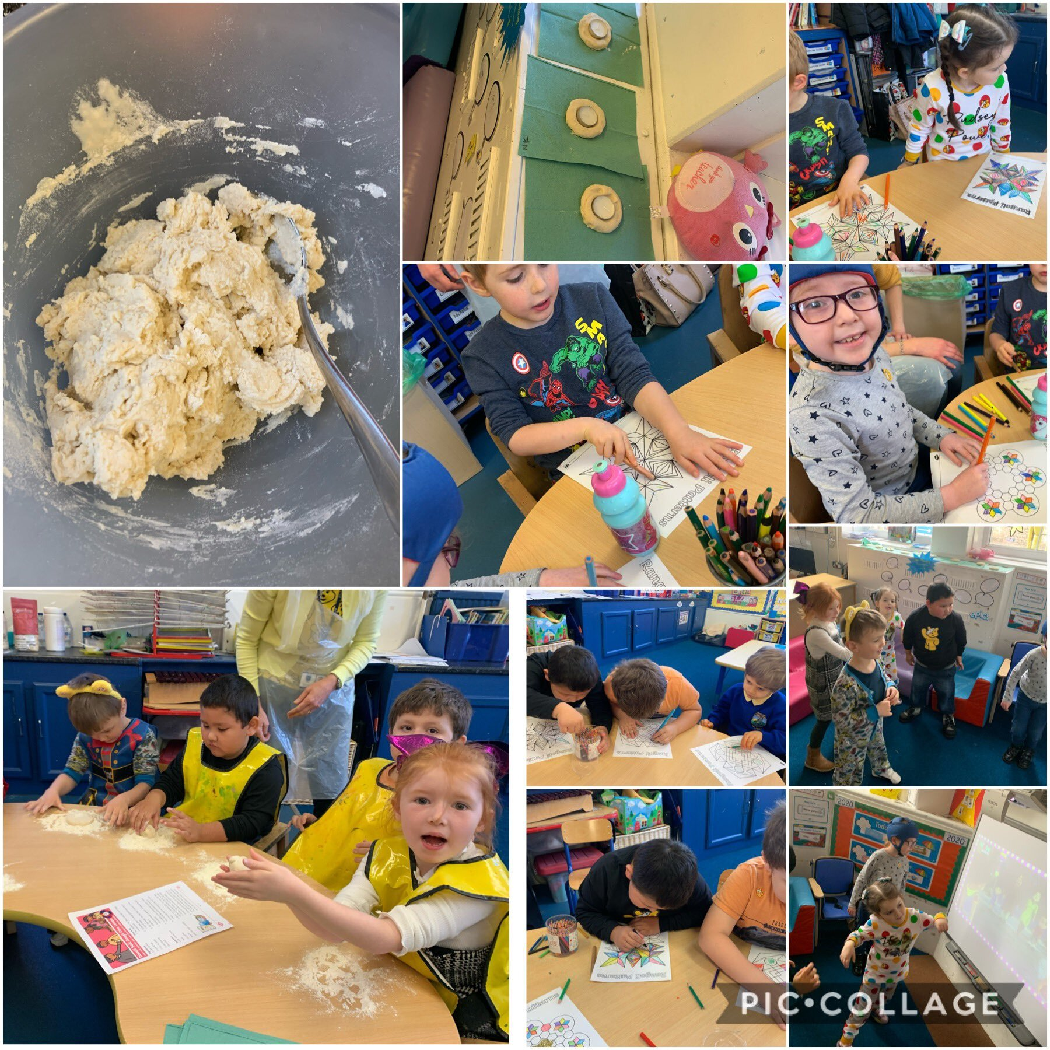
E Twinning with another school, Guadeloupe
(Using ICT and Geography skills together to engage and learn about another area of the world.)
Learning about Diwali and their rituals.
So learning about other cultures is a key Geography/ESDGC strand
Welsh water Online learning about the water cycle, and water wastage. (Ethical, informed citizens)

Slide 5


Awards achieved

Slide 6
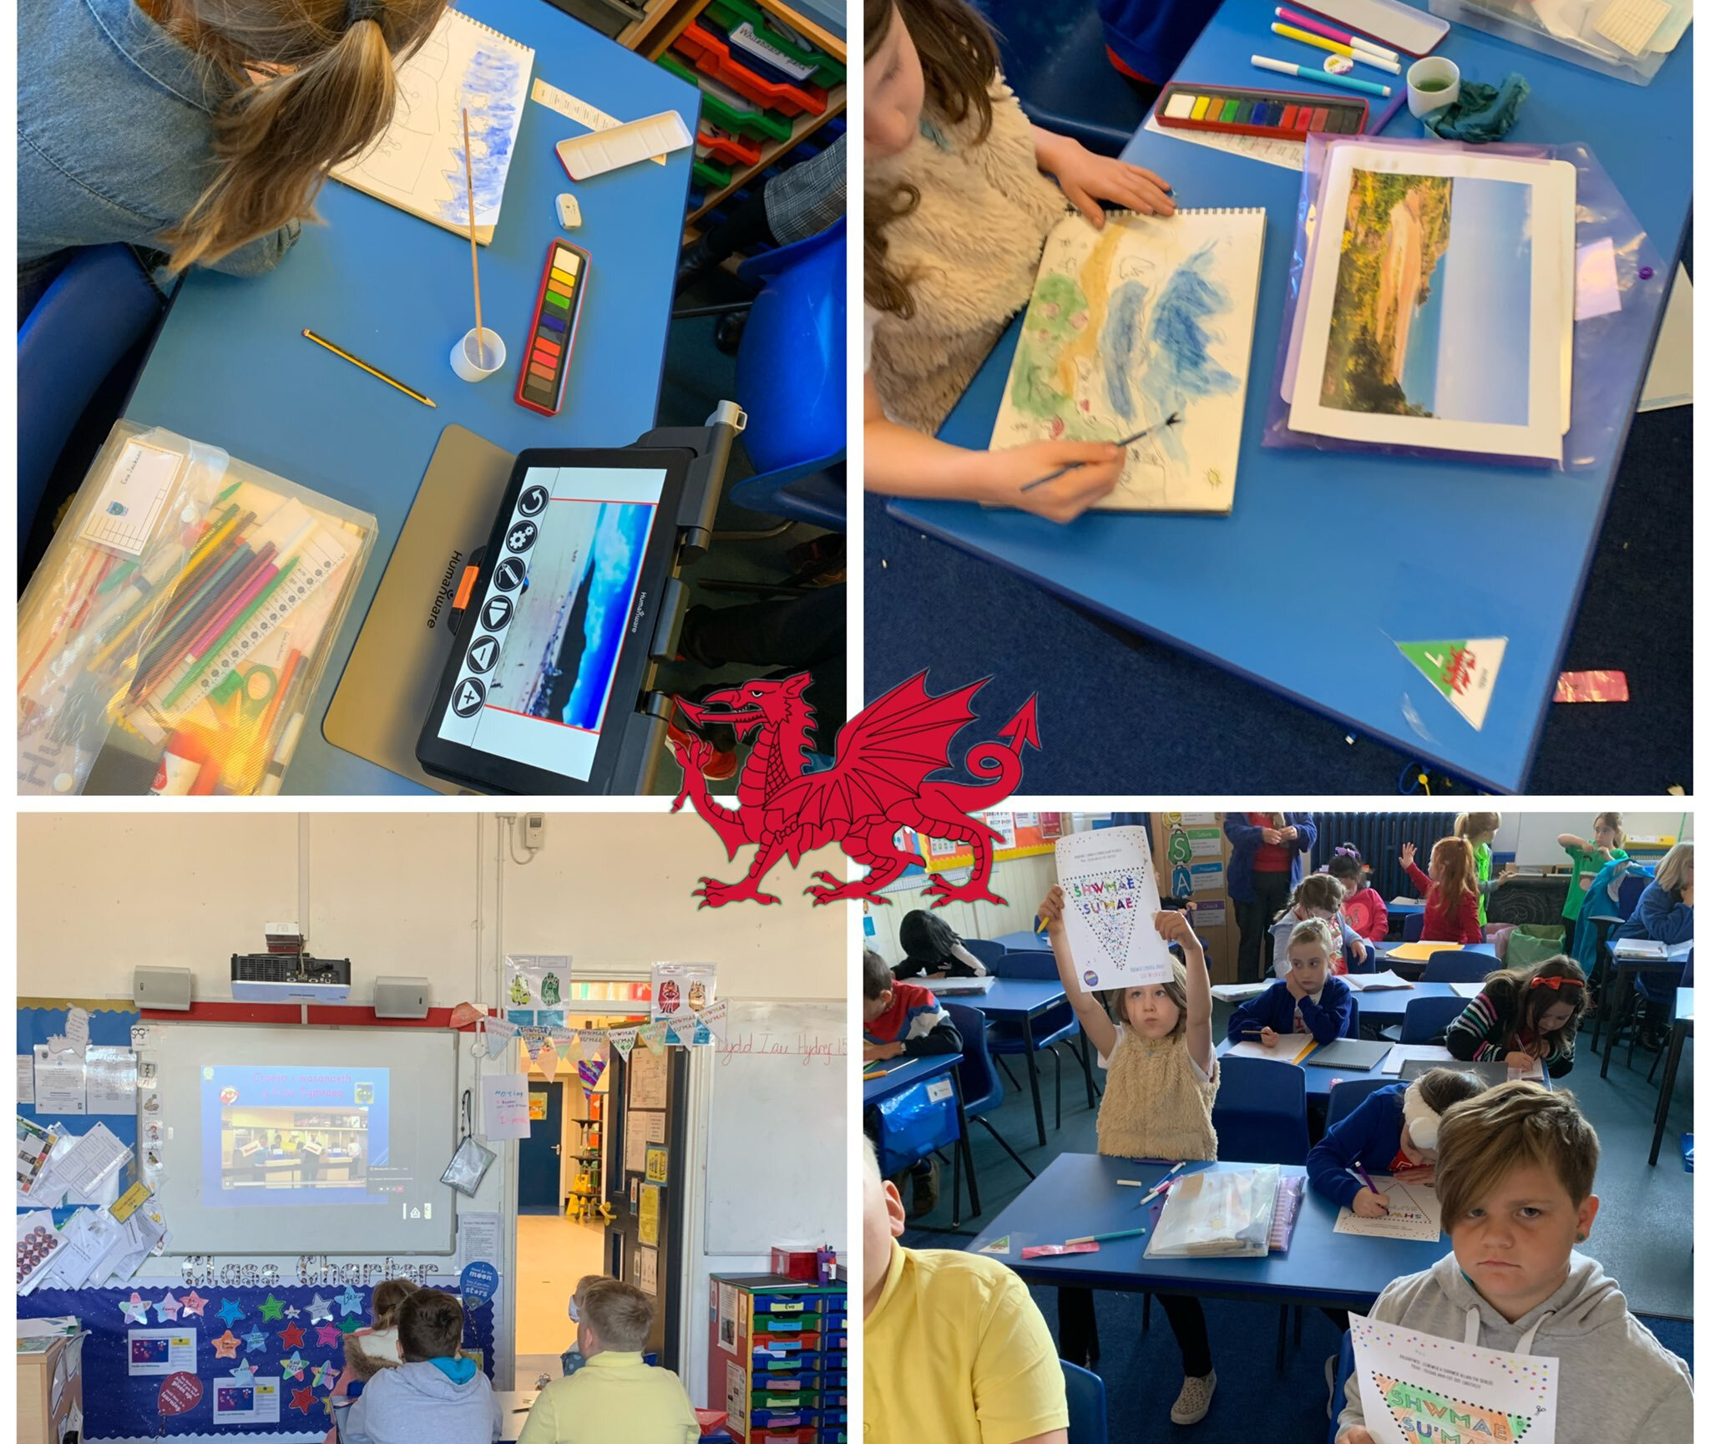
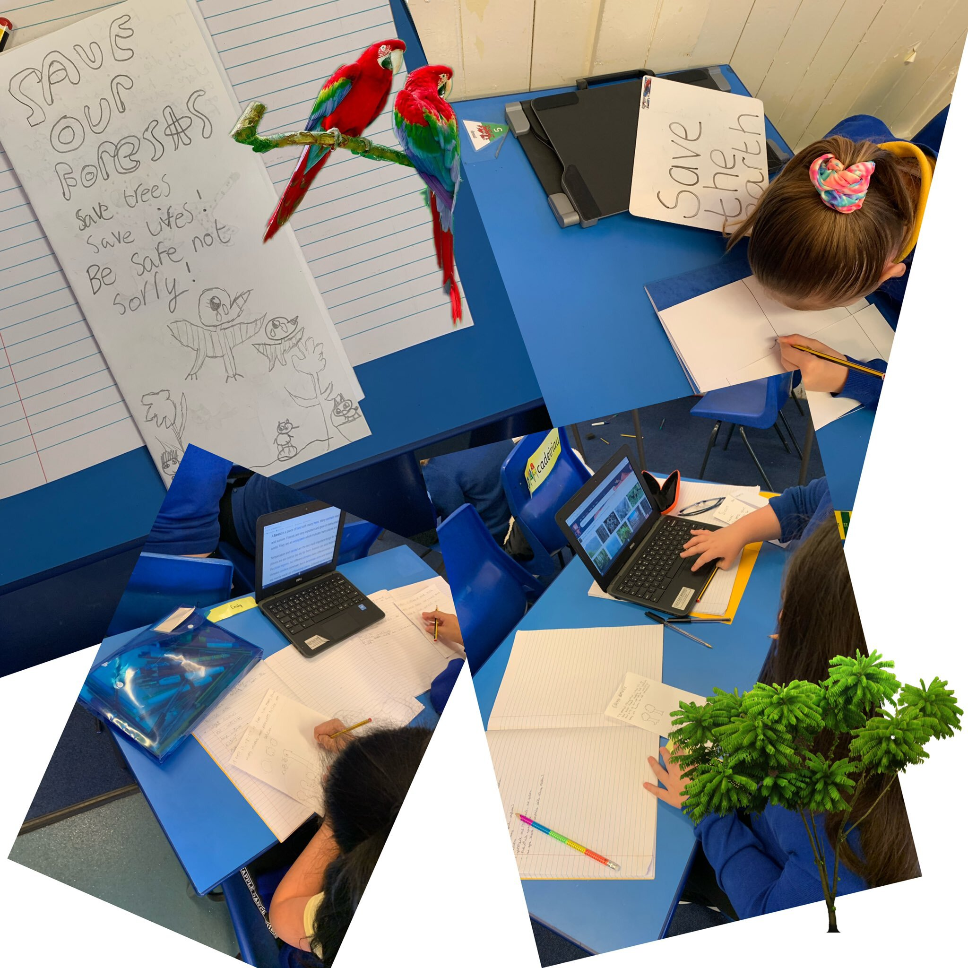
Saving the Rainforests
Evidence of global issues embedded within our schemes of work. Pupils used persuasive and information writing to develop leaflets about the ongoing global issue.
Wales
Learning about our own local community through art and local artists.
Using Geography skills to see our place in the world.

Slide 7
Ongoing/Aims
Engage with the woodlands trust. (Silver Award status, 1-2 years)
Continue to build the HWB ESDGC network. Now has more than 37 schools in Wales.
Online platform to inform community about Eco in the school. Newsletters, Online learning
Embed the same Eco code yearly rather than changing every year.
Resources for classes to use for further engagement such as scale models of different types of power/water cycle so pupils can create information pieces of writing, explanation texts and draw own diagrams.

Slide 8
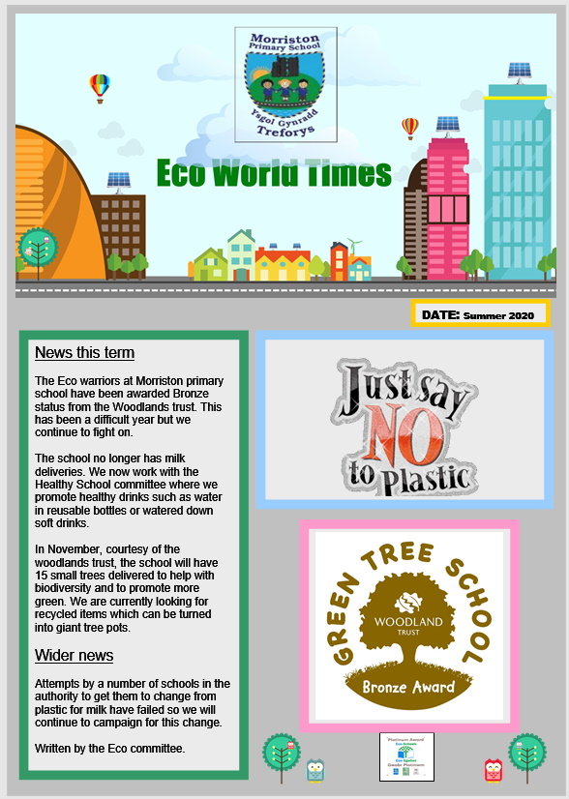
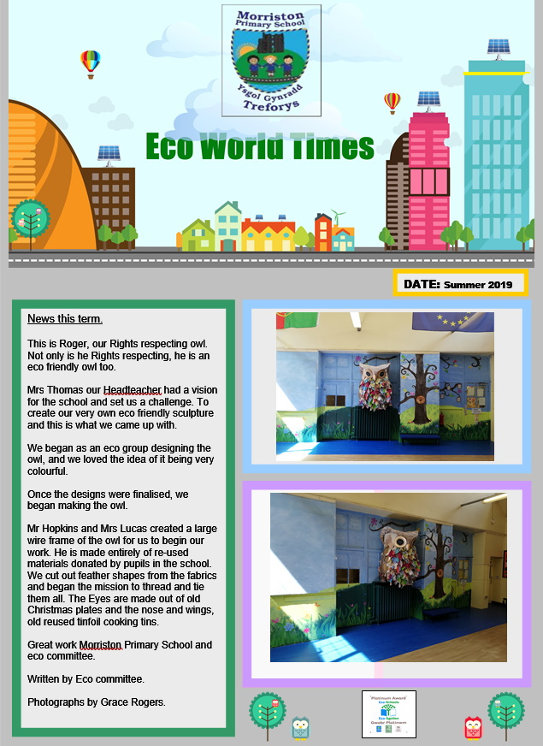
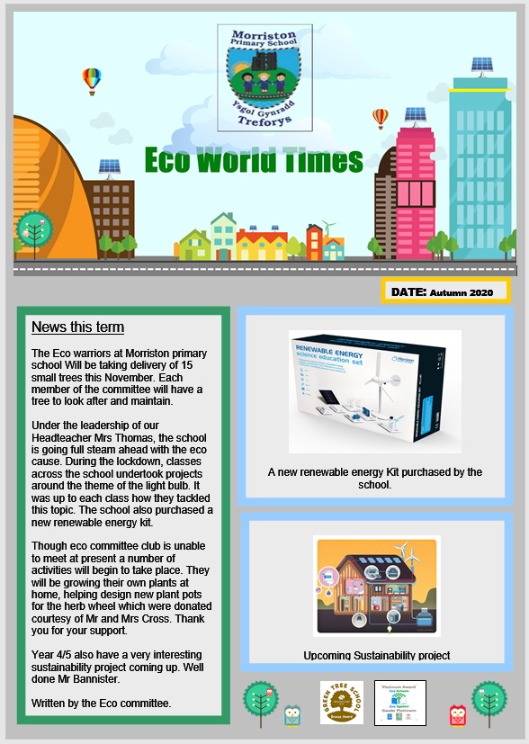
Termly newsletters online

Slide 9



Eco online engagement
www.morristonprimaryschool.co.uk

Slide 10
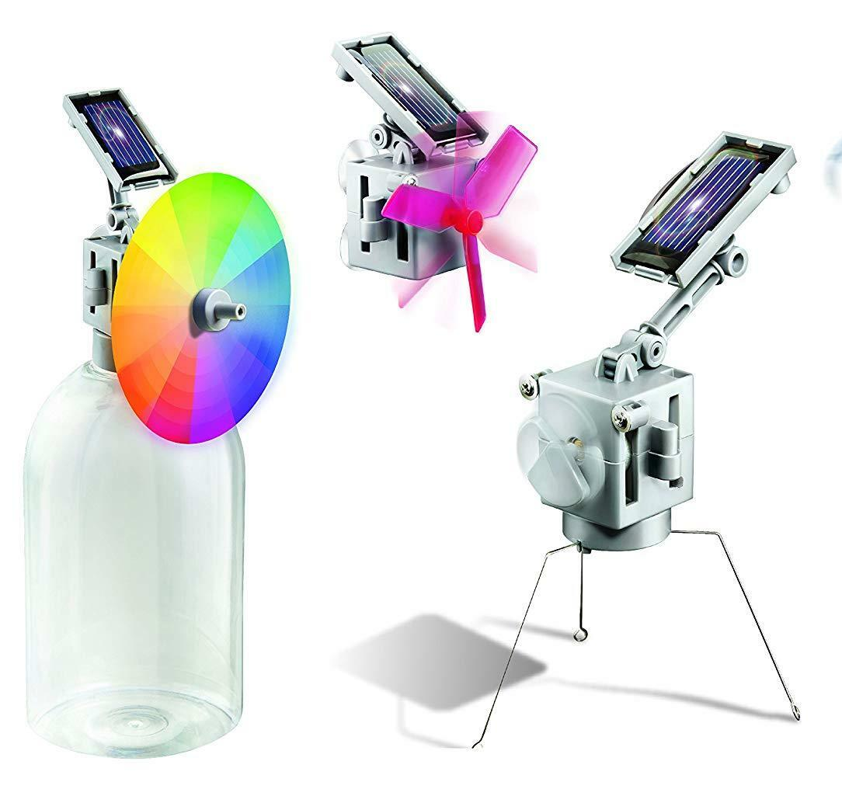



Resource aims
Aim is to create some permanent models so staff could carousel them as a days activities. Write instructions, explain how they work, draw diagrams, explain water cycles. Later year groups could expand on this and design and create whole towns, explaining their work etc. Links with global community strand of the ESDGC and has science, literacy, geography links and skills..

