Slide 2
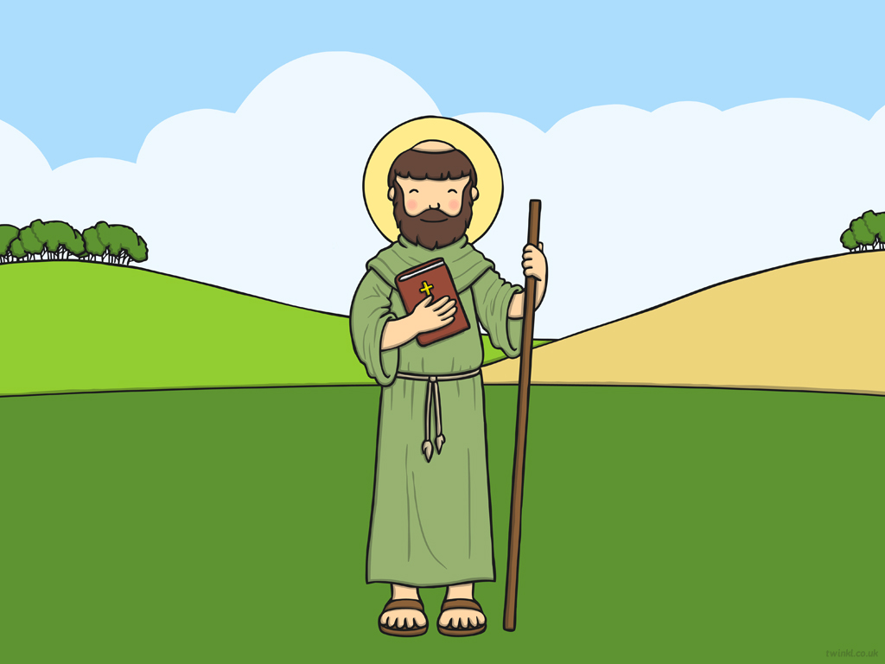
This is Saint David. Saint David is the patron Saint of Wales. We celebrate St. David’s Day on the 1st of March. This day is called Dydd Gŵyl Dewi in Welsh.

Slide 3
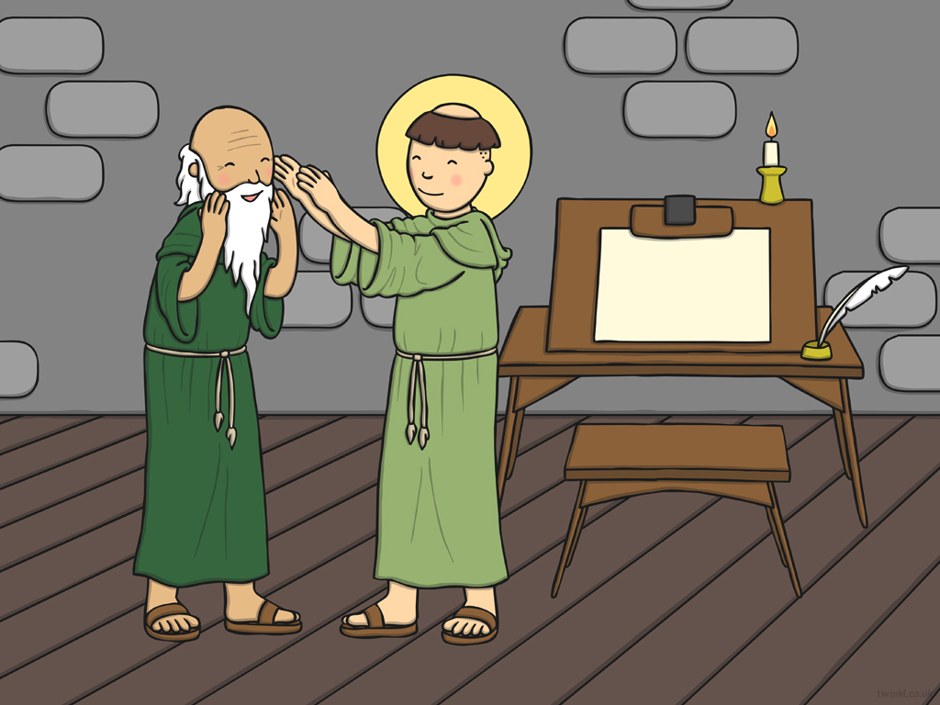
David enjoyed reading and writing. His teacher’s name was Paulinus. David loved to listen to monks spreading the good word of Jesus.

Slide 4
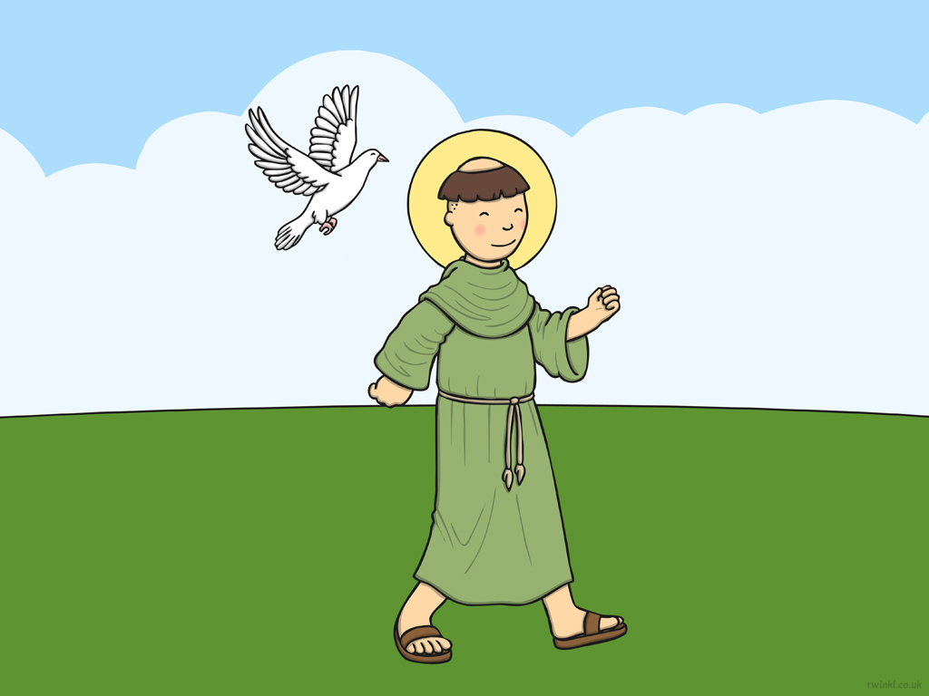
David’s mother’s name was Non and his father’s name was Sant: King of Ceredigion. They soon realised that he was a special boy. Wherever David went, he was followed by a white dove.

Slide 5
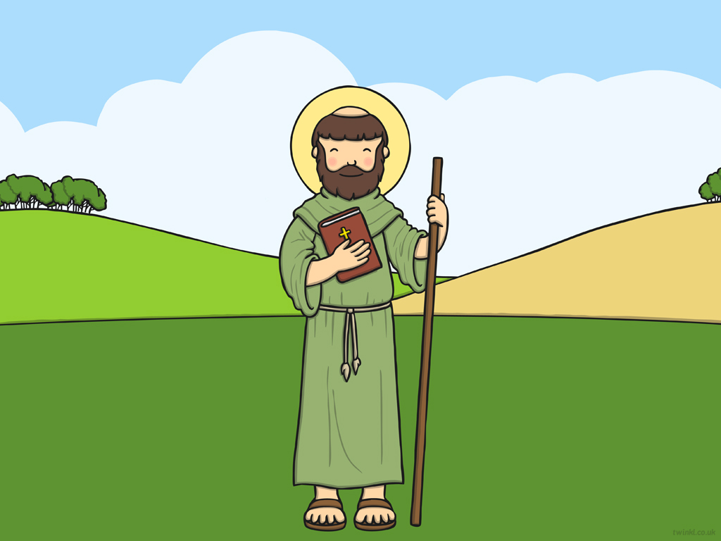
David loved to hear stories about Jesus, so he decided to become a monk when he was older. He was a good and kind man. Dyn da oedd Dewi Sant.

Slide 6
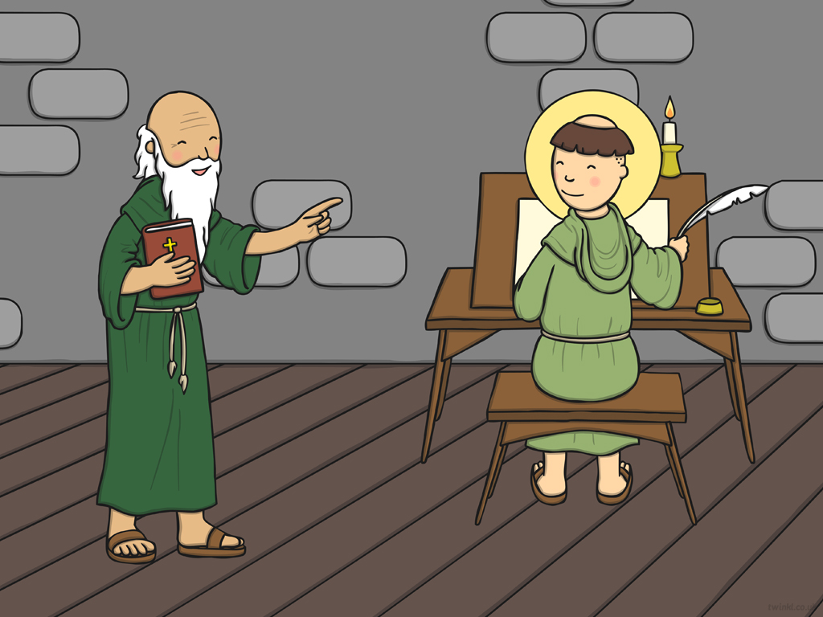
David was shy and quiet, and would sit and listen to the monks. One day, he could see Paulinus, his teacher, struggling. He had lost his eyesight over time and was now blind. David thought he might be able to help so he touched Paulinus’ eyes. Suddenly, Paulinus could see!

Slide 7
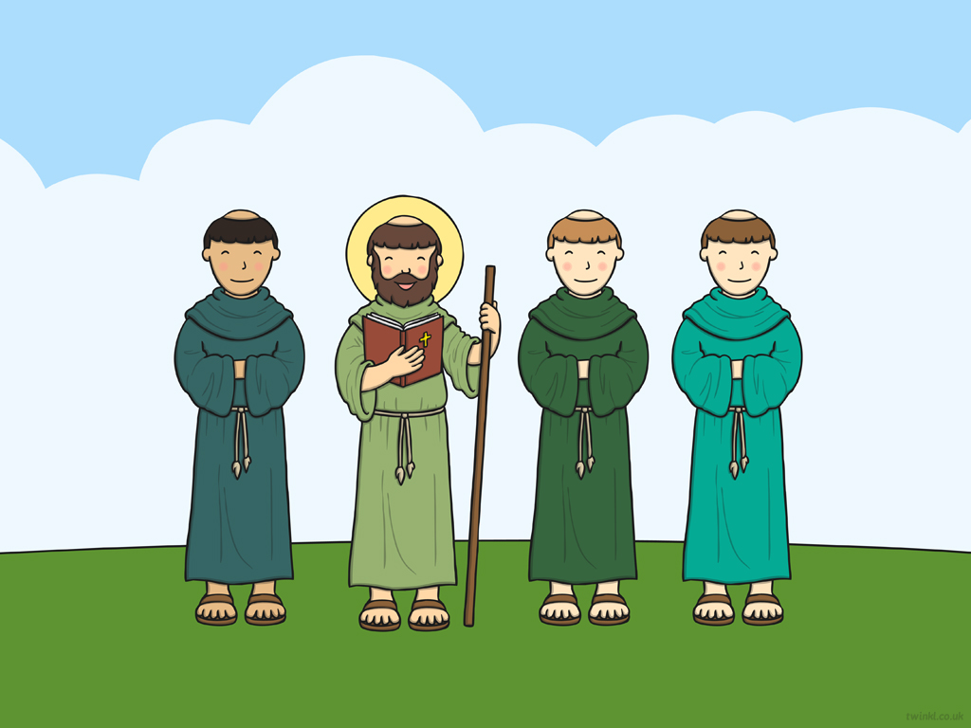
After spreading the word of Jesus around Britain, David returned with his friends Aidan, Ishmael and Teilo. He had plans to build a monastery for the monks.

Slide 8
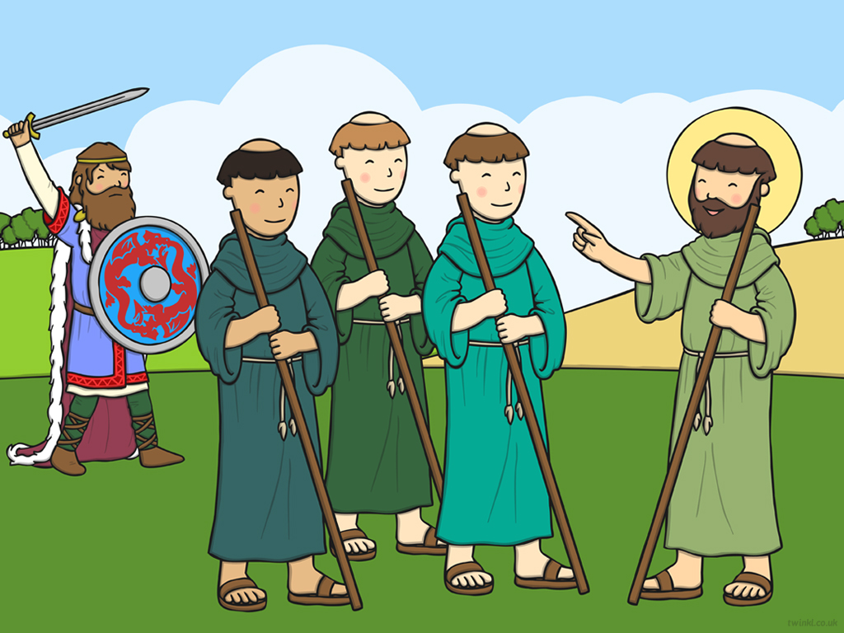
He wanted to build a monastery for the monks to worship and live in.
Unfortunately, a fierce man called Boia didn’t want David to build a monastery on the land near him. He went to hurt David, but God protected David from harm. After this, David was even more determined to build the monastery. He worked hard and he made sure everyone else worked very hard too.

Slide 9
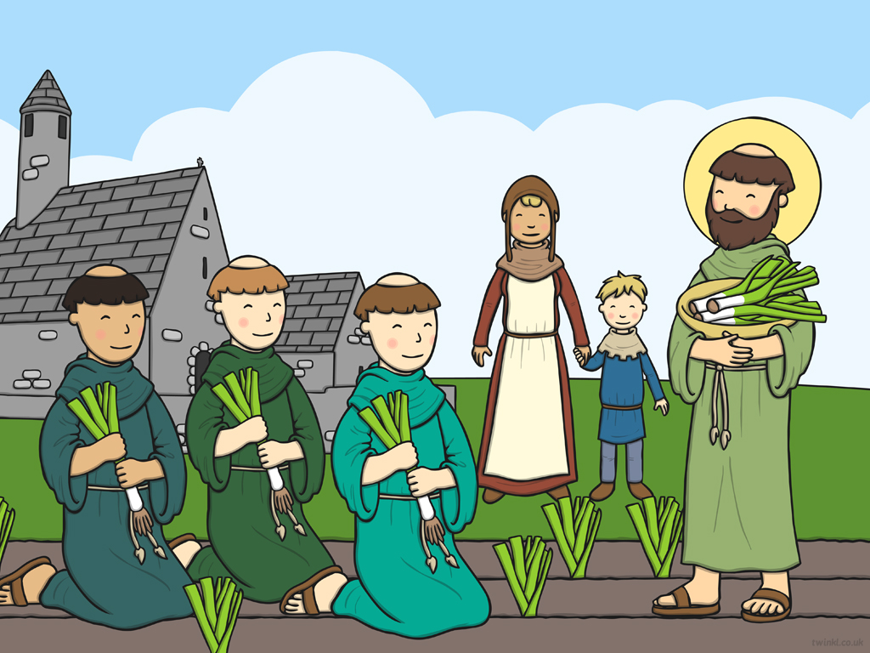
They grew vegetables and would always share with people around them.

Slide 10
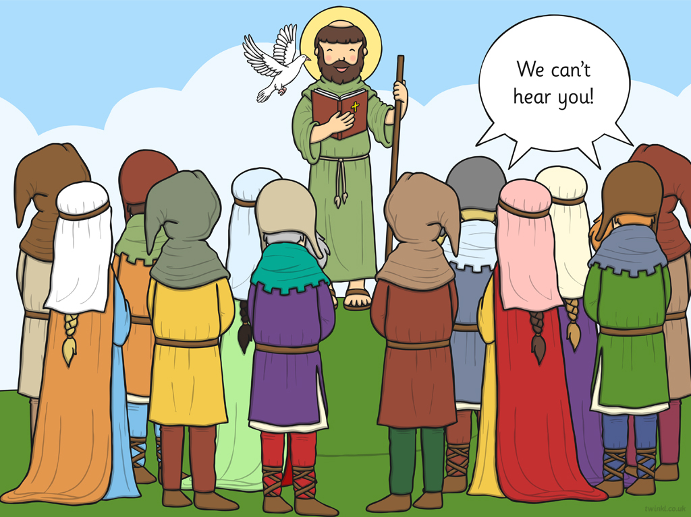
We can’t
see you!
One day, while David was preaching in a place called Brefi. Something wonderful happened! The people of Llanddewi Brefi (what Brefi is called today), went to hear David preach but they could not see him. Suddenly, when David started to preach, the ground rose to make a little hill! Everyone could now see and hear David!

Slide 11
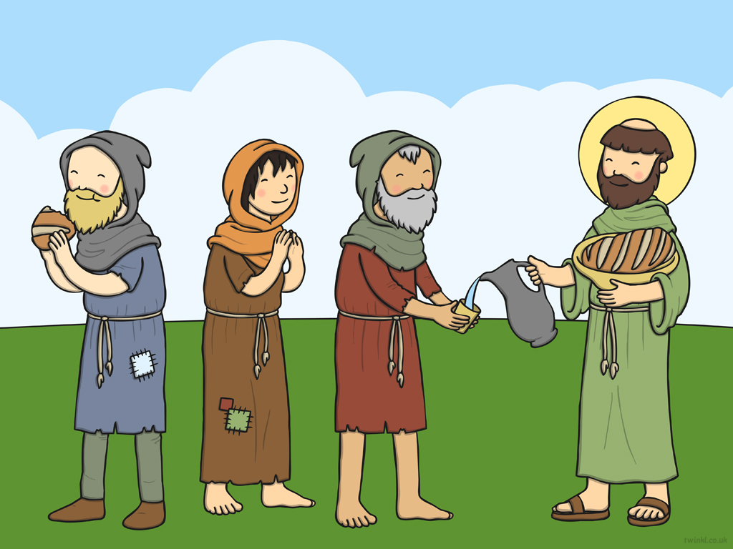
Let’s learn a new song about St. David:
Dydd Gŵyl Dewi
Dyn da oedd Dewi
Dyn da oedd Dewi
Dyn da oedd Dewi
Dewi Sant.

Slide 12


