Slide 1
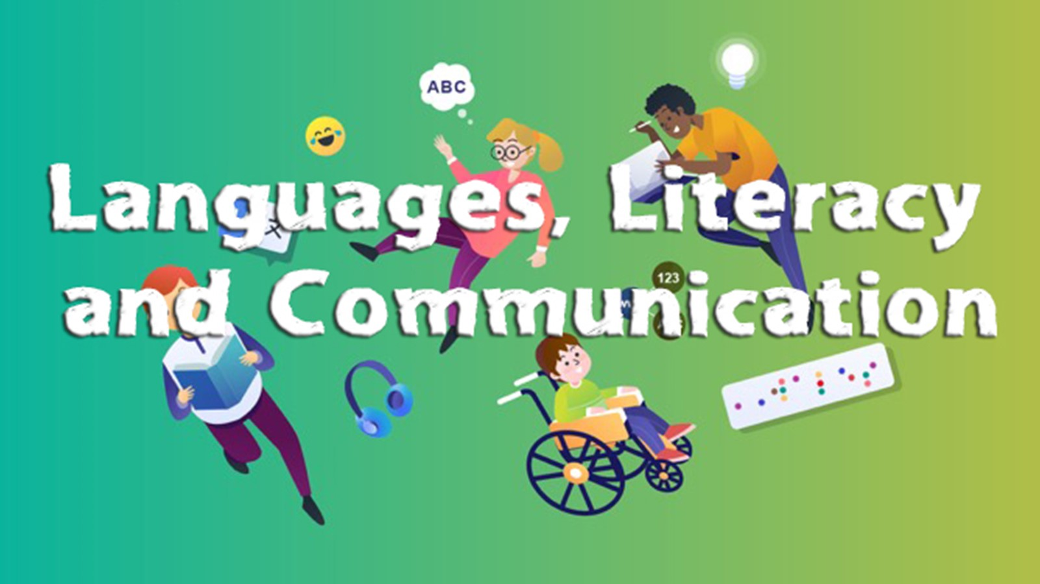

An introduction to the Languages, Literacy and Communication Area of Learning and Experience @ Morriston Primary School

Slide 2

Vision for Languages, Literacy and Communication
Pupils of Morriston Primary School are inspired to be lifelong learners who meet the four purposes of learning in meaningful contexts. In rich learning environments, learners will celebrate languages and cultures, embracing a bilingual Wales in an international context. Bringing together Welsh, English and international languages and literature for all.
Learners will listen, speak, read and write to the best of their abilities at all times, developing ambitious, capable and confident language learners who communicate effectively using a number of different international languages. Becoming creative, resilient, adaptable and empathetic young people; who learn about their own identity and others; who have pride in themselves and their cultures.

Slide 3
The aim of the AoLE
The Languages, Literacy and Communication Area of Learning and Experience addresses fundamental aspects of human communication.
It aims to support learning across the whole curriculum and to enable learners to gain knowledge and skills in Welsh, English and international languages as well as in literature.

Slide 4
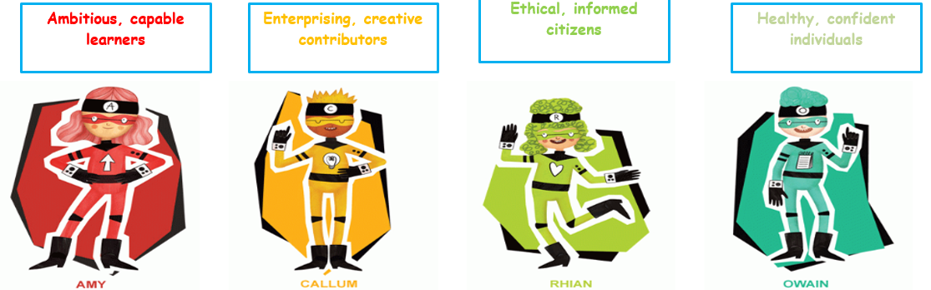
How Languages, Literacy and Communication supports the four core purposes.
Languages, literacy and communication are about developing knowledge, skills and dispositions in oracy, reading, writing and literature within and across languages.
They also develop learners’ cultural understanding and identity, their sense of self, and their place and voice in society which can contribute significantly to a thriving economy and cultural life for Wales.

Slide 5
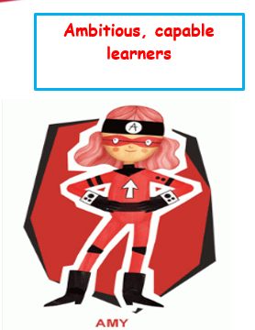
Ambitious capable learners
Languages, literacy and communication contribute to developing ambitious, capable learners who are effective communicators in Welsh, in English, in other languages and through digital media

Slide 6

Enterprising, creative contributors
Being confident in using languages enables learners to adapt skilfully to different roles and contexts, think creatively, solve problems and take risks, becoming enterprising, creative contributors, both individually and collaboratively.

Slide 7
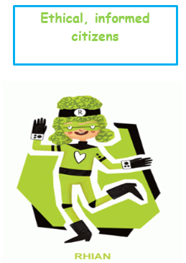
Ethical, informed citizens
Languages, literacy and communication contribute to developing ethical, informed citizens. Learners gain the knowledge and skills they need to participate confidently and make their voice heard effectively

Slide 8
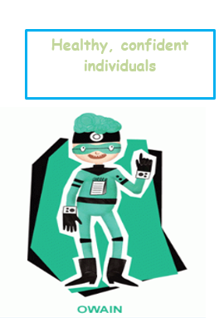
Healthy, confident individuals
Developing skills in languages, literacy and communication can help learners to keep themselves and others safe in the real and virtual world.
Healthy, confident individuals can articulate their feelings, interpret those of others, and develop positive relationships.

Slide 9
Statements of what matters
The four statements that express what matters in this area should be addressed holistically.
This means that different languages should be explored in relation to one another, also the skills of listening, speaking, reading and writing

Slide 10
Statements of what matters
Languages connect us.
Understanding languages is key to understanding the world around us.
Expressing ourselves through languages is key to communication.
Literature fires imagination and inspires creativity.

Slide 11
Embedded provisions which develops Languages, Literacy and Communication @ Morriston Primary
Read Write Inc approach
Class guided reading sessions
Teaching and using the 8 reading behaviours
Digital literacy e.g Pobble
Slot Drilio
Oracy tasks in different languages
Intervention groups for identified learners
EmpathyLab approach
Half termly text type / narrative studies
Literacy Challenges / Missions
Digital Platforms e.g My Rising Star & Spell Blast
Spelling Schemes
Scheme of work for Literacy and Welsh
Weekly Welsh patterns
Tric a Chlic
WellComm & Speech Link
Cerdd Iaith
Curriculum Cymreig

