Slide 1

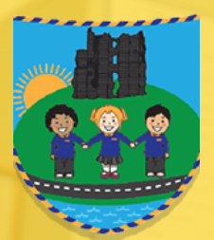
Lead creative schools
Morriston Primary School 2023 – Diversity and creativity Project.
"This is us."

Slide 2

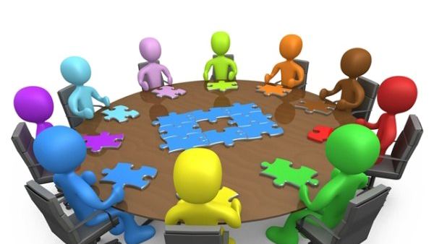
Initial Meetings
Having had an extremely successful Lead Creative Schools Project in 2020-21 and 2021-22, we successfully secured an extension grant from Arts Council Wales for a project aimed at celebrating diversity. Lisa Zahra Jouzdani organised an initial planning meeting with Michelle and herself to discuss exploring the theme of Diversity linked to our school setting.
A lead creative team was assembled with Michelle McTernan, N’didi John, Cara Walker and Steve Balsamo.
Initially ideas were discussed on how the project could be implemented and which classes would be involved. It was decided that across the school all classes would explore the theme of diversity but years 4,5 and 6 would work with the creative practitioners.

Slide 3
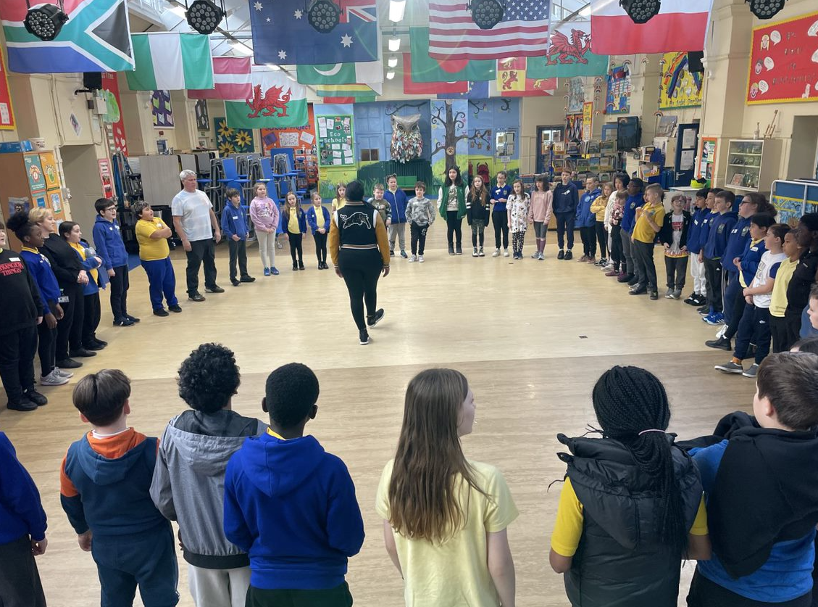
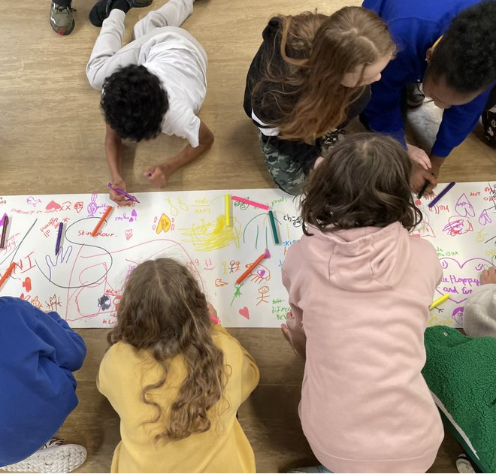
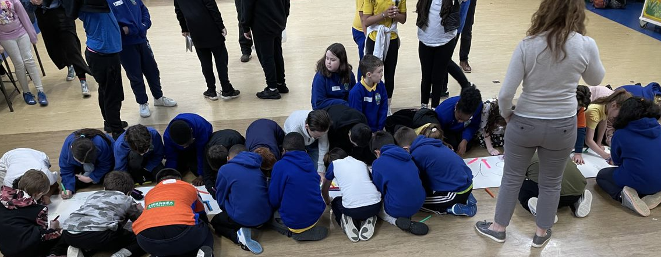
Lead Creative Schools Sessions
At the beginning of the project the creative practitioners, Michelle, N’didi and Steve introduced themselves and played warm up games with the children. Following this they explored everyone’s name and its origin which produced a wealth of discussion and began the exploration of the diverse nature of the school. The children then had the opportunity to write and draw what diversity meant to them.

Slide 4
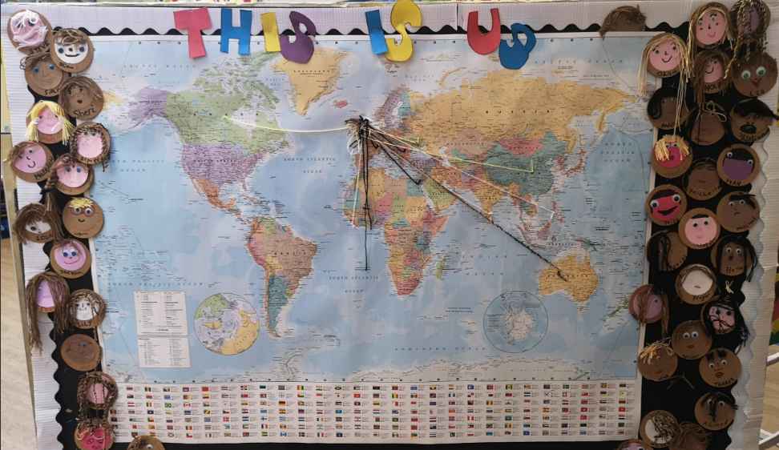
Further sessions:
In further sessions the Lead Creative Schools Practitioners - Steve Balsamo, Michelle McTernan played warm up games with the children, where the children took part in breathing exercises, vocal warm-ups and physical short focus warm-ups. They were then involved in ice breakers such as the Whizz activity, using diverse coloured paper with the focus - let’s make a mini portrait. They then carried out an activity around the question - Where in the world ? Discussing the different places in the world that they are from. Each child Placed a pin on the map of the world and used string identifying where each child was from. This was then left on wall for others to see and add to it if they wished. The activity was then split into groups where they were asked to choose a country and find out a fact e.g. food, music, dance, flower/plant, animal etc. They were asked to record their information by writing, drawing etc. being creative in presenting your findings.

Slide 5
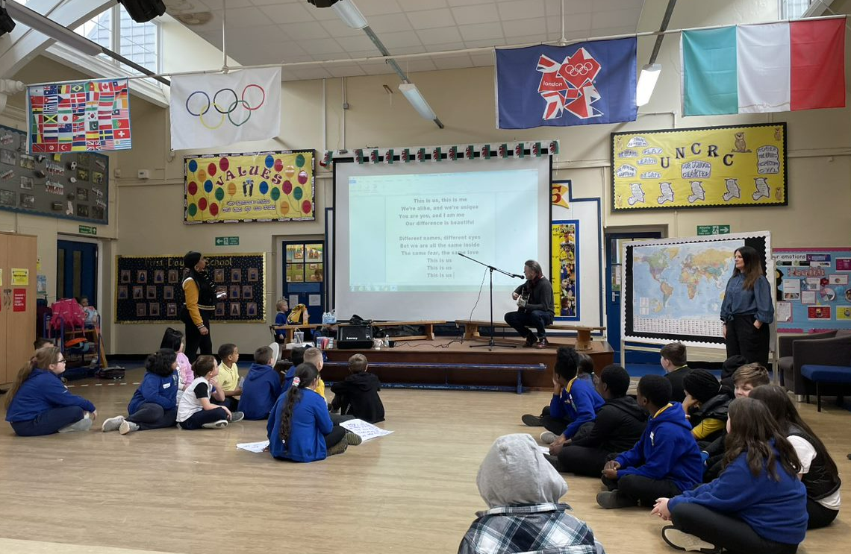
Other activities that were completed during the project were:
*Activity task - Splitting into groups of 4, discussing similarities and differences within the group and logging their findings.
*Activity task - Splitting the class into 2, calling out and running to the side of the room according to their difference e.g. If they've they’ve got red/blonde/brown/black hair or if they've got blue/green/brown eyes etc."
*Activity task – Considering what makes them unique? Celebrating the wonderful things that make them who they are. Talking about interesting facts about themselves e.g. do they play an instrument? Do they cook? Do they play a sport or have a hobby? Can they juggle, can they do the splits, roll their R’s? etc. Giving 2/3 words that describes them.
*Activity task - Creating the song, playing the chorus of ‘This is Us,’ working on the spoken word verses etc.
*Activity task - Creating a mood board. Rehearsing the song. Creating some movements to aid the performance of the song.

Slide 6
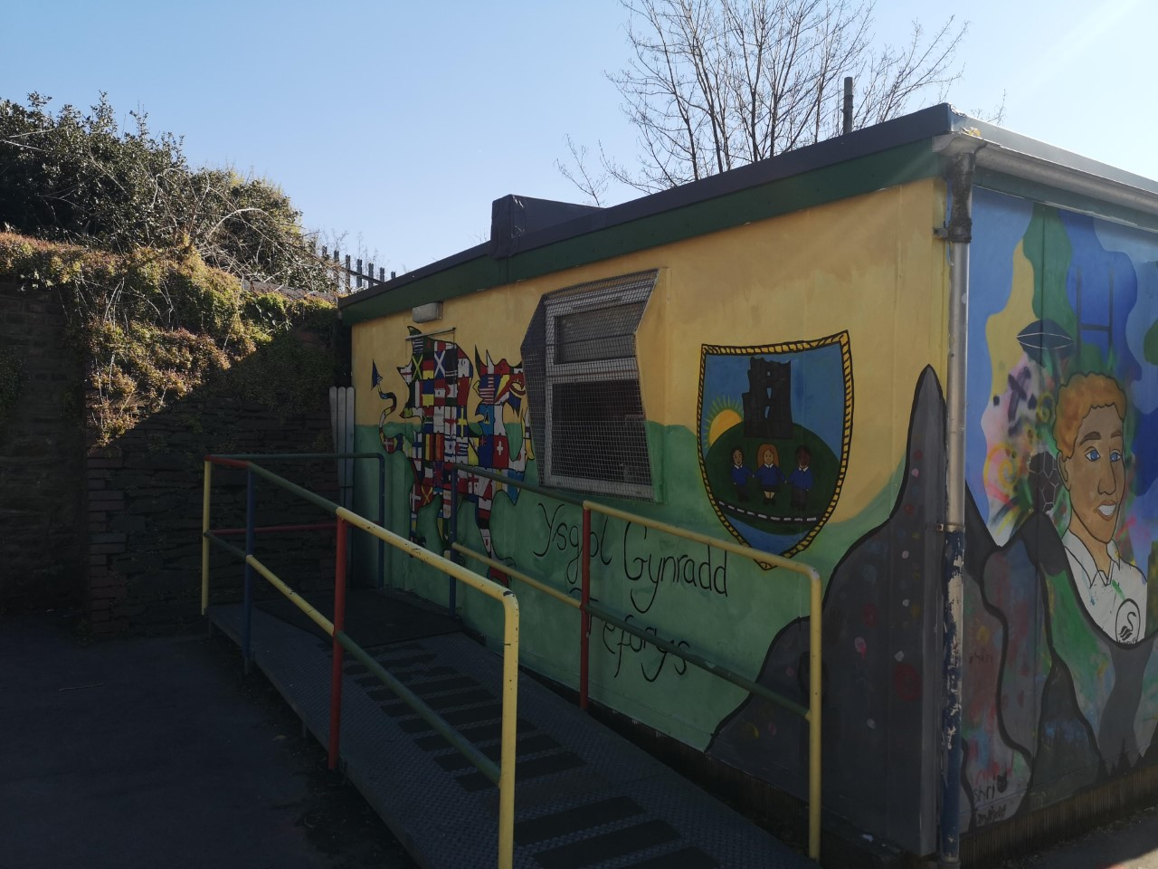
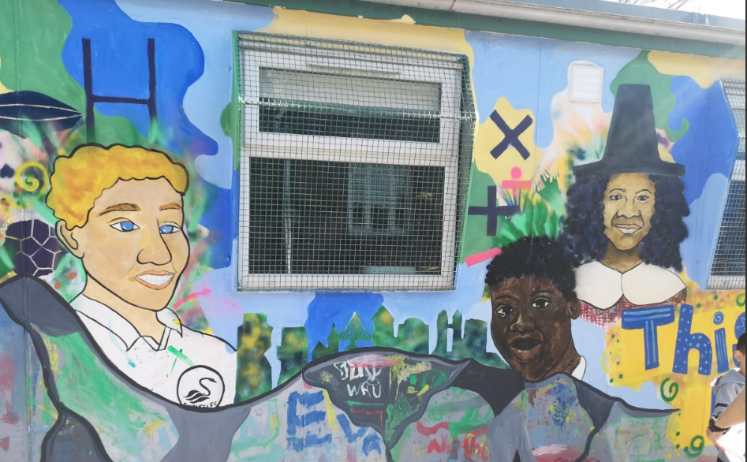
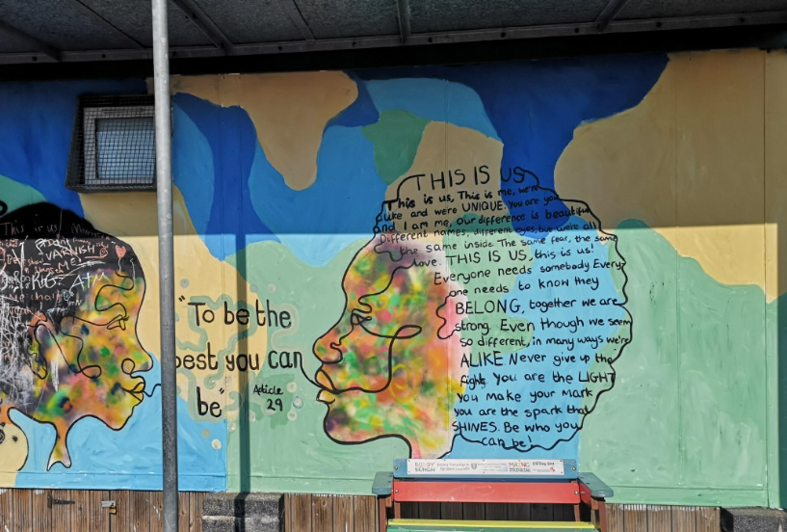
Creating the mural
Having created their own designs, relating to celebrating diversity, the pupils along with the artist Cara, helped to create the mural on our outdoor classroom. The pupils were extremely enthusiastic and enjoyed gaining ownership of the work. They also managed to include the words of the song they had written together.

Slide 7
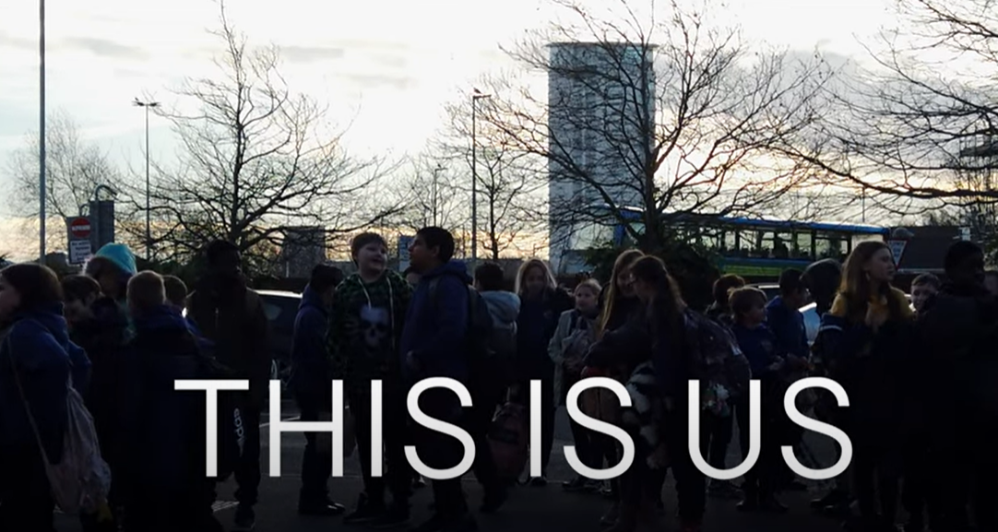
The Five Creative Habits of Mind
During the period of the project, the learners developed in the 5 Creative Habits of Mind, and this was seen when they became inquisitive and eager to find out about each other's names and origins. The learners had to persevere to work together to write verses for their song 'This is Us.' They had to draw on their imagination by creating their own images and designs for the outdoor classroom. They had to be disciplined in rehearsing their song and spoken word for the performance in the Swansea Grand Theatre. They had to work collaboratively to bring the whole performance together into a finished production, which was then filmed and shared with governors, parents, staff and stakeholders and was a huge success and well received. All pupils felt the project had had a positive impact on them and this was evident in their confident final performance.
Click the picture to view the performance .

Slide 8
Impact of the Project
The children have developed in the creative habits of mind and have generally grown in confidence and in their ability to express themselves creatively. All pupils felt the project had a positive impact on them and this was evident in their confident final performance of the song they had written and performed collectively. All staff involved were enthusiastic about the creative process and the progress made was well received by governors when pupils shared their learning with them in a governing body meeting. The class teachers also went on to support the pupils to translate the chorus of the song into Welsh and the pupils enjoyed performing their song in our school Eisteddfod on St. David’s Day. The pupils will again perform for parents and the wider community in the leaver’s assembly at the end of the summer term.
On an individual basis pupils that were somewhat shy or reluctant to perform, or some of the boys who perhaps were slightly embarrassed in front of their peer group, performed admirably both as a whole and/or as part of a duet for the ‘spoken word’ element of the song.
The lasting mural on our outside classroom, is now a symbol and celebration of our diversity and creativity. Our pupils have embraced the project in all its creative forms.
Here are quotes from the learners:
Creativity
“I think being creative (to me) is thinking of new ideas and really using your imagination for something you love.”
“It means to express yourself and stand up to what you believe in with music or art.”
“Being creative to me means expressing your inner self.”
“I feel like being creative is expressing your true self, I personally think that drama and art is important, but all types of expressive arts are important.”
Diversity
“I think diversity means the difference in all people. Gender, race, skin colour and celebrating and embracing that.”
“Diversity means coming together and working as one being careful with other people's feelings and being proud of each other in different ways. It does not matter what skin colour or hair colour we are; we are not all the same.”
Diversity means:
“Accepting people for who they are.”

