Slide 1
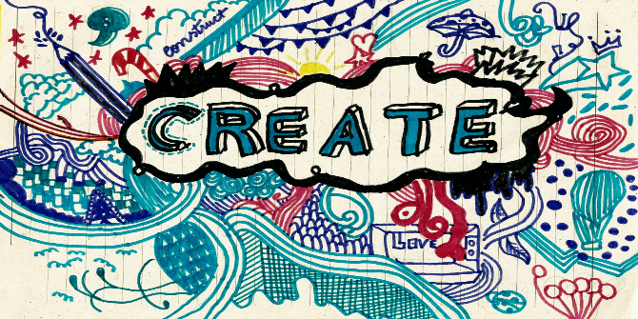
Our Lead Creative Schools Project
Year 1/2 Morriston Primary School
With
Michelle Mcternan
This Photo by Unknown Author is licensed under CC BY

Slide 2
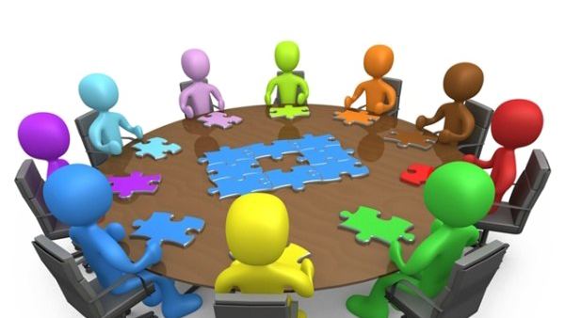
Meeting 1 – 26th February 2021
Today we met Michelle for the first time. The children introduced themselves and Michelle told us a little about who she is and what job she does.
We then split into groups and Michelle talked about the project and we began to share our ideas about what we would like our story to be about.

Slide 3

Our Ideas
Tree of life
Stalk of life
The land for little creatures
Sees a human house
Message of story to help creatures.
Night bug/Day bug.
Mini bug story.
Talking Bugs
Help bugs have a better life.
How could we help the bug population.
Baddies/Goodies
Family of bugs
Giant/Scared

Slide 4

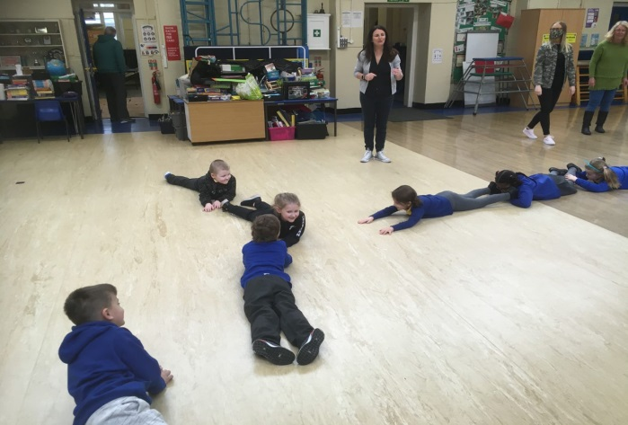
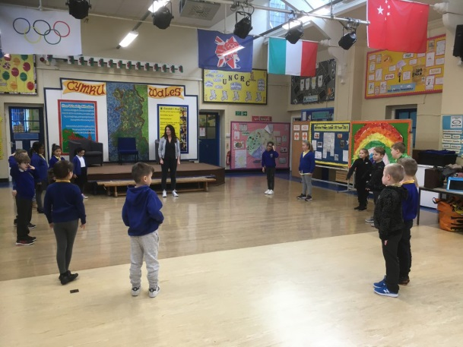
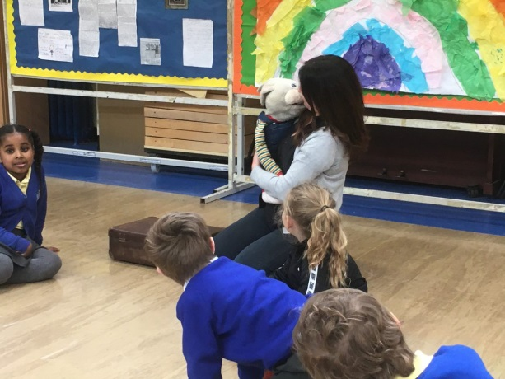
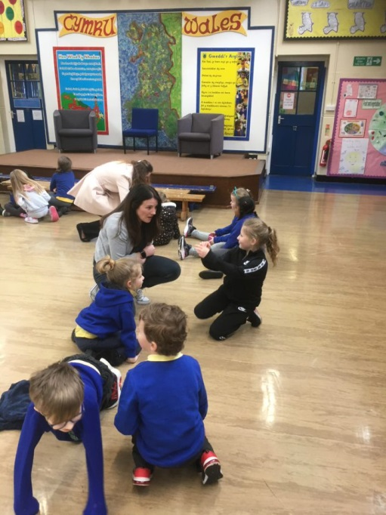
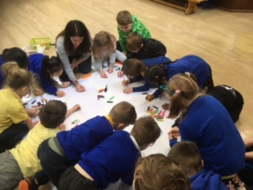
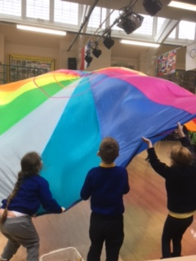
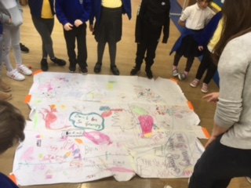
Meeting 2 – 12th March 2021
The letter game
Listening games.
Meeting Jamba
Team work
Discussion
We put all our ideas onto a
story mountain.
Our Story Mountain
Story Time
Sharing
Telling our friends
stories about ourselves.

Slide 5

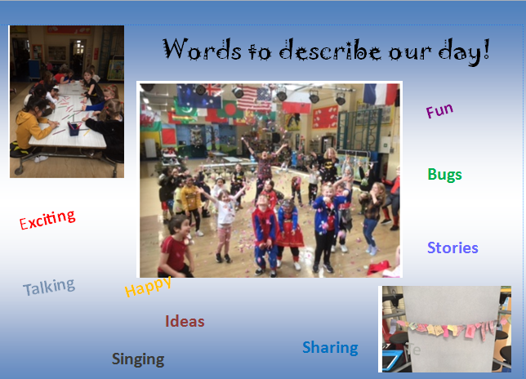
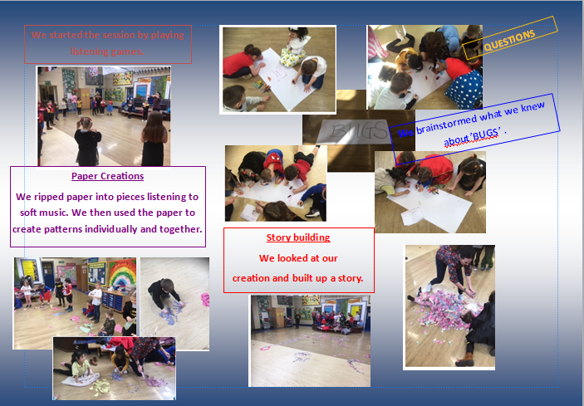

Meeting 3 – March 19th 2021

Slide 6
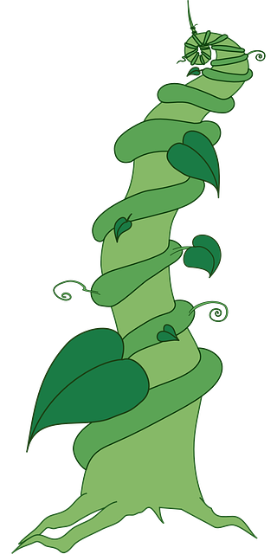
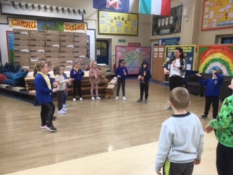
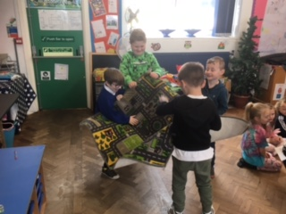
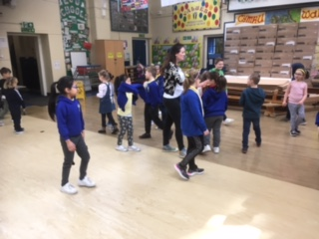
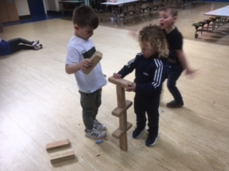
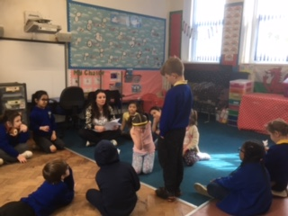
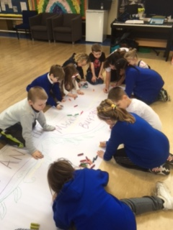
Meeting 4 – March 25th 2021
We started the day by playing listening games.
Listening
We made sounds during out soundscape session.
Oracy
Communication
We sang a song about the environment.
We animated our story
Word Building
Thinking
Fine/Gross Motor
We built structures using our word blocks. Look at our bug stalk.
Team Work
We listened to our story and acted out the parts.

