Slide 1


Food and fitness policy
By healthy schools club
2025
Article 13: you have the right to information.

Slide 2
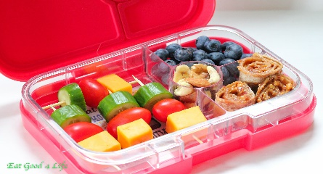
Article 6: the right to grow up and be healthy
Things to include in your lunchbox
Fresh vegetables such as carrots
Fresh fruit such as apples, strawberries and bananas
Healthy sandwich or wrap for example chicken, cucumber and lettuce
A small treat
A refillable drink bottle for water (or weak squash)

Slide 3
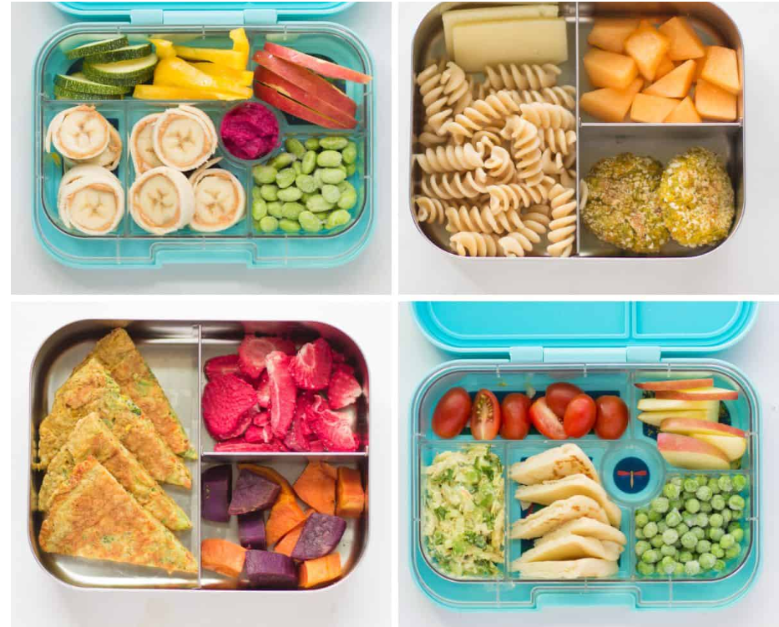


Slide 4
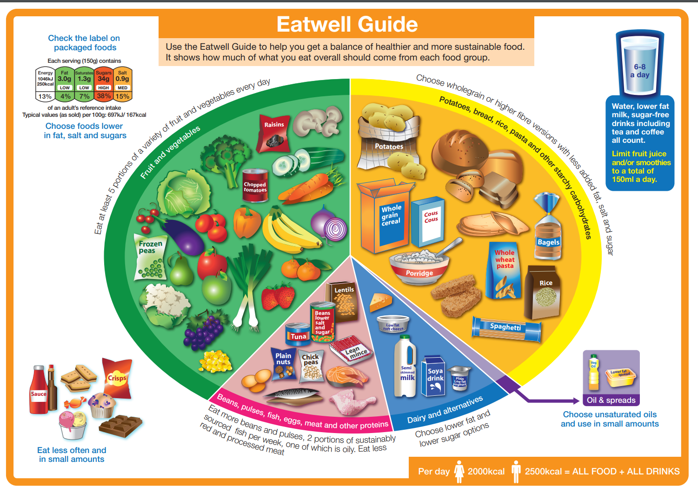
Article 24: the right to good food and water and see a doctor if you are ill
Balanced diet

Slide 5



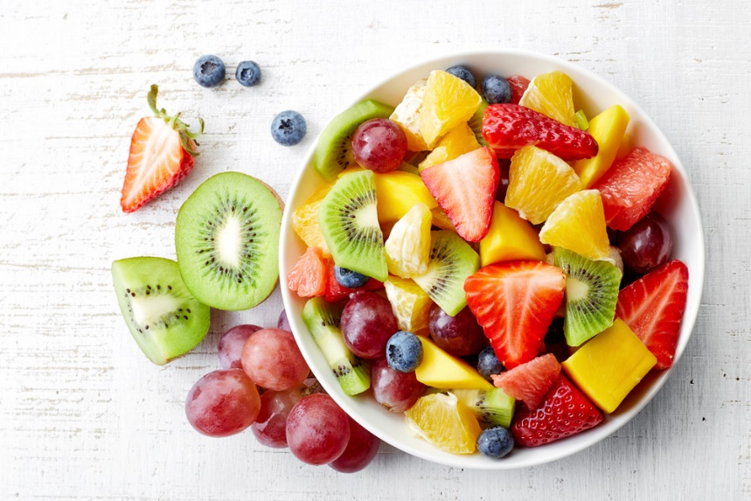

Healthy snacks for playtime
Fruit and vegetables are the only snacks allowed!

Slide 6




Health and Fitness clubs in school
Dance club
Netball club
Football club
Healthy schools club
Eco club
School council/Rogers Rights Respecting Owls

Slide 7


Mindfulness and brain breaks
Daily mindfulness breathing for example using Namaste school
https://www.youtube.com/@namasteinschools
Clap along songs for brain breaks
https://www.youtube.com/@GreenBeansMusic/videos

Slide 8

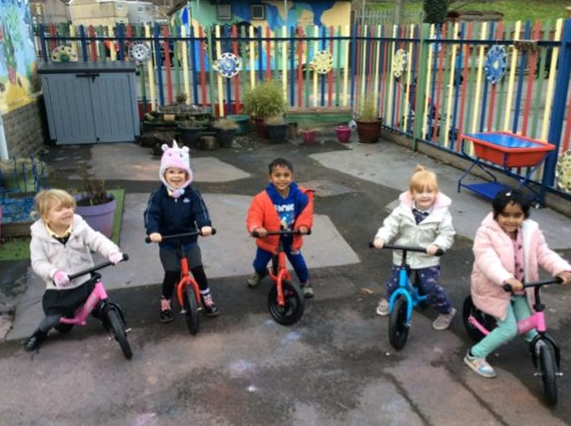
Playground games and activities
Playground games (in English and Welsh)
Playground equipment at playtimes to encourage positive behaviour and social skills
Fixed play equipment
Bikes and scooters

Slide 9


If its your birthday
You can wear non-school uniform
Receive a birthday badge sticker created by the Healthy School Club
X Please do not send in sweet treats or birthday cakes X

