Slide 1
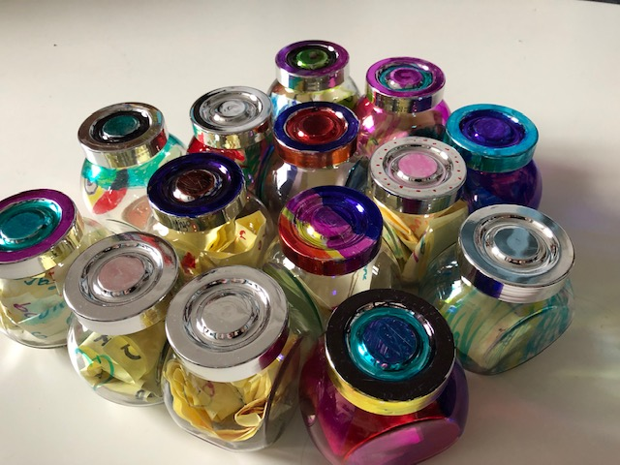
What is developmentally appropriate RSE?

Slide 2
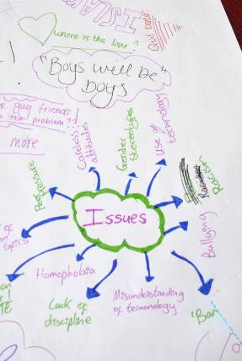
WHY DOES RSE MATTER?
  RSE starts before children come to school
  Shaping daily life and imagined futures
  Schools can listen, learn and respond
  Co-produce a responsive and responsible ‘living curriculum’
Notes:
OK – this may seem all too obvious a starting point, I wanted to begin a discussion of Dev app RSE by re-stating why RSE matters and how children learn about sexuality and relationships long before they start school.
As soon as they enter the social world they will be interacting with complex and often contradictory messages about gender, sexuality and relationships from, for example: advertising, books, music, social media and television and from family members, peers and communities. Even very young children will be negotiating a range of social and cultural norms on these issues that will shape their day to day lives and imagined futures. This knowledge, often termed as the ‘hidden curriculum’ can include misconceptions and misinformation. It can also challenge and exceed adult expectations of what children and young people are learning and experiencing.
RSE in school thus plays a vital role in working with children, young people, parents/carers and communities to create safe and non judgemental environments to explore the information and ethical values about sexualities and relationships that children are already exposed to and often struggling to navigate for themselves. And since COVID this informal learning has no doubt rapidly increased.
When we create safe non judgemental spaces, we give children the opportunity to ask questions and we are sometimes surprised about what they already know / the language that they use / the issues that they are aware of/the things they have seen. These questions are windows into their worlds. This learning – this experience - must always be our starting point – attuning to this informal learning is at the heart of a relevant and dev app curriculum.
By building upon children and young people’s own learning and experience, schools then can become key sites for learning from and responding to children and young people’s questions and needs (e.g. from sexism to sexual consent) and key sites for prevention, protection and change.
So what we are effectively working towards is what we call a ‘living curriculum’ – a living curriculum is a responsive and responsible curriculum – it is experience-near – which is why the working definition is:

Slide 3
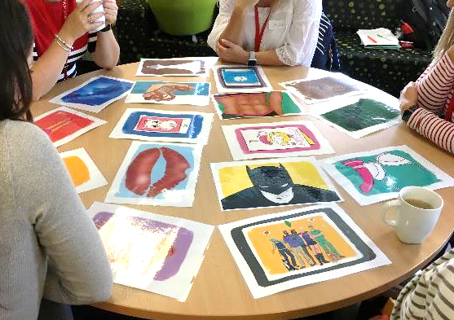
What is Developmentally Appropriate RSE?
“… to ensure that all RSE provision recognises and responds to learners’ own capacities and needs. It will not assume, but attune to and build upon learners’ evolving knowledge and experience”
(Welsh Government 2020, p.40)
Developmentally appropriate pedagogy is being responsive and flexible to the issues that may arise when curriculum content creates an interactive platform that welcomes children’s own curiosity and knowledge (Renold and McGeeney 2017, p.62)
Notes:
developmentally appropriate RSE is one that recognises and responds to learners’ own capacities and needs. It will not assume but attune to learners’ evolving knowledge and experience. And these capacities include social, physical, emotional and cognitive – all of which operate together – bodies-minds-world -
However, and if you have read appendix 1 (the summary of DAP from expert panel) – all too often – our curriculum is not experience-near, is not always needs-led –(some topics arrive too late for many people - and often not flexible enough for schools to make their own in ways that meet learners needs and experiences. Very simply – much RSE provision is out of touch with children’s lived realities and wider learning.
In fact, there is a large gap between children and young people’s lived experiences and the content of much RSE. Too often, notions of innocence and age appropriateness, that are often steeped in all kinds of assumptions around gender, race, social class, disability, sexuality, religion and so on inform how RSE is provided, or in many cases, avoided.
This not only makes for a very disempowering experience, but can also lead to mis- information.
Current SRE guidance for schools (Welsh Government 2010, para 2.18, p.10) states that “SRE programmes should be relevant to learners and sensitive to their needs”. However, the guidance also advises schools on the need to develop age-appropriate programmes and avoid answering questions in class that the teacher feels is ‘too old’ for a pupil or ‘inappropriate’ to share with the class.
However, without training, informed by up-to-date empirical research, how are educators expected to confidently differentiate between appropriate and inappropriate knowledge and behaviour (Ey, McInnes and Rigney 2017)?

Slide 4
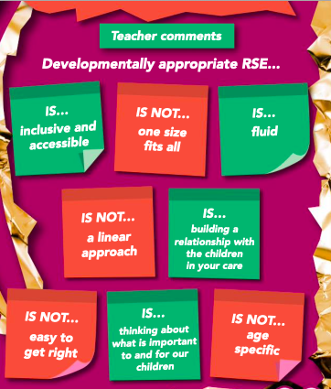
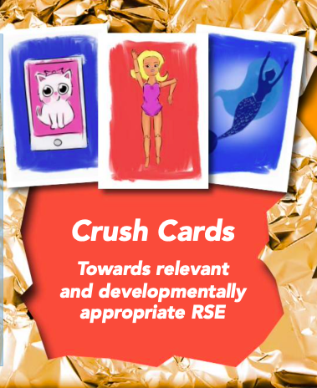
Notes:
The lived reality of children and young people’s own learning and experience on RSE issues often blurs and complicates many of the age and stage models in current SRE guidance around what children should or shouldn’t know, learn and experience (Epstein et al. 2012).
And one of the reasons why we include the research crush cards in your workshops, is not just to ensure that young people’s voices are in the room with us as we make decisions often on their behalf about what is included in the content of our new RSE curriculum. They are there because the learning and experience that children bring into school with them (and of course the learning and experience that goes on in school, because schools are social sites too) can sometimes crush and overturn our assumptions about what we think matters to children and young people.

Slide 5
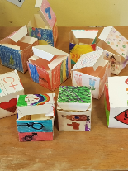
Guiding questions for discussion
What does ‘developmentally appropriate practice’ (DAP) mean to you?
How are you differentiating between ‘content’ (‘what’) and ‘pedagogy’ (‘how’)?
How do we ensure that the concept of ‘developmentally appropriate practice’ is not misused?

