Slide 1

Healthy Schools Committee
Through a pupil voice discussion we have come up with the following ideas for our next school disco.
The HSC would be more than happy to help with any preparations.

Slide 2
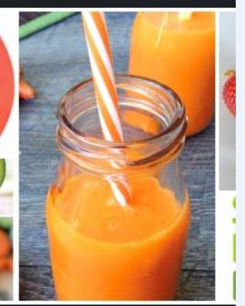

Slide 3
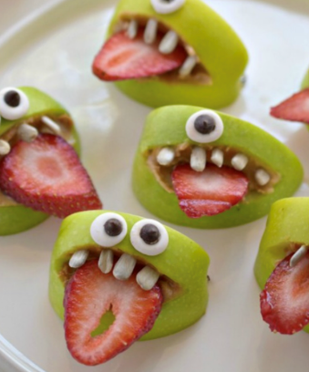

Slide 4
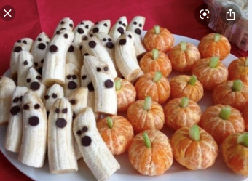

Slide 5
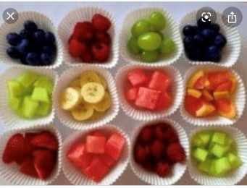

Slide 6
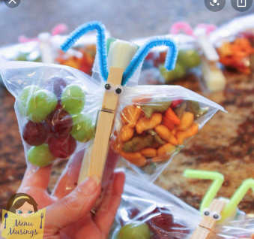

Slide 7
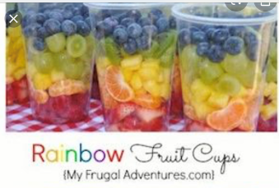

Slide 8
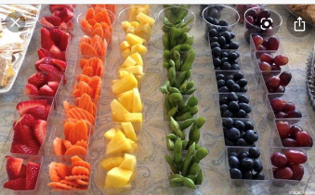

Slide 9


