Slide 1
Mathematics and Numeracy in Morriston Primary School

Slide 2




Overview
Other AoLEs
ERW
Scheme of Work
Skills across the curriculum
Planning
Guided Numeracy
Daily Mathematics lessons
Missions

Slide 3

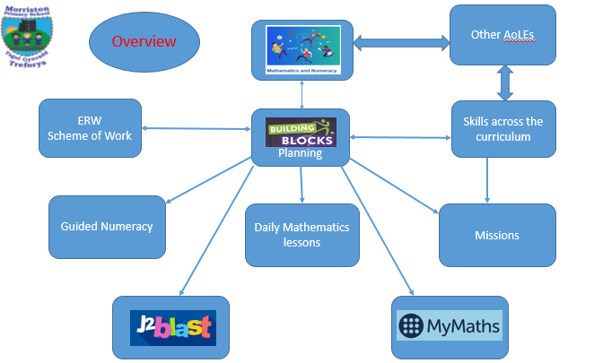

Slide 4
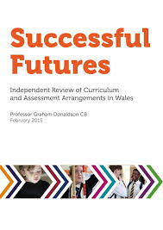

“The curriculum, then, has become overloaded, complicated and, in parts, outdated. Assessment arrangements are not making the contribution they should to improving learning. The ability of schools and teachers to respond to rapidly changing needs is constrained.”
Notes:
The case for change
The case for change rests partly on concerns about perceived shortcomings in the present curriculum and assessment arrangements.
Evidence from Programme for International Student Assessment (PISA) surveys,
the relative performance of children and young people in Wales in national qualifications, and evaluations in Estyn reports all demonstrate that levels of achievement are not as high as they could and should be.
An Organisation for Economic Cooperation and Development (OECD) report published in 2014 highlighted the continuing high proportion of young people in Welsh schools whose performance was low and concluded that current assessment and evaluation arrangements are unsatisfactory.
Concerns have been expressed about continuity in primary education and at points of transfer between stages. There is also a strong perception that personal, social and health education and the educational experience of young people at Key Stage 3 require radical improvement.
International surveys such as the OECD’s PISA highlight differences in performance between countries leading to worries in some countries about loss of global competitiveness if their education systems are seen to be weak. The disappointing performance of Wales in successive PISA surveys has been and remains a significant driver for change.
Prof Donaldson asked by WG to conduct a review in 2014. SF published in 2015.
68 recommendations.

Slide 5
Notes:
Education in Wales:
Our national mission, Action plan 2017–21 is our revised plan of action. We are more than half way through the national action plan.
Many of the key actions have been implemented.

Slide 6
Notes:
Reference to creation of a transformational curriculum.
Supported by 4 EOs.
The timeline is useful.
Reference throughout the CfW guidance to WBFGA.
This requires the Welsh Ministers and local authorities, among others, to set objectives designed to maximise their contribution to achieving each of the seven well-being goals and to take all reasonable steps in exercising its functions to meet those goals. One of the Welsh Ministers’ well-being objectives is: ‘supporting young people to make the most of their potential.’ Our approach to curriculum reform contributes to achieving that objective and, through that, maximising our contribution to the well-being goals

Slide 7

A vision for every school’s curriculum
Nothing is so essential as universal access to, and acquisition of, the experiences, knowledge and skills and that our young people need for employment, lifelong learning and active citizenship.
The four purposes are the shared vision and aspiration for every child and young person.
A school’s curriculum is everything a learner experiences in pursuit of the four purposes. It is not simply what we teach, but how we teach and crucially, why we teach it.
Notes:
Experiences = The combination of knowledge and skills in a learning environment to further progress learners towards the curriculum purposes.
Knowledge = Facts, information and skills acquired through experience or education; the theoretical or practical understanding of a discipline.
Skills = The ability to undertake activities that require application of knowledge, increasing in expertise and competence.
4Ps at the heart, driving everything.

Slide 8
Designing A SCHOOL curriculum
A defining feature of the Framework is that it requires schools to design their own curriculum and assessment arrangements
Within the national framework, schools and practitioners are best placed to make decisions about the needs of their specific learners, including choosing topics and activities which will best support their learning
A content-focused curriculum does not guarantee meaningful learning, only that certain topics are covered to varying extents; instead, the Curriculum for Wales guidance articulates what concepts and essence of learning should underpin a range of different topics, learning activities and acquisition of knowledge
Notes:
the need for innovation and creativity: Practitioners select content, enabling them to use their professional skills to drive improved learning and outcomes for their learners
the scope for practitioners to make greater links between Areas and disciplines: Practitioners will have the licence to use topics and activities to combine meaningful learning from different Areas, disciplines and concepts.

Slide 9
Progression and assessment at the heart of curriculum design
Another defining characteristic of the framework is the emphasis placed on learners’ progression
The statements of what matters are the basis of learners’ progression
CfW describes principles of progression for curriculum as a whole and each Area
Notes:
The Curriculum for Wales guidance has been informed by international evidence of what it means to make progress in learning
It is through exploration of the key ideas and principles contained in these statements that they will develop their learning. Practitioners will need to design learning which supports an increasingly sophisticated understanding and application of the statements of what matters. Taken together, the statements of what matters provide breadth and depth in the curriculum, and a level of consistency in curriculum design across settings and schools. That is why they will be drawn together in a mandatory statement of what matters once the Curriculum and Assessment Bill becomes law
the principles of progression articulate the broader principles of what progression means in the Area as a whole
As such, schools and practitioners must use these principles to inform all learning in supporting progression. When considering descriptions of learning or a specific context, topic or experience, the principles of progression help practitioners to understand how learners should progress with greater sophistication or depth

Slide 10
Progression is further supported by descriptions of learning
Arranged in five progression steps
Together, the principles of progression and the descriptions of learning are intended to guide the development of a curriculum which reflects appropriate progression
Progression should be supported through ‘deep’ learning
Assessment is key to supporting ‘deep’ learning and should be used to identify whether learners need to consolidate their learning, whether further support is needed and the next steps for learners’ progress.
Notes:
Progression is further supported by descriptions of learning which provide guidance on how learners should progress within each statement of what matters as they journey through the continuum of learning.
five progression steps which provide reference points for the pace of that progression. These expectations are expressed from the learner’s perspective and are framed broadly so that they can sustain learning over a series of years. They are not designed as stand-alone tasks, activities or assessment criteria. While the learning continuum is the same for each learner, the pace of progress through it may differ. As a result, the progression steps only broadly relate to age. They broadly correspond to expectations at ages 5, 8, 11, 14 and 16.
Progression should be supported through ‘deep’ learning. Each description of learning is designed to support increasing depth and sophistication of learning over time. This allows: space for a variety of diversion, repetition and reflection as learners’ thinking develops over time to new levels of sophistication. They are also designed to be considered through a range of contexts.
Assessment is intrinsic to curriculum design. Its overarching purpose is to support every learner to make progress. Assessment should always focus on moving learning forward by understanding the learning which has already taken place and using this to ensure that each learner is challenged and supported appropriately, according to their individual learning needs. It requires partnerships among all those involved, including the learner. It should recognise the individual learning needs and backgrounds of each learner and encourage a holistic view of each learner’s development. Accordingly, both practitioner and learner should develop an understanding of how the learner learns and their attitude and approach to learning, in order to support them to continue to progress and to foster commitment to their learning.

Slide 11
The curriculum requirements
The four purposes & general requirements
All schools must adopt a curriculum that:
  Enables learners to make progress towards the four purposes.
  Is broad and balanced.
  Is suitable for learners of differing ages, abilities and aptitudes.
  Provides for appropriate progression for learners and includes a range of provision to ensure this (linked to ages, abilities and aptitudes).
Notes:
The purpose of a curriculum is to enable learners to develop as:
• ambitious, capable learners, ready to learn throughout their lives
• enterprising, creative contributors, ready to play a full part in life and work
• ethical, informed citizens of Wales and the world
• healthy, confident individuals, ready to lead fulfilling lives as valued members of society.
Enabling learners to progress in relation to these purposes is intended to inform all decisions in relation to school’s curriculum and assessment arrangements

Slide 12
Curriculum requirements…
The areas of learning and experience
The following six areas of learning and experience (Area/Areas) must be reflected in the adopted curriculum.
  Expressive Arts.
  Health and Well-being.
  Humanities.
  Languages, Literacy and Communication.
  Mathematics and Numeracy.
  Science and Technology.

Slide 13
Curriculum requirements…
Mandatory cross-curricular skills
Literacy, numeracy and digital competence will be mandatory cross-curricular skills and must be embedded in any adopted curriculum.
Progression code
The Welsh Ministers will be required to issue a progression code setting out the way in which progression must be reflected in an adopted curriculum
Notes:
A school’s curriculum will need to reflect the principles of progression set out in the code. The code will be made up of the principles of progression which have been developed by the CAMAU project through engagement with practitioners and, for now, can be found within the area of learning and experience and ‘Designing your curriculum’ sections
Issuing a progression code with mandatory elements will ensure there is consistency in the approach to progression in school curricula.

Slide 14
Common to each AoLE’s guidance though specific to the Area
Introduction
Statements of what matters
Principles of Progression
Descriptions of learning
Designing your curriculum
  Skills
  Specific consideration
  Illustrating breadth
Key links with other areas
Cross-cutting themes (including)
  Local, national and international contexts
  Careers and work-related experiences
  Human rights and diversity
Notes:
Introduction
The disciplines spanned by the AoLE
How many what matters statements
How the area will develop pupils in relation to progress towards the 4Ps
Statements of WMs
Gives each SWM and then elaborates on skills
PoP
How the 5 PoPs are specifically developed through the AoLE

Slide 15

Mathematics and Numeracy Area of Learning and Experience
The development of mathematics has always gone hand in hand with the development of civilisation itself.
What is more, numeracy – the application of mathematics to solve problems in real-world contexts – plays a critical part in our everyday lives, and in the economic health of the nation. It is imperative, therefore, that mathematics and numeracy experiences are as engaging, exciting and accessible as possible for learners, and that these experiences are geared towards ensuring that learners develop mathematical resilience.

Slide 16
Progression in the Mathematics and Numeracy Area of Learning and Experience (Area) involves the development of five connected and interdependent proficiencies which have no hierarchy. These are crucial considerations for schools when designing their curriculum to ensure the progression of learners.
Conceptual understanding
Communication using symbols
Fluency
Logical reasoning
Strategic competence
What matters in this Area has been expressed in four statements which support and complement one another and should not be viewed in isolation.

Slide 17
Statements of what matters
The number system is used to represent and compare relationships between numbers and quantities.
Algebra uses symbol systems to express the structure of mathematical relationships.
Geometry focuses on relationships involving shape, space and position, and measurement focuses on quantifying phenomena in the physical world.
Statistics represent data, probability models chance, and both support informed inferences and decisions.

Slide 18
Principles of progression
In the Mathematics and Numeracy Area of Learning and Experience (Area), the model of progression is based on the development of five interdependent proficiencies
To ensure progress in any mathematics learning, proficiencies should be developed and connected in time and should also develop over time.
Each proficiency may relate to multiple principles

Slide 19
Proficiencies
Conceptual understanding
Communication using symbols
Fluency
Logical reasoning
Strategic competence
Notes:
Guidance elaborates on each proficiency. E.g.
Mathematical concepts and ideas should be built on, deepened and connected as learners experience increasingly complex mathematical ideas. Learners demonstrate conceptual understanding through being able to explain and express concepts, find examples (or non-examples) and by being able to represent a concept in different ways, flowing between different representations including verbal, concrete, visual, digital and abstract.

Slide 20
Descriptions of learning

Slide 24
Specific considerations for this Area
The different areas of mathematics are highly interconnected and dependent on one another and concepts are built up over time, drawing on prior knowledge and learning, often from more than one area of mathematics. What is important when planning to teach any specific topic is to be aware of the prior knowledge the learners need in order to access and understand the new topic.
The aspiration is to deliver this Area so that there is a shift in culture towards learners fostering a positive and resilient attitude towards it.
Notes:
Algebra, geometry and statistics cannot be understood without a prior understanding of number and consistent reference to numbers, calculations and the number system. As learners progress, they learn to see numerical expressions as relational rather than computational, e.g. a computation such as 2 + 8 = 10, and that this is the basis for deriving other facts, e.g. 8 + 2 = 10, 8 = 10 – 2, and so on. This lays the foundations for using algebraic symbolisation successfully.

Slide 25
Considerations for curriculum development
Learners should be given opportunities to explore mathematically rich environments both indoors and outdoors. The environment will be developmentally appropriate and facilitate first-hand experiences with mathematical concepts and a range of resources.
The structure and sequence of mathematics and numeracy topics should be informed by the hierarchical and connected nature of mathematical concepts, in order to ensure foundations are built upon and experiences are connected.
Learners need to become increasingly fluent in their use of number, through a broad range of experiences, in order to describe, interpret and communicate size, scale and comparisons, both within and beyond mathematics. They should also become increasingly fluent in their calculations, both with and without the use of calculators.

Slide 26
By introducing a reasoning and problem-solving approach to all mathematics and numeracy experiences, the development of the four purposes and positive dispositions will be supported.
By using real-life examples to introduce, explore and consolidate mathematical concepts, learners of all ages make connections between the concrete, the pictorial and the abstract. Through a broad range of experiences, learners appreciate the power of mathematics to express relationships concisely, in forms that are universally understood.
Learners should engage in meaningful and substantial tasks such as: modelling real-life numerical problems, financial calculations such as creating and evaluating budgets for events and analysing risks, developing mathematical sequences through patterns in nature and using the sequential data-handling cycle to pose and investigate their own research questions.

Slide 27
Practitioners should consider the appropriate use of a range of digital technologies, manipulatives, everyday objects, and concrete and abstract representations of mathematical objects to help learners to engage with mathematical concepts from more than one perspective.
It is important that learners are able to interpret answers and check that they make sense in context, including by estimation, and are able to use appropriate methods to answer questions by collecting, analysing and summarising data and interpreting results. They are able to evaluate their methods and suggest different or better ways to approach investigations in the future.
Deep understanding in mathematics and numeracy should develop through planning for all five of the mathematical proficiencies, and the connection and application of these in a range of contexts.
Notes:
And there are still more in CfW.

Slide 28
Considerations for pedagogy
There is no research that says one way of teaching mathematics is better than any other. Nevertheless pedagogy should ensure the overall development of these proficiencies and also be relevant for the mathematics being taught.
Mathematics teaching needs to be conceptually connected and coherent. This requires mastery and memory of earlier concepts; comprehensible starting points; consistent use of language, symbols, images and other representations; illuminating choice of examples; relevant use of digital tools. These should be combined into lesson sequences which might include problem-solving, exploration, direct instruction, application, exercises and extended tasks as appropriate for the specific mathematics being taught and the overall development of the five proficiencies. At any point in a sequence the mathematical focus might be a new concept, an extension of an earlier concept, a relationship, a technique, a fact, a theorem, a mathematical strategy or a way of thinking.
Notes:
Guiding questions and information about choice and sequencing of pedagogical approaches to manage this diversity will be included in the resource on pedagogy.

Slide 29
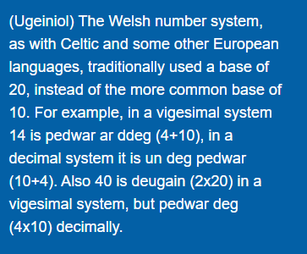
Local, national and international contexts in this Area example…
Welsh language: consider teaching learners the traditional, vigesimal, way of counting in Welsh, as well as the modern decimal way, to highlight the distinctive nature of mathematics in a Welsh language context.

Slide 30
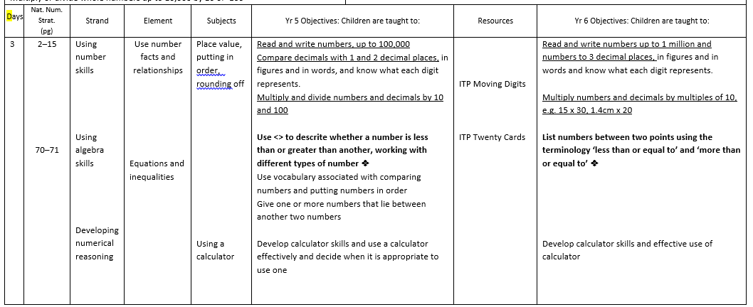
ERW – Scheme of Work

Slide 31
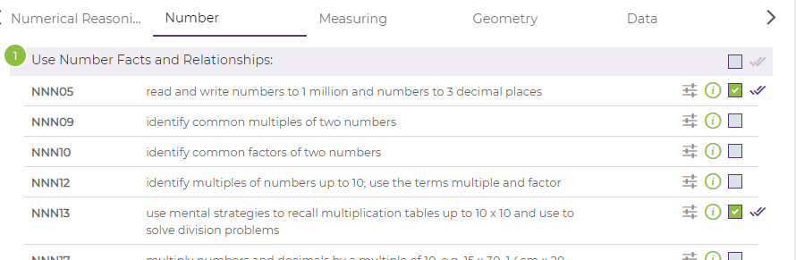
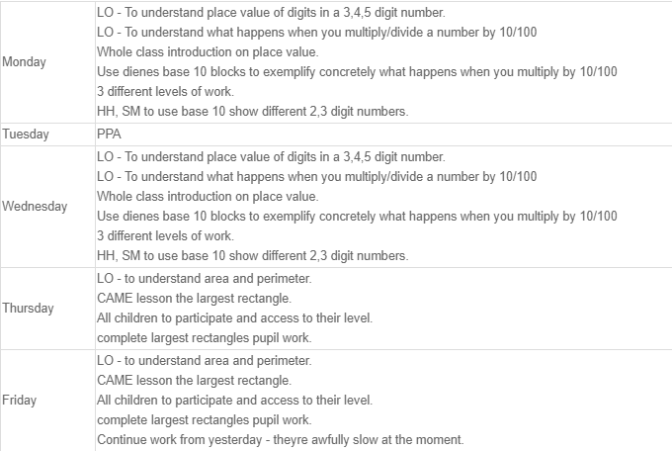
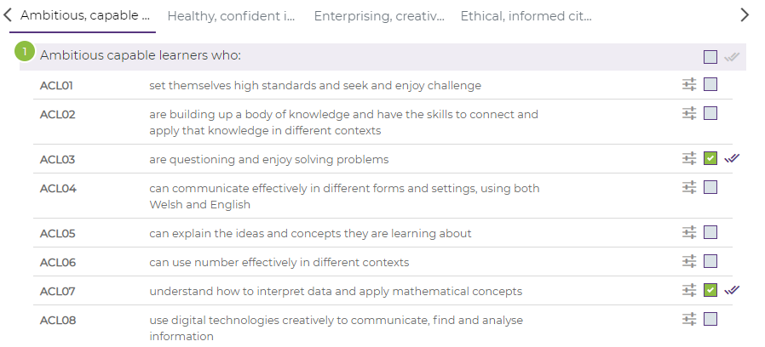
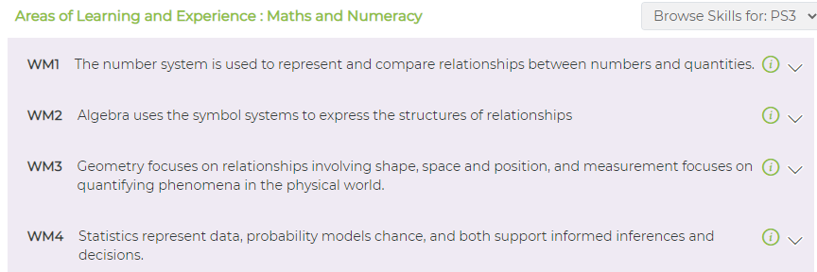

Slide 32
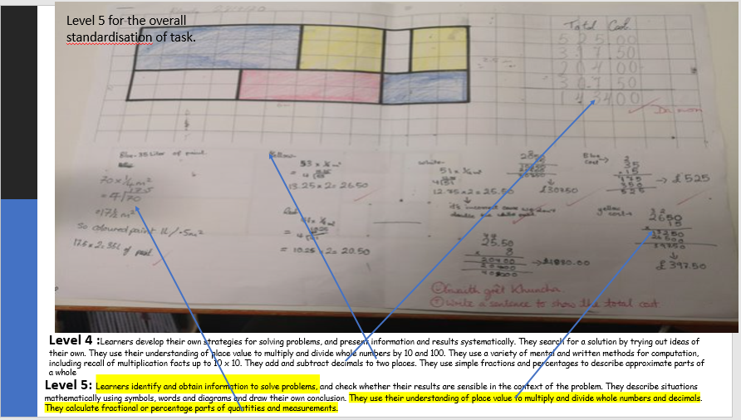
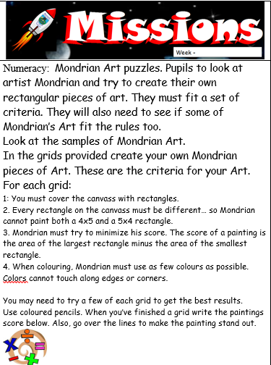
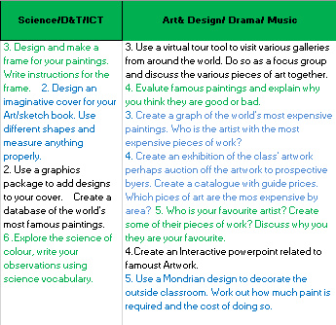
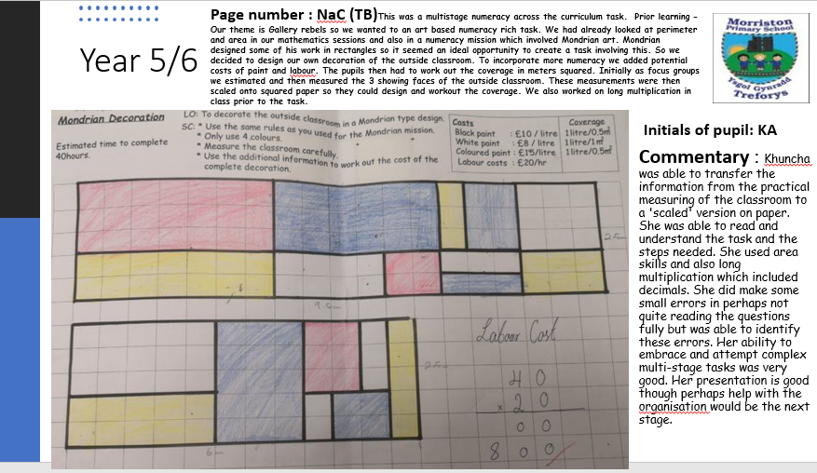
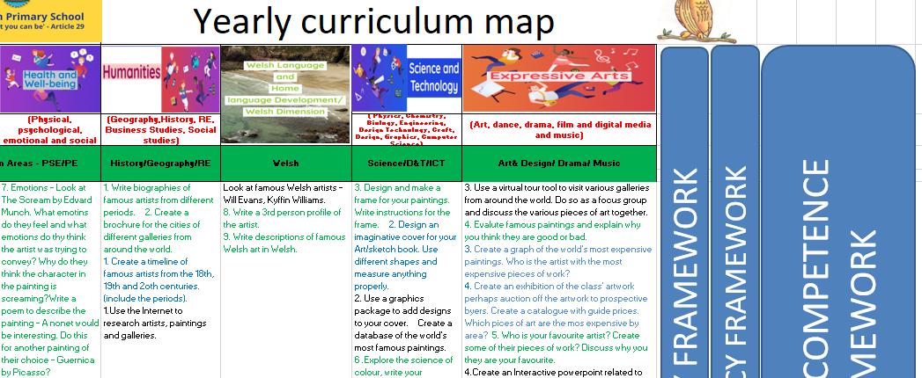
Skills across the curriculum

Slide 33
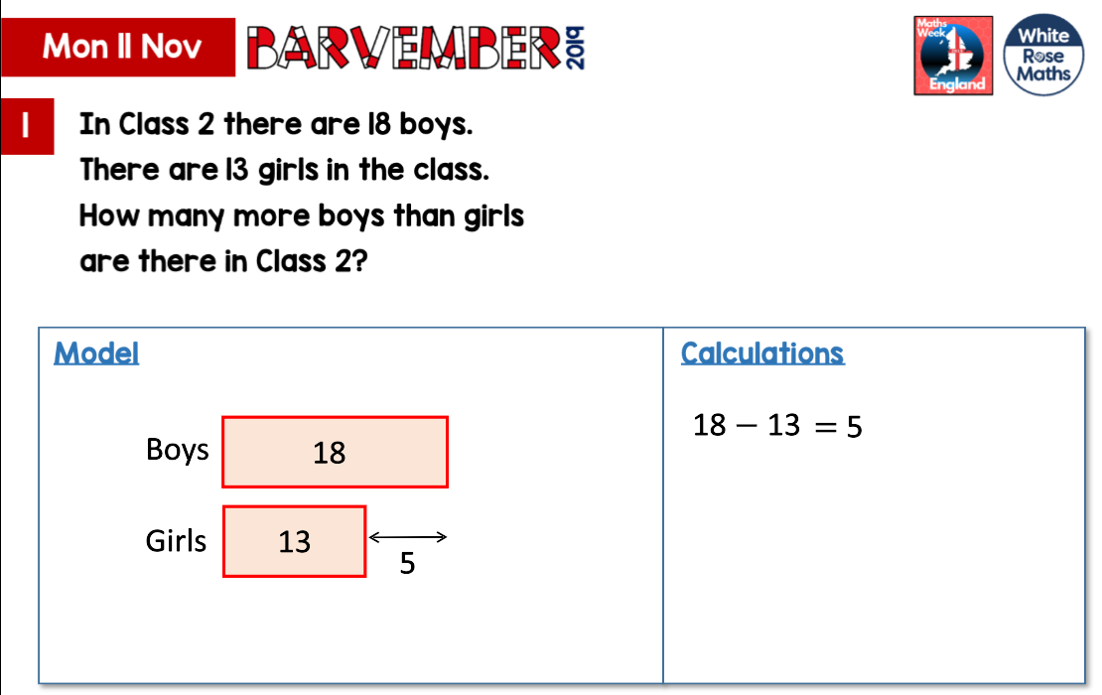
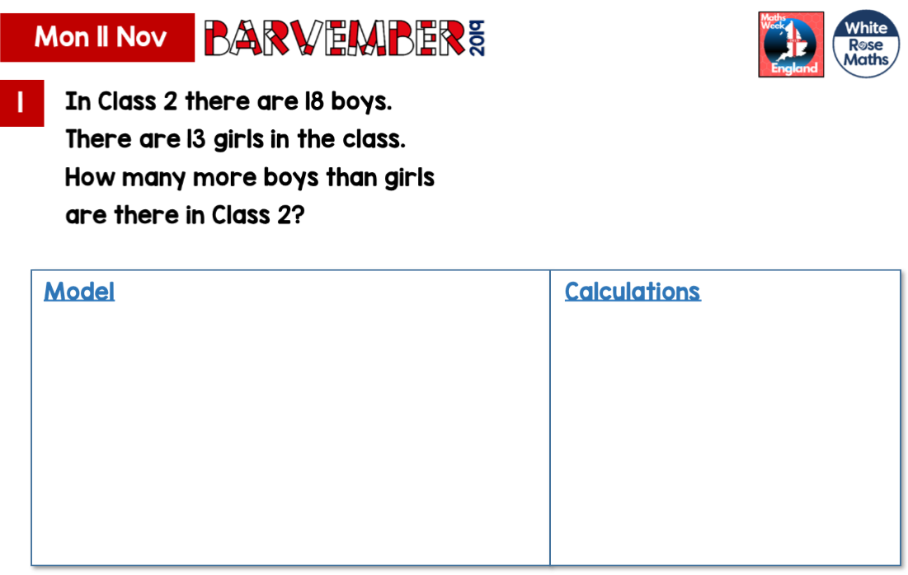
Guided Numeracy Sessions

Slide 34


Creating independence and application of skills.

