Slide 1


Erasmus+ Outdoor Education and Teaching Methodology
Livadia, Greece
Monday 22nd November – Friday 26th November

Slide 2



Outdoor Education & Teaching Methodology

Slide 3
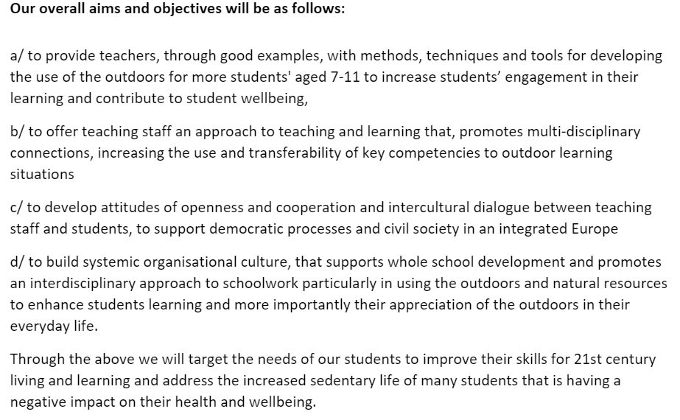
Aims of the project

Slide 4
About the project
The trip was planned around visiting the local schools in Livadia and Viotia, however, shortly before we were due to leave the itinerary had to change due to increased rates of Coronavirus in the area.
As a result, the itinerary was then focussed around networking with other schools, sharing good practice, learning about school life/curriculum in each country, future plans for the project and tours of the local points of interest.
Schools from Wales, Spain, Romania and Greece took part. Some have previously worked on projects together and others were new to the project.

Slide 5
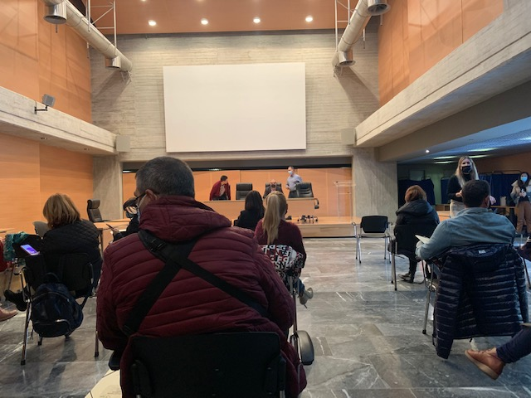
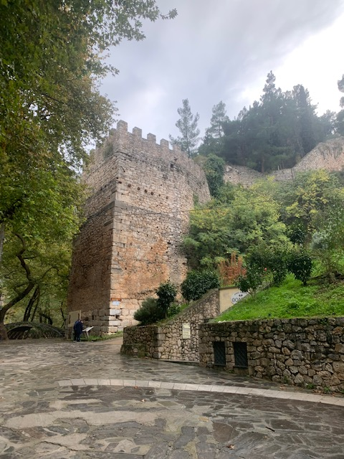
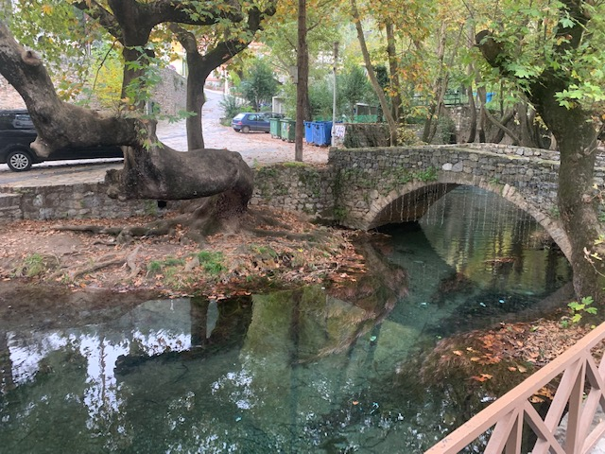
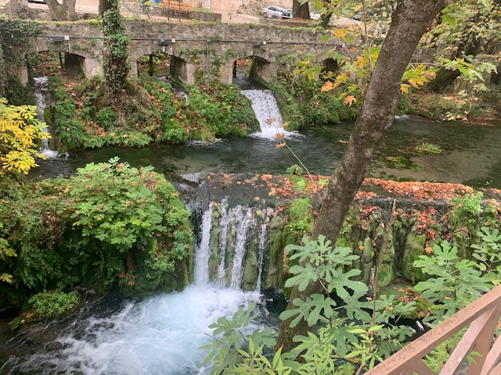

Day 1 – Official meeting, LTT & TPM meetings then exploring the area
All delegates met for an official meeting and introductions. Directors of Secondary, Primary, Special education of Viotia and course instructors welcomed delegates and provided information for the week.
Delegates were then taken to Thebes to work in their group eg LTT, TPM, Active Schools and Outdoor learning.
During these meetings delegates from each school shared what their schools have done for the project to date, what worked well, any resources/games/apps/sessions they could recommend and future plans.
Late afternoon – time to explore the area and network with Team Wales.

Slide 6
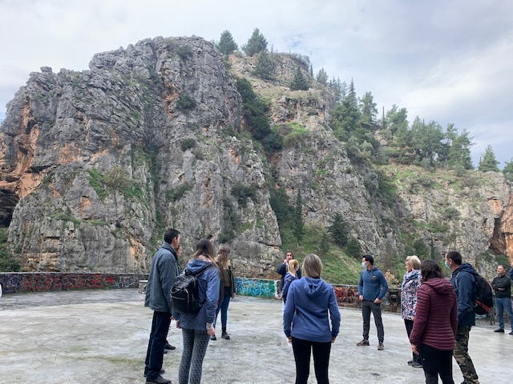
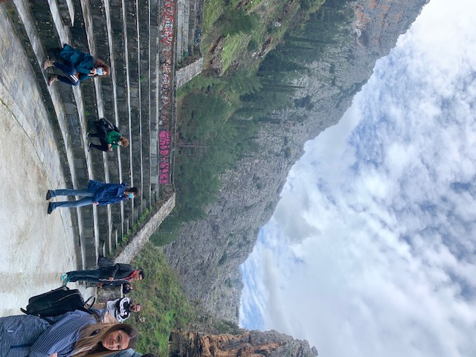
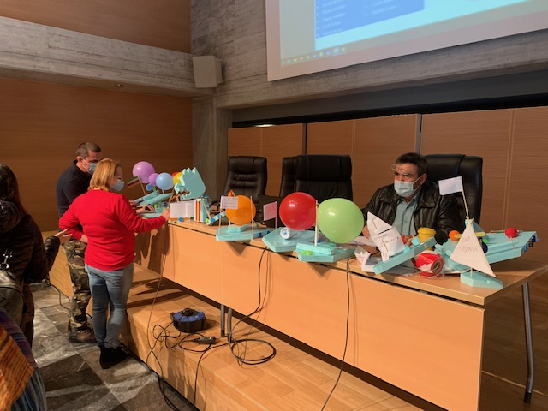
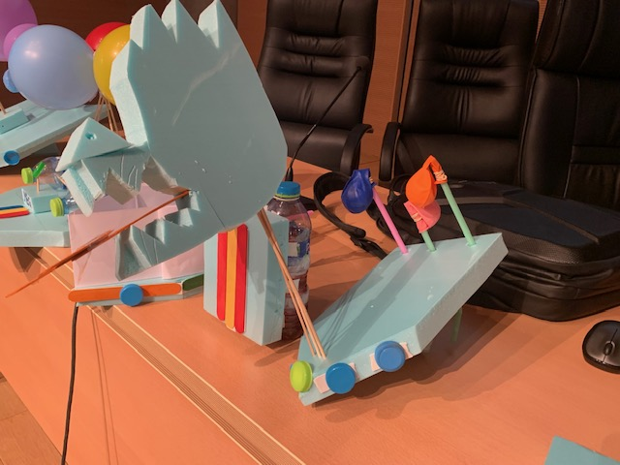
Day 2 – Getting to know Levadia, Science & Technology – Newton's Law and boat building
Delegates were taken on a guided tour around Levadia so that they could learn the history of the area.
Delegates engaged in ice breaker games and outdoor activities with the tour guide.
At the Amphitheatre we took part in some mindfulness Tai-chi with the host of the programme and spoke about the importance of lowering stress levels and mindfulness.
Delegates then took part in a Science & Technology session in which we spoke about Newton's Law and shared examples of each part. We then had to put it into practice by designing and making a boat which worked on Newton's third law – action/reaction.

Slide 7
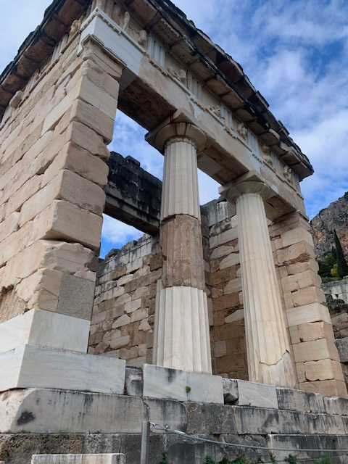
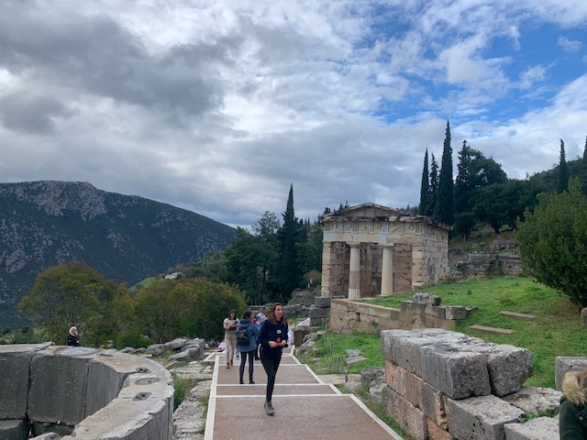
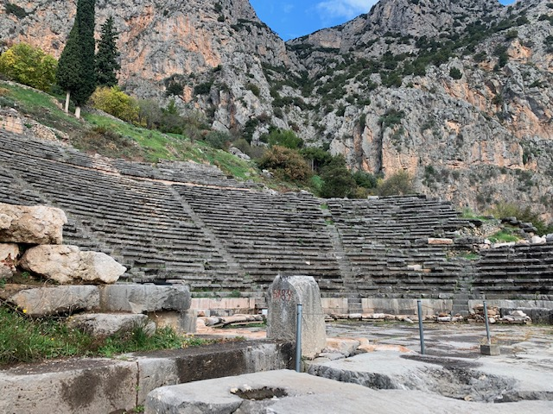
Day 3 – Cultural Visit to Delphi. Lunch Hosted by the Direction.
Delegates were taken to Delphi to learn about Greek mythological history and to explore the site and museum.
We were then taken to Zemenos for a lunch hosted by the Direction to sample traditional Greek food.

Slide 8
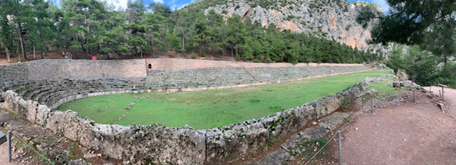
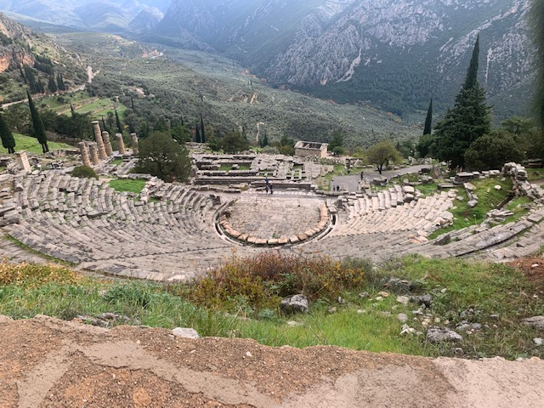
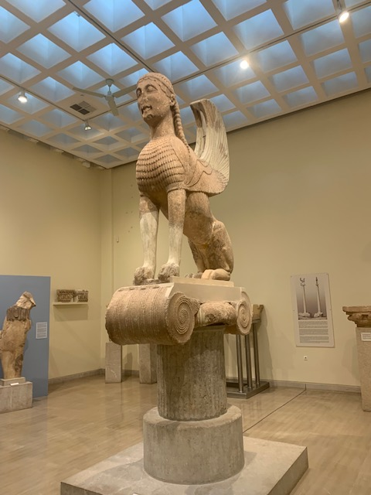
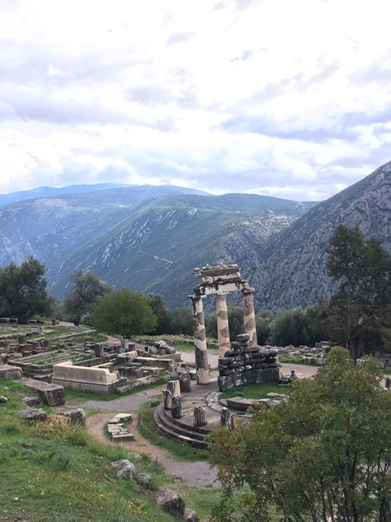
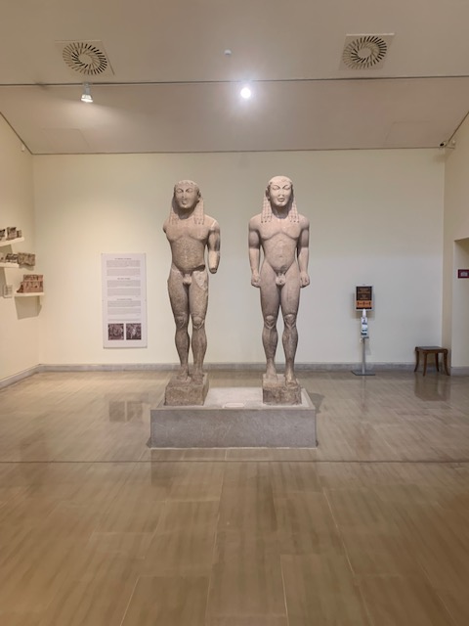
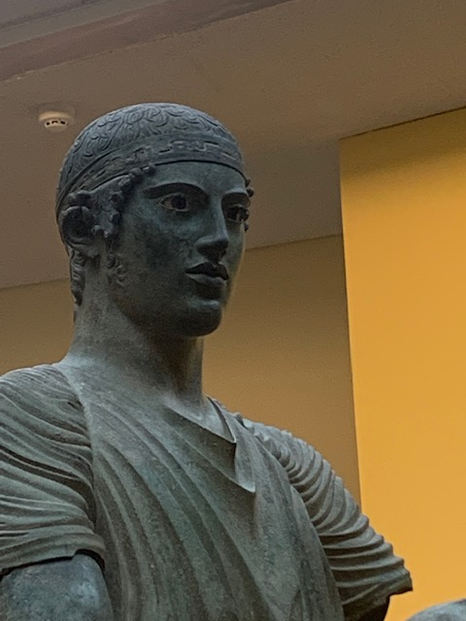
Delphi continued

Slide 9
Day 4 – Environmental Education Centre, Stilida forest and monastery
Delegates were taken to Stilida to visit an environmental education centre that focusses on outdoor learning activities. Delegates were told about the flora and fauna of the area.
Delegates were then taken up the mountain to a forest where they had a guided tour, learnt about the trees, flowers, wildlife and took part in outdoor learning activities.
Activities were based on experiential learning and to provide ideas/good practice to facilitators that will use them in their creative learning process.
Visit to Stilida Monastery.

Slide 10
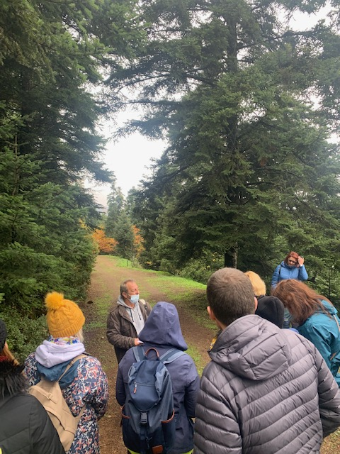
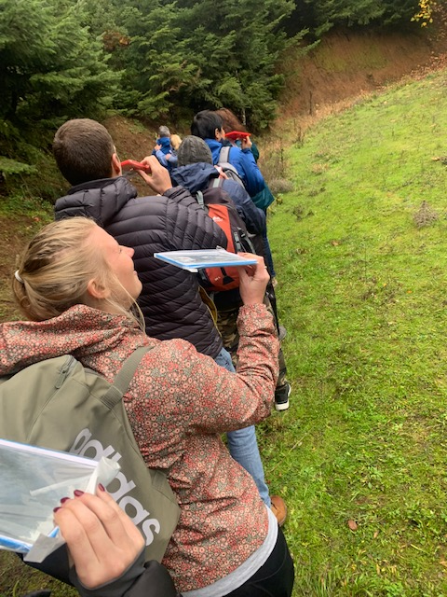
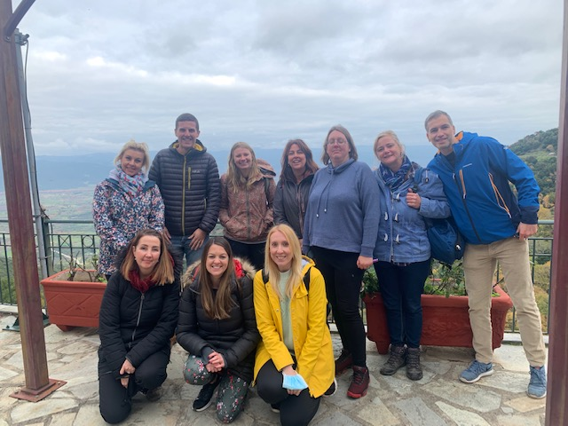
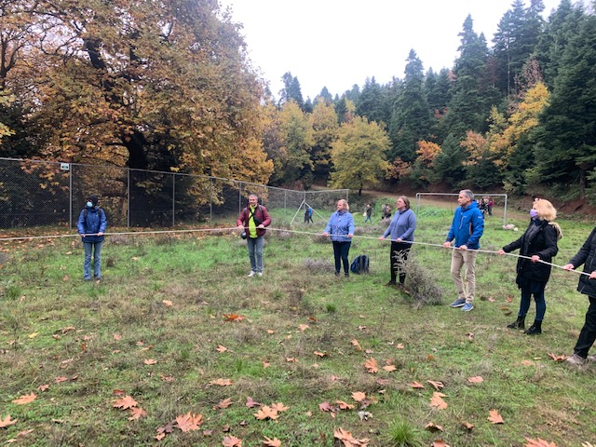
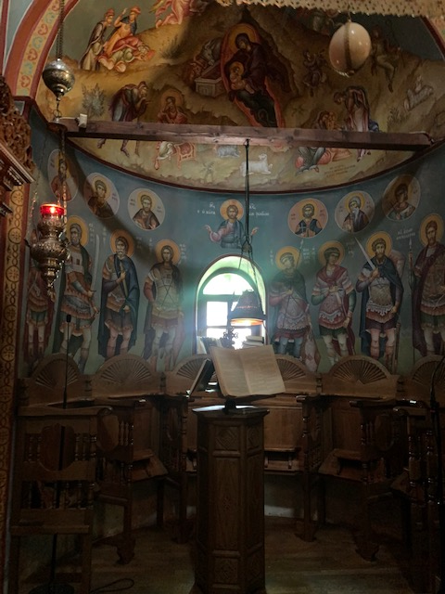
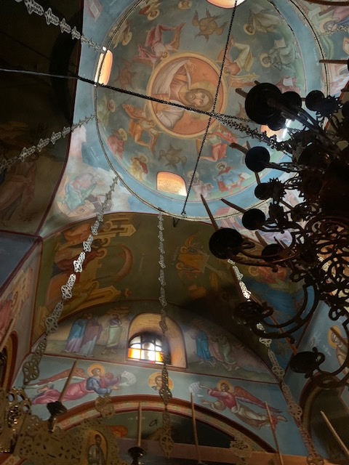
Day 4 pictures

Slide 11
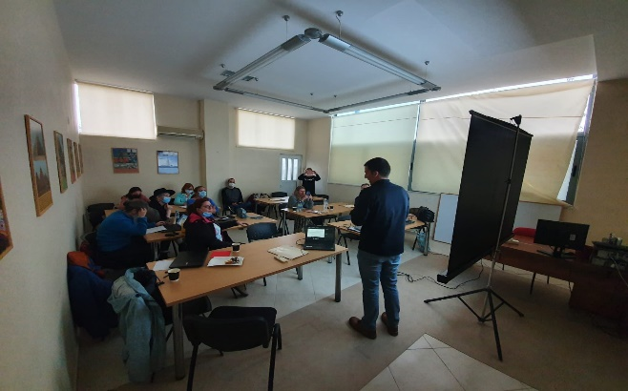
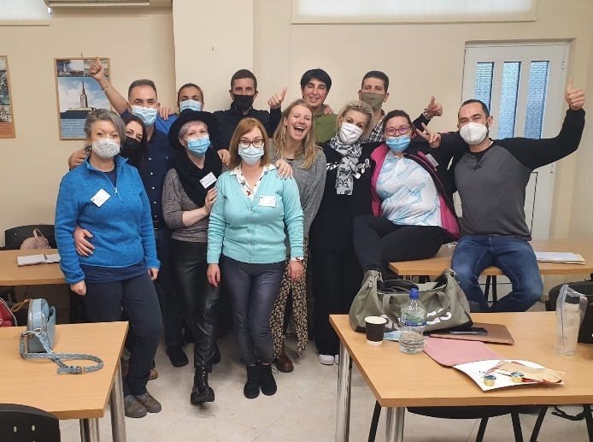
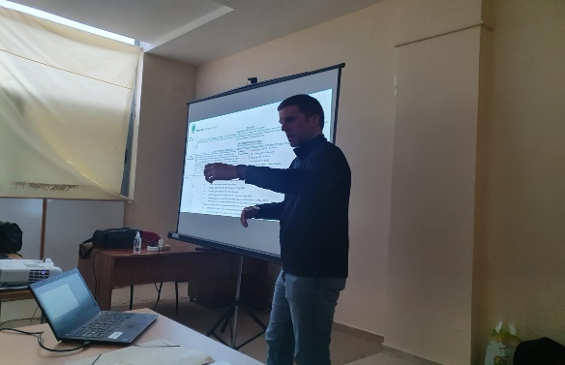

Day 5 – LTT and TPM meetings. Thebes museum
On the final day delegates met with their groups to present information about their schools, their experience with outdoor learning, share good practice and plans for future projects.
RJ shared the school's Twitter feed to show examples of outdoor learning across all year groups and our outside areas.
MB shared his presentation to show what each class did for outdoor learning week.
Delegates were then taken to Thebes museum before heading to the airport.

Slide 12
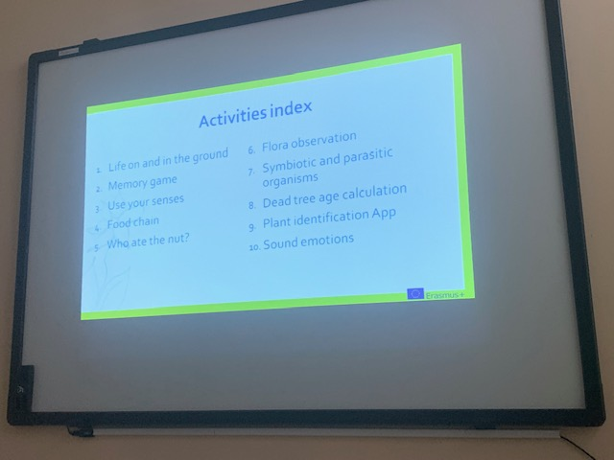
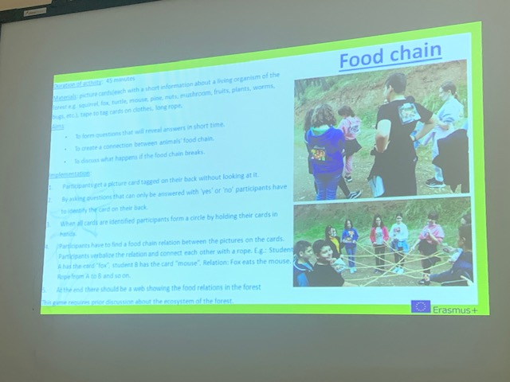
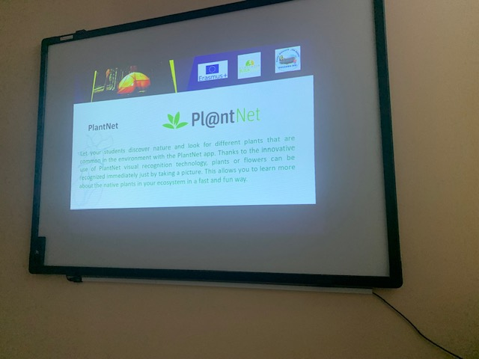
Apps and activities
Delegates shared useful outdoor learning apps which RJ has recorded and will share with staff.
Delegates also shared a range of outdoor activity lesson plans which will also be shared with staff.

Slide 13
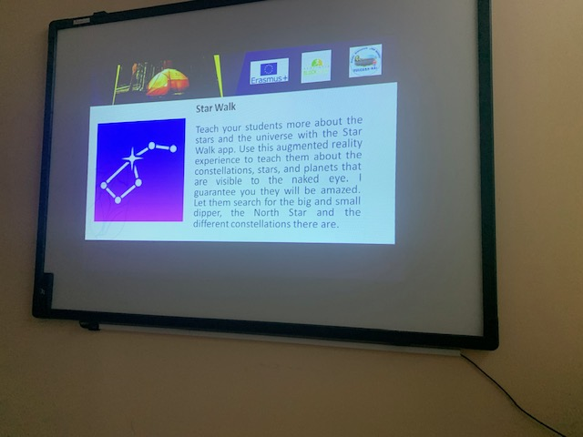
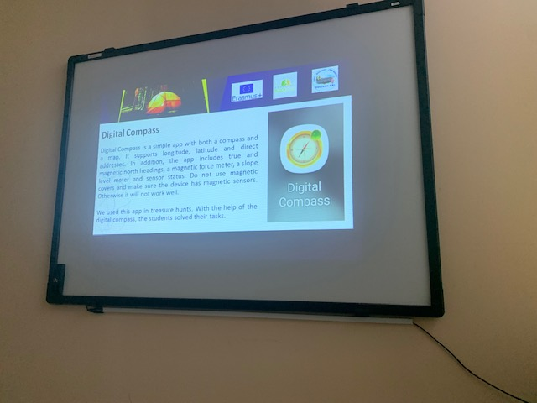
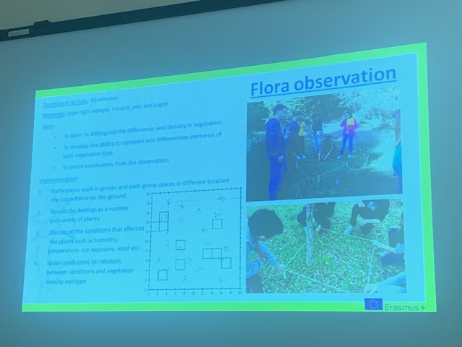
Apps and activities continued

Slide 14
Future plans
Romanian and Greek delegates are visiting the four schools in Wales during the last week of February. Morriston Primary, Bishopston Primary, Townhill Primary and Derwendeg Primary. Delegates will also explore local areas of interest eg the coast, Cardiff, St Fagans, Big Pit etc.
Welsh and Greek delegates are planning to visit Romania end of June.
Active learning delegates from Wales, Greece and Romania are visiting Spain end of May.
Morriston Primary School plan to make Christmas cards to send to schools in the project this week.

