Slide 1


Erasmus+ Outdoor Education and Teaching Methodology
Livadia, Greece
Sunday 16th October – Friday 20th October

Slide 2



Outdoor Education & Teaching Methodology

Slide 3
Aims of the project
Provide teachers with good examples, methods, techniques and tools for developing the use of outdoors.
To offer teaching staff an approach to promote multi-disciplinary connections.
To develop attitudes of cooperation and intercultural dialogue between staff and students to support civil society in an integrated Europe.
To support whole school development, particularly when using the outdoors and natural resources to enhance students learning and more importantly their appreciation of the outdoors!

Slide 4
About the project
Teachers had previously visited the area, however, due to Covid restrictions we were unable to visit any schools.
The opportunity was then aimed at networking for future mobilities and an opportunity to visit some of the local areas in which we may take children on the next visit to Livadia.
This was the first mobility in which we were able to take students and could now visit the schools. The itinerary was carefully planned around school visits, experiencing outdoor activities and enjoying the local areas.

Slide 5
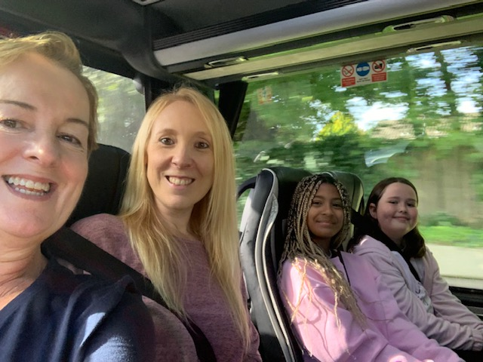
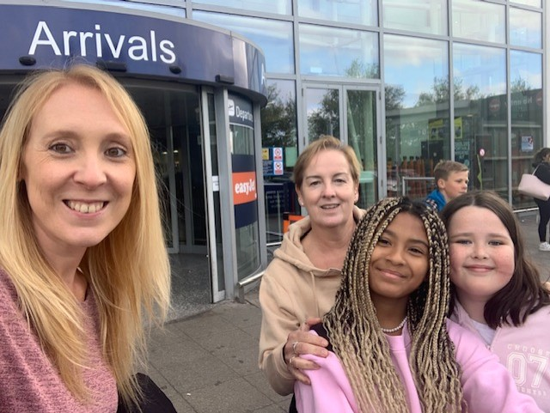
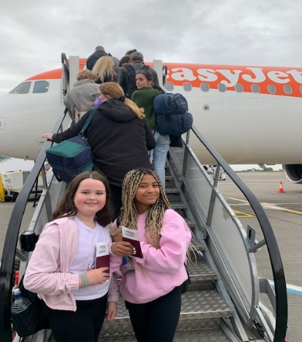
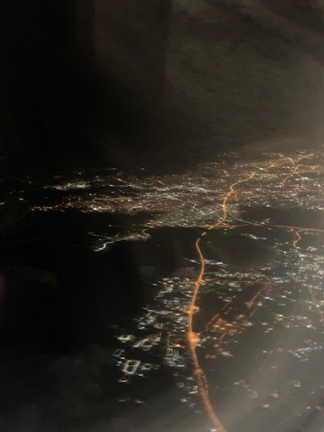
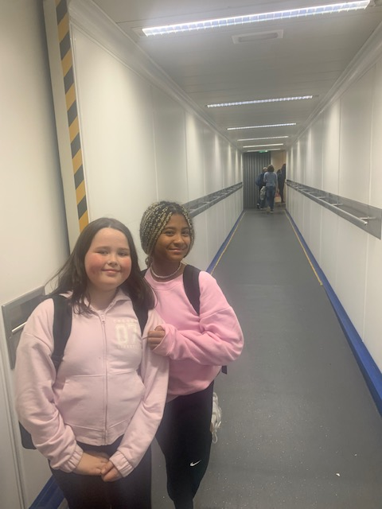
On our way!

Slide 6
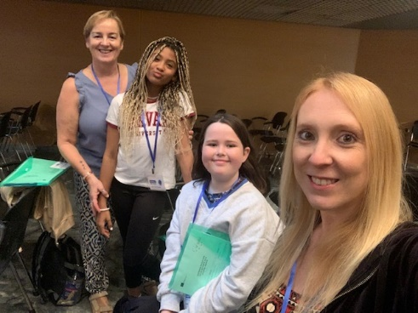
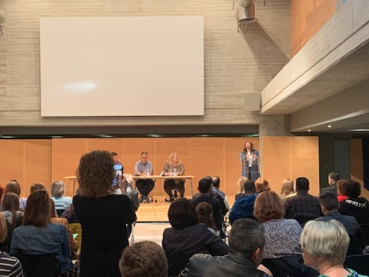
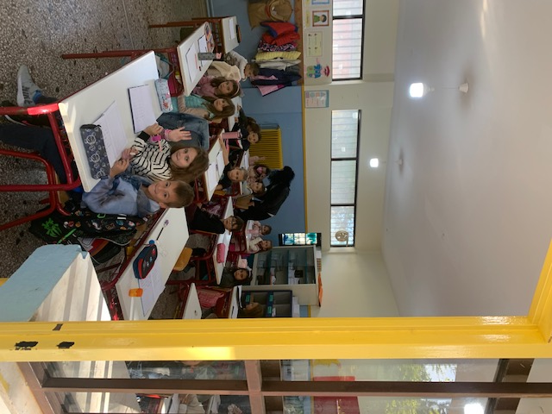
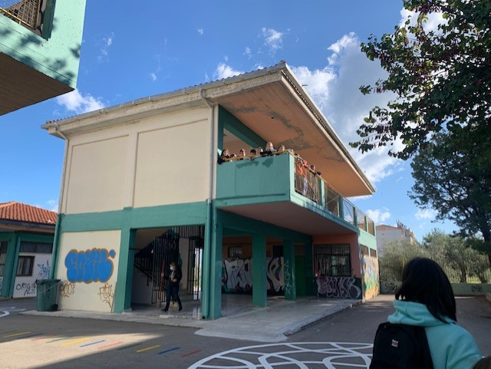
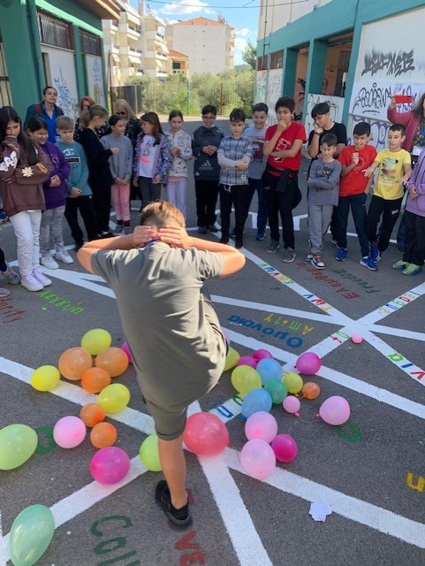
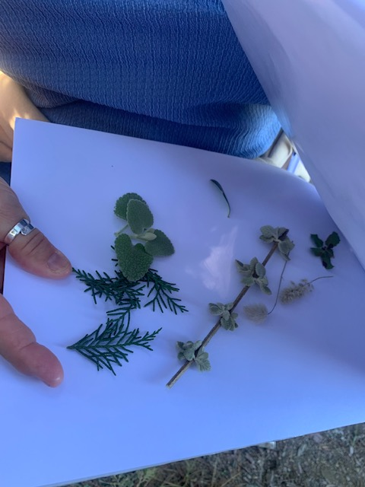

Day 1
Official meeting with all school staff and students.
Delegates walked to 8th Primary School where we had a tour of the school.
Ice breaker activities at the school.
A trip to the forest.
A guided walk along River Erkina to learn about the history of the area.

Slide 7
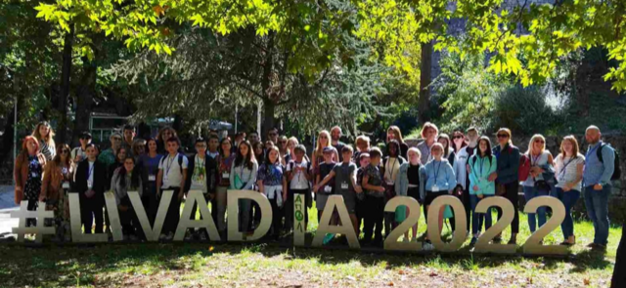
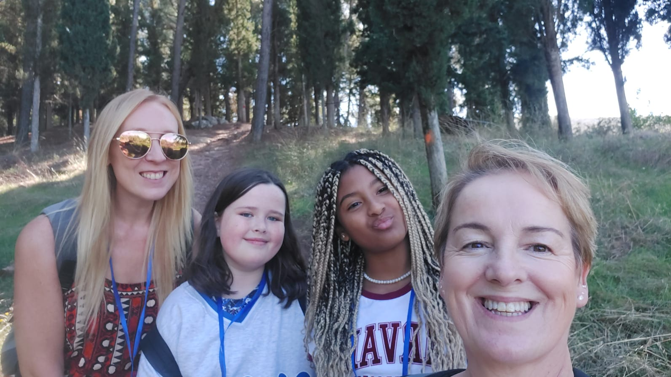
Day 1

Slide 8
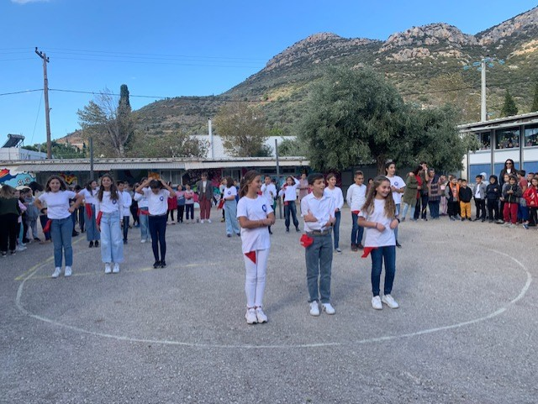
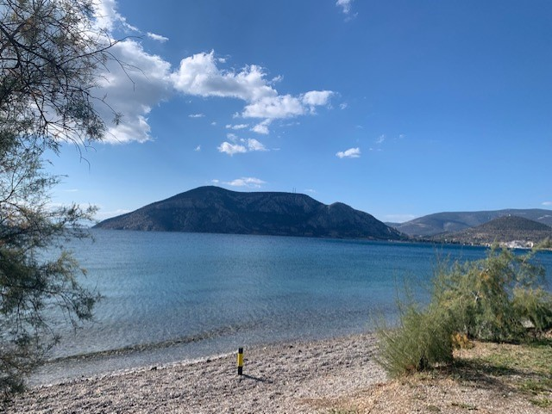
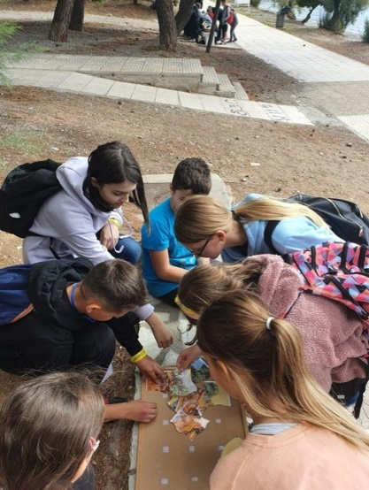
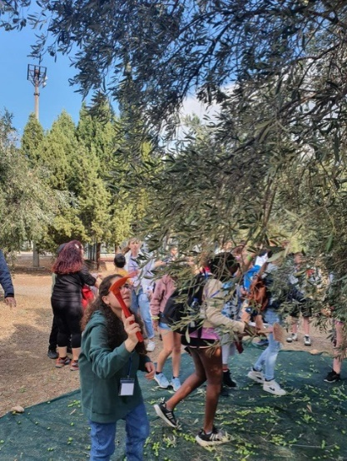
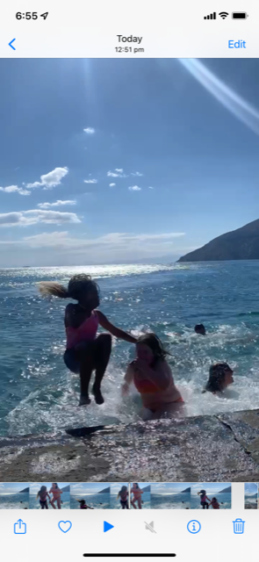
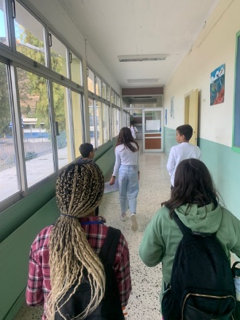
Day 2
A visit to a second primary school in Aspra Spitia
A presentation of the school
Beach activities

Slide 9
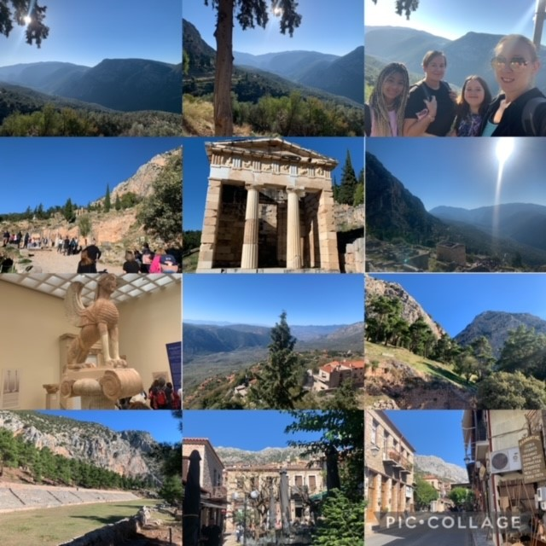
Day 3
Cultural visit to Delphi
Delphi Museum
A shopping trip to Arachova

Slide 10
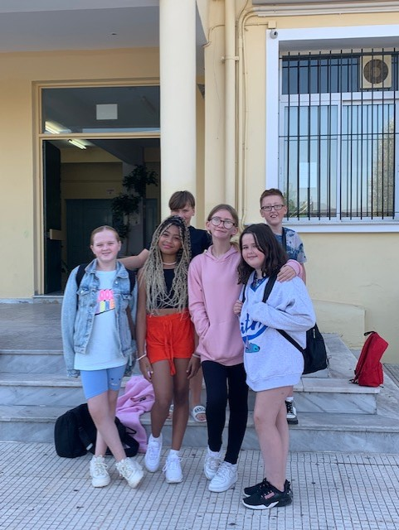
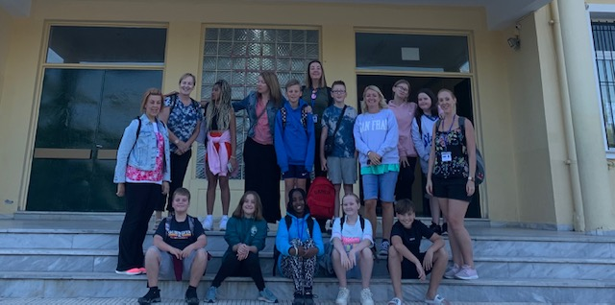
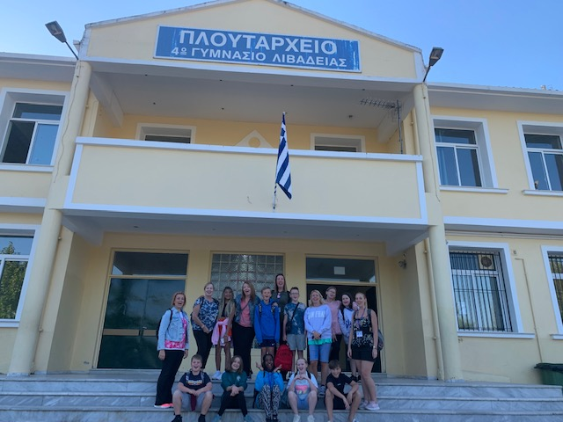
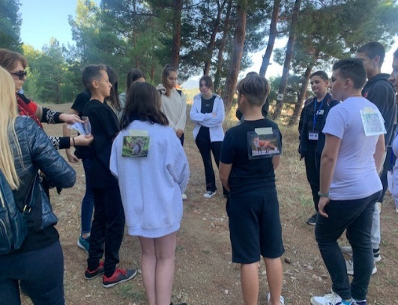
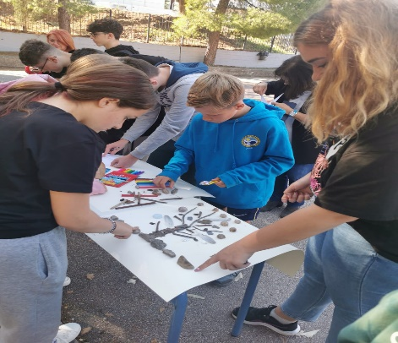
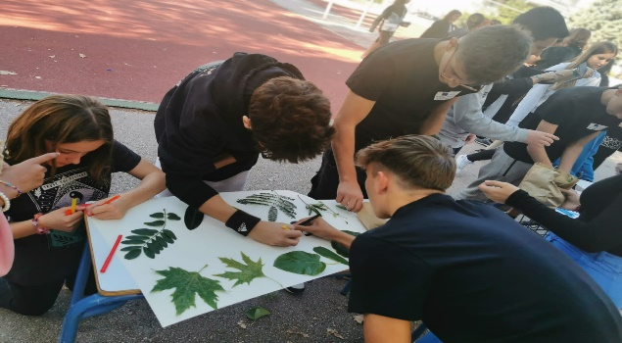
Day 4
A visit to the third primary school – 4th Gymnasium of Levadia
Presentations of the school
Outdoor learning activities
Treasure hunt around the city

Slide 11
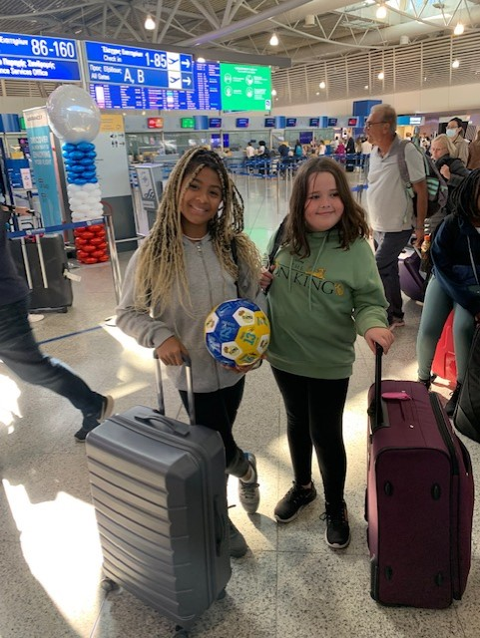
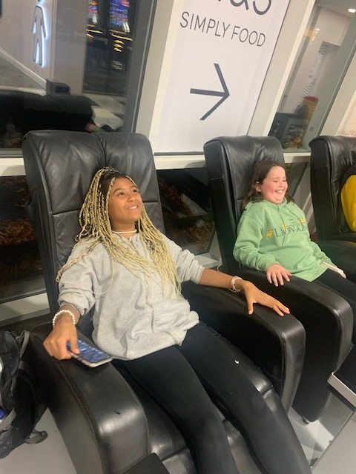
Day 5
The long journey home!

Slide 12
Future plans
Greek and Welsh delegates mobility to Romania 5th – 10th March
Greek and Romanian delegates mobility to Wales 7th – 12th May
Both trips will also include students from each school

Slide 13
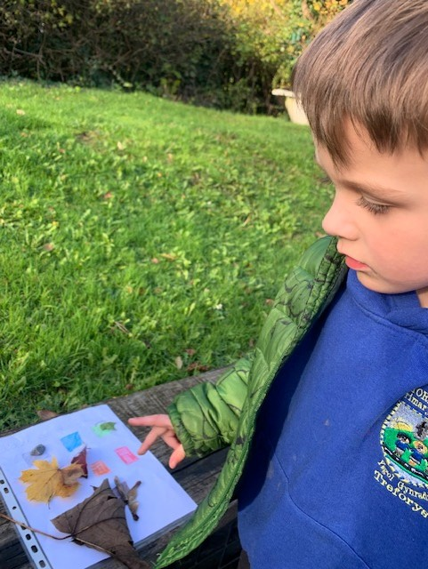
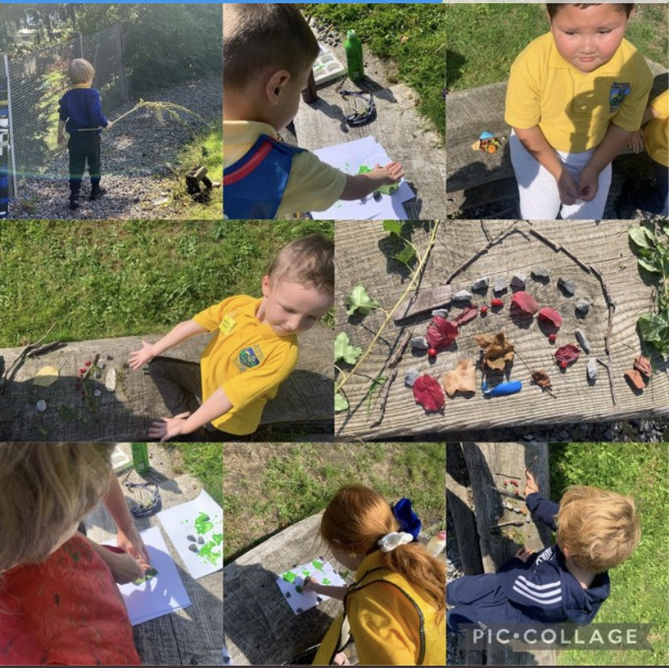
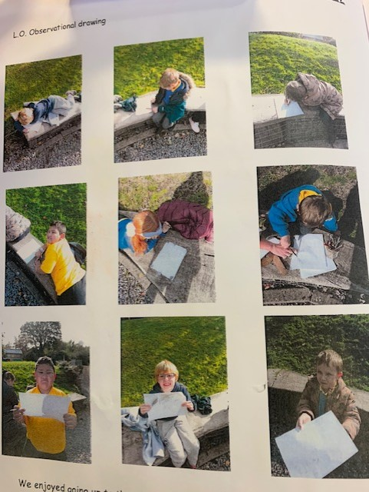
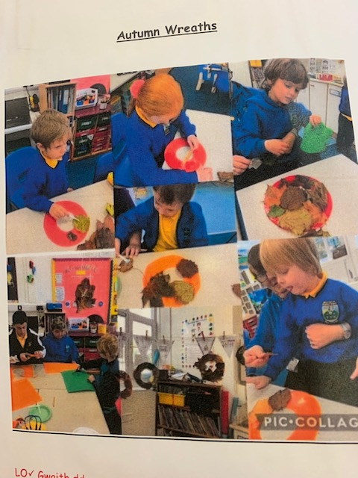
Implementing ideas/strategies
Colour scavenger hunt – matching colours, counting, naming items
Exploring & naming, leaf printing, leaf rubbings & rainbow making – naming colours in English & Welsh
Observational drawings – outdoor vocabulary, shapes, art
Autumn wreaths – exploring, using senses, talking about changes & creating

