Slide 1

Instilling a culture of enquiry at Morriston Primary School
Matthew Bannister – Deputy Headteacher
Wednesday 26th June 2024

Slide 2
School Information
School Vision
‘Your Right to be the best you can be.’
In Morriston Primary School we aim to provide a broad, balanced and rich curriculum.
We offer an inclusive environment where pupils are encouraged to be healthy. happy, digitally competent, creative, confident and resilient learners. We challenge our pupils to reach their full potential, equipping them with the skills necessary to continue on their journey of life-long learning.
Our School Mission Statement
‘Together Everyone Achieves More.’
Learning and working together as a community, we challenge and support each other, to achieve our goals.

Slide 3
School context
206 pupils aged 3-11 including 31 who attend the nursery class part-time
Staffing: 11 Teachers, 25 Teaching Assistants
There are 9 classes, including a nursery, two STFs and an Observation and Assessment Unit
32.8% A-E EAL, 22.6% A-C EAL
No pupils speak Welsh as their first language
45.9% eFSM
70.3% of pupils are in the 30% most deprived area in Wales
Mobility (number of in year leavers and joiners) was last reported as 25.4% for 2022-23, with a 5-year average of 20.7%. Mobility is always high, compared to other schools, due to the social housing, traveller community and OAU (which is a short-term placement provision)
22.6% ALN

Slide 4
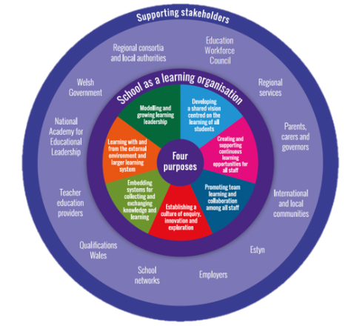
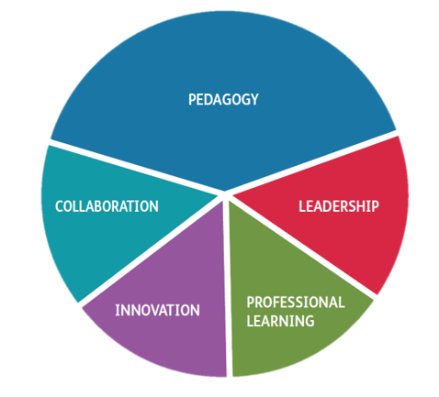
Rational –
The National Agenda
Schools as Learning Organisations – driving the new curriculum
Professional standards

Slide 5
The history of enquiry @ Morriston Primary School
Annual engagement with the SLO model as a self evaluation/ contentious development tool.
Enquiry is embedded within the settings – practitioners undertake enquiries linked to school development priorities.
Self-evaluation producers are linked to priorities/ action research enquiries e.g triads and sharing of learning opportunities.
The school has been involved with NPEP for a number of years.
DHT appointed as an ‘experienced enquirer’ to support settings within the region.
DHT part of Welsh Government’s Research & Enquiry Practitioners’ Working Group (‘REPPERS’) to inform the development of the research and enquiry within Wales.
DHT currently working with a range of stakeholders to feed in to a current piece of research linked to the OECD

Slide 6
A typical enquiry timeline
Rational – Why?
Enquiry Literature Review
Enquiry question
Enquiry design and methodology
Ethical considerations
Data collection methods (including pre/post baseline data)
Emerging findings
Limitations
Key/emerging recommendations
Next steps – Continuation, informed practice

Slide 7
What makes a good enquiry question?
Is it feasible, doable?​
Does it have an answer? An answer that will be clear? An answer that will be useful?​
Does the answer already exist?
This often happens – questions are often too broad at the outset ​and often lack depth

Slide 8
Possible limitations?
Busy educational reforms in Wales, such as adopting and developing a new curriculum and considering the new ALN bill.
Schools and their stakeholders are still battling the effects of the pandemic and how this has affected learner’s abilities and attendance.
Staffing?
Budget?
Learners?

Slide 9
Examples of past enquiry questions
Can a focus on developing Welsh oracy in pupils increase fluency and confidence in speaking Welsh?
Does the use of formative assessment strategies reduce the poverty gap of learners in Year 4/5 ?
Does an increased focus on empathy impact learners understanding of the points of view of others and making ethically informed decisions?

Slide 10
Key/emerging recommendations post enquiry
What has the enquiry told you? Is this as expected ?
Are the results a surprise?
Does the enquiry need to be continued? Does this lead in a different direction?
What are the next steps?

Slide 11
Impacts?
Teacher enquiry is a process of systematically questioning practice in order to improve learning and learner outcomes.​
Enquiry can be used to identify issues, promote action and reflection around a question related to improving learning and teaching. ​
It can situate teachers, individually and collectively, as key agents of purposeful changes in their own professional practice.
Purposeful school improvement
Individual professional learning / CPD

Slide 12

Questions

