Slide 1

Why are trees tall?
Year 4/5 Science investigation – Week 5

Slide 2
Prior knowledge
Trees can grow to tremendous heights. The largest trees in the world are coastal redwoods which can reach over 100 m tall – about three times the length of a blue whale!
A tree’s height depends by a number of factors, such as where it grows and what access it has to nutrients and water.
A tree can only grow as tall as the distance it can move water from its roots up its trunk. The taller the tree, the more energy it needs to transport water.

Slide 3
Prior Knowledge
Trees and plants have vessels that carry water, nutrients and sugars to where they are needed
When you drink through a straw, you create a vacuum by sucking all the air out. As you continue to suck, the air pressure inside the straw and your mouth is less than the air pressure outside the straw, which forces the liquid to move upwards.
The longer the straw, the harder it is to suck up water

Slide 4
Pre investigation
Plants and trees use vessels to move water up their stems from the roots.
Question
What do you think would happen if these vessels couldn’t suck the water to the top of the tree?

Slide 5
Pre investigation tasks
Suck water through a range of straws and tubes that have different diameters.
Identify which require the least and most effort. Put a straw into a cup of water, place your finger over the top of the straw and lift it from the water. What happens when you take it out of the water?
Next, take two straws and put one in a cup of water. Put both straws in your mouth and suck – what happens? Can you explain any of your observations?

Slide 6
Investigation
You are going to model how trees move water and observe how challenging it is to suck water over long distances.
Equipment
Straws of the same diameter
Masking, gaffer or PVC tape
Cup
Drinking water
Ruler
Scissors
Measuring tape or metre stick

Slide 7
Predict
How easy will it be to suck water through a long straw?
How long will your straw be before you can no longer suck water through it?

Slide 8
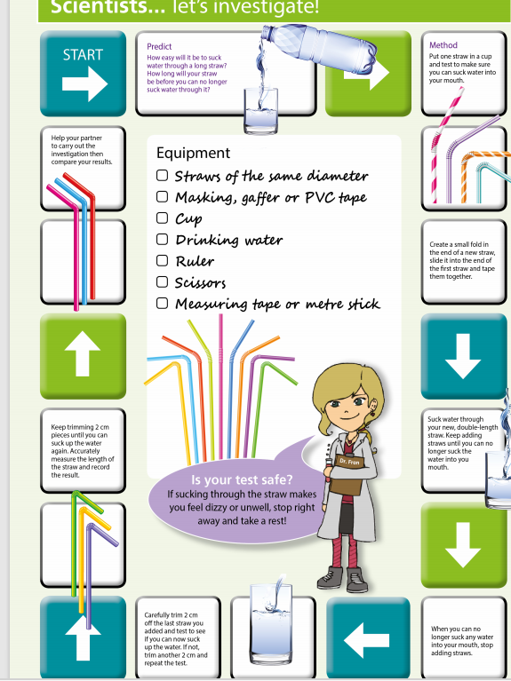
Let's investigation
Use the method board to follow the instructions
A full size copy of the method can be found
Within the resources.

Slide 9
Recording
Measure and record the length of the longest straw that each person in your house can suck water through using centimetres and metres
Create a table in excel and record each person's results.
Calculate the difference between the longest and shortest straws.
Use your skills within excel to create a bar graph of results.

Slide 10
Concluding and reflecting
Compare your initial predictions to your findings from the investigation.
Were you surprised by how far you could suck water through the straw?
How do plants transport water?
How hard was it to suck water over a greater distance? Does this tell you anything about the energy trees need to transport water?
Did you use any strategies when sucking the water? What else could you do to improve your results?
Would changing the diameter of your straws affect the results? How could you test this?

