Slide 1

Morriston Primary School Development Plan 2026–2029
Notes:
---

Slide 2
Contents
School Vision | Priority 3 -Leading and Improving – Sharpen self-evaluation and improvement processes so that the school has a clear understanding of their impact on outcomes for pupils.
School Context | Maintenance
National Priorities Content | Grant Expenditure
Summary of Priorities for 2026/2027 | Summary of Professional Learning
Child Friendly SDP | The school improvement priorities for the 2 school years immediately proceeding the current school year
Priority 1 -Teaching and Learning – Challenge pupils more consistently to apply their skills at an appropriate level across the curriculum, through high quality approaches to teaching and learning. | Ongoing Activities
Priority 2 -Well-being, care, support and guidance – Ensure pupils attend school, develop their ability to reflect and improve and take responsibility for their learning. | Review of previous year’s priorities

Slide 3
School Vision
Notes:
---
School Vision and Mission, School Context

Slide 4
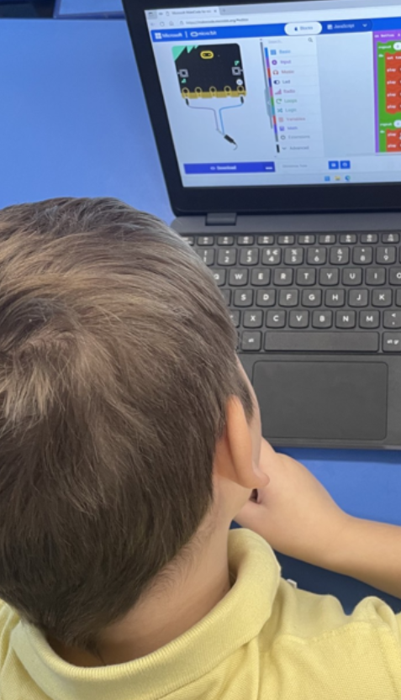

School Vision and Mission
School Vision
‘Your Right to be the best you can be.’
In Morriston Primary School we aim to provide a broad, balanced and rich curriculum. We offer an inclusive environment where pupils are encouraged to be healthy. happy, digitally competent, creative, confident and resilient learners. We challenge our pupils to reach their full potential, equipping them with the skills necessary to continue on their journey of life-long learning.
Our School Mission Statement
‘Together Everyone Achieves More.’
Learning and working together as a community, we challenge and support each other, to achieve our goals.
Notes:
Morriston Primary School’s vision, ‘Your Right to be the best you can be,’ underpins every aspect of its development plan. This vision emphasizes inclusivity, well-being, and the holistic development of pupils, ensuring they become healthy, happy, digitally competent, creative, confident, and resilient individuals. The mission statement, ‘Together Everyone Achieves More,’ reflects the collaborative ethos of the school, where staff, pupils, parents, and the wider community work in partnership to achieve shared goals. The vision and mission are aligned with the Curriculum for Wales, focusing on learner progression and the four purposes: ambitious, capable learners; enterprising, creative contributors; ethical, informed citizens; and healthy, confident individuals. These guiding principles inform strategic priorities, resource allocation, and professional learning initiatives, ensuring that every decision supports the overarching aim of enabling pupils to reach their full potential. The school’s commitment to equity and well-being is evident in its emphasis on emotional health, inclusivity, and fostering positive attitudes toward learning. By embedding these values into daily practice, Morriston Primary creates an environment where pupils thrive academically, socially, and emotionally.

Slide 5
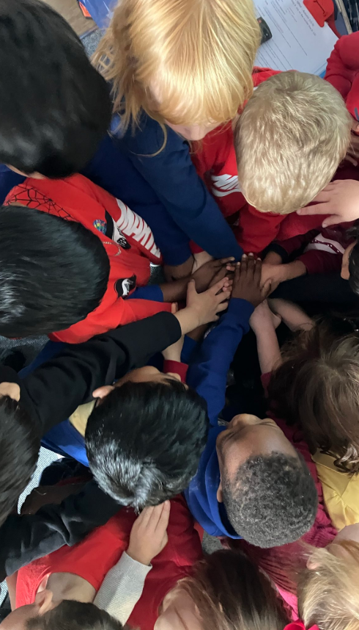
School Context
166 pupils aged 3-11, including 17 who attend the nursery class part-time.
Staffing: 10 Teachers, 20 Teaching Assistants, 1 Office Manager, 1 Admin Assistant, 1 Caretaker, 3 Cleaners, 2 kitchen staff.
There are 8 classes, including the nursery.
46.1% A-E EAL, 40% A-C EAL (numbers at Plasc 2026). There are 29 different languages spoken at home.
No pupils speak Welsh as their first language.
40.7% eFSM (statutory school age only - numbers at Plasc 2026), with a 3-year average of 40.5%.
61.7% of pupils are in the 30% most deprived area in Wales (numbers at Plasc 2026).
Mobility (number of in-year leavers and joiners) was last reported as 22.6% for 2023-24, with a 5-year average of 20.6%.
Mobility was 8th highest across Swansea when last reported and is always high, compared to other schools, due to the social housing and our traveller community.
24.07% ALN (numbers at Plasc 2026).
Date of last inspection was November 2025.
Attendance: 91.4%.

Slide 6
Context of the School Development Plan
The School Development Plan has been created within the guidelines of the Framework for Evaluation, Improvement and Accountability
Information and Evidence for ‘improvement planning’ has been gathered and evaluated through honest, robust, evidence-based self-evaluation arrangements. The 3 main purposes for the use of this information is for:-
Improvement – for the learner
Accountability – for governance purposes
Transparency – for the wider citizen – telling them how well the school is doing
This Plan was written after consultation and input from the headteacher (if that person is not a member of the governing body), pupils, parents or carers of pupils, school staff and any such other persons as the governing body considers appropriate. The consultation was carried out through INSET days, questionnaires and school council meetings. Due regard is given to the school’s comparative data and pupil outcomes when creating the plan.
The plan is formulated as part of the school’s self-evaluation procedures. The duration of this plan is from September 2026 to July 2027. All grant funding referred to in this plan is to be spent by March 31st 2027 (unless grant provider allows carry forward).
The governing body will seek to meet the school improvement targets for the current school year by working with:-
Pupils at the school and their families; and
People who live and work in the locality in which the school is situated.
Progress against the plan is reported in each Headteacher’s Report to Governors and through the work of the various governor committees. The plan is reviewed and updated annually. Copies of the plan are given to the Governing Body and every member of school staff. A summary is available to other stakeholders on request.

Slide 7
National Priorities

Slide 8
NATIONAL PRIORITIES
Framework on embedding a whole-school approach to emotional and mental well-being
Cymraeg 2050: A million Welsh speakers
Additional Learning Needs and Education Tribunal (Wales) Act 2018
Supporting learner progression: assessment guidance
CONTENT | EVIDENCED IN SDP |  | REFERENCE TO STRATEGIC PRIORTY
Framework on embedding a whole-school approach to emotional and mental well-being | YES | NO | Priority 1
Cymraeg 2050: A million Welsh speakers | YES | NO | Priority 2
Additional Learning Needs and Education Tribunal (Wales) Act 2018 | YES | NO | Priority 3
Supporting learner progression: assessment guidance | YES | NO | Priority 3 and Priority 4

Slide 9
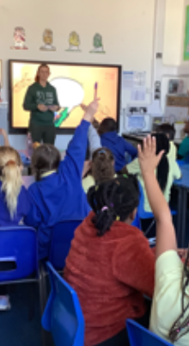
National Priorities
Curriculum for Wales: The context for improvement. Vision for Successful Schools under the Curriculum for Wales
Learner Progress is central to the Curriculum for Wales, so progression needs to have similar importance within evaluation and improvement activities, and accountability processes. The School Improvement Guidance suggests that schools use the following 2 questions as a starting point for their improvement activities:-
1. Are learners progressing in the ways described in the principles of progression, supporting them to develop towards the four purposes?
2. Is the pace of learners’ progress in line with the expectations of teachers and the curriculum?
The new ‘national priorities’ which schools must have regard to when setting their improvement priorities, will be:-
improving pupils’ progression by ensuring their learning is supported by a range of knowledge, skills and experience
reducing the impact of poverty on learners’ progression and attainment
To support schools to navigate this new context, 8 contributory factors have been set out describing key attributes that schools that are successfully realising the curriculum will possess.
Enabling all learners, and in particular those from disadvantaged backgrounds, to progress along their own learning pathway and raise their aspirations to achieve their full potential; allied to a range of assessment approaches to understand and support this progress.
Co-constructing a curriculum, in line with the Curriculum for Wales Framework, which promotes a broad range of knowledge, skills and experiences (including social and interactional experiences) with a clear understanding of why these matter.
Ensuring the school environment supports learners’ and practitioners’ well-being.
Supporting practitioners' understanding of what works in curriculum design by investing in the enquiry and pedagogic skills of all staff.
Enabling ambitious professional learning for all practitioners in a school dedicated to being a learning organisation.
Embedding reflection, self-evaluation and improvement within schools, with good school leadership as a pre-condition for that.
Being at the heart of their communities - building better relationships between schools and families, communities and employers, to support and promote educational achievement and excellent employment, next steps education and training.
Listening to children and young people as they engage with their learning and supporting them in achieving their aspirations.
Notes:
The School Development Plan aligns with Welsh Government national priorities, which include improving pupils’ progression by ensuring learning is supported by a broad range of knowledge, skills, and experiences, and reducing the impact of poverty on attainment. These priorities are embedded within the Curriculum for Wales framework and supported by guidance on emotional and mental well-being, Cymraeg 2050, ALN reforms, and effective assessment strategies. Morriston Primary School addresses these priorities through targeted interventions, inclusive practices, and curriculum design that promotes equity and progression. The school’s approach includes fostering emotional resilience, enhancing teaching and learning, and ensuring robust assessment and tracking systems. By integrating national priorities into its strategic planning, the school ensures compliance with statutory requirements while delivering meaningful improvements in learner outcomes. This alignment strengthens accountability and transparency, demonstrating the school’s commitment to raising standards and supporting all pupils, particularly those from disadvantaged backgrounds.

Slide 10
Summary of priorities 2026/27
National priorities underpin our school development: improving pupils’ progression by ensuring their learning is supported by a range of knowledge, skills and experience reducing the impact of poverty on learners’ progression and attainment
Priority | SI Overarching areas for Self-Improvement |  |  | UNCRC Article
Priority 1 - Teaching and Learning – Challenge pupils more consistently to apply their skills at an appropriate level across the curriculum, through high quality approaches to teaching and learning. | Vision and Leadership | Curriculum, Teaching & Learning | Wellbeing, Equity and Improvement | A3 – do the best for a child A28 – have an education. A29 – be the best you can be
Priority 2 - Well-being, care, support and guidance – Ensure pupils attend school, develop their ability to reflect and improve and take responsibility for their learning. | Vision and Leadership | Curriculum, Teaching & Learning | Wellbeing, Equity and Improvement | A3 - do the best for a child. A7– name and nationality A8 - belonging and identity A12 - say what you think should happen and be listened to. A14 – have a religion A19 – be safe A28 – have an education. A29 – be the best you can be
Priority 3 - Leading and Improving – Sharpen self-evaluation and improvement processes so that the school has a clear understanding of their impact on outcomes for pupils. | Vision and Leadership | Curriculum, Teaching & Learning | Wellbeing, Equity and Improvement | A3 - do the best for a child A28 – have an education. A29 – be the best you can be

Slide 11
Estyn Recommendations January 2026
Recommendation | SI Overarching areas for Self-Improvement |  |  | UNCRC Article | Progress
1. To challenge pupils more consistently to apply their skills at an appropriate level across the curriculum. | Vision and Leadership | Curriculum, Teaching & Learning | Wellbeing, Equity and Improvement | A3 - do the best for a child. A8 - belonging and identity. A12 - say what you think should happen and be listened to. A28 – have an education. A29 – be the best you can be.
2. To sharpen self-evaluation and improvement processes so that the school has a clear understanding of their impact on outcomes for pupils. | Vision and Leadership | Curriculum, Teaching & Learning | Wellbeing, Equity and Improvement | A3 - do the best for a child. A8 – identity. A14 – have a religion. A29 – be the best you can be. A28 – have an education.

Slide 12
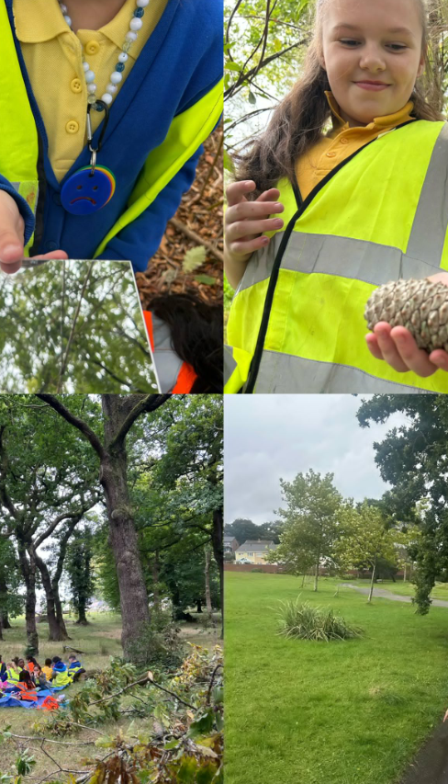
Priorities Overview
Priority 1 - Teaching and Learning – Challenge pupils more consistently to apply their skills at an appropriate level across the curriculum, through high quality approaches to teaching and learning.
Priority 2 - Well-being, care, support and guidance – Ensure pupils attend school, develop their ability to reflect and improve and take responsibility for their learning.
Priority 3 - Leading and Improving –
Sharpen self-evaluation and improvement processes so that the school has a clear understanding of their impact on outcomes for pupils.

Slide 13

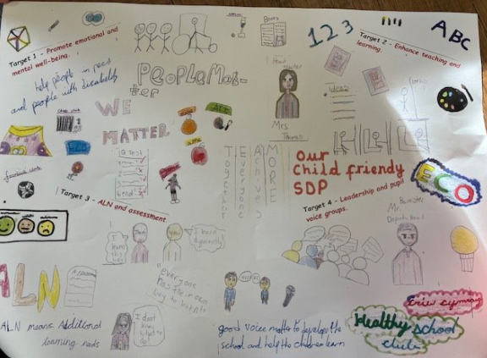


Child Friendly SDP

Slide 14
Detailed Strategic Priorities
Notes:
Priority 1: Emotional and Mental Well-being, Priority 2: Teaching and Learning Enhancement, Priority 3: ALN and Assessment, Priority 4: Leadership and Professional Learning

Slide 15
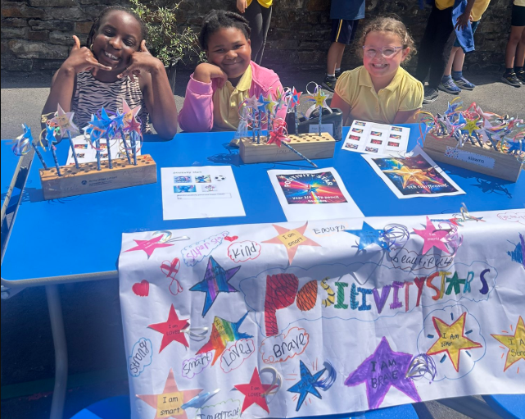
Priority 1
Teaching and Learning –challenge pupils more consistently to apply their skills at an appropriate level across the curriculum, THROUGH HIGH QUALITY APPROACHES TO TEACHING AND lEARNING.

Slide 16
STRATEGIC PRIORITY 1: Teaching and Learning – Challenge pupils more consistently to apply their skills at an appropriate level across the curriculum, through high quality approaches to teaching and learning.
RATIONALE: (Why is this on the plan this year? Schools should outline clearly using information (quantitative and qualitative) to justify.) A great deal of work has been carried out on refining our curriculum design offer. This year we are going to refine our curriculum maps to include our coverage of knowledge, skills and experiences for Year A, ensuring progression of pupils across the school. Further to our Estyn inspection and recommendations and our own monitoring outcomes, we feel we need to continue to refine our practice to ensure we challenge pupils more consistently to apply their literacy, numeracy and digital skills at an appropriate level across the curriculum, especially when pupils are working independently. We feel pupils need to improve their oracy skills in order to feed into their extended writing opportunities whilst editing and re-drafting their work to consider audience and purpose. We also feel pupils need to further develop their ability to apply their mathematical reasoning skills in unfamiliar and open ended contexts.
Sub Priorities Estyn Recommendation | Intended Impact/ Success Criteria | Key Actions | Lead Person (to include governors) | Time- line | Funding (to include grant funding) | Link to Monitoring/Self Evaluation Activities that will give you evidence of impact on pupils (Reference documents or pages of documents from quality assurance timetable)
a) To challenge pupils more consistently to apply their skills at an appropriate level across the curriculum. | Pupils offered/ accessing tasks that challenge their skills at an appropriate level across the curriculum, both when learning indoors and outdoors. Pupils demonstrating increased confidence when applying their skills across the curriculum. | Additional training for staff from the LA Performance Specialists. Lower Phase Lower Phase staff to ensure differentiated level of challenge offered. Staff to continue to observe and monitor pupil progress, noting which pupils access the higher level of challenge. Staff to ensure pupils can apply their Literacy/ Numeracy and DCF skills in focused lessons and the provision areas. In addition staff to ensure the development of the physical skills of pupils (gross/fine motor) – via indoor and outdoor provision. Staff to continue to develop the Reception/Year 1 outdoor areas and garden in order to support outdoor learning opportunities and experiences for pupils. Upper Phase To re-visit Focused tasks/Missions/skills challenges and how these are outlined/delivered. Practitioners to consider a carousel approach to skill development. Practitioners to monitor and intervene when needed to ensure those higher levels of challenge are being offered/accessed. Staff to utilise the updated Upper Phase proformas/templates – with skills identified / extension activities and learner and teacher assessment opportunities. Upper Phase staff to also consider further enhancing their provision to ensure they are offering the following resources/opportunities for pupils to access: Maths - Cuisenaire / Numicon, Base Ten, Fraction board, Template boards, Challenges, Reasoning and problem-solving challenges Welsh - Welsh books, dictionaries, sentence patterns, Welsh alphabet, text type challenges Science and Technology - Science resources, circuits, mirrors, magnifiers, micro:bits, green screen, STEM challenges Thinking area - Books linked to topic, artefacts linked to topic, globes/maps Construction - Lego/Knex Creative - Paints, pencils, chalk, charcoal, work linked to different artists Calm Area/ Mindfulness/ Sensory - Sensory boxes, fidgets, play dough Literacy - Text type challenges, Letter-Join challenges/login information, range of paper, pencils and envelopes, dictionaries/thesaurus, text type skeletons Upper Phase to create new 'Skills' books for pupils where they can record their independent work. | Leaders and all teaching staff. | Sept 26 - July 27 | Curriculum support funding | SLT self-evaluation reports. AoLE monitoring and listening to pupils. Reports to governors. Planning, pupil books/work.
Evaluation (Continuous) Autumn Term

Slide 17
STRATEGIC PRIORITY 1:Teaching and Learning – Challenge pupils more consistently to apply their skills at an appropriate level across the curriculum, through high quality approaches to teaching and learning.
RATIONALE: (Why is this on the plan this year? Schools should outline clearly using information (quantitative and qualitative) to justify.) A great deal of work has been carried out on refining our curriculum design offer. This year we are going to refine our curriculum maps to include our coverage of knowledge, skills and experiences for Year A, ensuring progression of pupils across the school. Further to our Estyn inspection and recommendations and our own monitoring outcomes, we feel we need to continue to refine our practice to ensure we challenge pupils more consistently to apply their literacy, numeracy and digital skills at an appropriate level across the curriculum, especially when pupils are working independently. We feel pupils need to improve their oracy skills in order to feed into their extended writing opportunities whilst editing and re-drafting their work to consider audience and purpose. We also feel pupils need to further develop their ability to apply their mathematical reasoning skills in unfamiliar and open ended contexts.
Sub Priorities | Intended Impact/ Success Criteria | Key Actions | Lead Person (to include governors) | Timeline | Funding (to include grant funding) | Link to Monitoring/Self Evaluation Activities that will give you evidence of impact on pupils (Reference documents or pages of documents from quality assurance timetable)
b) Most pupils will confidently apply the knowledge, skills and experiences planned through the Year A curriculum, enabling them to make good progress, demonstrate increasing independence in their learning and achieve improved outcomes across areas of learning. | Pupils offered appropriate coverage of knowledge, skills and experiences as outlined via curriculum mapping, for Year A from teaching staff, resulting in increased pupil outcomes. | Curriculum maps to clearly outline knowledge skills and experiences covered across the term for all year groups, ensuring progression in learning across the school. Continue to map activities linked to termly themes onto the progression maps across every AoLE, including the DCF progression map outlining activities for each progression step. | HT, PB and all teaching staff. | Sept 26 - July 27 | Curriculum support funding | AoLE monitoring and listening to pupils. Curriculum maps. AoLE progression maps. Shared understanding of progression portfolios. Pupil books and portfolios.
Evaluation (Continuous) Autumn Term

Slide 18
STRATEGIC PRIORITY 1: Teaching and Learning – Challenge pupils more consistently to apply their skills at an appropriate level across the curriculum, through high quality approaches to teaching and learning.
RATIONALE: (Why is this on the plan this year? Schools should outline clearly using information (quantitative and qualitative) to justify.) A great deal of work has been carried out on refining our curriculum design offer. This year we are going to refine our curriculum maps to include our coverage of knowledge, skills and experiences for Year A, ensuring progression of pupils across the school. Further to our Estyn inspection and recommendations and our own monitoring outcomes, we feel we need to continue to refine our practice to ensure we challenge pupils more consistently to apply their literacy, numeracy and digital skills at an appropriate level across the curriculum, especially when pupils are working independently. We feel pupils need to improve their oracy skills in order to feed into their extended writing opportunities whilst editing and re-drafting their work to consider audience and purpose. We also feel pupils need to further develop their ability to apply their mathematical reasoning skills in unfamiliar and open ended contexts.
Sub Priorities | Intended Impact/ Success Criteria | Key Actions | Lead Person (to include governors) | Timeline | Funding (to include grant funding) | Link to Monitoring/Self Evaluation Activities that will give you evidence of impact on pupils (Reference documents or pages of documents from quality assurance timetable)
c) Support pupils to become increasingly independent learners by enhancing the learning environment and providing experiences that build confidence, resilience and decision-making skills. | Pupils making strong progress in their independence skills, via enhanced learning environments, experiences and interactions, with a balanced interplay between the 3 enablers, ensuring pupils are challenged appropriately through enabling environments, experiences and effective interactions, with many pupils selecting resources, persevering, explaining choices, seeking feedback and identifying their next steps in learning. | Pupils offered learning environments, experiences and interactions that develop their independence skills. Staff to continue to utilise approaches centred around the 3 enablers, ensuring provision is learner-centred, process driven and progressive from where the pupils have come from. Observations will be noted and this work will be shared amongst staff via a shared action research area on Teams, allowing staff to learn from each other’s practice. Teachers will also have the opportunity to watch each other teach and share this learning opportunity. | HT, GH and all teaching staff. | Sept 26 - July 27 | Curriculum support funding | AoLE monitoring and listening to pupils. Shared understanding of progression portfolios. Pupil books and portfolios. Action research.
Evaluation (Continuous) Autumn Term

Slide 19
STRATEGIC PRIORITY 1: Teaching and Learning – Challenge pupils more consistently to apply their skills at an appropriate level across the curriculum, through high quality approaches to teaching and learning.
RATIONALE: (Why is this on the plan this year? Schools should outline clearly using information (quantitative and qualitative) to justify.) A great deal of work has been carried out on refining our curriculum design offer. This year we are going to refine our curriculum maps to include our coverage of knowledge, skills and experiences for Year A, ensuring progression of pupils across the school. Further to our Estyn inspection and recommendations and our own monitoring outcomes, we feel we need to continue to refine our practice to ensure we challenge pupils more consistently to apply their literacy, numeracy and digital skills at an appropriate level across the curriculum, especially when pupils are working independently. We feel pupils need to improve their oracy skills in order to feed into their extended writing opportunities whilst editing and re-drafting their work to consider audience and purpose. We also feel pupils need to further develop their ability to apply their mathematical reasoning skills in unfamiliar and open ended contexts.
Sub Priorities | Intended Impact/ Success Criteria | Key Actions | Lead Person (to include governors) | Timeline | Funding (to include grant funding) | Link to Monitoring/Self Evaluation Activities that will give you evidence of impact on pupils (Reference documents or pages of documents from quality assurance timetable)
d) Pupils confident in their oracy, reading and writing. Pupils encouraged to speak and present with fluency, develop their reading skills to a high standard through phonics and guided reading, and pupils using sentence stems, text types and given time to edit and re-draft their writing in order to up-level their work, with a sense of audience and purpose. | Most pupils will speak with confidence, read with confidence and write with greater clarity and precision, enabling them to express their ideas more effectively across all areas of learning. Pupils’ editing and re-drafting their work in order to up-level and raise the standard of their extended writing work, with a sense of audience and purpose. | ADDs session from Literacy Performance Specialist. A focus on continuing to strive for oracy, reading and writing. Practitioners continuing to utilise our phonics/reading scheme, our guided reading resources and our Literacy scheme of work to support learner’s progression. This will be evident in planning, book scrutiny, learning walks, shared understanding of progression meetings and listening to pupils. Practitioners continuing to utilise a progressive progression map of sentence types in their planning and teaching. Pupils given time to edit and re-draft their work, with a sense of audience and purpose. | HT, DHT and all staff | Sept 26 – Jul 27 | ADDs session from Literacy Performance Specialist. Phonics/reading scheme, guided reading, Literacy scheme of work. Progression map of sentence types. | Teacher assessment and AoLE monitoring and listening to pupils/ book looks.
Evaluation (Continuous) Autumn Term

Slide 20
STRATEGIC PRIORITY 1: Teaching and Learning – Challenge pupils more consistently to apply their skills at an appropriate level across the curriculum, through high quality approaches to teaching and learning.
RATIONALE: (Why is this on the plan this year? Schools should outline clearly using information (quantitative and qualitative) to justify.) A great deal of work has been carried out on refining our curriculum design offer. This year we are going to refine our curriculum maps to include our coverage of knowledge, skills and experiences for Year A, ensuring progression of pupils across the school. Further to our Estyn inspection and recommendations and our own monitoring outcomes, we feel we need to continue to refine our practice to ensure we challenge pupils more consistently to apply their literacy, numeracy and digital skills at an appropriate level across the curriculum, especially when pupils are working independently. We feel pupils need to improve their oracy skills in order to feed into their extended writing opportunities whilst editing and re-drafting their work to consider audience and purpose. We also feel pupils need to further develop their ability to apply their mathematical reasoning skills in unfamiliar and open ended contexts.
Sub Priorities | Intended Impact/ Success Criteria | Key Actions | Lead Person (to include governors) | Timeline | Funding (to include grant funding) | Link to Monitoring/Self Evaluation Activities that will give you evidence of impact on pupils (Reference documents or pages of documents from quality assurance timetable)
e) Pupils to have increased opportunities to apply mathematical reasoning in unfamiliar and open-ended contexts to increase challenge and attainment. | Most pupils will approach mathematical challenges with confidence, using a range of problem-solving and reasoning strategies effectively. Most pupils will achieve higher standards in mathematics and numeracy through improved reasoning, problem-solving and application of their learning. | ADDs session from Numeracy Performance Specialist. Staff using the White Rose resources, CAME resources, NCETM, Numicon and Cuisenaire etc. Pupils using practical resources to support their learning and understanding of problem solving and reasoning in Mathematics and Numeracy. Pupils experiencing a range of reasoning activities and challenges that are open-ended and out of context to increase their confidence in applying these skills. | HT, PB and all staff | Sept 26 – Jul 27 | ADDs session from Mathematics and Numeracy Performance Specialist. MyMaths subscription, £449. Reasoning resources. White Rose subscription £220. NCETM, Numicon and Cuisenaire resources etc. | Teacher assessment and AoLE monitoring and listening to pupils/ book looks.
Evaluation (Continuous) Autumn Term

Slide 21

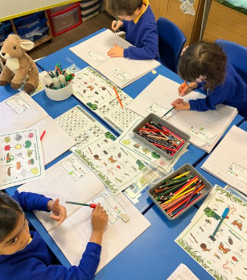
Priority 2
Well-being, care, support and guidance – ensure pupils attend school, develop their ability to reflect and improve and take responsibility for their learning.

Slide 22
STRATEGIC PRIORITY 2: Well-being, care, support and guidance – Ensure pupils attend school, develop their ability to reflect and improve and take responsibility for their learning.
RATIONALE: (Why is this on the plan this year? Schools should outline clearly using information (quantitative and qualitative) to justify.) Further to self-assessment we feel it is imperative that we continue to build on pupil attendance, by further developing our relationship with parents and continuing with our work on fostering parental and community engagement within the school. It is also felt that further work is required in enabling the pupils and making them take greater ownership of moving their own learning forward. This involves the pupils reflecting in greater depth on their learning and progression and also taking responsibility for their presentation and handwriting. Steps to success continue to need to be used with the pupils to enable them to understand how they are performing and what the next steps are in their progression as well as skilful questioning from staff to deepen the learning. Staff will also focus on handwriting to continue to strive for those improved levels of presentation for all pupils.
Sub Priorities | Intended Impact/ Success Criteria | Key Actions | Lead Person (to include governors) | Timeline | Funding (to include grant funding) | Link to Monitoring/Self Evaluation Activities that will give you evidence of impact on pupils (Reference documents or pages of documents from quality assurance timetable)
a) Pupils demonstrating further improved attendance and school continuing to foster home/school links in order to support pupil progress. | Pupils attending school regularly. Pupils’ learning supported further via good communication between home and school, with an increase in pupil progress for pupils who previously had low attendance. | Well-being support officer monitoring attendance, making first day calls home and sending out attendance letters as required, following the Attendance Pathway. Continue to record and track the progress of those under 90%, offering bespoke interventions as required. Good links with EWS and home/school links established. Continue to encourage good attendance through attendance awards in assembly and attendance reporting on school newsletters. | Well-being support officer, HT, EWS and all staff. | Sept 26 – Jul 27 | PDG funding for well-being support officer. | Weekly monitoring of attendance levels. Letters sent home and meetings arranged/attendance plans as appropriate.
Evaluation (Continuous) Autumn Term

Slide 23
STRATEGIC PRIORITY 2: Well-being, care, support and guidance – Ensure pupils attend school, develop their ability to reflect and improve and take responsibility for their learning.
RATIONALE : (Why is this on the plan this year? Schools should outline clearly using information (quantitative and qualitative) to justify.) Further to self-assessment we feel it is imperative that we continue to build on pupil attendance, by further developing our relationship with parents and continuing with our work on fostering parental and community engagement within the school. It is also felt that further work is required in enabling the pupils and making them take greater ownership of moving their own learning forward. This involves the pupils reflecting in greater depth on their learning and progression and also taking responsibility for their presentation and handwriting. Steps to success continue to need to be used with the pupils to enable them to understand how they are performing and what the next steps are in their progression as well as skilful questioning from staff to deepen the learning. Staff will also focus on handwriting to continue to strive for those improved levels of presentation for all pupils.
Sub Priorities | Intended Impact/ Success Criteria | Key Actions | Lead Person (to include governors) | Timeline | Funding (to include grant funding) | Link to Monitoring/Self Evaluation Activities that will give you evidence of impact on pupils (Reference documents or pages of documents from quality assurance timetable)
b) Continue to strengthen pupils’ ability to take charge of their learning, demonstrating understanding by asking and answering questions, reflecting on feed forward opportunities in the classroom and further developing their presentation and handwriting skills. | Nearly all older pupils will be able to ask and answer a range of questions. Pupil’s learning extended and deepened. Pupils reflecting on their learning and how this can be progressed in next steps. Pupils reflecting on their peer’s work to support learner progress. Pupils demonstrating further improved handwriting and presentation skills. | Staff to embed strategies for effective questioning and reflection on learning using guides to support learning. Practitioners across the school to utilise Blooms Taxonomy. Pupils continuing to have a key involvement in self-assessment and meaningful reflection opportunities whilst developing their ability to identify next steps in progression. Pupils provided with prompts for peer assessment to support their feedback, learning and development. Practitioners utilising a handwriting scheme to support pupils to focus further on improving their handwriting and presentation skills. | DHT, HT and all staff. | Sept 26 – Jul 27 | Letter – Join Subscription - £430.80 | Pupil books, listening to pupils, teacher assessment.
Evaluation (Continuous) Autumn Term

Slide 24
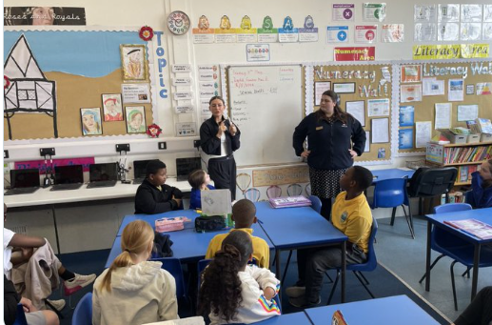
Priority 3
Leading and Improving –
Sharpen self-evaluation and improvement processes so that the school has a clear understanding of their impact on outcomes for pupils.

Slide 25
STRATEGIC PRIORITY 3: Leading and Improving – Sharpen self-evaluation and improvement processes so that the school has a clear understanding of their impact on outcomes for pupils.
RATIONALE: (Why is this on the plan this year? Schools should outline clearly using information (quantitative and qualitative) to justify.) Further to the Estyn inspection and our own self-evaluation, a recommendation was to Sharpen self-evaluation and improvement processes so that the school has a clear understanding of their impact on outcomes for pupils. A great deal of work has already been carried out regarding developing strategic leadership across the school. AoLE Leads have continued to grow in confidence with regard to their knowledge and understanding of the curriculum Framework and our own curriculum offer to our leaners. It is however felt that AoLE Leads need continued time to develop their evaluation skills and to embed systems in order to further develop the monitoring of progression and coverage of knowledge and skills, supporting further developments in the delivery of their AoLE, securing high standards and learner outcomes across the school.
Sub Priorities Estyn Recommendation | Intended Impact/ Success Criteria | Key Actions | Lead Person (to include governors) | Timeline | Funding (to include grant funding) | Link to Monitoring/Self Evaluation Activities that will give you evidence of impact on pupils (Reference documents or pages of documents from quality assurance timetable)
a) Sharpen self-evaluation and improvement processes so that the school has a clear understanding of their impact on outcomes for pupils. | Leaders at all levels able to demonstrate clearly the impact on outcomes for pupils following school improvement processes. School improvement processes and documentation that demonstrates a clear understanding of the impact on outcomes for pupils. School improvement priorities based on a rationale in response to self-evaluation focussing on the impact on pupil outcomes. | Leaders to audit and update proformas used for carrying out self-evaluation activities in order to ensure the focus is on the impact on outcomes for pupils. Leaders to review the format of the SDP and ensure that the evaluations focus on the outcomes for pupils. HT to report to governors on the impact on outcomes for pupils on a termly basis. Leaders to ensure the rationale for strategic priorities is based on self-evaluation and improvement processes, demonstrating a clear link to outcomes for pupils. | Leaders | Sep 26 – Jul 27 | SLT time to complete self-evaluation reports | Self-evaluation activities carried out by SLT, staff and governors e.g. learning walks, book looks and listening to pupils, assessment data review, monitoring planning, evaluations and progress reports, school improvement planning etc.
Evaluation (Continuous)

Slide 26
STRATEGIC PRIORITY 3: Leading and Improving – Sharpen self-evaluation and improvement processes so that the school has a clear understanding of their impact on outcomes for pupils.
RATIONALE: (Why is this on the plan this year? Schools should outline clearly using information (quantitative and qualitative) to justify.) Further to the Estyn inspection and our own self-evaluation, a recommendation was to Sharpen self-evaluation and improvement processes so that the school has a clear understanding of their impact on outcomes for pupils. A great deal of work has already been carried out regarding developing strategic leadership across the school. AoLE Leads have continued to grow in confidence with regard to their knowledge and understanding of the curriculum Framework and our own curriculum offer to our leaners. It is however felt that AoLE Leads need continued time to develop their evaluation skills and to embed systems in order to further develop the monitoring of progression and coverage of knowledge and skills, supporting further developments in the delivery of their AoLE, securing high standards and learner outcomes across the school.
Sub Priorities | Intended Impact/ Success Criteria | Key Actions | Lead Person (to include governors) | Timeline | Funding (to include grant funding) | Link to Monitoring/Self Evaluation Activities that will give you evidence of impact on pupils (Reference documents or pages of documents from quality assurance timetable)
b)AoLE Leads to continue to lead on curriculum development, ensuring developing knowledge of progression and coverage of knowledge and skills in their areas for pupils as well as ongoing school improvement and raised standards. | All pupils benefit from more coherent and progressive learning experiences as AoLE leads ensure curriculum coverage and progression are well understood and implemented. AoLE Leads demonstrating clear understanding of strengths and next steps for development in their curriculum areas, based on robust self-evaluation. Leaders at all levels making clear links between where monitoring results in changed action and subsequent pupil improvement. | AoLE Leads to audit area for the new school year and create action plan. AoLE Leads to liaise with staff, Cluster and wider, keeping up to date with developments in their area and sharing this information with the rest of the staff. AoLE Leads to continue to develop understanding of progression and monitor standards and coverage of knowledge and skills in their area for pupils and liaise and report to governors. AoLE Leads to liaise with pupil voice groups as appropriate. AoLE Leads to work with outside agencies/partners on any awards/initiatives as required. AoLE leads to monitor their curriculum areas and report on strengths and next steps for development, based on robust self-evaluation. | AoLE Leads | Sep 26 – Jul 27 | AoLE time to monitor area. | Monitoring through learning walks, book looks and listening to pupils and monitoring planning.
Evaluation (Continuous)

Slide 27
Resources and Monitoring
Notes:
Grant Funding Summary, Monitoring and Evaluation

Slide 28
Grant Funding Summary
Source of Funding | Purpose | Amount | Linked Priorities
School Standards Grant | Improve literacy, numeracy, and equity | £97,126 | Priority 1, 2
Pupil Development Grant | Reduce inequalities, support well-being | £85,157 | Priority 1, 2
Curriculum Reform Grant | Support curriculum development | £2,257.34 | Priority 1, 2
Professional Learning | Curriculum and ALN reform | £5,179 | Priority 4
Hwb Infrastructure | To support infrastructure and devices. | £4,200 | Priority 1
Period poverty | To ensure access to period products for all, free of charge and accessible in the most practical and dignified way possible. | £221 | Priority 2
ALN | To support ALN reform and training. | £4,278 | Priority 1, 2
MEGRT | Supporting pupils with English as an additional language to access their learning and settle into school. | £18,701.28 | Priority 1, 2 and 3
FEO Grant | Supporting pupil and family well-being and attendance. | £5,015 | Priority 2

Slide 29
Summary of Professional Learning
How the Governing Body will further the professional development of staff in order to meet the school improvement targets.
Governing bodies must consider:
Professional learner needs of ALL staff, including leadership development, in relation to achieving the school improvement priorities. These provisions also include teaching assistants and staff temporarily placed at the school.
Priority | Activity | Staff Group | Costs
Priority 1 | Mathematics school improvement officer | Teachers | /
Priority 1 | Literacy school improvement officer | Teachers | /
Priority 3 | SIA Training | Teachers | /
Priority 1, 2 & 3 | TAs to access training from the ALN menu as relevant | TAs | Cover at £140 per day
Total |  |  | £2,100 approx.
STAFF GROUPS
SMT – Senior Management Team
CL – Curriculum Leaders
TS – Teaching Staff
TA – Teaching Assistants
OSS – Other Supporting Staff (to include administrative, reception, cleaning, lunchtime, caretaking staff – this list is not exhaustive)
TS – Temporary Staff

Slide 30
Maintenance
Aspect | To Maintain and continue to improve current practice.
Learning – Teaching and Curriculum | Continue to ensure purposeful and authentic curriculum offer responsive to pupil voice. Continue to promote love of reading and development of higher order reading skills through RWI, guided reading strategies and Empathy approach. Continue to promote strong mathematics and numeracy teaching strategies, including White Rose, MyMaths, Numicon, problem solving and reasoning activities. Continue to develop outdoor learning opportunities that encourage engagement, positive attitudes and cross-curricular learning. Pupils and staff to continue to develop fluency and confidence when speaking, reading and writing Welsh.
Wellbeing /Care | Continue to embed emotional and mental wellbeing provision Continue to embed Pupil Voice – influencing planning through Epic planning and Pupil Voice groups involved in continuing to improve our school by monitoring and leading whole school projects. Continue to embed tracking and assessment processes. Continue to implement inclusive education and ALN strategies that support the progression of all pupils in line with the ALN Code.
Leadership | Continue to use SLO approach and reflective practice. Continue with quality profession learning offer linked to school development priorities and professional development review. Continue to develop all staff as leaders – staff self-reflection using performance development review model, professional standards and CPD logs etc. Continue to mentor and induct new staff. School to school work e.g. Enterprise and action research. Continue to refine self-evaluation processes – learning walks, book scrutiny and lesson studies to make accurate judgements and move teaching and learning from good to excellent with a focus on the difference made on outcomes for pupils. Continue to develop role of parents in their children’s education through community focused schools approach e.g. workshops, parent support groups, community café, community bank etc. Premises Review current H&S, safeguarding procedures to ensure they continue to meet requirements. LA links with Lisa Collins (Safeguarding) /Adam Butler (H&S).
Notes:
Grant Funding Summary, Monitoring and Evaluation

Slide 31

The school improvement priorities for the 2 school years immediately proceeding from the current school year.
Aspect | YEAR 1 | YEAR 2
Learning – Teaching and Curriculum | Continue to ensure purposeful curriculum planning. Continue to enhance pupil engagement and independence, ensuring the appropriate level of challenge. Continue to work with the Cluster developing a shared understanding of progression and assessment procedures across the AoLEs and DCF. Continue to increase learner confidence with Welsh oracy, reading and writing. Continue to develop Pupil Voice to promote continued independent learning. Continue to develop outdoor learning opportunities that encourage engagement, positive attitudes and cross-curricular learning. | Continue to refine and embed the curriculum offer. Continue to enhance pupil engagement and independence, ensuring the appropriate level of challenge. Continue to raise pupil standards with effective teaching and learning across the school.
Wellbeing /Care | Embed emotional and mental wellbeing provision. Continue to improve attendance. Continue to embed Pupil Voice – influencing planning through Epic planning and Pupil Voice groups involved in continuing to improve our school by monitoring and leading whole school projects. Continue to embed tracking and assessment processes. Continue to improve levels of attendance. Continue to offer an inclusive school with strategies to support inclusive education and ALN provision. | Continue to reflect on and improve our emotional and mental wellbeing provision. Continue to improve attendance. Continue to ensure pupil voice is firmly embedded. Continue to embed ALN provision to meet the needs of all pupils.
Leadership | Continue to ensure self-evaluation focuses on the difference made to outcomes for pupils. Continue to use SLO approach and reflective practice. Continue to offer quality PL Continue to mentor and induct new staff. School to school work e.g. Enterprise and action research. Continue to refine self-evaluation processes – learning walks, book scrutiny and lesson studies to make accurate judgements and move teaching and learning from good to excellent. Continue to develop all staff as leaders – staff self-reflection using performance development review model, professional standards and CPD logs etc. Continue to develop role of parents in their children’s education through e.g. workshops, parent support groups etc. Premises Review current H&S, safeguarding procedures to ensure they continue to meet requirements. LA links with Lisa Collins (Safeguarding) /Adam Butler (H&S). | Continue to ensure self-evaluation focuses on the difference made to outcomes for pupils. Continue to drive the school forward ensuring high standards and expectations for all. Continue to foster positive parental engagement e.g. support/ information/groups/attendance etc. Continue to develop professional learning offer and action research approach that impacts on standards. Premises Continue to review current H&S, safeguarding procedures to ensure that they continue to meet requirements.

Slide 32
Ongoing Background Activities
TARGET | TIMESCALE | PERSON RESPONSIBLE | COST
ALN Annual report to Govs | Summer term | ALN GOV /ALNCO | NIL
Analysis of data /pupil progress | Autumn / Spring / Summer | Teachers/SLT/HT | NIL
Analysis of class data / pupil progress | Termly | Teachers | Adds/Phase NIL
IDP writing and reviews twice annually, PCR, ALN support timetable & intervention programs according to need (see provision mapping and intervention programs records) | Ongoing | ALNCO/ALN Team | ALNCO/ALN Team Time
Local colleges link for training students /student mentoring | Termly | PB Teacher Mentor training | £115 ½ DAY PER TERM
Pupil Voice groups | Termly | Teachers | NIL
Criw Cymraeg | Termly | Ll. A | NIL
ECO Committee | Termly | AR | NIL
Healthy Schools | Termly | PW | NIL
MEGRT Monitoring and Record keeping | Annual survey | EAL Lead Ll. A/HT | MEGRT Grant
Digi Superheroes | Termly | PB | NIL
Reporting to parents /parents’consultations | Termly | Teachers | NIL
Curriculum monitoring/ standards | On-going program | AoLE teams | £115 ½ day Autumn/Summer Term per staff member
T&L monitoring | Termly | SLT / Phases | NIL
Performance development teachers /associate staff | Autumn / Summer | Team leaders / HT | £460/PPA (SUPPLY)
NGRT & Personalised Assessments- Numeracy, English, Reading | Summer term | SLT/teachers | NIL Phase time
Analysis / feedback of tests | Summer Term | SLT/teachers | NIL Phase time
AoLe Team annual review of policies and Action plans | Ongoing | AoLE teams | PPA TIME
AoLE Teams cluster work | Termly | AoLE teams | £460 per term
Health & Safety checks eg Fire / Risk Assess. | Annual audit /Termly check | Health and Safety Team/HT/Teaching staff | £230 supply
Pupil / Parent / staff / Gov questionnaires | Annual calendar ongoing | HT | NIL
ELKLAN/Wellcomm support for staff /pupils | On –going | D O’C | NIL
Thrive/ELSA/Therapeutic play/Scerts | Start of yr audit, group/individuals | HT/ Thrive TA / ELSA TA/ ALN Team | In-house cover
Ed Psych and ALNCo planning | Annual meeting – Sept | ALNCO | ALNCO Time
In-house Shared understanding of progression / standardisation and moderation | Termly | Teachers/SLT | Adds
Governor AoLE link meeting | Annual program | AoLE Leads/Govs | NIL
Community Assemblies | Termly | Libanus | NIL
After School / extra-curricular clubs | Weekly program | Teachers/TAs | NIL
Safeguarding procedures and site security | Ongoing (termly staff reminders) | HT/ DHT / All staff | NIL

Slide 33
Review of previous year’s priorities 2025-26
On reviewing school improvement targets, the school has evaluated its performance through asking 2 questions:-
Are pupils progressing in the ways described in the principles of progression, supporting them to develop towards the four purposes?
Is the pace of pupils’ progress in line with the expectations of teachers and the curriculum?
Answers to this have supported the development of lines of enquiry of subsequent self-evaluation and improvement.
Priority
Priority 1: To continue to embed systems that promote positive emotional and mental well-being of pupils and staff, supporting inclusivity and positive attitudes to learning.
Sub-priority | Expected outcome
a) All pupils and in particular our most vulnerable pupils having their needs met through consistency of approach, relational/​ PACE strategies, therapeutic play, Elsa and Thrive strategies and approaches. | Pupils able to call on strategies to support emotional regulation. Staff using a consistent, relational/pace approach leading to improved well-being for all and nearly all pupils being able to engage well in learning and sustain focus.
Actual outcome
All pupils (100%) benefit from a consistent, trauma-informed approach, with approximately 15–25% receiving targeted interventions and 5–10% accessing specialist support. As a result, around 90–100% of pupils feel safe and 85–95% demonstrate positive behaviour and attitudes to learning. Thrive re-assessments indicate that 75–85% of targeted pupils show improved emotional wellbeing, while over 80% of all pupils, including vulnerable groups, make expected or better progress. Behaviour incidents are effectively managed with very low escalation, learning disruption is minimal.
Sub-priority | Expected outcome
b) Pupils supported to understand their emotions, learn about healthy relationships and a healthy lifestyle and develop a greater understanding of inclusivity and non-discrimination by introducing updated health and well-being and RSE Curriculum resources. | Pupils demonstrating improved understanding of their emotions, about healthy relationships and a healthy lifestyle and developing a greater understanding of inclusivity and non-discrimination.​
Actual Outcome
All pupils (100%) access a progressive H&WB and RSE curriculum, many are receiving enhanced input through Spectrum sessions. As a result, approximately 90–100% of pupils demonstrate respectful attitudes and inclusivity, while 85–95% show developing understanding of emotions and relationships. Monitoring evidences clear progression across all stages, with most pupils able to identify healthy relationships and apply inclusive behaviours. This strong impact is supported by Estyn findings, which highlight that nearly all pupils respect differences and celebrate diversity. | All pupils (100%) access a progressive H&WB and RSE curriculum, with around 25–35% receiving enhanced input through Spectrum sessions. As a result, approximately 90–100% of pupils demonstrate respectful attitudes and inclusivity, while 85–95% show developing understanding of emotions and relationships. Monitoring evidences clear progression across all stages, with most pupils able to identify healthy relationships and apply inclusive behaviours. This strong impact is supported by Estyn findings, which highlight that nearly all pupils respect differences and celebrate diversity.

Slide 34
Review of previous year’s priorities 2025-26
On reviewing school improvement targets, the school has evaluated its performance through asking 2 questions:-
Are pupils progressing in the ways described in the principles of progression, supporting them to develop towards the four purposes?
Is the pace of pupils’ progress in line with the expectations of teachers and the curriculum?
Answers to this have supported the development of lines of enquiry of subsequent self-evaluation and improvement.
Priority
Priority 1: To continue to embed systems that promote positive emotional and mental well-being of pupils and staff, supporting inclusivity and positive attitudes to learning.
Sub-priority | Expected outcome
c) Pupils demonstrating improved well-being, engagement, resilience, collaboration and team building skills from taking part in outdoor learning sessions. | Most pupils are ready to learn both independently and collaboratively, demonstrating increased engagement and resilience.
Actual outcome
All pupils (100%) engage in a wide range of outdoor learning experiences, from continuous provision in the lower phase to structured upper-phase activities. As a result, around 90–100% of pupils demonstrate increased engagement, with 85–95% showing improved perseverance and resilience. Most pupils apply teamwork, communication and problem-solving skills effectively in meaningful real-life contexts. These experiences support strong skill progression, enhanced wellbeing and high levels of motivation in learning.
Sub-priority | Expected outcome
d) Pupils demonstrating further improved attendance and school continuing to foster home/school links. | Pupils attending school regularly. Pupils’ learning supported further via good communication between home and school, with an increase in pupil progress for pupils who previously had low attendance.
Actual Outcome
All pupils (100%) are closely monitored for attendance, with targeted support provided to approximately 10–20% of families. Through structured systems, strong multi-agency working and regular parental engagement, attendance has shown a small improvement of +0.28% and is currently stable at 91.8%. Most targeted families engage positively with support. While strategies are effective in maintaining attendance and strengthening home–school relationships, further improvement is needed to raise overall attendance levels.
Sub-priority | Expected outcome
e) Learner/​ parental and community engagement further developed in the in the life of the school.​ | Stronger relationships with families, community partners, and external agencies provide pupils with broader learning experiences and timely support for emotional and social needs. This leads to improved engagement, confidence, and readiness to learn across the curriculum.
Actual outcome
All families (100%) have access to a wide range of parental engagement opportunities, with approximately 40–60% actively participating and 10–20% engaging in targeted support programmes. As a result, around 90–100% of parents report strong relationships with the school. Initiatives such as Caffi Cymuned Treforys and the savings club enable most pupils to develop and apply real-life skills confidently, while parent programmes show high engagement and positive outcomes. This highly effective provision has been recognised by Estyn as outstanding, with parental partnerships significantly enhancing pupil wellbeing, learning and community cohesion.

Slide 35
Review of previous year’s priorities 2025-26
On reviewing school improvement targets, the school has evaluated its performance through asking 2 questions:-
Are pupils progressing in the ways described in the principles of progression, supporting them to develop towards the four purposes?
Is the pace of pupils’ progress in line with the expectations of teachers and the curriculum?
Answers to this have supported the development of lines of enquiry of subsequent self-evaluation and improvement.
Priority
PRIORITY 2:​ To continue to further enhance teaching and learning with a focus on the 3 Enablers and a purposeful curriculum that builds systematically on pupils’ existing knowledge, understanding, skills and experiences, securing progression as pupils move through the school.
Sub-priority | Expected outcome
a) Pupils offered a curriculum with an emphasis on the quality and impact of the interplay between the three enablers to inspire and challenge pupils in their learning through offering enabling adults, engaging experiences and effective environments. | Pupils making strong progress via enhanced learning experiences with a balanced interplay between the 3 enablers, ensuring they are challenged appropriately through enabling experiences, the correct support and effective environments.
Actual outcome
Approximately 85% of pupils demonstrated increased independence through engagement with enhanced learning environments, missions and skills-based activities. Around 80% of pupils were able to complete tasks independently, make effective use of learning spaces and show greater ownership of their learning. Pupil voice and action research findings indicated that approximately 90% of learners reported improvements in their confidence, participation and understanding as a result of the interplay between enabling adults, engaging experiences and effective learning environments. Overall, the initiative has had a positive impact on learner engagement and progress, with the majority of pupils responding well to increased levels of challenge and opportunities for independent learning.
Sub-priority | Expected outcome
b) Pupils offered a curriculum ensuring progression in knowledge, skills and experiences across the school, outlined clearly on curriculum plans for Year B by teachers. | Pupils offered appropriate coverage of knowledge, skills and experiences as outlined via curriculum mapping, for Year B from teaching staff, resulting in increased pupil outcomes.
Actual Outcome
100% of practitioners have contributed to the development of a coherent and progressive curriculum. Consequently, most pupils (approximately 85–90%) are making strong progress in acquiring and applying skills across the Areas of Learning and Experience. The implementation of detailed curriculum mapping and a fully established Cycle B curriculum has ensured consistency, progression and improved outcomes for learners across the school.
Sub-priority | Expected outcome
c) To challenge pupils more consistently to apply their skills at an appropriate level across the curriculum. | Pupils offered/accessing tasks that challenge their skills at an appropriate level across the curriculum.
Actual Outcome
Through the consistent implementation of independent skills tasks, outlined on consistent proformas, alongside the continued development of engaging learning environments, most pupils (85–90%) have shown improved independence, engagement and application of key skills. Practitioners have successfully applied approaches that promote learner autonomy and support sustained progress, resulting in positive outcomes for the majority of learners. This work will be continued in the new academic year.

Slide 36
Review of previous year’s priorities 2025-26
On reviewing school improvement targets, the school has evaluated its performance through asking 2 questions:-
Are pupils progressing in the ways described in the principles of progression, supporting them to develop towards the four purposes?
Is the pace of pupils’ progress in line with the expectations of teachers and the curriculum?
Answers to this have supported the development of lines of enquiry of subsequent self-evaluation and improvement.
Priority
PRIORITY 2:​ To continue to further enhance teaching and learning with a focus on the 3 Enablers and a purposeful curriculum that builds systematically on pupils’ existing knowledge, understanding, skills and experiences, securing progression as pupils move through the school.
Sub-priority | Expected outcome
d)Further improve learner fluency and understanding of number to support learner confidence across all areas of Mathematics and Numeracy. | As a result of well-planned lessons and activities from teaching staff, pupil’s confidence in number is increased with most pupils able to recall number facts/manipulate numbers (appropriate to their stage).​ ​ Raised standards of pupils in Mathematics and Numeracy as evident from teacher observations, pupil books and testing and National Test Scores.
Actual Outcome The school's mathematics provision is highly effective, with most pupils (85–90%) making good progress and developing secure mathematical understanding. Consistent use of White Rose Maths, CPA (Concrete, Pictorial, Abstract) approaches and high-quality practical resources have strengthened pupils' fluency, confidence and independence. Estyn recognised mathematics as a strength of the school, noting that the approach enables most pupils to make good progress and apply their numeracy skills effectively. Moving forward, further opportunities for reasoning in unfamiliar and open-ended contexts will support even greater levels of challenge and attainment.
Sub-priority | Expected outcome
e) Pupils confident using a range of sentence types, encouraging a sequential and explicit writing process, allowing pupils to develop and extend their writing. | Most pupils will write with greater clarity and precision, enabling them to express their ideas more effectively across all areas of learning. ​ Pupils’ books demonstrating evidence of the development of a range of different sentences within books.​ Raised standards of pupils in extended writing opportunities.
Actual Outcome The school's strategic and consistent approach to literacy has resulted in most pupils (85–90%) making good progress in writing. Through the effective use of the Literacy Scheme of Work, Sentence Progression Map and carefully planned cross-curricular opportunities, pupils are developing increasingly strong writing skills. Estyn recognised that most pupils make good progress over time, with older pupils writing confidently across a range of contexts and applying grammar, punctuation and text features effectively. As a result, standards in writing are improving across the school, with many pupils producing high-quality extended writing that demonstrates confidence, accuracy and creativity.
Sub-priority | Expected outcome
f)Pupils and staff continuing to develop fluency and confidence when speaking Welsh. | Continued increased use of Welsh across the school which builds pupils’ confidence and fluency, enabling them to communicate more naturally in a range of contexts. An increased vocabulary will support progression and strengthen their identity as Welsh speakers.
Actual outcome
The school's strong emphasis on Welsh language development has resulted in most pupils (85–90%) making good progress in their Welsh oracy skills. Through high-quality teaching, daily language practice and a consistent whole-school approach, pupils are becoming increasingly confident Welsh speakers. Estyn identified Welsh as a significant strength, noting that most pupils develop strong Welsh language skills over time, with many able to hold simple conversations by the time they leave the school. The achievement of the Siarter Iaith Gold Award in July 2026 further demonstrates the school's success in embedding Welsh language and culture throughout all aspects of school life and fostering positive attitudes towards bilingualism.

Slide 37
Review of previous year’s priorities 2025-26
On reviewing school improvement targets, the school has evaluated its performance through asking 2 questions:-
Are pupils progressing in the ways described in the principles of progression, supporting them to develop towards the four purposes?
Is the pace of pupils’ progress in line with the expectations of teachers and the curriculum?
Answers to this have supported the development of lines of enquiry of subsequent self-evaluation and improvement.
Priority
PRIORITY 3:​ To continue to develop purposeful ALN and assessment and tracking procedures that secure pupil progression and achievement and provision that meets the needs of all pupils.
Sub-priority | Expected outcome
a) Continue to strengthen pupils’ depth and extension of learning and understanding, via skilful questioning and reflective feed forward opportunities in the classroom. Encourage further improved presentation and handwriting skills from pupils. | Nearly all older pupils will be able to ask and answer a range of questions.​ Pupil’s learning extended and deepened.​ Pupils reflecting on their learning and how this can be progressed in next steps.​ Pupils reflecting on their peer’s work to support learner progress. ​ Pupils demonstrating further improved handwriting and presentation skills.
Actual outcome
The school's focus on developing questioning, critical thinking and authentic learning experiences has had a positive impact on pupil engagement, independence and progress. Most pupils (85–90%) demonstrate improved higher-order thinking skills, confidently asking and responding to increasingly challenging questions. Meaningful engagement with STEM professionals and enterprise projects has strengthened pupils' understanding of careers and the relevance of their learning beyond the classroom. In addition, the majority of pupils (90%) have improved their handwriting, presentation and communication skills, contributing to higher-quality outcomes across the curriculum. Overall, these approaches are successfully developing confident, reflective and ambitious learners.
Sub-priority | Expected outcome
b) Pupils’ IDP outcome progress tracked and monitored using a person-centred approach, continuing to move pupils closer to their positive change/aspirations. | Pupil outcomes tracked to ensure they are child centred, relate to the child’s specific need and relate to either the aspirations, what’s working or what could be better for them within at least one of the areas:​ • Language, Learning and Development and Skills.​ • Living Independently.​ • Friends, Relationships & Community Inclusion.​ • Health and Wellbeing.
Actual Outcome
The school's approach to supporting pupils with ALN continues to be a significant strength. Through robust Person-Centred Meetings, regular IDP reviews and effective collaboration between staff, families and external professionals, most pupils with ALN (85–90%), including those in the STF, make good progress from their individual starting points. Precise target-setting, responsive provision and well-planned support programmes ensure that most pupils' needs are identified early and addressed effectively. As a result, pupils are supported successfully in overcoming barriers to learning, achieving their outcomes and progressing towards their long-term aspirations.
Sub-priority | Expected outcome
c) All pupils making strong progress from their starting points. | All pupils provided with a high standard of provision by all school stakeholders who understand their starting points using a range of data and evidence. Pupils make clear progress from their relative starting points.
Actual Outcome
The school's approach to ALN continues to be a significant strength. Robust assessment and tracking procedures ensure that all pupils with ALN are carefully monitored, with provision adapted quickly to meet emerging needs. As recognised by Estyn, most pupils with ALN (85–90%), including those in the STF, make good progress from their starting points as a result of precise target-setting, effective interventions and strong multi-agency collaboration. Ongoing professional learning has enhanced staff expertise and confidence, while rigorous transition planning and well-established systems ensure continuity of support. Consequently, pupils with ALN are well supported to achieve their individual outcomes, participate fully in school life and develop the skills required for future success. | The school's approach to ALN continues to be a significant strength. Robust assessment and tracking procedures ensure that all pupils with ALN are carefully monitored, with provision adapted quickly to meet emerging needs. As recognised by Estyn, most pupils with ALN (85–90%), including those in the STF, make good progress from their starting points as a result of precise target-setting, effective interventions and strong multi-agency collaboration. Ongoing professional learning has enhanced staff expertise and confidence, while rigorous transition planning and well-established systems ensure continuity of support. Consequently, pupils with ALN are well supported to achieve their individual outcomes, participate fully in school life and develop the skills required for future success.

Slide 38
Review of previous year’s priorities 2025-26
On reviewing school improvement targets, the school has evaluated its performance through asking 2 questions:-
Are pupils progressing in the ways described in the principles of progression, supporting them to develop towards the four purposes?
Is the pace of pupils’ progress in line with the expectations of teachers and the curriculum?
Answers to this have supported the development of lines of enquiry of subsequent self-evaluation and improvement.
Priority
PRIORITY 4:​ To continue to ensure leadership and professional learning impact on standards and learner outcomes across the school.
Sub-priority | Expected outcome
a)AoLE Leads to continue to lead on curriculum development, ensuring developing knowledge of progression and coverage of knowledge and skills in their areas for pupils and ongoing school improvement and raised standards.​ (Support to be provided for new ECO Lead to settle into role and continue to drive the school forward in this area).​ | All pupils benefit from more coherent and progressive learning experiences as AoLE leads ensure curriculum coverage and progression are well understood and implemented. The ECO Committee’s work fosters pupil leadership, environmental awareness, and real-world problem-solving, enhancing engagement and responsibility across the school.
Actual outcome
Leadership of the Areas of Learning and Experience is highly effective, with 100% of AoLE Leads actively monitoring, evaluating and improving provision across the school. As a result, most pupils (85–90%) are making strong progress in developing their skills and knowledge through a broad, balanced and engaging curriculum. Effective collaboration between staff, cluster schools and curriculum leaders has strengthened progression, transition and curriculum coherence. Ongoing monitoring and evaluation ensure that strengths are built upon and areas for development are addressed promptly, contributing to continued improvement in pupil outcomes and learning experiences.
Sub-priority | Expected outcome
b) To sharpen self-evaluation and improvement processes so that the school has a clear understanding of their impact on outcomes for pupils.​ | Leaders able to demonstrate clearly the impact on outcomes for pupils following school improvement processes.​ ​ School improvement processes and documentation that demonstrates a clear understanding of the impact on outcomes for pupils.​ ​ School improvement priorities based on a rationale in response to self-evaluation focussing on the impact on pupil outcomes.
Actual Outcome The development of self-evaluation and monitoring processes has strengthened leadership capacity across the school. All AoLE Leads (100%) have engaged in professional learning and undertaken effective monitoring activities, leading to more accurate evaluation of pupil progress and provision. As a result, most pupils (85–90%) are making good progress in developing their knowledge and skills, while identified areas for improvement are being addressed through informed planning and targeted actions. This is contributing positively to continuous school improvement with a focus on the impact on learner outcomes.
Sub-priority | Expected outcome
c) Continue to foster professional development and action research that impacts on pupil performance. | Staff self-reflective and ensuring their professional learning is impacting on pupil progress. Professional development linked to school development plan targets, therefore impacting on pupil performance.
Actual Outcome
The school's professional learning culture continues to be a significant strength. All staff (100%) actively engaged in professional development, enquiry-based learning and reflective practice aligned to whole-school priorities. Estyn recognised the positive impact of this approach, noting that professional learning encourages staff to update and improve their practice through research-informed strategies. As a result, most pupils (85–90%) have benefited from enhanced learning experiences, improved engagement and increased opportunities to take ownership of their learning. The effective use of action research and pupil voice has further strengthened self-evaluation processes and is feeding into a continued focus on improving outcomes for all learners.

Slide 39
Review of previous year’s priorities 2025-26
On reviewing school improvement targets, the school has evaluated its performance through asking 2 questions:-
Are pupils progressing in the ways described in the principles of progression, supporting them to develop towards the four purposes?
Is the pace of pupils’ progress in line with the expectations of teachers and the curriculum?
Answers to this have supported the development of lines of enquiry of subsequent self-evaluation and improvement.
Priority
PRIORITY 4:​ To continue to ensure leadership and professional learning impact on standards and learner outcomes across the school.
Sub-priority | Expected outcome
d)Continue to develop pupils as leaders and support their involvement in school improvement processes. | Pupils confident to talk about how they have improved and developed their school and what they like about their school.​ Pupils aware of their rights and responsibilities.
Actual outcome
Pupil leadership is a significant strength across the school. Nearly all pupils (90%) have benefited from opportunities to influence school life, contribute to decision-making and participate in meaningful leadership activities. The work of the School Council, Healthy Schools Committee, Eco Committee and Criw Cymraeg has resulted in notable successes, including the achievement of the Eco-Schools Platinum Award for the 6th time and Cymraeg Campus Gold Award. Through these experiences, pupils have developed confidence, leadership, communication and teamwork skills whilst making a positive contribution to the school community and wider society. As a result, pupils are increasingly becoming ethical, informed and active citizens who understand their role in shaping their school and community.
Sub-priority | Expected outcome
e)To continue to ensure the monitoring and maintenance of safeguarding and health and safety procedures and processes. | A safe environment maintained for pupils, staff and visitors to the building.​ Safeguarding and health and safety procedures maintained to a high standard.
Actual Outcome
Safeguarding, health and safety arrangements remain a significant strength of the school. All staff (100%) have received relevant training and updates throughout the year, ensuring a strong culture of safeguarding and vigilance. Robust systems, regular audits and effective record-keeping ensure statutory responsibilities are met consistently. Estyn recognised that the school provides a safe and nurturing environment and confirmed that safeguarding and site management arrangements give no cause for concern. As a result, nearly all pupils (95–100%) learn in a secure, supportive environment where their wellbeing, safety and welfare are prioritised effectively.

