Slide 1

Morriston Primary School
Prospectus 2026-2027

Slide 2

Our School Vision
Our vision is encapsulated in Article 29 –
‘Your Right to be the best you can be.
In Morriston Primary School we aim to provide a broad, balanced and rich curriculum. We offer an inclusive environment where pupils are encouraged to be healthy, happy, digitally competent, creative, confident and resilient learners. We challenge our pupils to reach their full potential, equipping them with the skills necessary to continue on their journey of life-long learning.
Our School Mission Statement
“Together Everyone Achieves More”
Learning and working together as a community, we challenge and support each other, to achieve our goals.

Slide 3
The Governing Body of
Morriston Primary School
Mr A Beynon | Chair of Governors (CO)
Mrs N James | Vice Chair (LA)
Ms. L Davies | Parent
Cllr A Harrington | LA
Cllr Y Jardine | LA
Mr J Nsofor | CO
Mrs C Beynon | CO
Miss P White | Staff
Mrs D O’Connor | Support staff
Mrs A Thomas | Headteacher
Mr M Bannister | Deputy Headteacher (Ex-officio governor)
Miss R Eynon | Clerk to the Governors
Together Everyone Achieves More

Slide 4

Staff
Mrs A Thomas | Headteacher | BA (Hons), PGCE, PG Dip, NPQH
Mr M Bannister | Deputy Headteacher | BSc (Hons), PGCE, PG Cert., PG Dip, NPQH
Mr P Bendle | Teacher | BA Ed (Hons), PG Dip
Mrs S Watts (PT) | Teacher | BA (Hons), PGCE, MA
Mrs L Moore | Teacher | BA Ed (Hons)
Miss P White (PT) | Teacher | BA Ed (Hons)
Mrs G Harris | Teacher | BA Ed (Hons), PG Dip
Miss A Rees | Teacher | BA Ed (Hons)
Miss R Johns | Teacher | BA Ed (Hons)
Together Everyone Achieves More

Slide 5

Associate Staff
Mrs L Lovering | Miss S Cole | Miss S Osborn
Ms D O’Connor | Mrs D Samuel (PT) | Miss S Otter
Mrs D. Bowen (PT) | Mrs S Siberry (PT) | Ms S Chamunni
Miss L. Sellere | Mrs R Phillips | Miss R Eynon
MIss R Cosgrove | Mrs J Griffin (PT) | Miss M Jones
Ms A Matthews | Miss E Hill (PT) | Ms K Watkins
Mrs S Melville (PT) | Ms A Cross (PT)
Mr J Jones | Caretaker
Together Everyone Achieves More

Slide 6
At Morriston Primary School we aim:
·To make everyone feel special
·To listen to each other
·To do our best in all activities
·To respect others
·To be healthy, happy, tolerant and kind
·To develop the four purposes
·To look after our environment
·To live our lives through positive values
·To work together as a team
·To understand and value the UNCRC
·To foster a love of Wales and where we come from
Further aspects of school ethos are incorporated in the Home–School Agreement. This agreement was produced in consultation with parents. A copy of this agreement can be found on the next few pages.
Our School Aims
Together Everyone Achieves More

Slide 7
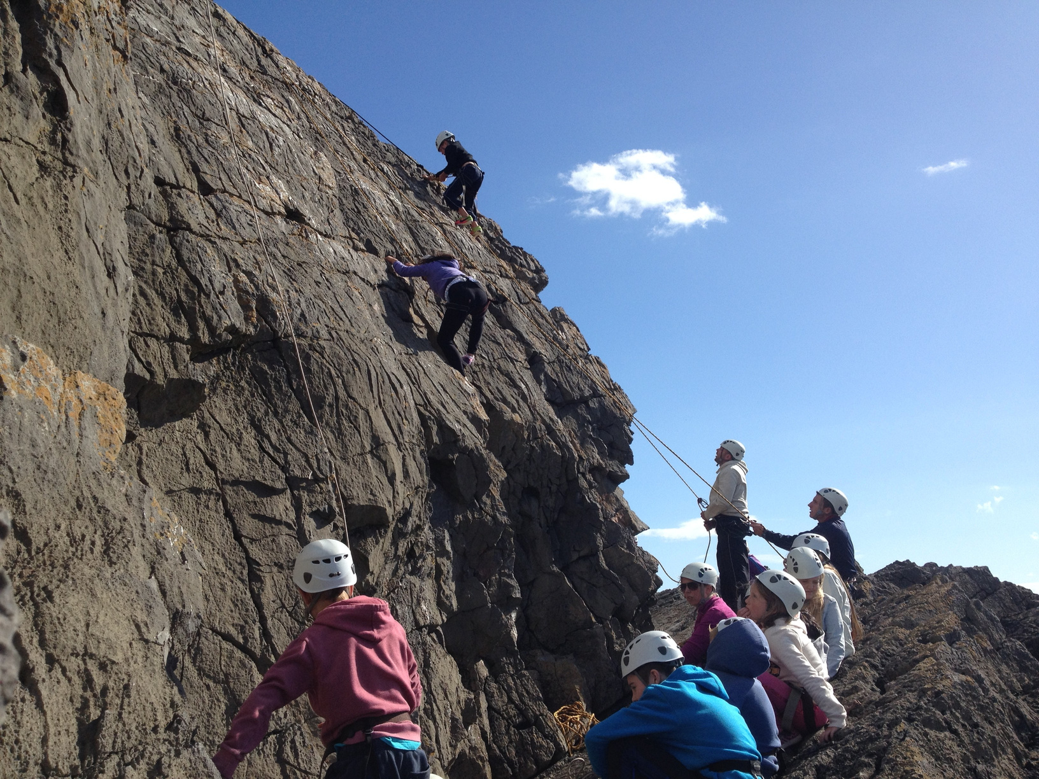
Equal Opportunities
It is our aim in Morriston Primary School to offer equal opportunities to every pupil irrespective of sex, race, learning needs or disability, religion or demographic.
All learners are to be regarded as equal.
Whatever their stage of development, all learners will be equipped with skills, knowledge, concepts and attitudes necessary for their future work and family life.
We believe that an awareness of equal opportunities leads to good educational practice, including the review of teaching methods and materials.
We aim to promote an ethos and atmosphere to show respect and to develop a personal moral code sensitive to the needs of others. This is the entitlement of all persons entering the school. To this extent all within the school will work towards ensuring a community based on mutual respect, offering equal opportunities to everyone.
This equal opportunity statement will be reviewed periodically.
Together Everyone Achieves More

Slide 8
A parent/guardian will need to:
  Ensure that their child goes to school regularly, on time and properly dressed
  Inform the school of any concerns or problems about their child’s work or behaviour
  Support the school’s policies and guidelines for behaviour
  Support their child in homework and other opportunities for home learning
  Attend parents’ evenings and discussions about their child’s progress
  Contact the school if their child is absent on the first day this occurs
  Attend any school meetings, assemblies, events, and concerts
  Keep the school informed of any changes of information e.g. change of address, telephone number etc.
  Get to know about their child’s life at school
Morriston Primary School
Home – School
Agreement
Together Everyone Achieves More

Slide 9
The School will:
  Provide a caring, safe and happy environment where learners are encouraged to be healthy
  Keep you informed about your child’s progress
  Set and mark homework
  Insist that learners observe school rules of behaviour, safety and learning
  Expect learners to take an active role in the life of the school
  Encourage learners to value what they achieve
  Expect parents/guardians to bring or send their children to school on time
  Provide a broad and balanced curriculum offering authentic learning experiences where the four purposes are developed fully
  Endeavour to educate each individual learner to reach their potential
Learners will need to:
  Always try to do their best at school so they feel proud of themselves.
Morriston Primary School
Home – School
Agreement
Together Everyone Achieves More

Slide 10
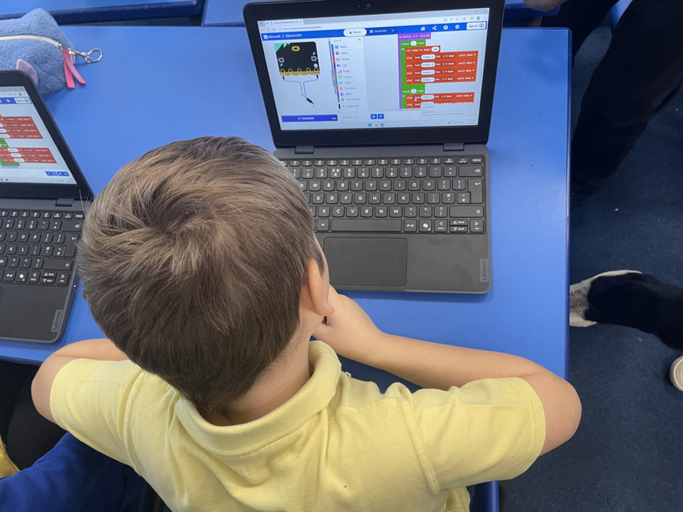
Curriculum and School Organisation
The underlying beliefs regarding the aims mentioned above emphasise the way we want our pupils to experience the curriculum at Morriston Primary School. These beliefs may be summarised as follows: -
  Pupils should feel happy, healthy, secure and motivated
  Pupils should be enabled to achieve their full potential
  Pupils should develop towards the four purposes
  Pupils should have opportunities to work together and independently
  Pupils should experience success in what they do
  Pupils should have the opportunities to learn and discover things for themselves through first-hand experience
  Pupils need to be aware of the needs of others and respect their views and values
  Pupils’ individuality should be valued, encouraged and respected
  All pupils should be treated equally and fairly
  Pupils need to realise their unique Welsh identity and also understand the other cultures, traditions and religions
  That learning is a shared process between home, school and the wider community
  Pupils should develop their cross curricular literacy, numeracy and digital competence skills and their integral skills, ready for a journey of life-long learning.
  Pupils should be encouraged to develop their creativity, health and well-being and resilience as learners.
Together Everyone Achieves More

Slide 11
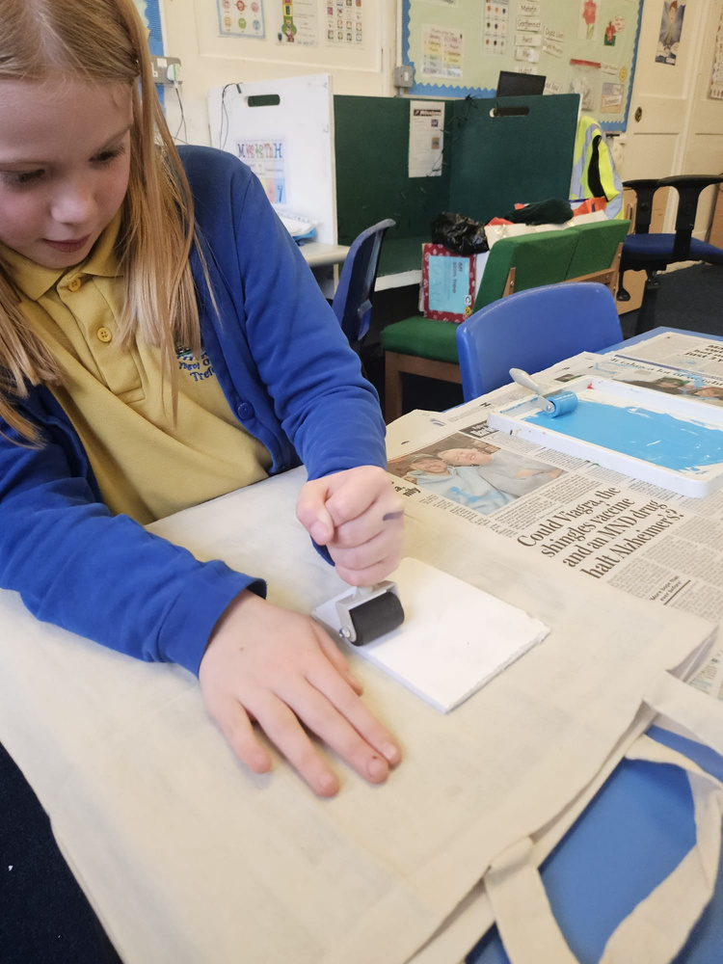
Curriculum and School Organisation
All pupils are encouraged to develop their knowledge and skills through the Four Purposes and the Six Areas of Learning and Experience – Languages, Literacy and Communication, Mathematics and Numeracy, Science and Technology, Expressive Arts, Humanities and Healthy and Well-being. The Foundation Phase principles are applied in the Lower Phase in Morriston Primary to ensure the children are given the opportunities to become more independent in their learning. EPIC (Everybody Planning In Class) planning is an approach we foster. This involves the children planning with the teacher on what they would like to explore further. This information is then displayed clearly on the pupil voice boards and can be referred to throughout the week again to allow children to practice their skills. Pupils are responsible for directing their learning whilst also applying their integral skills and skills across the curriculum in Numeracy, Literacy and DCF and recording their challenges in their Challenge/Skills Books.
Teacher assessments are reported to parents at parent interviews and also through mid-year and end of year written reports. The teacher’s planning is supported by Curriculum Maestro. Planning often includes rich tasks and enterprise activities which give pupils the opportunity to apply their literacy, numeracy and DCF skills through real life, authentic learning situations.
Great emphasis is placed on the teaching of reading as good reading skills are imperative for a pupil to access the curriculum. The school has adopted ‘Read Write Inc’ which is a structured reading program, used throughout the school as appropriate. Staff have received training in this phonic approach. Pupils can then be taught individually or in small groups and at the correct ability level. This approach to reading has been a huge success in the school and impacted greatly on standards.
Together Everyone Achieves More

Slide 12
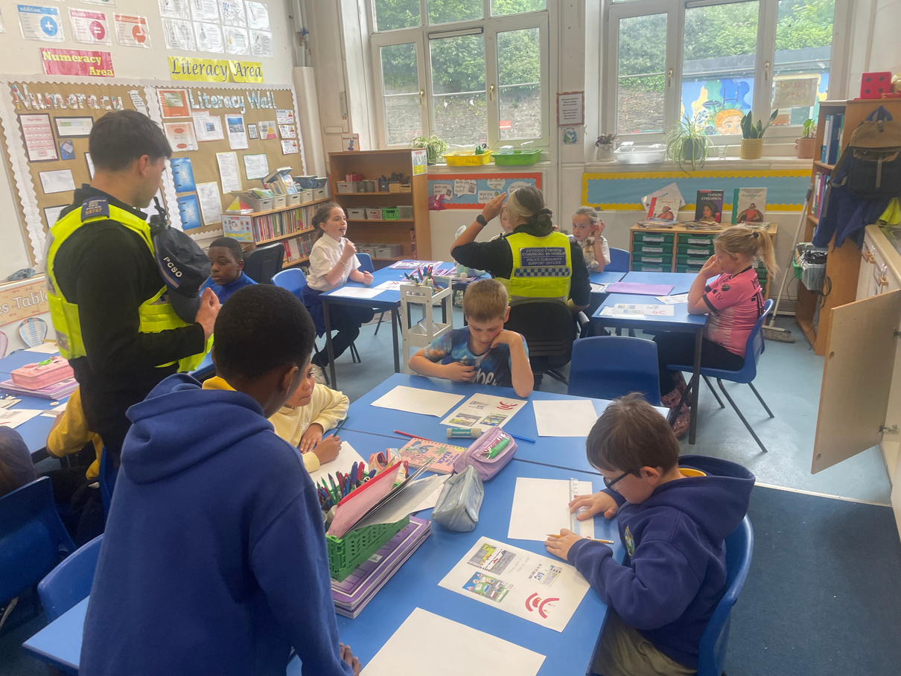
Curriculum and School Organisation
Reading is also taught through a Guided Reading approach. Guided Reading sessions involve a teacher and a small group being taught during a session lasting approximately 20 minutes. While guided reading takes place with one group of children, the remaining children are engaged in quality independent or group literacy tasks, with the aim of allowing the teacher to focus on the small group without interruption.
The school also invites outside specialists into school to develop experiential learning. The school also recognises the value of educational visits in offering direct experiences that are difficult to create in school.
Together Everyone Achieves More

Slide 13

Pupil Voice groups
School council
The School Council plays an active role in helping to improve our school and ensure pupils have a voice and influence school decisions.
Message from the members of the School Council:
“Welcome to the School Council. In our group we make decisions about how our school is run and we take on projects to support our school and peers. We help organise events with our fellow pupil voice groups and this helps to make our school community a safe and happy place.”
Together Everyone Achieves More
Eco council
The school has an ECO Committee and club which aims to help promote sustainability and global citizenship amongst pupils, parents and governors.
The school Eco Committee and club meets regularly to discuss issues relating to the school, its local environment and the wider community. Pupils contribute to planning events and assemblies on a regular basis.
Message from the members of the Eco-committee:
“In our group we recognise that we will have a responsibility to our environment and that of the wider planet. We pledge to raise the awareness of our members and to reduce energy usage and re-use and recycle. Environmental issues are key across our curriculum at Morriston Primary School. We take part in many activities including recycling, taking care of our school grounds and learning to care for the wildlife in our local environment.
Our hard work has paid off and we are a Platinum Plus Eco School and also a Beacon School for the ECO Schools initiative.”

Slide 14
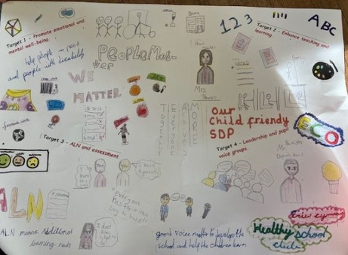
Pupil Voice groups
Digi Superheroes
The School Digi Superheroes are an asset to the school and they work hard to ensure they reinforce the importance of online safety.
Message from the members of the Digi Superheroes group:
“Welcome to the Digi Superheroes group, in our group we like programming using software such as Scratch and J2Code. We help to share the important message of keeping safe online, with the rest of the school, as well as supporting them to access software and apps as needed.”
Criw Cymraeg
The Criw Cymraeg work hard to promote and maintain the Welsh ethos within our school community. The members of the Criw support the Welsh Co-ordinator to foster the use of Welsh throughout the school.
Message from the members of the Criw Cymraeg:
“Croeso! We work to instill a genuine enthusiasm for the Welsh language and Welsh heritage across the school. We ensure the school’s vision for Welsh has a high focus. We work hard to improve the amount of incidental Welsh spoken by both staff and pupils, for example we made Welsh menus for the dining hall.
We create a genuine enthusiasm for Welsh within the school that extends to all pupils and staff. We are responsible for introducing initiatives aimed at improving standards in Welsh. We support with maintaining the standards of the Gold Siarter Iaith Award which we achieved in July 2026. We also support with Welsh Assemblies and parent/governor learning sessions.”
Together Everyone Achieves More

Slide 15
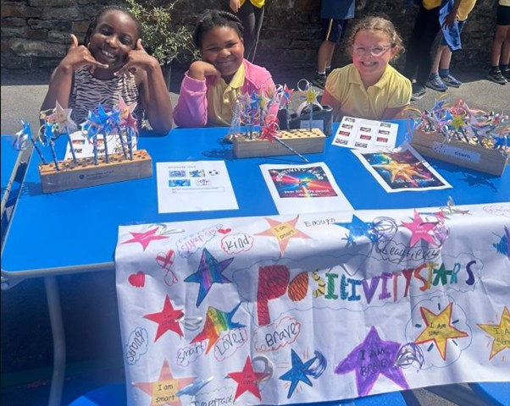
School Organisation
All classes are of mixed ability. There are two Specialist Teaching Facility classes, one for Lower Phase pupils and one for Upper Phase pupils.
Class organisation may be shown in the following way: -
  Nursery pupils (3 and 4 year olds)
  Reception (4 – 5 year olds)/Year 1 (5 – 6 year olds)
  Year 1 (5 – 6 year olds)/Year 2 (6 – 7 year olds)
  Year 3/4 (7 – 9 year olds)
  Year 4/5 (8 – 10 year olds)
  Year 5/6 (9 – 11 year olds)
Class organisation may change from year to year as pupil numbers fluctuate. In all classes teachers match learning experiences to the individual needs of each learner.
Together Everyone Achieves More

Slide 16
Religion, Values and Ethics
Religion, Values and Ethics is a mandatory element of the Curriculum for Wales for pupils aged 3-16. RVE is taught following the Agreed Syllabus.The school policy, based on this syllabus is available for inspection at the school. The teaching of RVE is also supported by Curricwlwm Maestro, Love to Celebrate resources and NATRE resources. Children study the major religions including Christianity during their primary school years. The school has established links with places of worship within the county that represent various denominations and faiths, and pupils make visits in connection with themes being studied in their classroom.
Collective Worship
We ensure there is a daily act of collective worship in school. This takes place during morning/afternoon assembly (either in class or in the hall). Assemblies are aimed at highlighting positive values and the way we live our lives and the importance of the UNCRC. A parent can request that their child is excused from collective worship and schools must agree to such requests.
The school has established good working relationships with local churches and chapels and it is a privilege to welcome clergy and lay representatives into the school to take acts of worship.
Together Everyone Achieves More

Slide 17
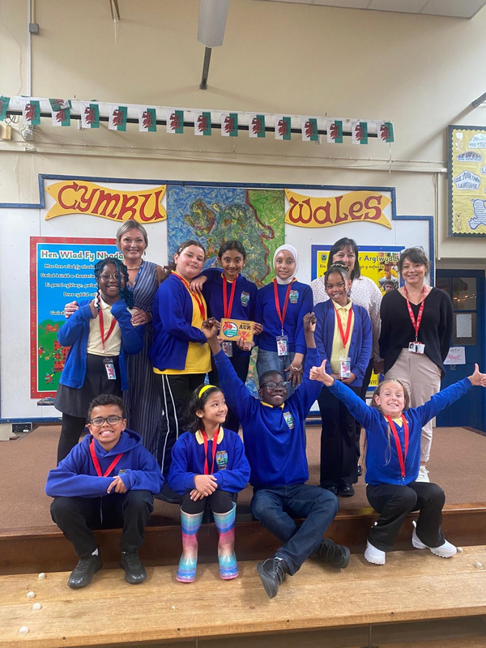
Relationships and Sexuality Education
The school’s policy is based on the Authority’s Policy Statement that has the approval of the Governing Body. Parents may examine the RSE Policy, view teaching materials and ask questions. The policy, which covers the whole of the primary school age range, is both sensitive and supportive and is available for inspection at the school. The school works alongside the school nurse, Spectrum and other relevant outside agencies to deliver the RSE curriculum.
Welsh
The medium of instruction at Morriston Primary School is English, however, the teaching of Welsh is a requirement of the Curriculum for Wales. All teachers teach Welsh language as a second language. Children’s understanding and use of the Welsh language is developed through conversation, understanding and use of Welsh language patterns, responding to questions and instructions in Welsh. Welsh is also used across the curriculum and in as many contexts as possible and there is evidence of Welsh Signage and displays around the school.
Learning Welsh songs, listening to traditional Welsh stories, studying aspects of Welsh history, geography, art and music are some of the other areas through which the school seeks to develop an understanding and love of the richness of Welsh culture and Cynefin.
A Welsh Education Officer, also visits the school on a regular basis and provides advice, resources and visual materials to support the speaking, listening, reading and writing activities of the learners.
The Criw Cymraeg have worked incredibly hard under the guidance of Mrs. Arnold and we achieved our Gold Siarter Iaith award in July 2026.
Together Everyone Achieves More

Slide 18
Admissions
Admissions to the school follow the City and County of Swansea Admissions Policy.
We welcome visits to the school from prospective families and we work with the local authority when considering applications to the school. Parents/carers apply online for places or for mid-year transfers. The school clerk is available to assist any parents having difficulty with this system. Nursery pupils can apply directly to the school.
Accessing Documents
Parents wishing to examine any documentation relating to the school’s curriculum should contact the school office or visit the school website https://www.morristonprimaryschool.co.uk/
A copy of a document can be provided by arrangement with the Headteacher.
Complaints Procedure
Any complaint should, in the first instance, be taken to the class teacher and then the Headteacher. The school complaints policy and procedure is available from the school office.
The Local Education Authority also has a formal complaints procedure. Further advice may be obtained form the Education Department Tel. 01792 636000.
Parents, Teachers & Friends Association (PTFA)
The school has a PTFA which plans fundraising events throughout the year. Every parent is automatically a member of the PTFA. The PTFA committee welcomes all parents (and other family members) to attend their meetings which are advertised at the school.
Together Everyone Achieves More

Slide 19
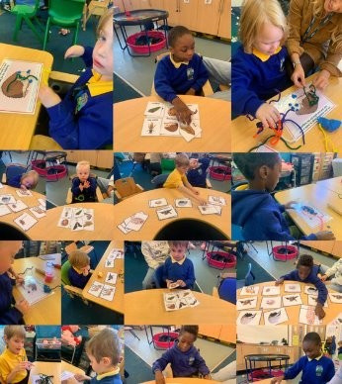
Meeting Individual Needs
Morriston Primary School has two Specialist Teaching Facilities (STFs), children are admitted to these STFs under arrangements made by the Local Authority. All children admitted are in receipt of an IDP. Prior to admittance the Headteacher/appropriate STF Teacher, the Education Psychologist, parents and any other agency representatives meet to discuss the perceived needs of the pupil.
As regards the additional learning needs of pupils in the mainstream classes the school offers school support and a referral system if additional support or assessments are needed. At all stages the school will liaise with the parent or legal guardian.
Pupils are assessed individually to identify any additional learning needs and provision needed based on the assessment findings. The school’s Educational Psychologist is involved in this process.
All children assessed as having Additional Learning Needs will have an Individual Development Plan (IDP), which outline learning needs, provision and outcomes for moving forward.
Fuller explanation of the additional learning needs provision can be found in the school’s policy statement that is available from the school office as required.
The school is committed to meeting the needs of each individual pupils in order that they achieve their full potential. Individual pupils will be encouraged to perform to the best of their ability. We will strive for excellence in all areas by creating an atmosphere in which all our pupils flourish and an environment where pupils feel comfortable and valued in a culture of ambition and aspiration.
Together Everyone Achieves More

Slide 20
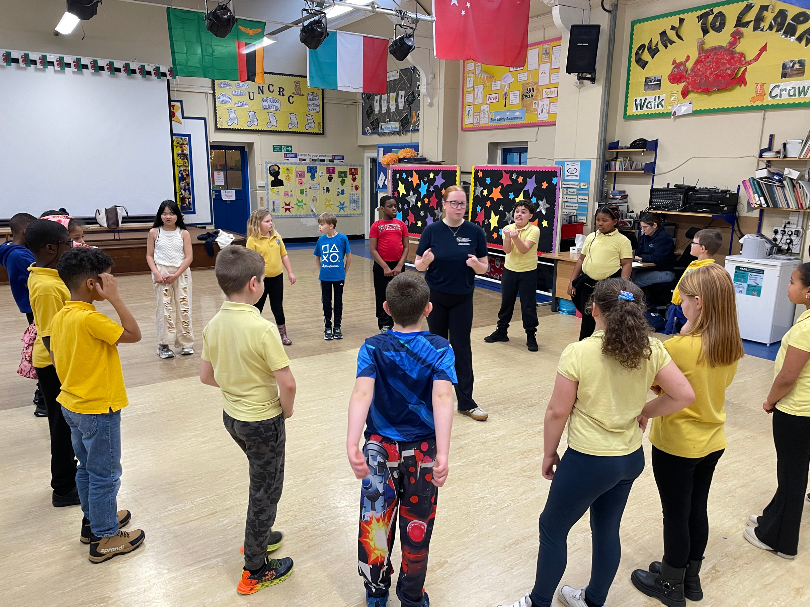
CLA (Children Looked After)
The designated member of staff who has the responsibility for promoting the educational achievement of Children Looked After children is the Headteacher, and in her absence the ALNCo.
Cllr. Andrea Harrington is the link governor for CLA.
Personal Education Plans and Individual Education Plans are kept and updated regularly for all CLA. These keep a track of strengths and areas for development and personal targets for the pupils. The Headteacher or a member of staff who knows the child well attends all CLA reviews as well as sending copies of PEPs and IDPs to the Independent Reviewing Officer prior to the review.
Governors are kept informed of the number and progress of CLA pupils through Headteacher’s reports. All staff liaise with carers of CLA pupils as and when this is necessary.
Together Everyone Achieves More

Slide 21
Attendance and Punctuality
EXCELLENT ATTENDANCE IS A PRIORITY OF THE SCHOOL
  Make sure that your child comes to school regularly, arrives on time. Start these good habits at an early age, while your child is at primary school.
  If your child is ill, contact the school on the first day of your child’s illness. Staff will be concerned if they do not hear anything. You will be contacted by the school on the first day of illness if the school have not received a reason for absence.
  Wherever possible, you should take your holidays during school holidays.
  Avoid taking your child on holiday at times when he or she should be in school.
  School will not authorise a family holiday during term time. Fines may be incurred for non-attendance and your child’s record of attendance will be taken into account.
  Parents and pupils will be kept informed of pupils’ attendance and will be notified if there are concerns and if they are doing well.
  Children are rewarded for excellent attendance, weekly, half termly and at the end of the year.
Together Everyone Achieves More

Slide 22
Attendance and Punctuality
EXCELLENT ATTENDANCE IS A PRIORITY OF THE SCHOOL
School attendance over the last 6 years
Our aim is that whole school attendance will reach 95% + but this will only be achieved if every pupil does their very best to attend every session.
An unauthorised absence is when the school has not received an oral or written explanation for a pupil’s non-attendance, or when an explanation is unacceptable. Morriston Primary follows the local authority attendance pathway.
Parents are sent letters about low attendance. If attendance does not improve within 2 weeks, a second letter is sent stating the EWO will become involved. If after a week, attendance still hasn’t improved, a third letter is sent asking the parents to come to school for a meeting. Fixed penalty notices have been reinstated since September 2022. Letters are also sent home concerning lateness. If no satisfactory explanation can be obtained for frequent lateness the school Educational Welfare Officer will be asked to call at the home in question.
2020/2021 | 2021/2022 | 2022/2023 | 2023/2024 | 2024/2025 | 2025/2026
90.6% | 89.8% | 89.5% | 90.4% | 91.9% | 91.4%
Together Everyone Achieves More

Slide 23
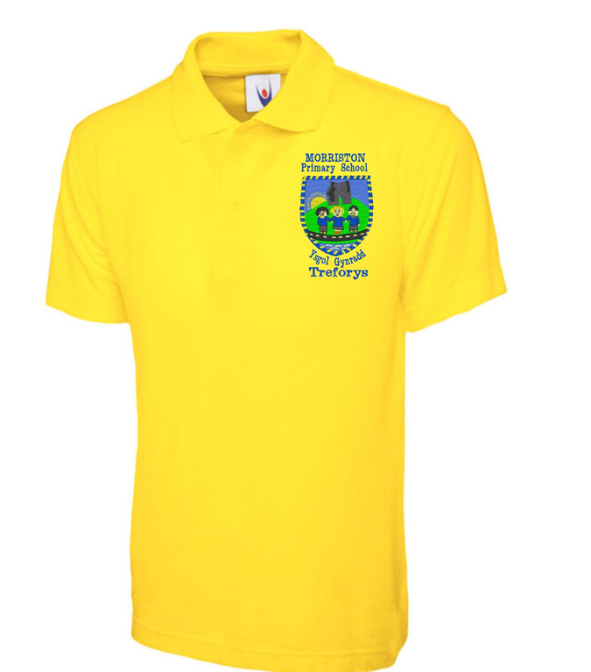
School Uniform
  Grey skirt/grey trousers
  Gold polo shirt
  Blue sweatshirt/cardigan/hoody with school logo
  Blue and white checked summer dress or grey shorts
Matching blue jogging bottoms may be worn as an alternative to the grey skirt and grey trousers.
Governors have made uniform a policy for the school, and many parents find it convenient for their children to wear the uniform daily. However, there is flexibility and the school understands that it is not always possible for children to wear uniform.
Pupils are expected to be dressed appropriately when representing the school at special ceremonies and public performances.
Uniform is available from, Bergoni, Mamselle’s or Sports Scene in Morriston.
As with all personal property it is strongly advised that all articles of clothing should be clearly marked or labelled with the name of the owner, as the school cannot accept responsibility for the loss of such items.
As indicated in the Sport section children are expected to change into suitable clothing for PE and Games.
For safety reasons jewellery is best left at home. If jewellery does constitute a risk, pupils will be asked to remove it especially during PE or games lessons. Watches are worn at the child’s own risk.
Together Everyone Achieves More

Slide 24
Homework
The class teachers, can provide homework as an extension of the class topic or current class work. Homework can also be given on an individual basis when a teacher feels it would be beneficial for the pupil’s progress.
Parental co-operation is appreciated to ensure homework is completed on time and presented in an acceptable manner. All teachers hold ‘Meet the Teacher’ sessions at the beginning of the school year where this and other class routines are explained. The school values parents/carers attendance at these meetings.
Pupils are encouraged to take their reading books home, the school would kindly request the help of parents by:-
  Encouraging their children to look after their books
  By listening to their children read every day (ten minutes is enough)
  By talking to their children about the books they bring home from school
Breakfast Club
The school usually operates a daily breakfast club for pupils from Nursery – Y6. The club is held from 8.00am to 8.50am (on parental request) and is therefore longer than the funded half hour so there is a cost of 50p per day per pupil for those pupils who arrive early from 8.00am and then it is free from 8.20am. Pupils who attend will be served with cereal, toast and juice.
Together Everyone Achieves More

Slide 25
Inclusion
The Disability Discrimination Act (DDA) defines a disabled person as one who has “physical or mental impairment, which has a substantial and long-term adverse effect on a person’s ability to carry out normal day-to-day activities”.
The admission arrangements for pupils with an Individual Development Plan are outlined in our Policy for Additional Learning Needs. A major priority of the school is that prior to admission there is consultation with the parents, agencies and other interested parties involved with the pupils who has additional learning needs. This is to allow for the smooth integration of that pupil into the life of the school.
The Governing Body recognises that as far as possible, pupils with additional needs should join in with everyday activities with other pupils.
The ground floor of the school building presents no difficulties to pupils, or visitors, with physical disabilities. Access into the school is one level and there is a substantial and permanent ramp into the playground area. The school office and headteacher’s room is located on the ground floor, and disabled toilets are also available on this level. However, there is no wheelchair access to the facilities on the first floor. While the school operates a “no dog” policy disabled people accompanied by a guide dog are welcome.
Parents or visitors who have difficulties understanding or presenting oral or written methods can be provided with large print copies. The person concerned, or their appointed representative, should contact the headteacher to discuss arrangements.
Together Everyone Achieves More

Slide 26
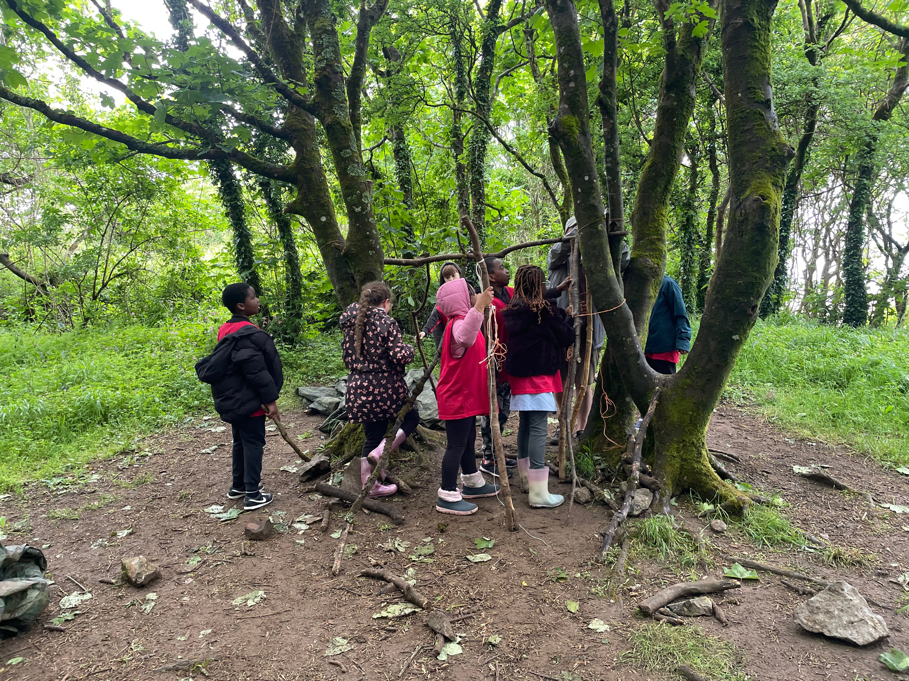
Safeguarding and Child Protection
Morriston Primary School takes Child Protection and Safeguarding seriously, and will act on information received. We may need to share this information with agencies. The school endeavours to seek information from parents when information is shared. However, this may not be possible, if by doing so, may place a child at risk of potential harm.
The Designated Senior Person for child protection who has undertaken the appropriate training is: Mrs. A. Thomas, Headteacher and Mr Anthony Beynon, Chair of Governors (and in his absence Cllr Andrea Harrington, also a member of the Governing Body). The deputy designated person is Mr Matthew Bannister, Deputy Headteacher. Personnel also designated and available to contact are (Mrs G Harris, ALNCo). Tel School: 01792 781811.
If the Designated Person or Deputy Designated person is not available a member of staff can take responsibility, or you can Contact Social Services directly on 01792 635700. Also available as a contact is Lisa Collins, LA Child Protection and Safeguarding Officer. Tel: 01792 637148/07827822700.
Together Everyone Achieves More

Slide 27
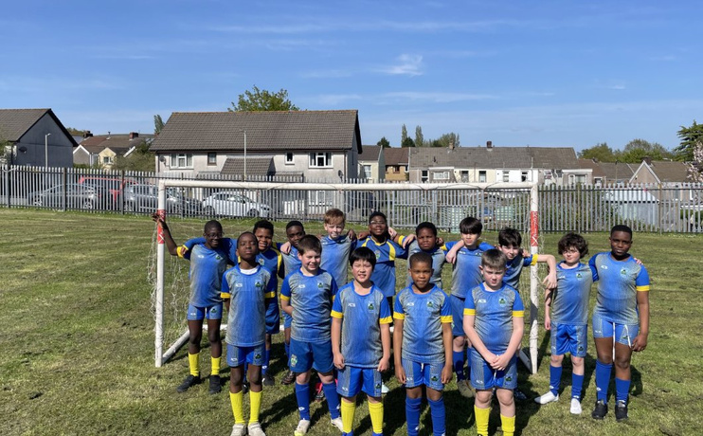
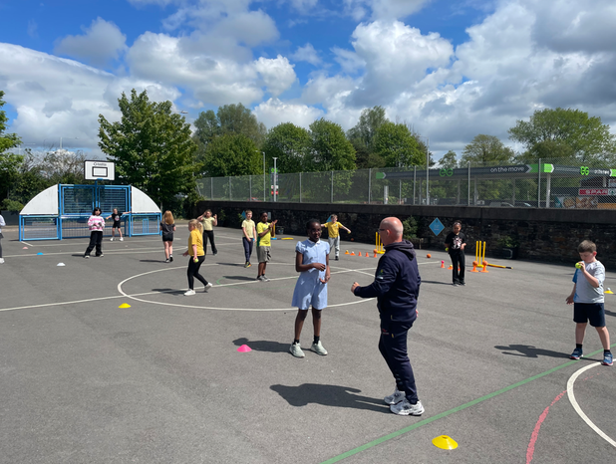
Sport at Morriston Primary School
Sport at Morriston Primary School is viewed as contributing to a happy and motivating school environment. It provides the opportunity not only to promote physical activity and healthy lifestyles but also to develop positive attitudes embraced in the school philosophy. To this extent the following aims have been identified:
  To provide a range of physical activities that have short-term and sustained levels of exercise.
  To make pupils aware of the effects of exercise on the body such as the development of health, muscular strength, and the need for personal hygiene.
  To develop the sense of belonging and participation in team activities.
  To promote positive conventions such as fair play, honest competition and good sporting behaviour as individual participants, team members and spectators.
  To ensure safe practices in physical activities by establishing a safety ethos that emphasises the importance of; listening to instruction, following rules, wearing appropriate clothing and footwear, removing jewellery that is a safety risk to oneself and others, how to lift, transport, use and store equipment safely, warm up and recover from exercise activities.
  Physical Education lessons either take place in the school hall or on the school yard. The hall is one of the largest of its kind in any Primary School within the County. It possesses a good range of equipment, some of which has been bought by the PTFA. Games are also played in the school hall, and in the school yard.
  The school has played competitively against local Primary schools in the following sports; soccer, rugby, netball, cricket, swimming, tennis and rounders. In the main these matches take place after school and are organised on a friendly basis and not part of any league structure.
  Outdoor and adventurous activities usually take place in the Upper Phase, mainly on residential trips to Llangrannog or St. Madoc.
  It is part of the school philosophy that all children be given the opportunity to access these activities, at the appropriate level, irrespective of race and sex.
Together Everyone Achieves More

Slide 28
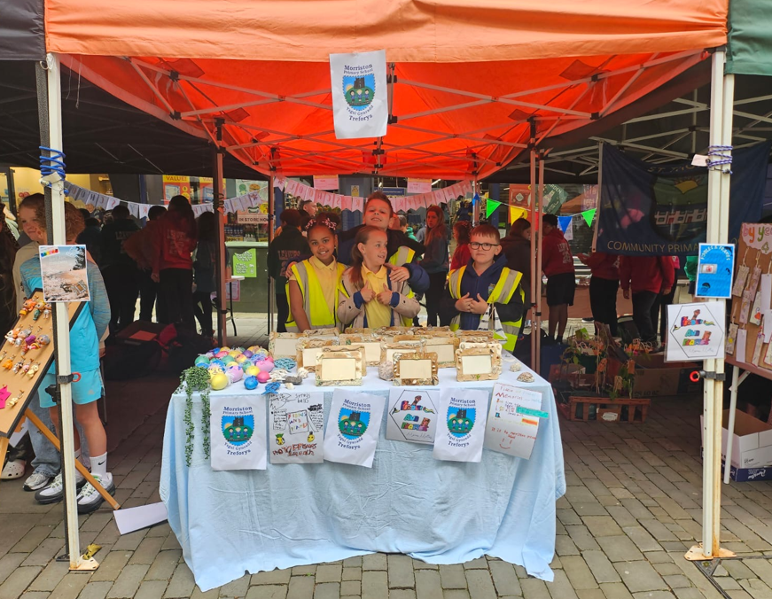
Behaviour
As a Rights Respecting School, we promote the values and principles of the UNCRC. Many of the UNCRC articles directly promote good behavior, tolerance and underpin positive values which are at the core of our school.
The school aims to create a community which is friendly and caring, with high expectations of good behaviour based on self-discipline. Everyone within the school is expected to behave in a reasonable and co-operative way at all times. The children are provided with school and class charters that help to achieve these objectives. The school uses positive behaviour systems and practices in all classes and in the school as a whole.
The school has staff trained in Restorative Practice and this is used on a daily basis to promote good behaviour and deal with conflict. Staff are also trained in Thrive, Derbyshire Positive Play and Nurture and these approaches are fostered in school for pupils who have difficulty coping with the classroom situation. This support concentrates on empathy, social skills and strategies to deal with situations that pupils may find difficult. The Thrive Lead Practitioner liaises closely with class teachers and the aim is to give these pupils the confidence and strategies to thrive in their mainstream class.
The school aims to reward positive behaviour and discourage negative behaviour. Every class has a recognition board where pupil’s names are recorded when they do something worthwhile. Pupils are encouraged to be ‘Ready, Respectful and Safe.’ They are also encouraged to have ‘kind hands, kind feet and kind words.’ Any form of bullying is not tolerated. Sanctions involve loss of privilege. If persistent misbehaviour occurs parents are contacted and reactive plans/behaviour contracts are established. The school expects the home to work with the school in overcoming behavioural problems that might arise. The school also works closely with outside agencies such as the behaviour support team who come into school to work with more challenging children.
Together Everyone Achieves More

Slide 29
Charging and Remissions
Parents are asked to make voluntary contributions to cover the cost of school visits and for some school events such as visiting theatre groups.
If the school premises are let outside of school hours, external organisations are usually asked to cover the cost to the school of the letting, and these costs may be reviewed periodically.
Pastoral Care
Each class teacher is responsible for the pastoral care of the pupils along with the Wellbeing Support Officer, with the Headteacher having overall responsibility.
If pupils are ill in school the parents, or named contacts, will be telephoned. The emergency services will be called if necessary and parents informed.
Medical and dental services attend the school regularly and the Education Welfare Service and School Psychologist Services are contacted if necessary.
The school is involved with the ‘Designed to Smile’ project which encourages pupils to clean their teeth during the school day.
It is important to inform the school if your child develops a medical condition that may require attention in some way should it arise in the school setting.
Together Everyone Achieves More

Slide 30
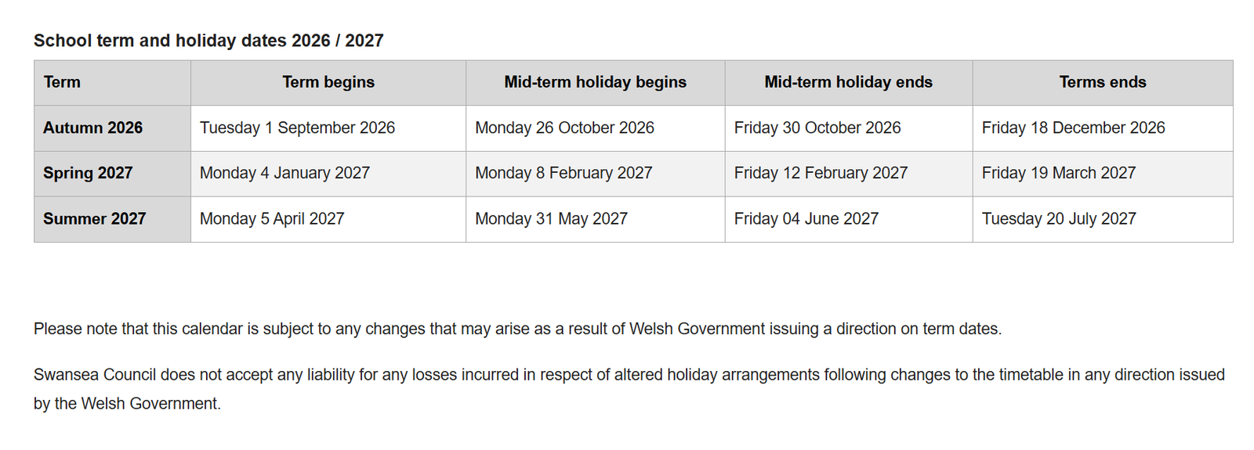
Morriston Primary School Terms and Holiday Dates
2026-2027 Academic Year
Together Everyone Achieves More

Slide 31
School Security
As part of the school philosophy, it is a stated aim that the school provides a learning environment that is happy and secure. To achieve this our major consideration must be:
  To prevent vandalism, theft, arson and assault on both staff and pupils.
  To stress the need for vigilance.
  To create excellent relationships with all connected with the school.
  To consider the design of the building and grounds.
  To have in place security procedures.
Security measures have been developed to help in this direction:
  Access Control Systems.
  Updated CCTV.
  Personal Security Alarms.
  Improvements to the school security alarm system.
  Relocation of the school office by the main entrance.
Such measures have helped improve the security of the school. However, we must not become complacent. The Governing Body would encourage all parents to continue to be vigilant, to bring and collect their children on time, and to keep class teachers informed about any changes as regards bringing or collecting children from school.
It must also be pointed out that while the school makes every effort to care for property it cannot be held responsible for the loss or damage of personal belongings. Parents are strongly advised to label their children’s clothes.
Together Everyone Achieves More

Slide 32
Safety of pupils leaving the school premises
during the school day
Schools have a duty to take reasonable care to ensure the safety of pupils from foreseeable risks.
The main school gate is locked while the school is in session and so the only entrance and egress for the school is the main door which has a key-pad entry and buzzer. This door is also covered by CCTV which is monitored by office staff.
However, the following procedures will be adopted if pupils leave the premises during the school day without permission.
A pupil should never leave the school grounds during the school day without the school having written permission off the parent or guardian. In an emergency the school office may be telephoned (01792 781811) to make appropriate arrangements.
If a pupil has been granted permission, an adult known to the pupil must report to the school office and the pupil will be brought to them. The school should be informed who will be collecting the pupil. If the pupil has to leave the premises at lunchtime, then the pupil’s parent/guardian is responsible for the supervision of their child and for making appropriate lunchtime arrangements. The pupil must sign in at the office on their return to school.
There may be times when a pupil manages to leave the premises without permission (abscond). The school regards this as a very serious matter and will adopt the following procedure.
If the absconding pupil runs away from the school premises, staff are to exercise great care not to increase the risk. Running after a pupil, or following a pupil, may cause the pupil to run further away and place the pupil in a dangerous situation as they confront crossing the roads around the school. As soon as it is known that a pupil has left the premises it is to be reported to the Headteacher, or in her absence the Deputy Headteacher, who will inform the pupil’s parent/guardian and the Community Police if necessary. All incidents of a pupil leaving the premises will be recorded and reported to parents and carers. This will happen even if the child returns after having crossed the road, sat on a pavement outside school etc.
If the absconding pupil is just outside the building, near the gates etc., they will be talked to gently and persuaded to come back into the school to talk about their problems.
The Headteacher/Governing Body may review the procedures outlined above when new guidance becomes available from central government or the LA or if school circumstances change.
Together Everyone Achieves More

Slide 33
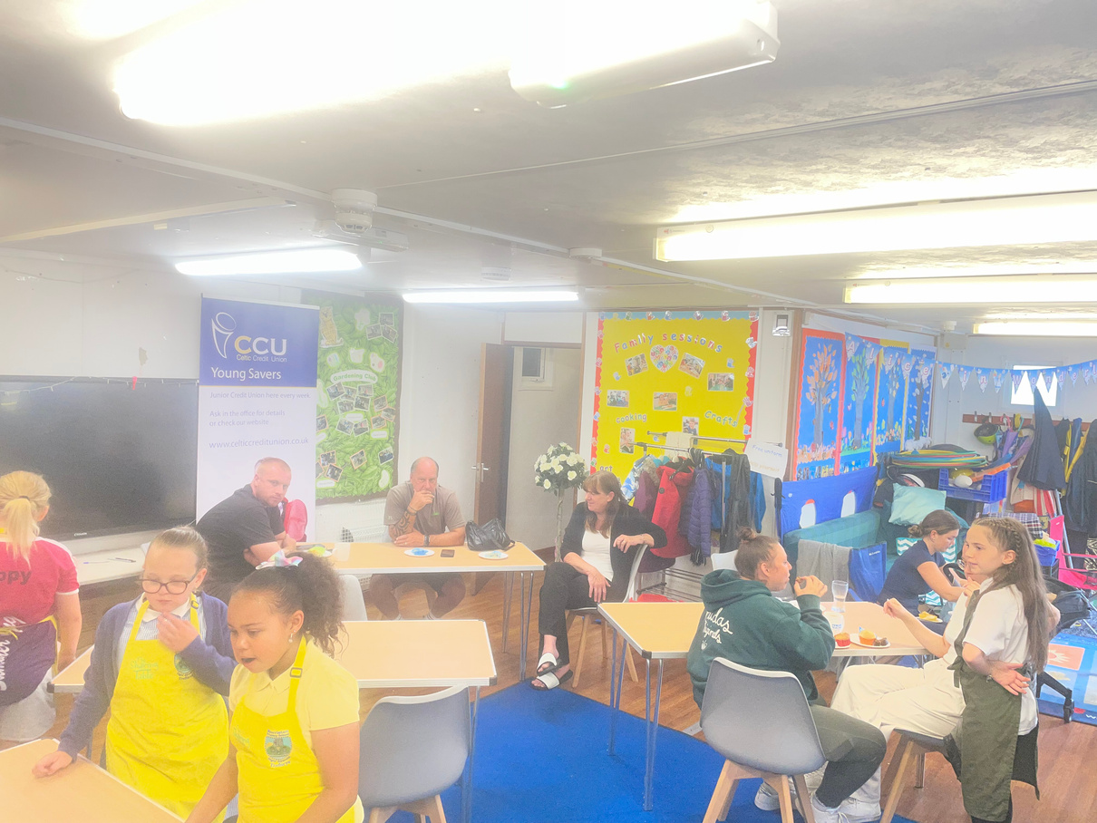
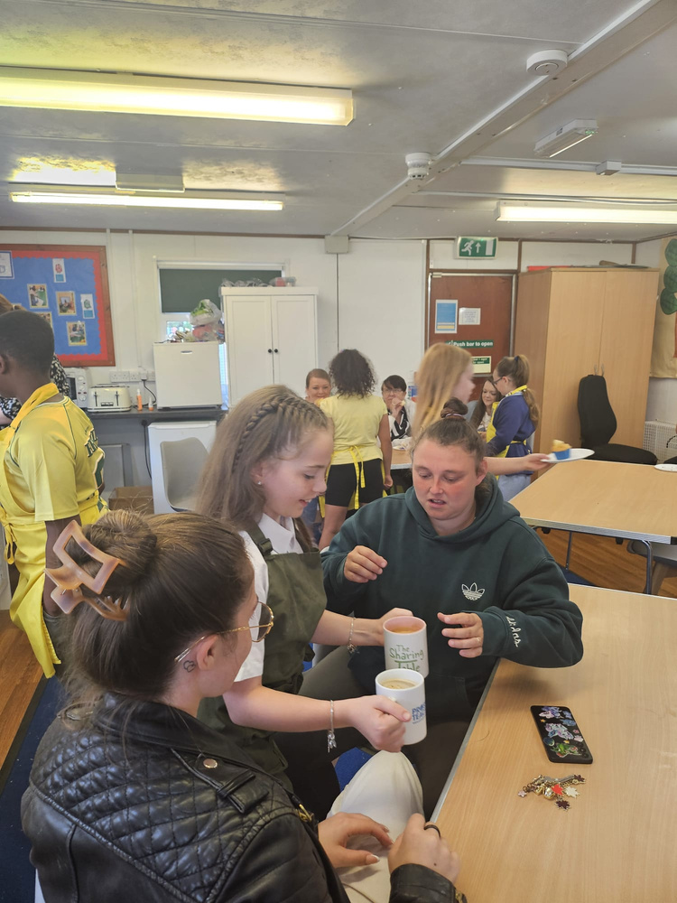
Parents wishing to visit the school
Any parents wishing to visit the school for any reason should telephone the school on 01792 781811 to make an appointment with whoever they wish to see or call in at the school office to make an appointment.
This will ensure that staff are available to meet with the parent.
Together Everyone Achieves More

Slide 34
Parents Code of Conduct
At Morriston Primary School, we are extremely fortunate to have a supportive and friendly parent body. Our parents recognise that educating children effectively is a process that involves partnership between parents, staff and the wider school community. As partners, our parents will understand the importance of a good working relationship to equip children with the necessary skills for adulthood.
For these reasons we continue to welcome and encourage parents/carers to participate fully in the life of our school. There is however an expected code of conduct for all parents, carers and visitors to our school. This is so we can continue to flourish, progress and achieve in an atmosphere of mutual understanding. We expect parents, carers and visitors to:
  Respect and model the caring ethos of our school whenever on school premises or when communicating directly with the school.
  Understand that school staff and parents need to work together for the benefit of all
  Demonstrate that all members of the school community should be treated with tolerance and respect and therefore set a good example in their own speech, conduct and behaviour
  Seek to clarify a child’s version of events with the school’s view in order to bring about a peaceful solution to any issue
  Discourage any behaviour which would lead to conflict, aggressive behaviour or unsafe behaviour. (Approach the right member of school staff to help resolve any issues or concern).
Together Everyone Achieves More

Slide 35
Parents Code of Conduct
In order to support a peaceful and safe school environment the school cannot tolerate parents, carers and visitors exhibiting the following:
  Disturbing school staff and trying to speak to them whilst they are supervising children
  Breaching school security procedures, e.g. entering main door without using the intercom system when another parent/visitor is leaving or entering
  Attempts to gain entry to any part of the school in disregard of procedure or without permission and appropriate supervision
  Disruptive behaviour which interferes or threatens to interfere with the operation of a classroom, an employee’s office, office area or any other area of the school grounds including team matches
  Using loud/or offensive language, swearing, cursing, using profane language or displaying temper
  Threatening to do actual bodily harm to a member of school staff, Governor, visitor, fellow parent/carer or pupil regardless of whether or not the behaviour constitutes a criminal offence
  Damaging or destroying school property
  Abusive, persistent or threatening e-mails or text/voicemail/phone messages or other written communication
  Defamatory, offensive or derogatory comments regarding the school or any of the pupils/parent/staff, at the school on Facebook or other social sites. (see additional advice regarding Social Media). Any concerns you may have about the school must be made through the appropriate channels by speaking to the class teacher, the Head teacher or the Chair of Governors, so they can be dealt with fairly, appropriately and effectively for all concerned
Together Everyone Achieves More

Slide 36
Parents Code of Conduct
In order to support a peaceful and safe school environment the school cannot tolerate parents, carers and visitors exhibiting the following:
  The use of physical aggression towards another adult or child. This includes physical punishment against your own child on school premises
  Approaching someone else’s child in order to discuss or chastise them because of the actions of this child towards their own child. (Such an approach to a child may be seen to be an assault on that child and may have legal consequences)
  Smoking and consumption of alcohol or other drugs whilst on school property.
  Should any of the above behaviour occur on school premises the school may feel it is necessary to contact the appropriate authorities and if necessary, even ban the offending adult from entering the school grounds. We trust that parents and carers will assist our school with the implementation of this code of conduct and we thank you for your continuing support of the school We would expect that parents would make all persons responsible for collecting children aware of this policy
Together Everyone Achieves More

Slide 37
Inappropriate use of Social Media
Social media websites are being used increasingly to fuel campaigns and complaints against schools or to share inappropriate information, e.g. naming children involved in incidences, sharing confidential information regarding an aspect of school life, making allegations or accusations or sharing false news.
Morriston Primary School considers the use of social media websites or Apps in this way as unacceptable and not in the best interests of the children or the whole school community. Any concerns you may have must be made through the appropriate channels by speaking to the class teacher, the leadership team or the Headteacher, so they can be dealt with fairly, appropriately and effectively for all concerned.
In the event that any pupil or parent/carer of a child/ren being educated at Morriston Primary School is found to be posting libellous or defamatory comments on Facebook or other social network sites or Apps, they will be reported to the appropriate ‘report abuse’ section of the network site. All social network sites have clear rules about the content which can be posted on the site and they provide robust mechanisms to report contact or activity which breaches this. The school will also expect that any parent/carer or pupil removes such comments immediately. In serious cases the school will also consider its legal options to deal with any such misuse of social networking and other sites.
Additionally, and perhaps more importantly is the issue of cyber bullying and the use by one child or a parent to publicly humiliate another by inappropriate social network entry. We will take and deal with this as a serious incident of school bullying. Thankfully such incidents are extremely rare.
Together Everyone Achieves More

