Slide 1
Pharaoh
Self Portraits

Slide 2
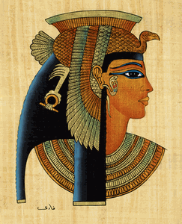
How the Ancient Egyptians drew their pharaohs
Heads were almost always shown in profile (sideways) view.
It is easier to get the nose correct when drawing a face from the side.
Profile heads also allowed the artist to show the ear and headdresses or hair.
Some headdresses were twisted to show the front view to make the image clearer.

Slide 3
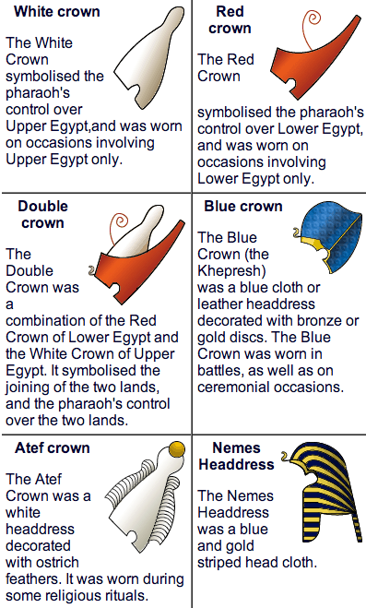

Different Ancient Egyptian Headdresses

Slide 4
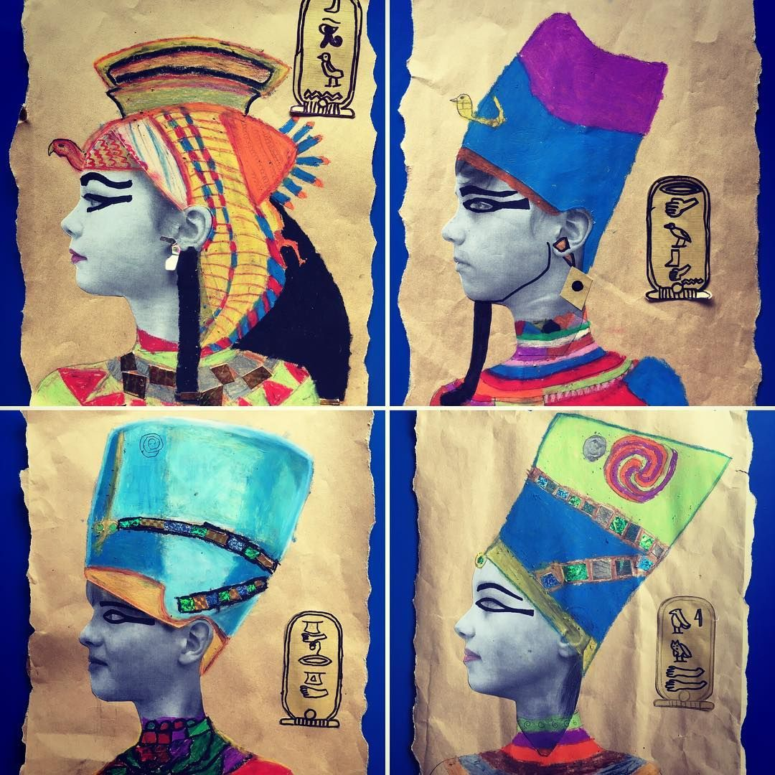
Turn yourself into a pharaoh!

Slide 5
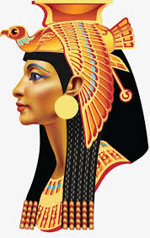
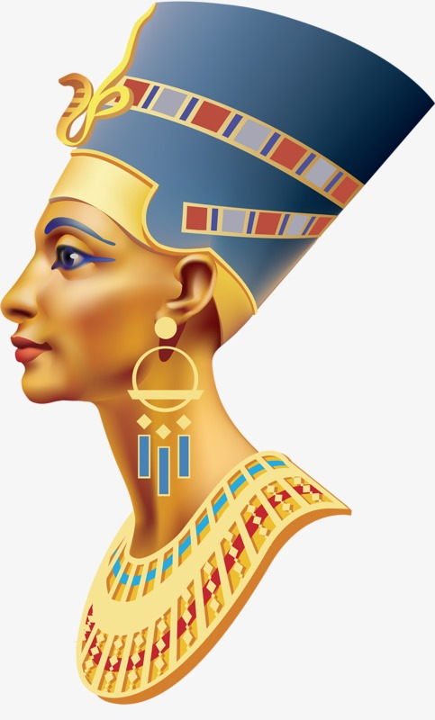
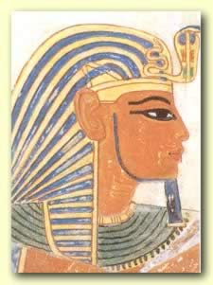
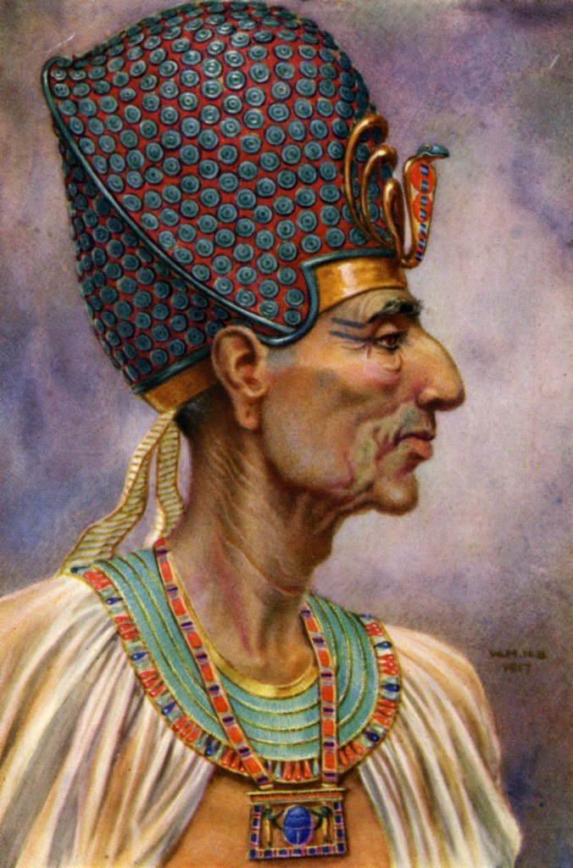
Some inspiration

