Slide 1

‘Meet the teacher’ session
Year 4/5
Mr Bannister
September 2022

Slide 2
Staffing
Teaching Staff
Mr Bannister
Ms Davies – Every Friday (Management time)
Mrs Watts – Every other Tuesday – (PPA)
Support staff
Mrs Lovering - Full time

Slide 3
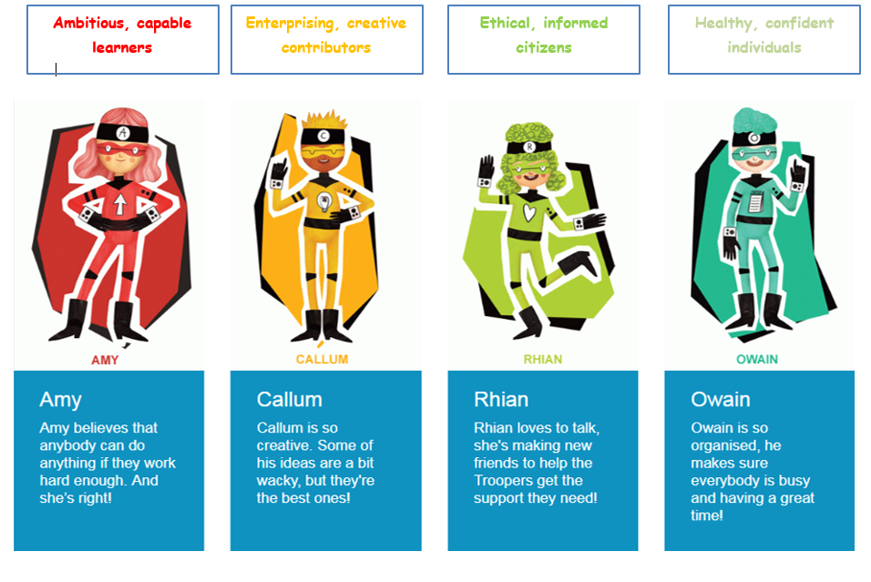
Four purposes

Slide 4
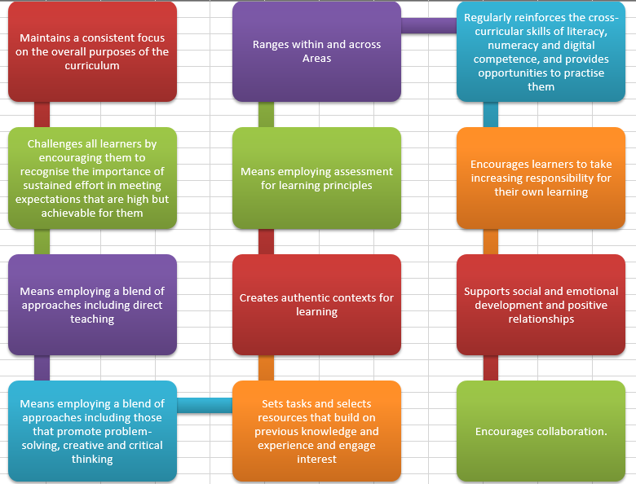
12 pedagogical principles

Slide 5
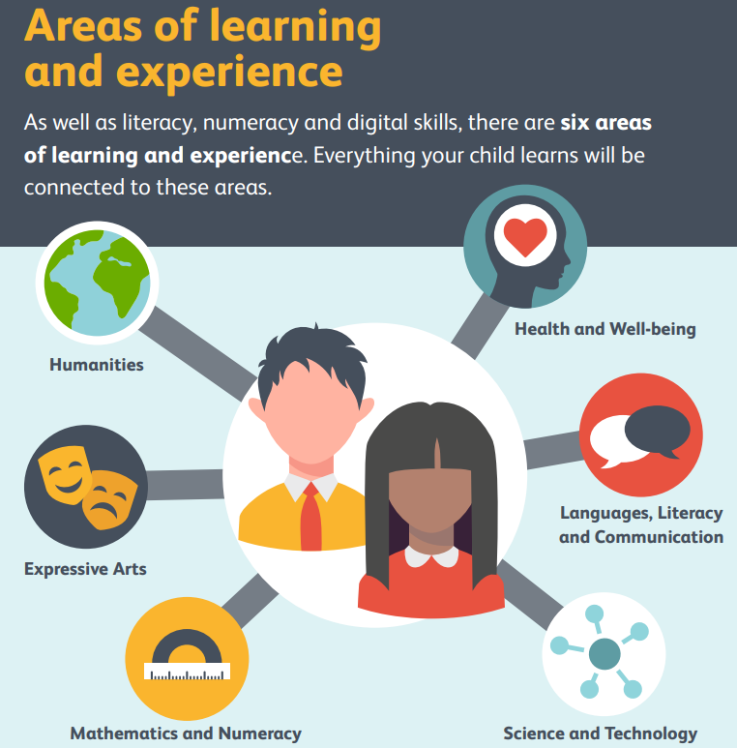

Slide 6
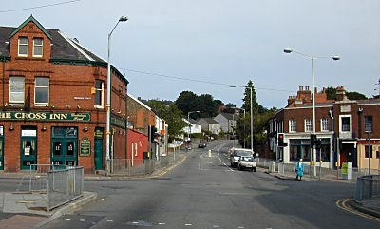



Topics
Morriston & Me / Misty Mountain, Winding River
Autumn
Pharaohs –Spring
Scream Machine – Summer
EPIC Planning – Pupil Voice
Authentic curriculum

Slide 7
Literacy
Reading We will be continuing to develop our reading skills through a whole school reading programme ~ Read, Write, Inc. and the 8 reading behaviours, using a range of fiction and non-fiction texts during guided reading and lessons. | Writing We will focus on a range of texts, looking at a variety of examples and applying the features to our own writing. We will also focus on word level work by learning spellings. The children will be given spellings to learn every week. | Oracy We will take part in presentations. These will be centred around our topic, presenting information, processes and ideas clearly and appropriately for the purpose.

Slide 8
Numeracy
Number work can be greatly helped by rapid recall of facts, in particular multiplications. Pupils will be spending time improving their responses, when for example they double and halve numbers, adding and subtracting 3,4 and 5 digit numbers, and reciting multiplication and division facts. Encourage your child to find the facts they should know and help them at home with quick, accurate answers.
Problem Solving
This will be a regular activity as part of our maths learning. This allows us to apply our maths learning to new contexts. We will use the scheme, ‘Let’s Think Through Maths / CAME and topic related activities to develop our reasoning skills. We will be applying skills learned to our ‘rich tasks’.

Slide 9


Homework
Choose one activity each week to complete in your homework book. Your book will need to be returned to school every Wednesday for the class reflection time where homework will be displayed and shared with class peers.
MyMaths
Rising Stars

Slide 10
P.E sessions
Indoor/Outdoor P.E - For Health and Safety reasons your child needs to have a full P.E. kit in school. This includes shorts or joggers, a t-shirt and suitable footwear.
P.E kits need to be labelled clearly

Slide 11

The Curriculum for Wales – Relationships and Sexuality Education Code
This mandatory RSE Code supports schools to design their RSE.
The content is set within the context of broad and interlinked learning strands, namely:
• relationships and identity
• sexual health and well-being
• empowerment, safety and respect.
The Act requires that the RSE schools provide must be developmentally appropriate for learners. This means schools and settings must take account of a range of factors including the learner’s age; knowledge and maturity; any additional learning needs and anticipating their physiological and emotional development.

Slide 12
Relationships and identity This strand focuses on:
• the range of relationships that human beings have throughout their lives
• how identity can be shaped by our relationships and sexuality
• the importance of human rights in securing healthy, safe and fulfilling relationships in an inclusive society
Sexual health and well-being This strand focuses on:
• learning about how living things grow, reproduce and have a life cycle
• developing an understanding of the human body, including people’s feelings about their bodies and how these can be represented
Empowerment, safety and respect This strand focuses on:
• learners’ rights to safety and protection and freedom from harm and discrimination
• how and where to seek information, help and support
• how to support and advocate for the rights, fair treatment and respect of all.

Slide 13

The Happen Survey
Your child is being asked to complete a short survey on their health and well-being as part of our primary school health network – HAPPEN (www.happen-wales.co.uk). They will be asked questions such as how active they are, how well they can concentrate, what activities they would like to try in school and how happy they are in school and with their friends.
Information Sheet - (happen-wales.co.uk)

Slide 14
Possibility of a future residential

Slide 15

Questions

