Slide 2
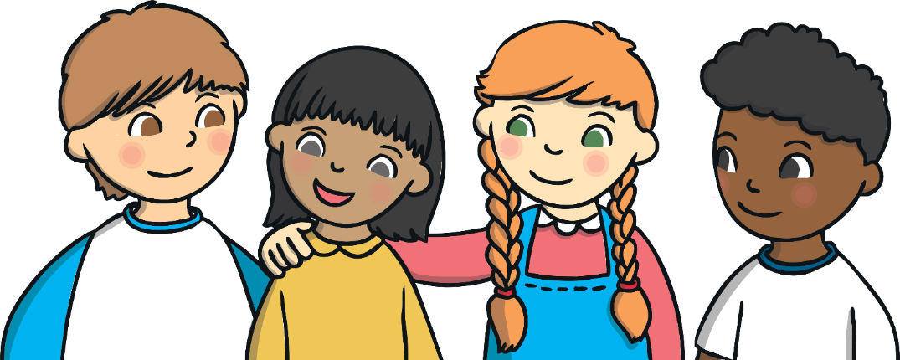
Learning Objective:
Use a full stop in a sentence.
Success Criteria
I know that full stops are needed at the end of a sentence.

Slide 3
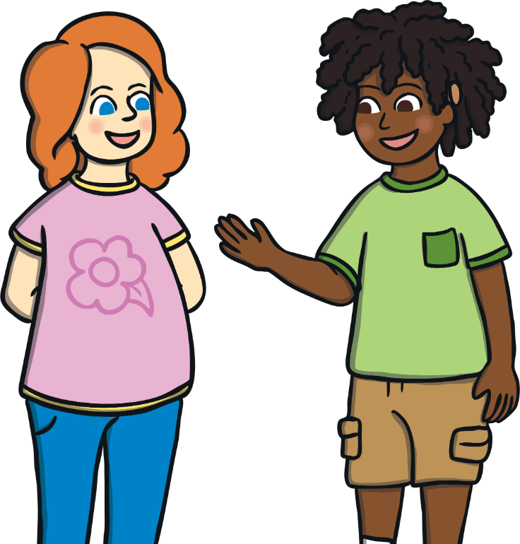
With your talking partner…
Where should we use full stops in our writing?
Be ready to give your ideas!

Slide 4
Ending Sentences
Full stops are always used to show where a sentence has ended.
I love to eat cake
.

Slide 5

Practise
Can you spot where the full stop will be added in these sentences?
Have a go on your whiteboard.
I want chips for dinner
I want chips for dinner.
Ben and Sam went on holiday to Spain
Ben and Sam went on holiday to Spain.

Slide 6
Activity
Can you spot where the full stop will be added in these sentences?
Have a go on your whiteboard.
I like to go on the swings at the park
I like to go on the swings at the park.
My brother is my best friend
My brother is my best friend.

Slide 7
Now it’s your turn…
Add full stops in the right places in these sentences.
Remember - the end of a sentence.
The dog sat on a mat
The dog sat on a mat.
A man went to the moon
A man went to the moon.
My dog is brown
My dog is brown.
Tom has a black cat
Tom has a black cat.

Slide 8
Getting trickier…
Add full stops in the right places in these sentences.
Remember - the end of a sentence.
I like going to London
I like going to London.
My favourite food is cheese
My favourite food is cheese.
I like to read my book in bed
I like to read my book in bed.
My mum told me to tidy my room
My mum told me to tidy my room.

Slide 9
The trickiest…
Add full stops in the right places in these sentences.
Remember - the end of a sentence.
I fed my dog after school He had chicken
I fed my dog after school. He had chicken.
My brother plays football every Sunday He scores lots of goals
My brother plays football every Sunday. He scores lots of goals.
I wish I had a magic lamp I would wish for lots of sunshine
I wish I had a magic lamp. I would wish for lots of sunshine.
The pirate followed the treasure map. He dug the treasure up and found stacks of gold.
The pirate followed the treasure map He dug the treasure up and found stacks of gold

