Slide 2

What is Red Nose Day?
Red Nose Day is a day when people across Britain raise money for charities in the UK and around the world.

Slide 3

When Is Red Nose Day?
Red Nose Day is on
Friday 18th March 2022.
March

Slide 4
Why Is Red Nose Day Important?
Money raised during Red Nose Day helps lots of different projects, including:
Providing reading books for children in community learning centres in Northern Uganda.
Training a preschool teacher in Africa.
Running a group to support visually impaired children.
Training a health volunteer to help improve the health, wellbeing and education of young children in Kenya.

Slide 5





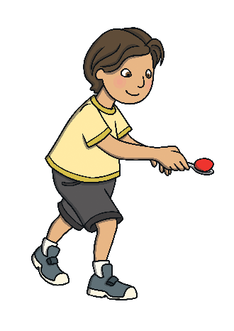
How Will You Celebrate Red Nose Day?
Wear a Red Nose
Non-uniform day
Cake sale
Dress up as superheroes
Red Nose and Spoon Race

