Slide 2
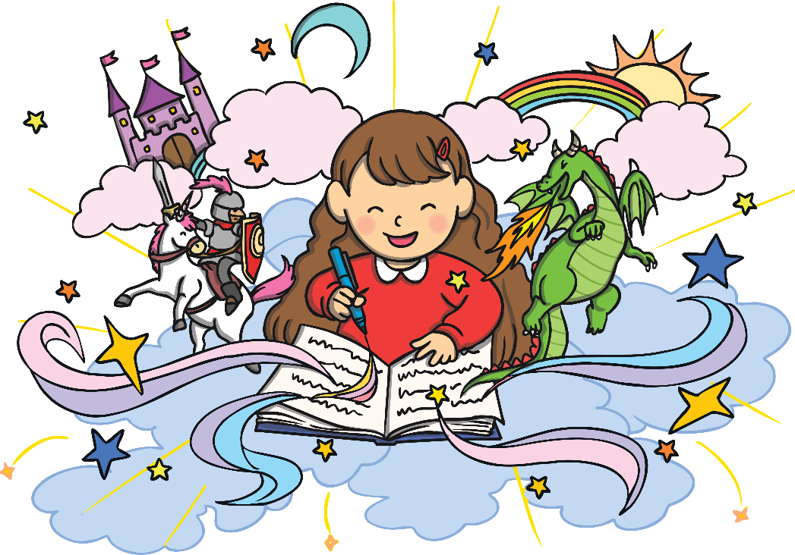
Why Should We Write?
It is fun to write and others may enjoy reading our writing.
It helps us to remember things that we have learnt!
It opens up new worlds. You can be as imaginative and creative as you like!
It allows us to share our thoughts and ideas with others.
What Do You Think?
Can you think of other reasons why it is good to write?

Slide 3

Who Can Write?
Everyone can take part. Writing is for all of us. We all have something to share with the world.
What Do You Think?
What is your favourite story?
Can you remember who it was written by?

Slide 4
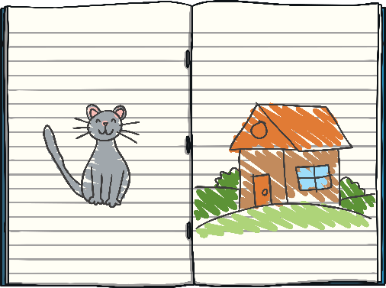
The Writing Competition
Are you up for the challenge of taking part in a writing competition?
Here are some rules of the competition:
The story has to be all of your own work.
Remember to get your story finished and handed to your teacher on time.
An adult can help to write the story down for you (using your words) if you can’t write it.
Your story must be fiction (made-up stories).
Your story can include real and well-known people, but what happens in the story must come from your own fantastic imagination!

Slide 5
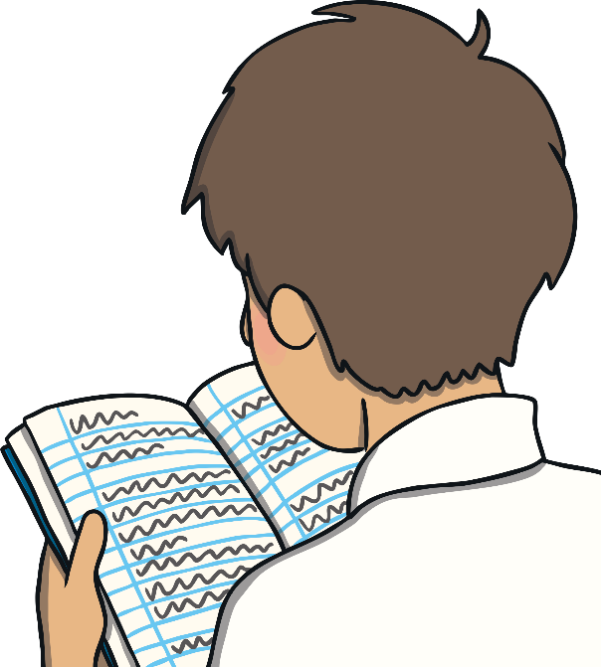
Top Tips
Remember these things when you write your amazing story:
New Ideas The best stories have totally new ideas.
Plot Plan out a good storyline that makes sense to your reader. Write a good beginning, middle and end.
Characters Think about the star of your story. Make it someone you would like to know more about if you were reading a book.
Language Choose your words well. Try to includes adjectives, similes and alliteration. You may even make up some of your own words!
Enjoyment Write the story that you would enjoy to read. It may be scary, funny or a little bit silly. The best stories are ones that we all want to enjoy and don’t want to end.
Fun Fact
Your story will be marked on how creative it is and what interesting words you are using.

Slide 6

Let’s Get Started!
Enjoy creating your own world in your story.
We can’t wait to see what your amazing imagination comes up with.

