Slide 1


Resilience: Bouncing Back

Slide 2

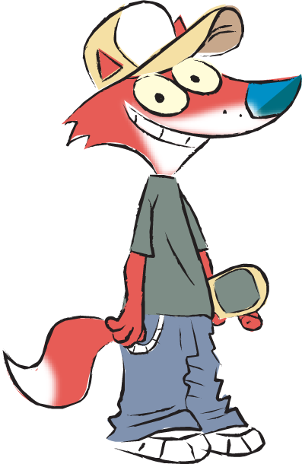
In this lesson we will looking at how we might bounce back when things get difficult.
2
© Young Citizens

Slide 3
I bounced back!
I remember when I first got my skateboard. I went down a hill too fast and fell down. At first I didn't want to get back on, but my dad said
"When you fall off you should get straight back on. "
It was good advice.
I overcame my fear.
3
© Young Citizens
Notes:
Images: Clipart

Slide 4
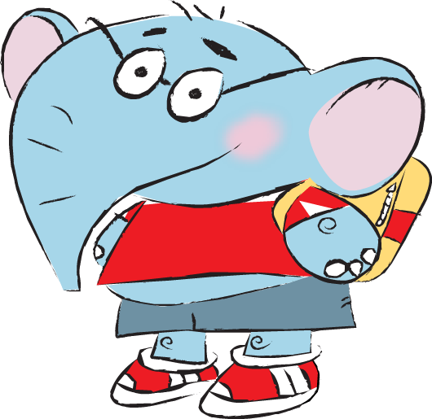
I bounced back!
I got a new puzzle for my birthday. I wanted to do it by myself, but it was really hard.
At first I got cross. Then I remembered I could ask for help.
I asked my Grandma to do it with me and it looked great when we’d finished.
4
© Young Citizens

Slide 5
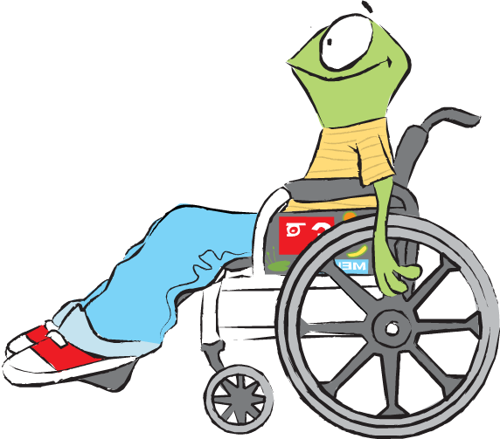
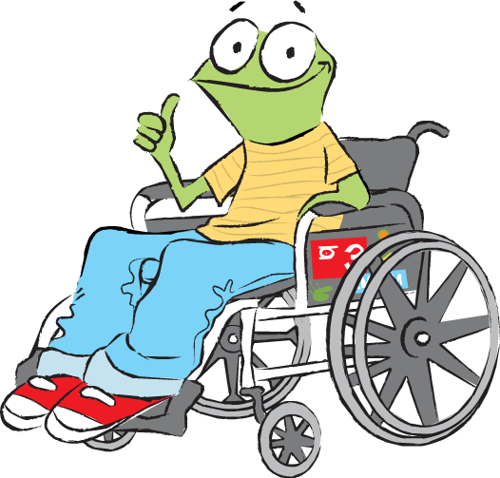
10 - 5 = 5
I love maths, but there was a time when I was frightened of learning new things. I was scared of making mistakes.
My teacher told me not to worry if I got it wrong at first, I was still learning.
Now I know that making mistakes helps us learn, and I love new challenges.
I keep bouncing back!
5
© Young Citizens

Slide 6
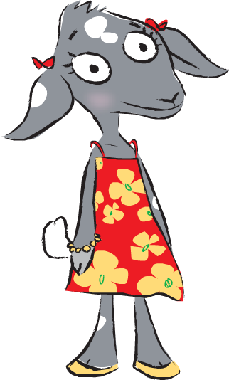
I bounced back!
When I first came to England sometimes I got my words mixed up.
It made me nervous about talking in class.
I asked my friends to tell me the right way to say things.
That way I learned quickly.
6
© Young Citizens

Slide 7
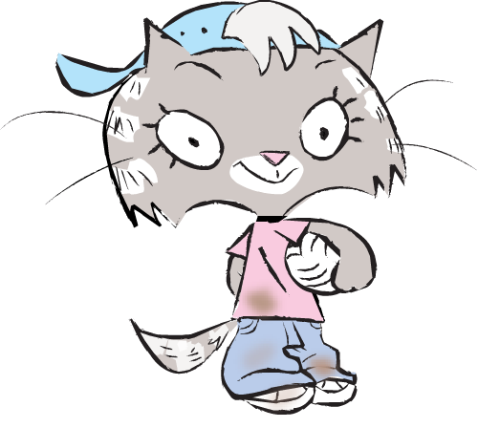
I bounce back!
People think I am brave and tough because I climb trees and go exploring.
I am not so much brave as good at finding solutions to problems when I get into difficulties.
7
© Young Citizens

Slide 8
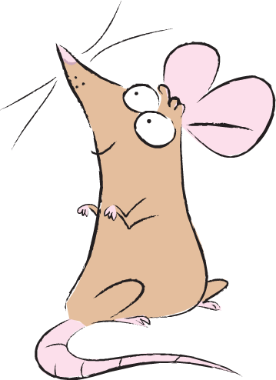
Now I’m as fit as a fiddle!
I was very sick when I was young, and was always at the vet, but I didn't let it get me down.
The vet said that my determination to get well really helped.
I bounced back!
8
© Young Citizens

Slide 9
Go-Givers don't worry if they make mistakes.
They know it's one of the best ways of learning.
When they get into problems, instead of worrying, they start thinking about ways of solving them.
9
© Young Citizens

Slide 10
When things are bad they imagine how they might be better in the future.
They shrug off bad experiences and carry on.
They bounce back!
10
© Young Citizens

Slide 11

There’s no point trying.
I’ve got a brilliant idea!
11
© Young Citizens

