Slide 1


Croeso I Blwyddyn 3/4
(UNCRC: Article 13 – Your right to information)

Slide 2
Time of day | MONDAY My duty am and pm | TUESDAY ME 8.30 DUTY My duty am and pm | WEDNESDAY | THURSDAY | FRIDAY S Watts teaching all day
8.50 -9.00 | Register/spelling/Reading | Register/spelling/Reading | Register/spelling/Reading | Register/spelling | Register/spelling
9.00 – 9.15 | Assembly | Assembly | Assembly | Assembly | Assembly
9.15 – 9.40 | RWI/GUIDED READING & GUIDED NUM | RWI/GUIDED READING & GUIDED NUM | RWI/GUIDED READING & GUIDED NUM | Library Spelling tests 9.30-10.00 Violins/ | GUIDED READING
9.40 – 10.25 | LITERACY | Literacy | Literacy | LITERACY- Welsh mymaths/boost | LITERACY
10.30-10.45 | PLAYTIME | PLAYTIME | PLAYTIME | PLAYTIME | PLAYTIME
10.50 – 11.35 | NUMERACY | NUMERACY | NUMERACY | PE indoor | NUMERACY
12:00-12.20 | LUNCH | LUNCH | LUNCH | LUNCH | LUNCH
12.20 – 12.45 | LUNCH PLAY | LUNCH PLAY | LUNCH PLAY | LUNCH PLAY | LUNCH PLAY
12.45 – 1.20PM | READING/SLOT DRILLIO/NUMERACY/CHEKCIN/MFL | READING/SLOT DRILLIO/NUMERACY/CHEKCIN/MFL | READING/SLOT DRILLIO/NUMERACY/CHEKCIN/MFL | SLOT DRILLIO/NUMERACY/CHEKCIN/MFL | SLOT DRILLIO/NUMERACY/CHEKCIN/MFL
1.20-1.50 | Skills | Skills |  | PPA Llinos= Welsh | RVE/ H W-B
1.50 – 2.00 | PLAYTIME Mindfulness | PLAYTIME Mindfulness | PLAYTIME Mindfulness | PLAYTIME Mindfulness | PLAYTIME Mindfulness
2.00 – 3.00 | Skills | Skills | Outdoor learning | PPA Llinos= EA music | RVE/ H W-B
3.00-3.15 KS2 | Story/Home time | Story/Home time | Story/Home time HEALTHY SCHOOLS CLUB | Story/Home time | Story/Home time

Slide 3

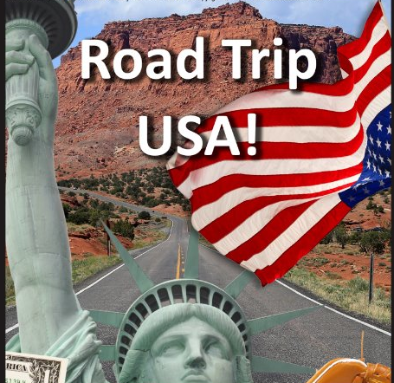
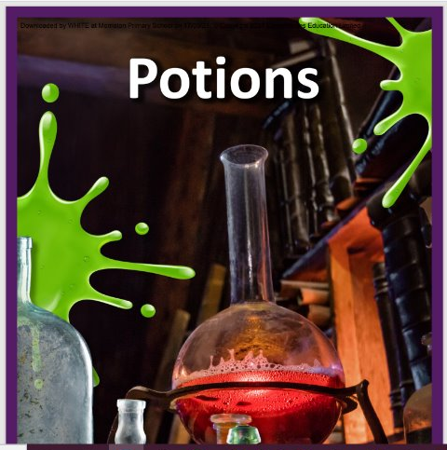
Autumn term 2025
Scrumdiddlyumptious
Geography
Spring term 2026
Road Trip USA
Summer term 2026
Potions
Literacy
Numeracy and Reasoning

Slide 4
Literacy
Recount
Text Types
Persuasion
Instructions
Report
Narrative
Discussion
Explanation
Notes:
Throughout the year, we will be writing in these text types. This term, we will be writing a recount e.g. of our visit to Tesco a persuasive text: writing e.g. a poster to sell a healthy snack . Throughout their time in Primary School, pupils will write in these text types. Each year, we build on what they already know about each one, so by the time they reach comprehensive school, they are aware of what the text types are and will write confidently. These text types will also be used throughout each topic to make it more meaningful and ‘real-life’ for them.

Slide 5
The 8 Reading Behaviours
Notes:
We take a holistic approach to reading in Morriston. One of the strategies which we use a great deal are, the 8 reading behaviours. (Talk briefly about each one). Not only is it important to hear children read but talk about the texts using the above behaviours.

Slide 6
Behaviour
Behaviour impacts on learning.
School Strategies:
Rights of the Child and how we respect our rights.
Class Dojo.
Growth mindset/positive thinking
Graduated Response.
We reinforce our school rules of:
Kind hands
Kind feet
Kind words.
Notes:
Explain class dojos and give out parent invites.

Slide 7
Spelling
Letters and Sounds
Spelling lists sent home and can be practised in homework book. Pupils are assessed and placed into phases. Pupils progress is recorded for assessment and monitoring
Notes:
At the beginning of every term, pupils are assessed on different spelling patterns, to see how much they know. From that assessment, pupils will be given a set of words to learn each week. Please encourage your child to learn them daily. In addition to this, we will look at spellings in words related to our topic.

Slide 8
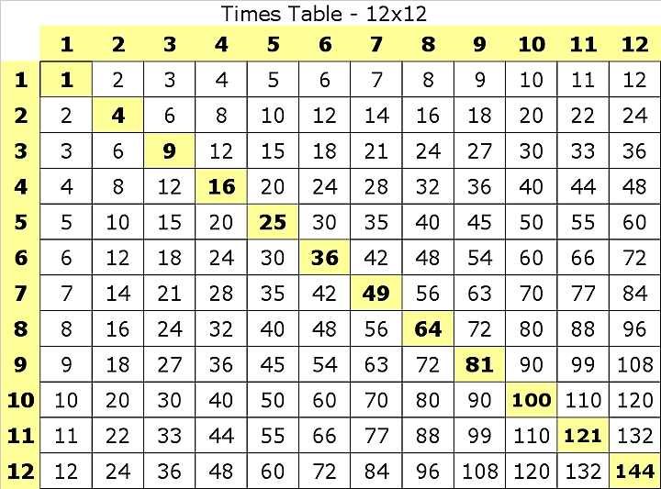
Numeracy
Place Value
Multiplication
And
Division
Problem Solving
(Reasoning)
Addition
And
Subtraction
Data handling, shape, measures, time, money
Notes:
Throughout the year, these topics will be learnt. We will also be completing numeracy activities connected to our topic. During our morning numeracy lesson, we learn the above skills, then in the afternoons, during different topic activities, we will apply those skills to real-life tasks whenever possible (linking to new curriculum 2022 entrepreneurial skills). Please practice multiplication tables with your child on a daily basis.

Slide 9
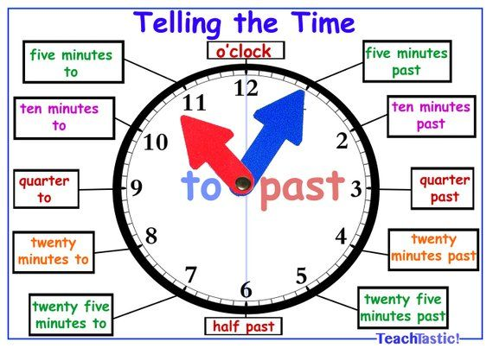
Numeracy

Slide 10







These are some of the apps and platforms the children will be accessing and becoming familiar with this year

Slide 11
Healthy Schools Club
NQA: Healthy school
Snacks for playtime: fruit or vegetables
Birthdays: no cakes Healthy schools club have decided pupils can wear non-uniform as a birthday treat.

Slide 12
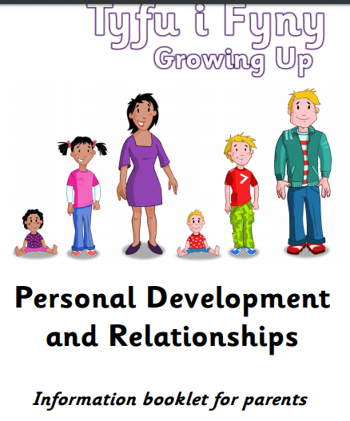

Slide 13
Weekly Needs
Monday: Homework book brought into school for marking if pupils have completed a task.
Thursday: P.E: Kit to be worn to school
Wednesday: suitable outdoor clothing
Thursday: afternoon teacher Mrs Arnold (PPA cover)
Friday: Teacher on Friday’s is Mrs Watts.
Reading books to be accessed via Boost, Numeracy homework
to be accessed via MyMaths.

Slide 14
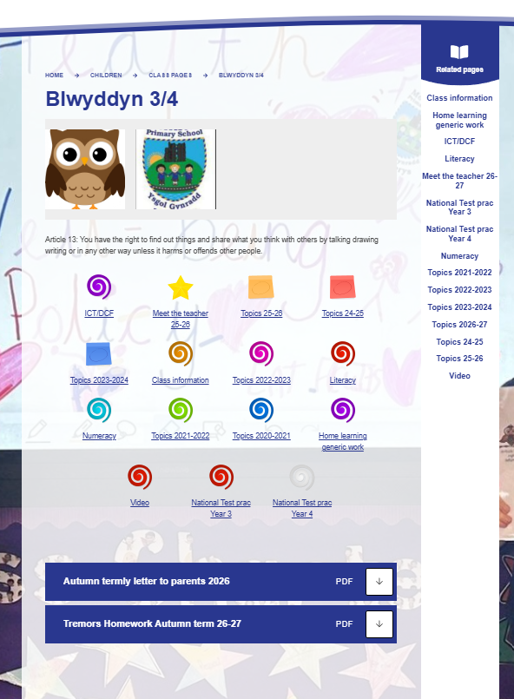
https://www.morristonprimaryschool.co.uk/blwyddyn-34

Slide 15
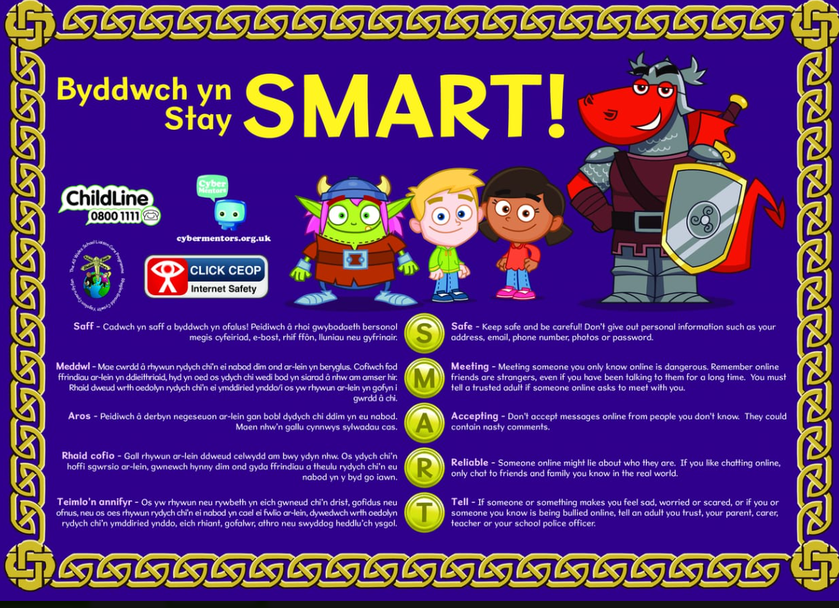

Slide 16
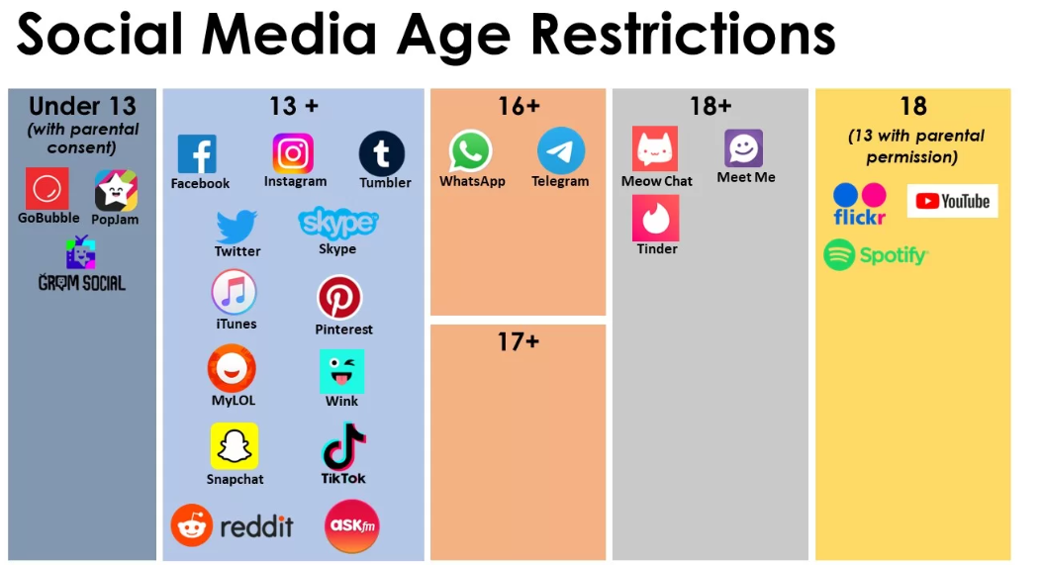

Slide 17
Thankyou for listening

